Slide 1
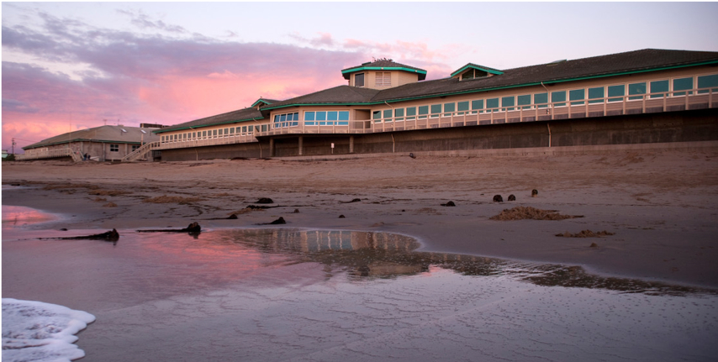
Promote a culture of inclusion
MBARI is located on the unceded land of Hueñeren and Guacharron peoples. This area was home to a settlement called Locuyusta in the region of Calendaruc, which means “ocean homeplace.” The Native peoples of this area were taken to Mission San Juan Bautista and Mission San Carlos Borromeo de Carmelo. Native people taken to Mission San Juan Bautista are represented today by the Amah Mutsun Tribal Band.
Land acknowledgement statement developed in partnership with the Amah Mutsun Land Trust.
Notes:
Pronunciation Guide:
Hueñeren: “Hwenn-yer-enn”
Guacharron: “Gwa-char-own”
Locuyusta: “Low-coo-ee-oo-stah”
Calendaruc: “Cah-lenn-dah-rook”
Amah Mutsun: “Ah-mah Moot-soon”

