Slide 1
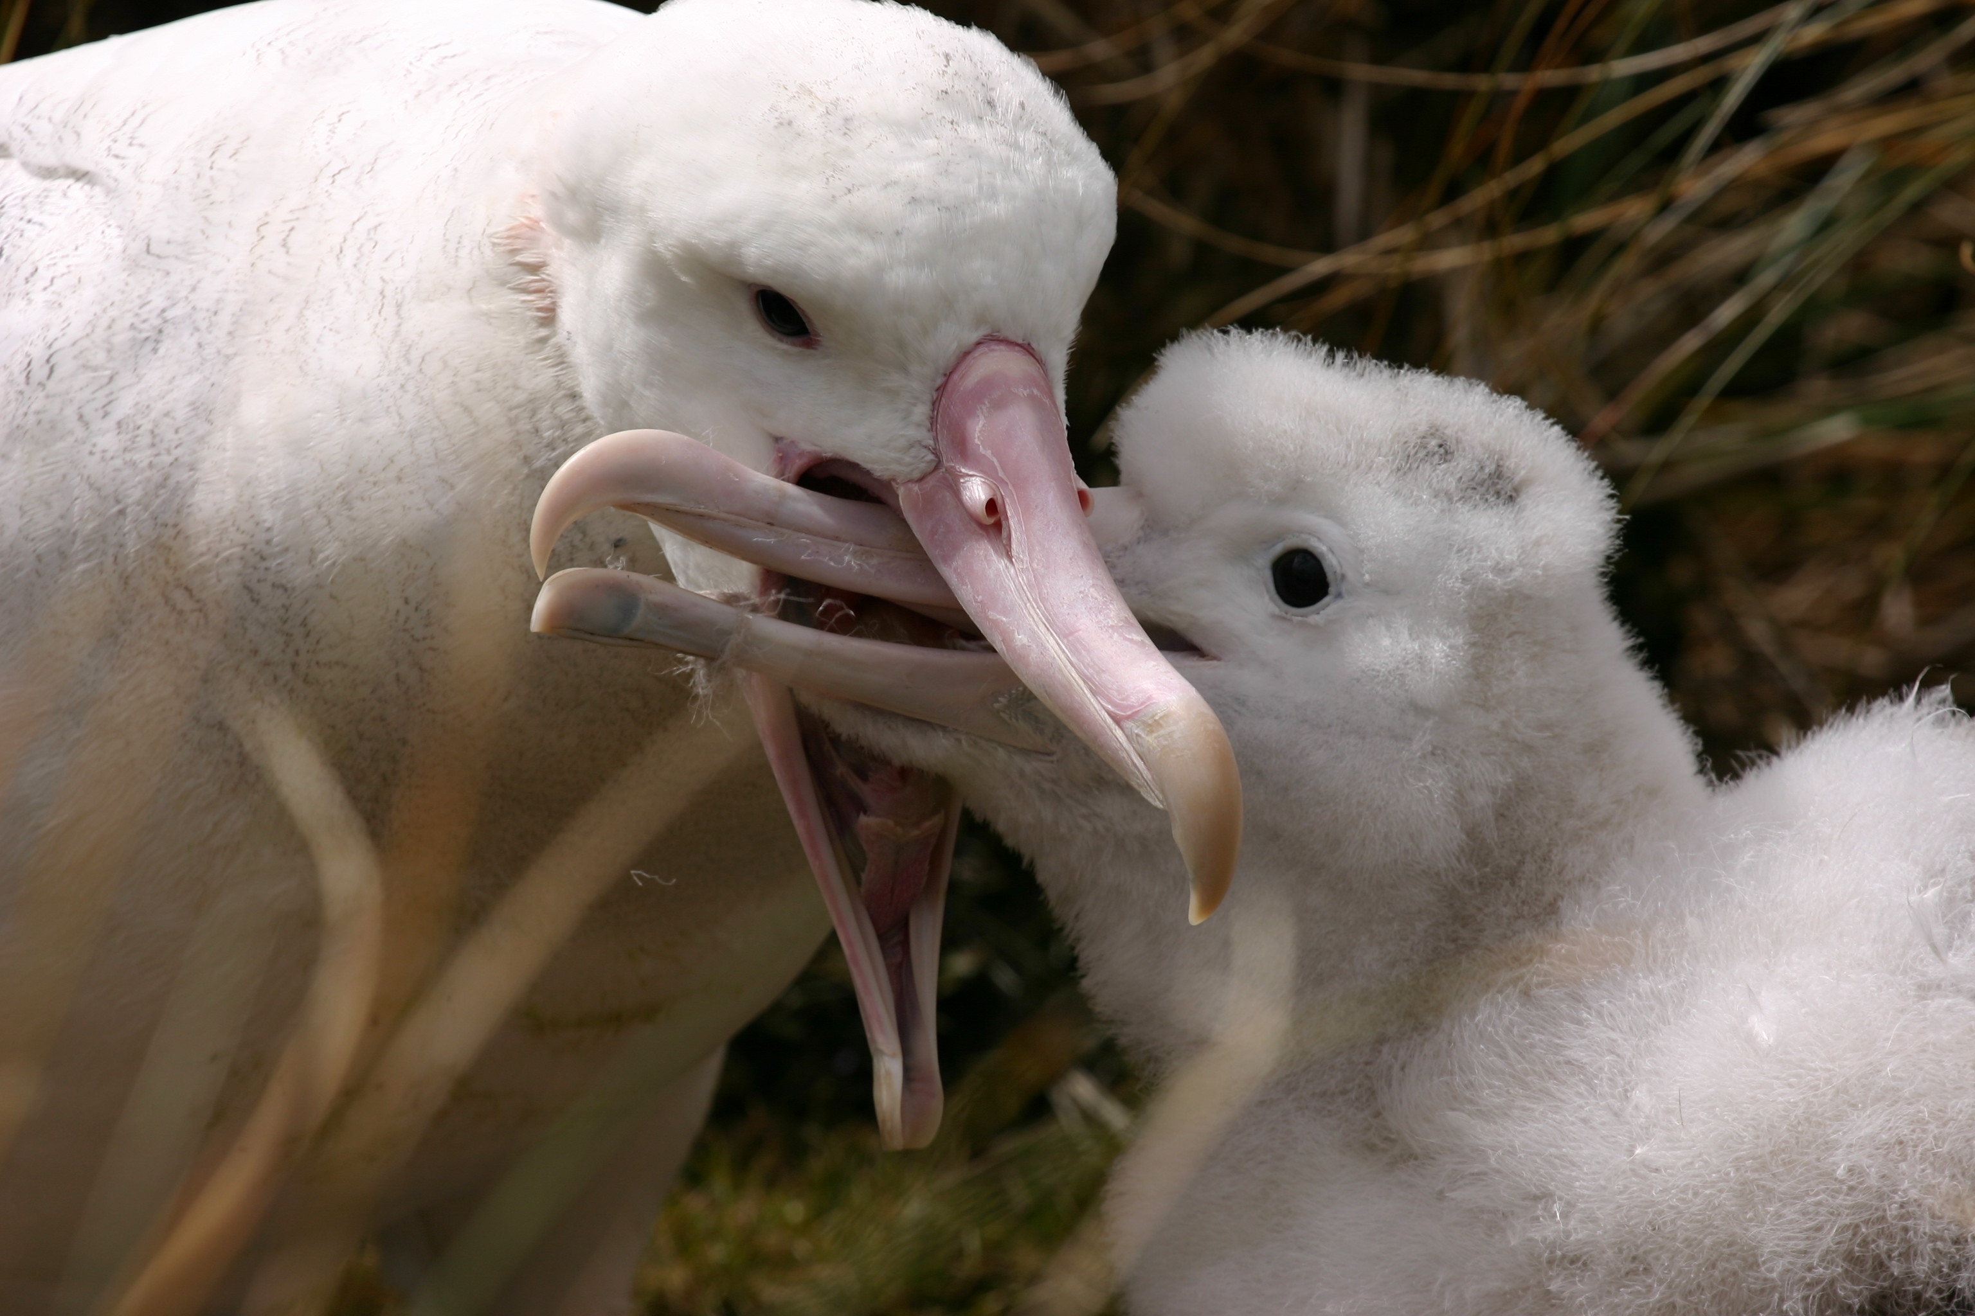
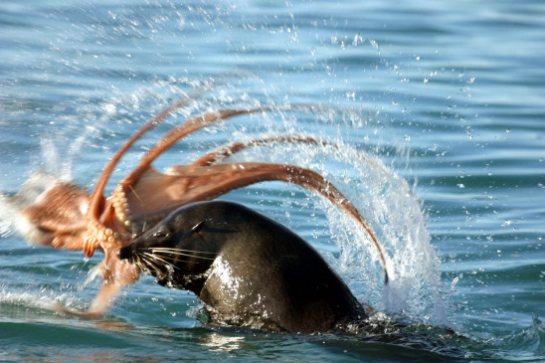

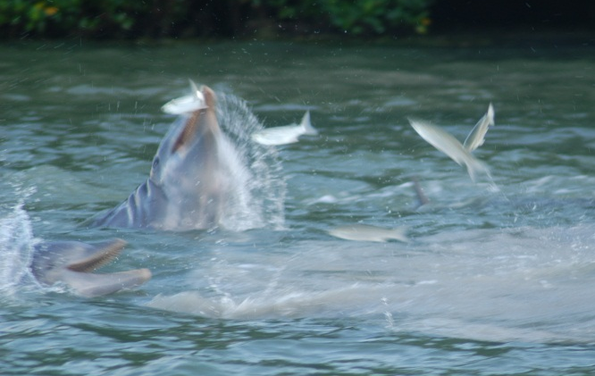
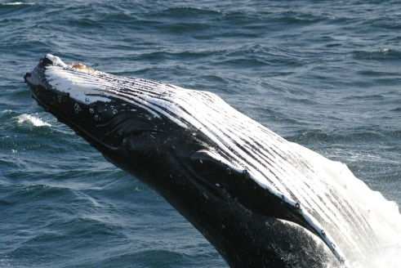


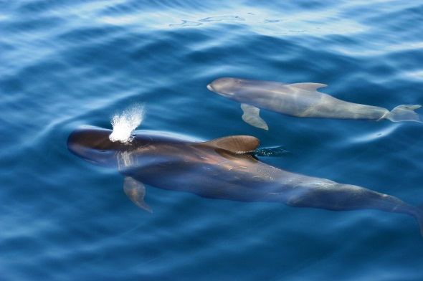
Leigh Torres, PhD.
Assistant Professor
Marine Mammal Institute, Oregon Sea Grant
Oregon State University

Slide 2
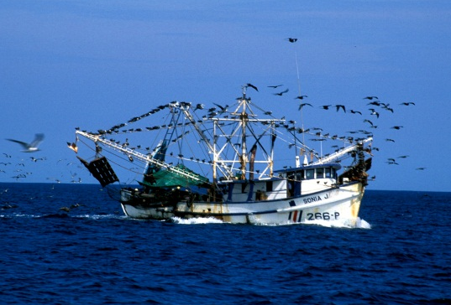
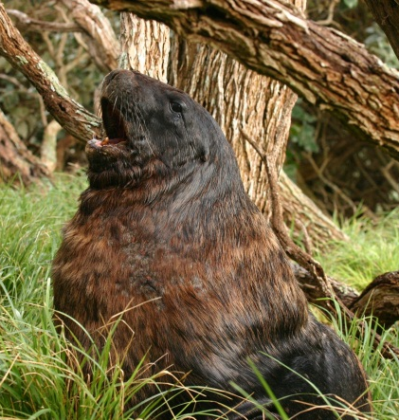
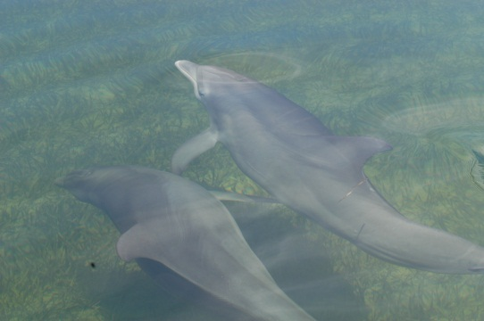
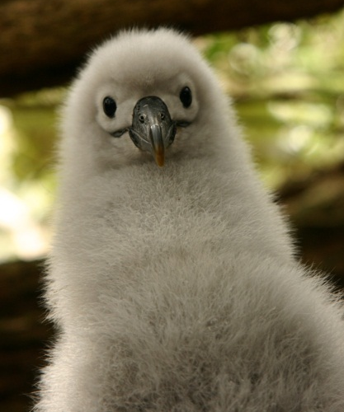
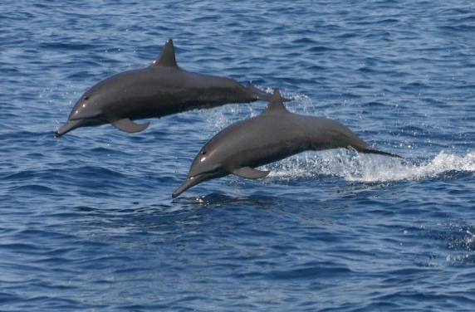
Mission:
Advance marine science and conservation
through innovative and engaged research
Website: http://mmi.oregonstate.edu/gemm-lab
Blog: http://blogs.oregonstate.edu/gemmlab/
Twitter: @GemmLabOSU

Slide 3
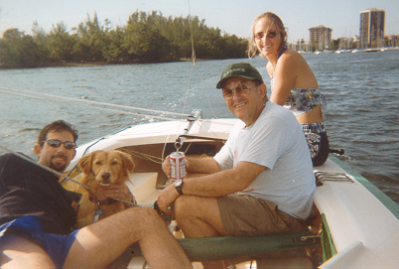
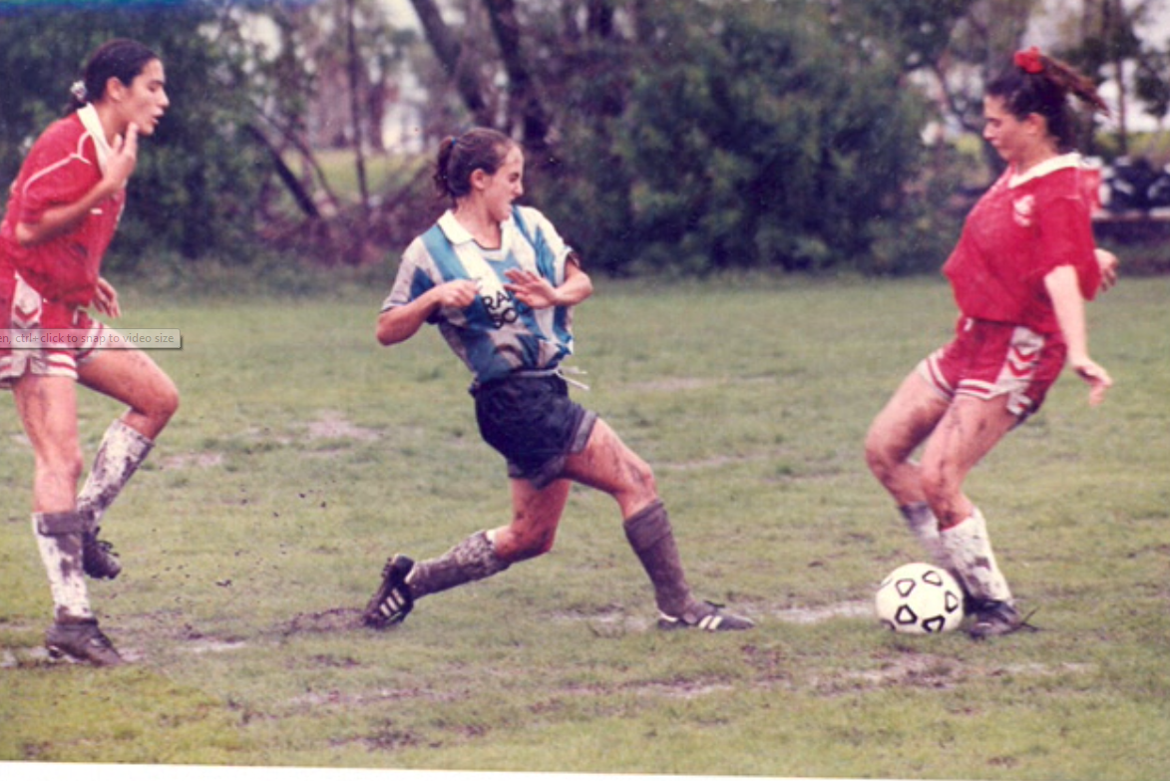
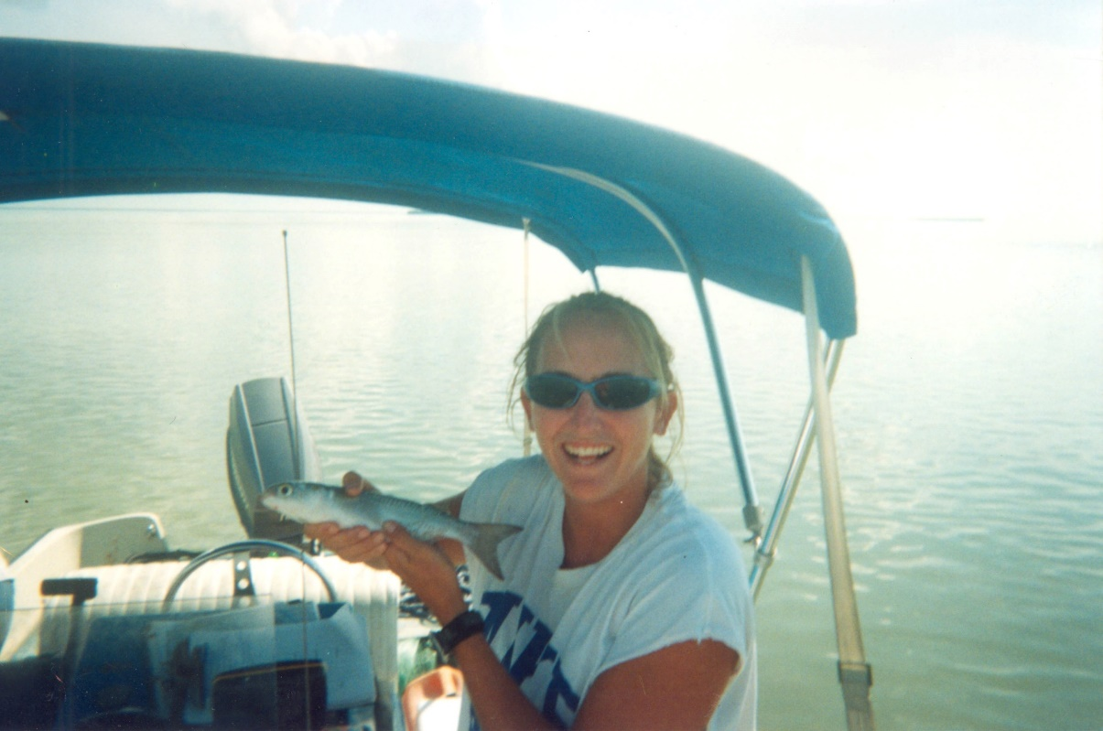
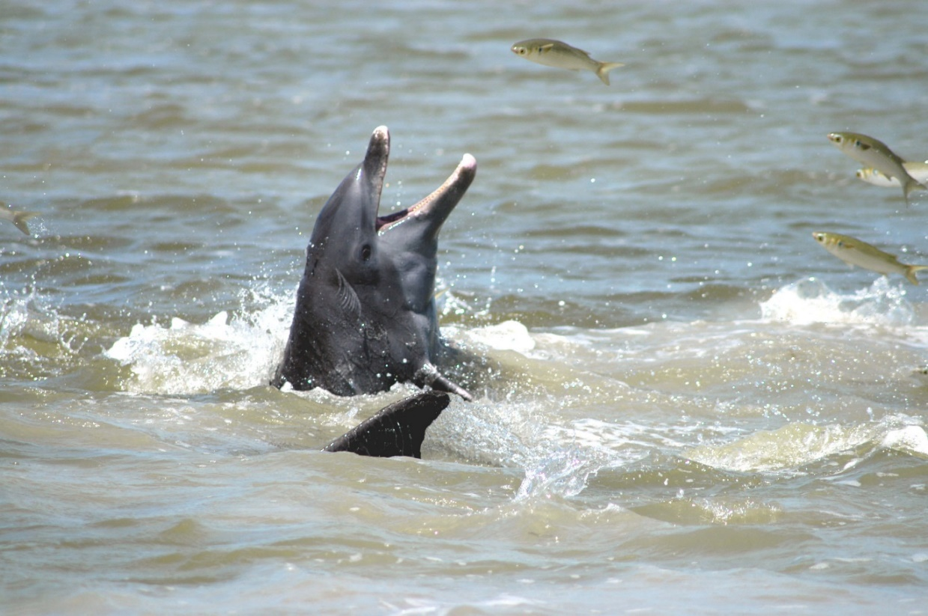

Slide 4
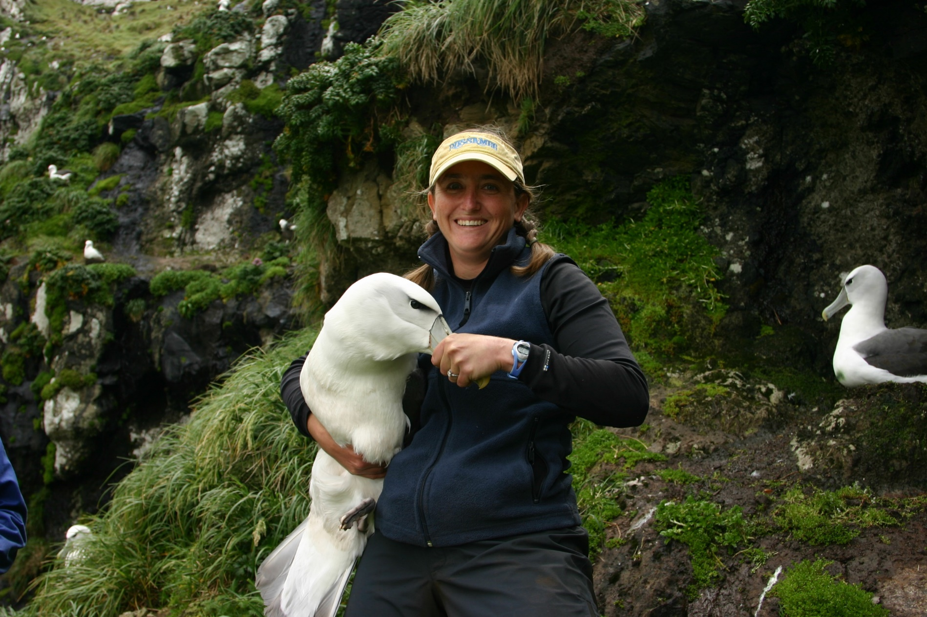
“I am not a seabird ecologist”
I am a spatial marine ecologist.

Slide 5
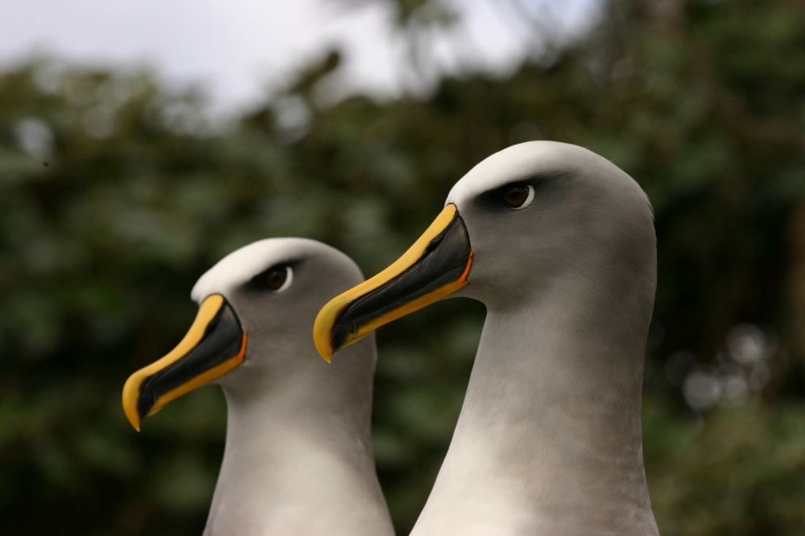
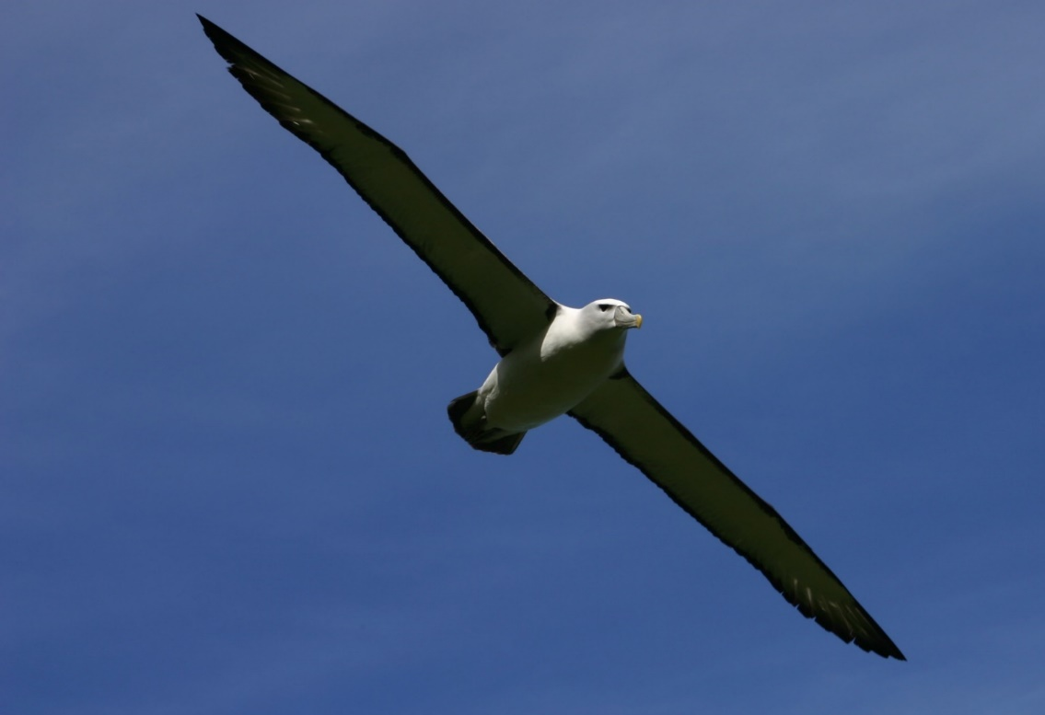
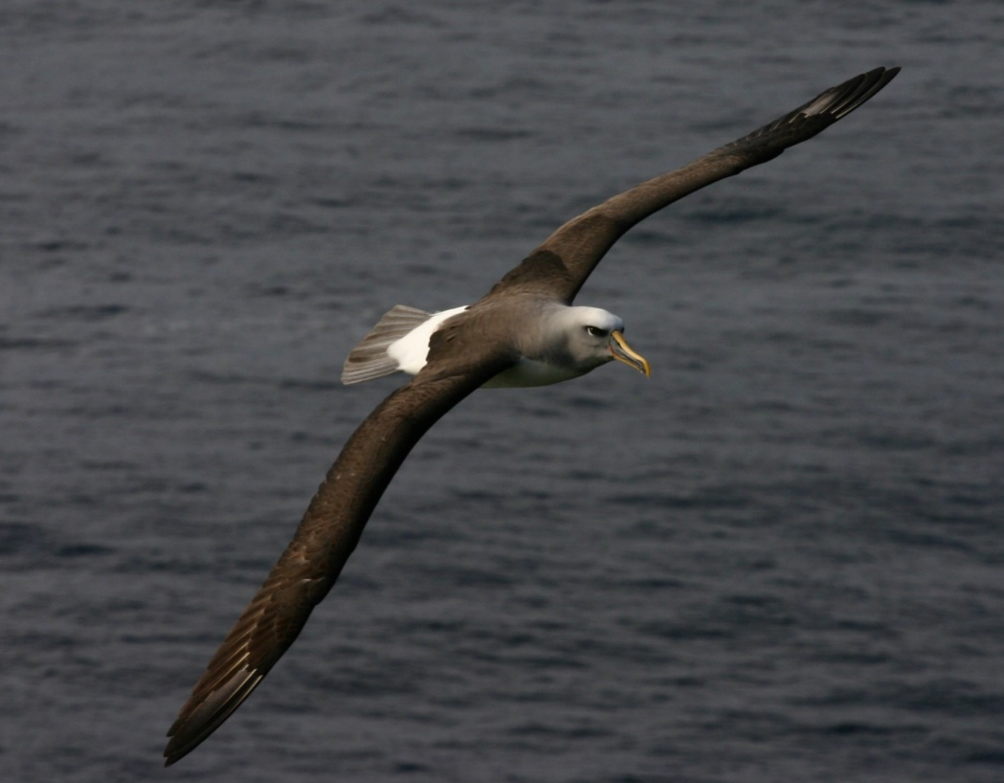
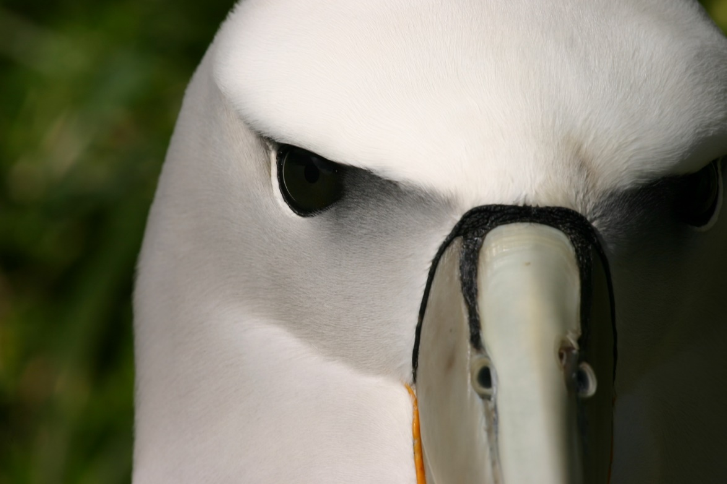

Slide 6
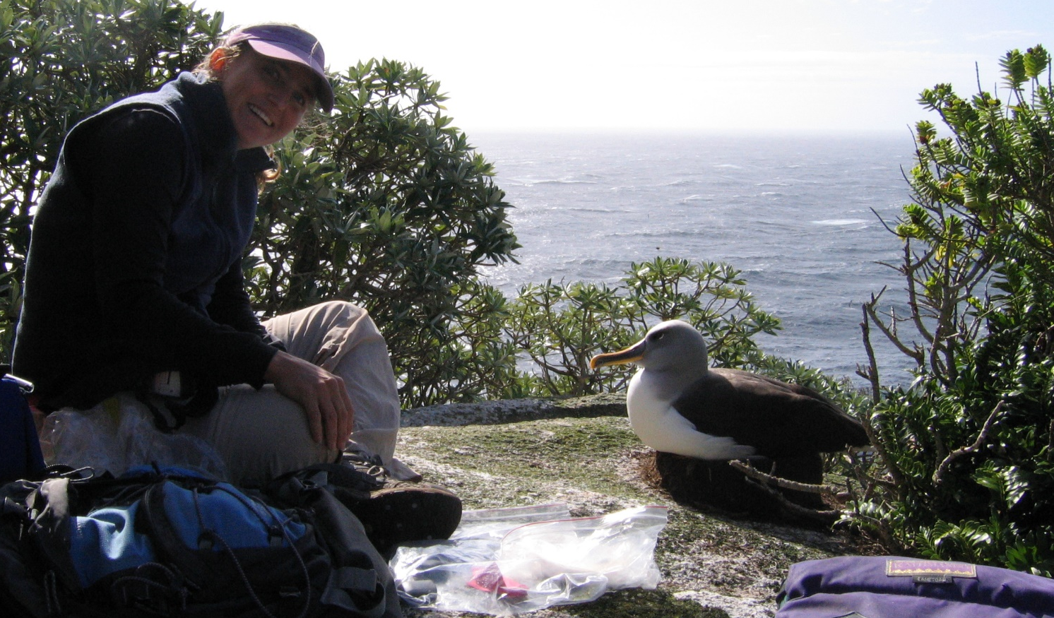
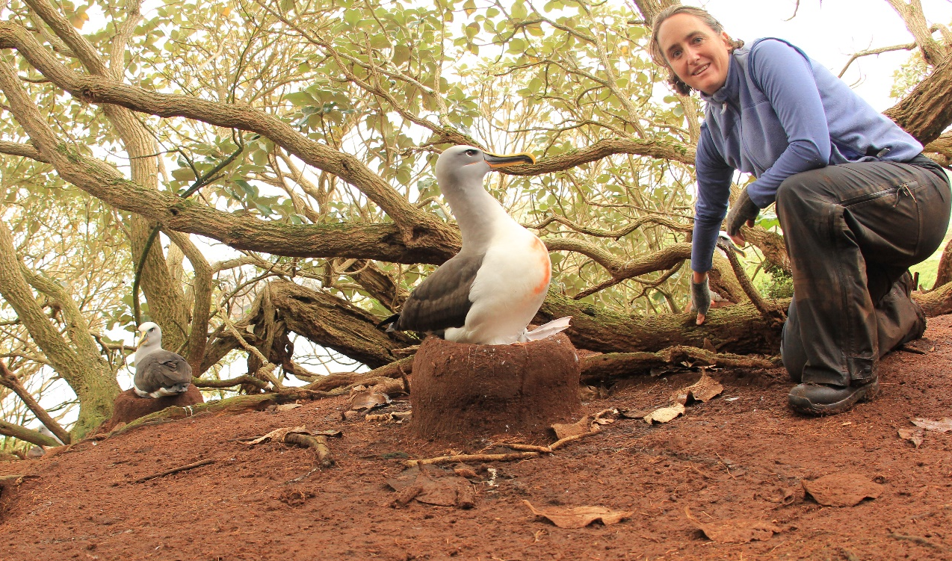
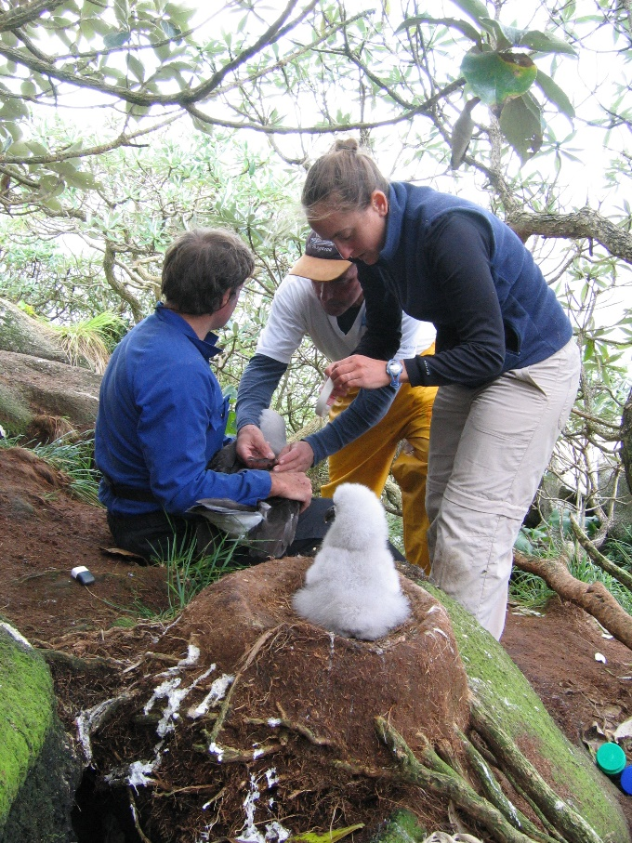
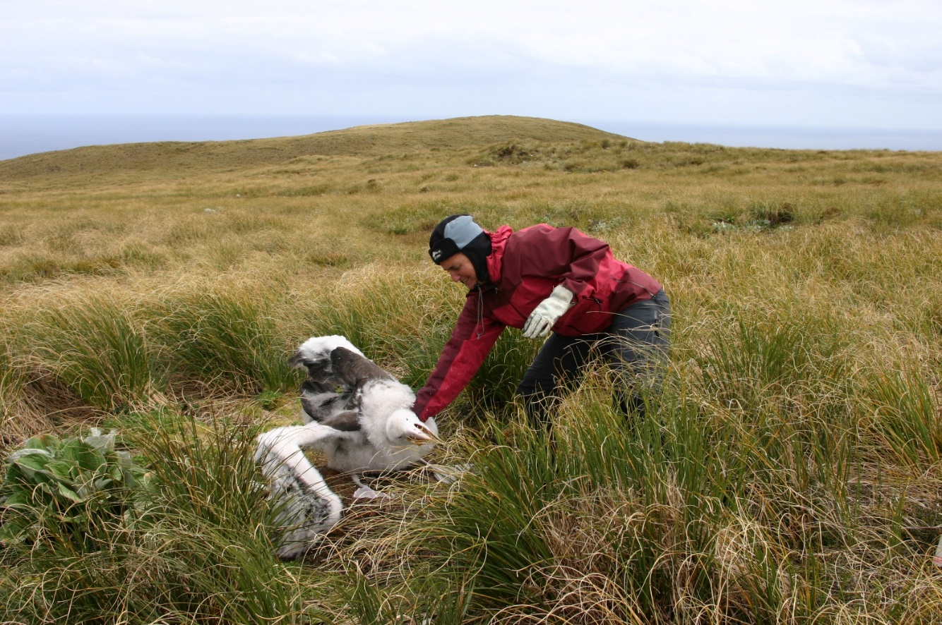
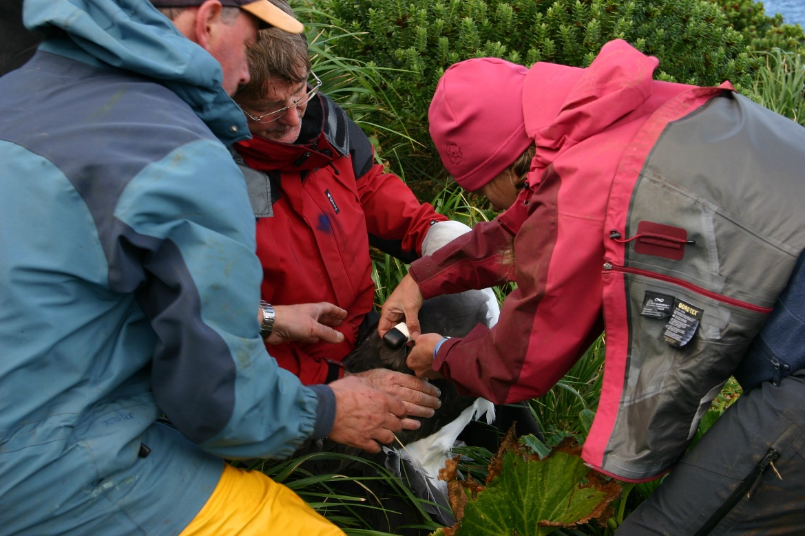

Slide 7
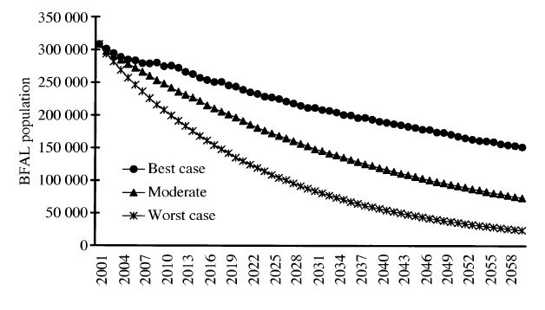
Seabird bycatch in fisheries a serious issue for many species
Birds attracted to boats (overlap in habitat)
Major impacts on populations
Caught on longline hooks and trawl warps
Injury and death (drowning)
Impacts on health and ecology
Black-footed albatross population
trajectories in response to three
levels of mortality in North Pacific
longline fleet.
Lewison, R.L. & Crowder, L.B. (2003) Estimating fishery bycatch and effects on a vulnerable seabird population. Ecological Applications, 13, 743-753.
Notes:
Population trajectories for Black-footed
Albatross (BFAL) over the next 60 years
in response the three levels of estimated mortality
from pelagic longlining in the North Pacific.

Slide 8
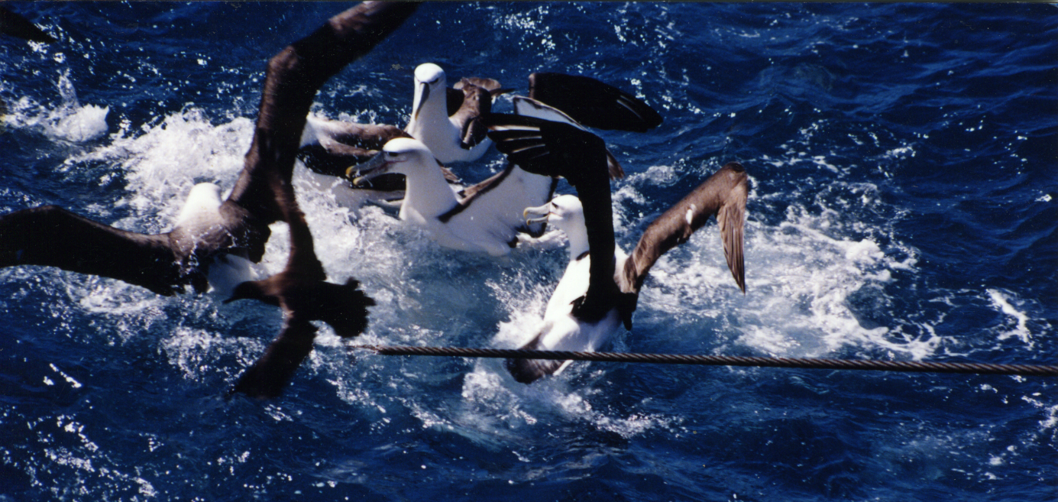
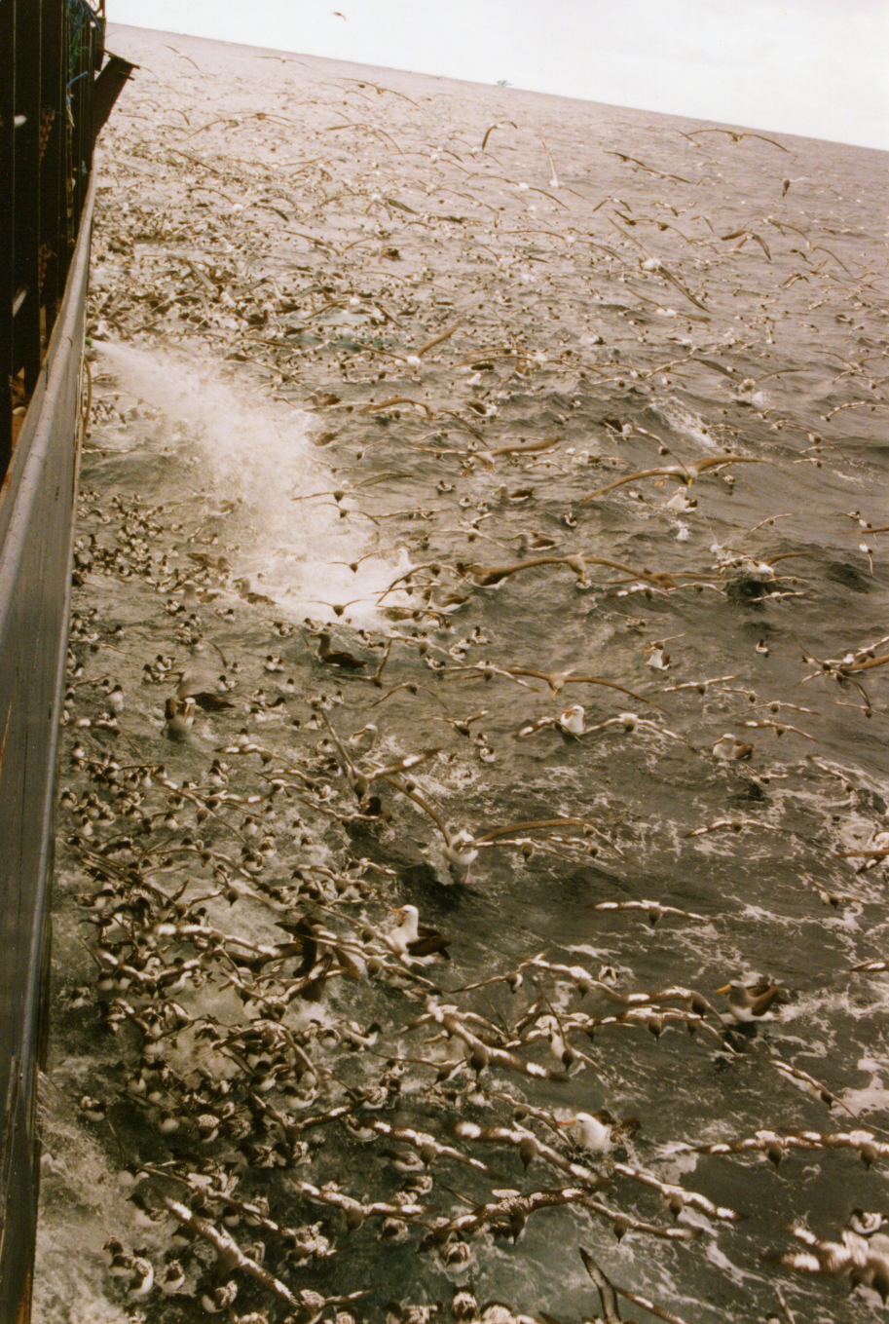
White-capped albatross
and fisheries overlap
Albatross-fisheries interactions
Where?
When?
Who?
Need to know to
inform management efforts

Slide 9
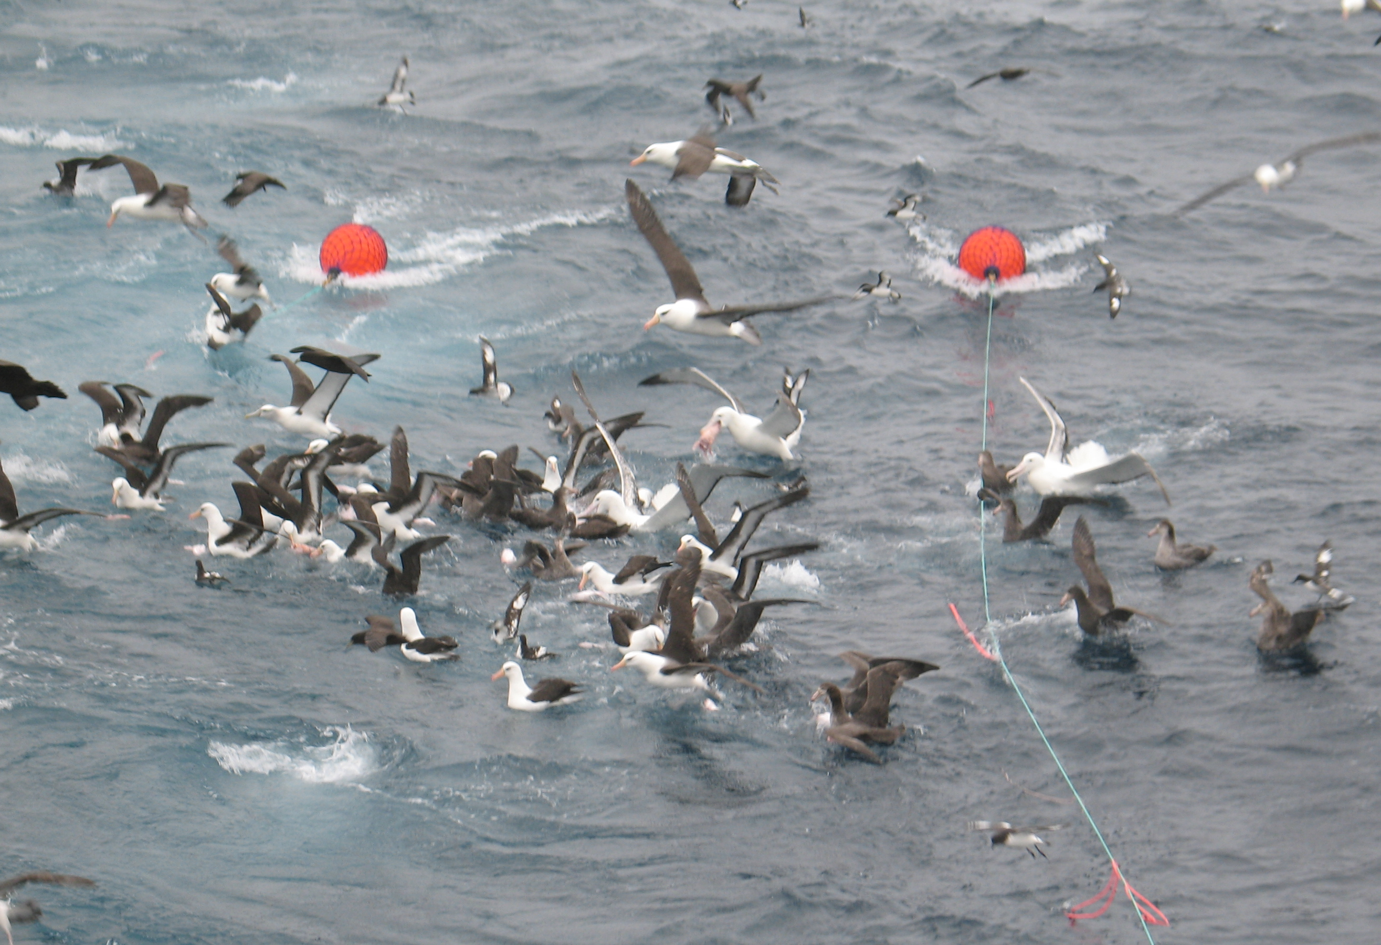
Understanding albatross-fisheries interactions has suffered from poor data
Fisheries:
No data → High seas
Low spatial resolution
Low temporal resolution
Aggregated data
Albatross:
Lack of tracking data
Low resolution data

Slide 10
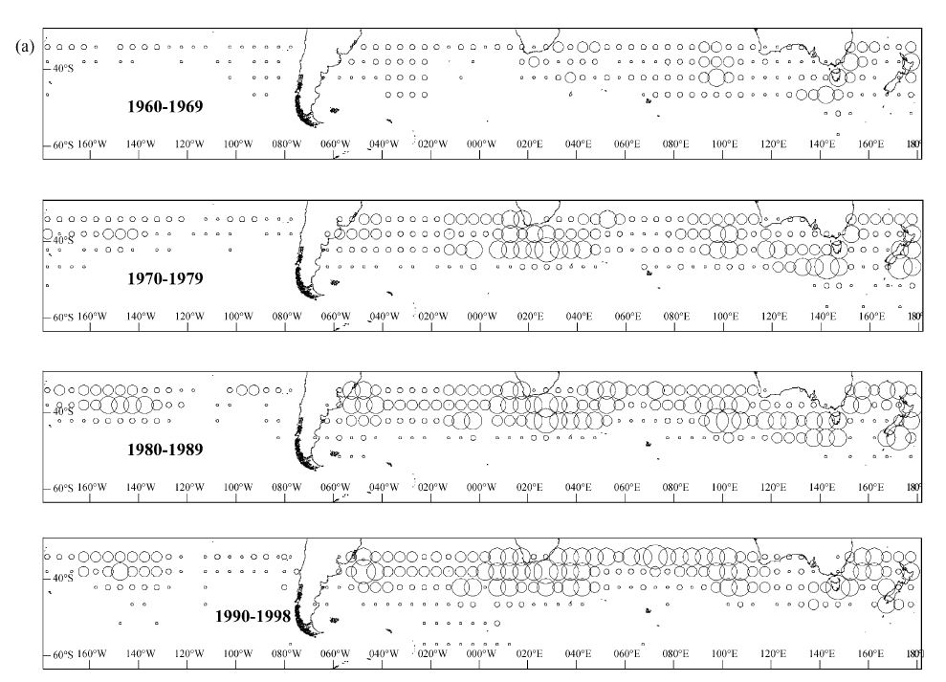
Pelagic longline fishing effort by five-degree squares across decades
Low
resolution
fishing data
Tuck, Polacheck, and Bulman, 2003. Spatio-temporal trends of longline fishing effort in the Southern Ocean and implications for seabird bycatch. Biological Conservation.
Notes:
The spatial distribution of reported annual effort by five-degree square averaged across years 1960–1969, 1970–1979, 1980–1989, and
1990–1998, from pelagic longline fleets operating south of 30S. Longline data are only that reported to the IOTC, ICCAT, SPC, IATTC, CCSBT
and domestic New Zealand, Australian and South African fishery agencies. The circles represent levels of effort with diameter increasing according
to the hook ranges: 1–10 000; 10 000–250 000; 250 000–1 000 000; 1 000 000–4 000 000; >4 000 000.

Slide 11
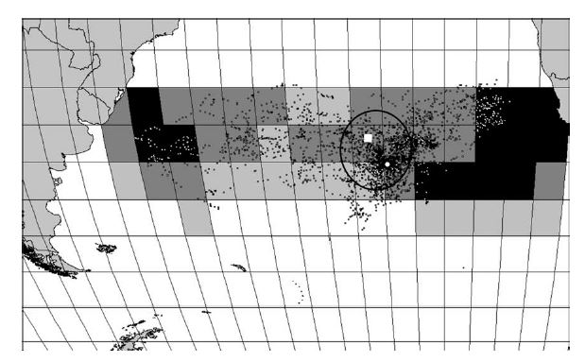
Spatial distribution of Tristan albatross in 2001, and pelagic fishing effort from 1970-1998
by hooks per 5 degree square
Low resolution
and aggregated data
Overlap vs interaction?
(same space use)
Cuthbert, R., G. Hilton, P. Ryan, and G. N. Tuck. "At-Sea Distribution of Breeding Tristan Albatrosses Diomedea Dabbenena and Potential Interactions with Pelagic Longline Fishing
in the South Atlantic Ocean." Biological Conservation 121, no. 3 (Feb 2005): 345-55.
Notes:
Fig. 2. Average annual reported pelagic fishing effort for the period 1970–1998 within the area of 30–50S and 60W to 20E, grouped into categories
of <10,000 hooks (no shading), 10,000–250,000 hooks (light grey), 250,000–1,000,000 hooks (dark grey) and >1,000,000 hooks (black shading) and
the distribution of Tristan albatrosses during the 2001 breeding season. Gough Island (unfilled circle) is located at 40S 10W, Tristan da Cunha
(unfilled square) is located at 37S 12W, and the approximate limits of the Tristan 200 nm EEZ (dashed oval) are indicated

Slide 12
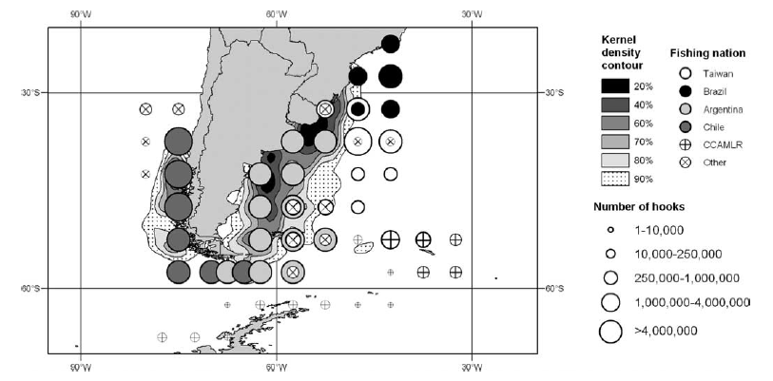
Kernel density contours of white-chinned petrels in 2003 overlaid on longline fishing effort
(number of hooks set per year) in 5 · 5 squares in the region in 1998/1999
Phillips, R. A., J. R. D. Silk, J. P. Croxall, and V. Afanasyev. "Year-Round Distribution of White-Chinned Petrels from South Georgia: Relationships with Oceanography and Fisheries."
Biological Conservation 129 (2006): 336-47.

Slide 13
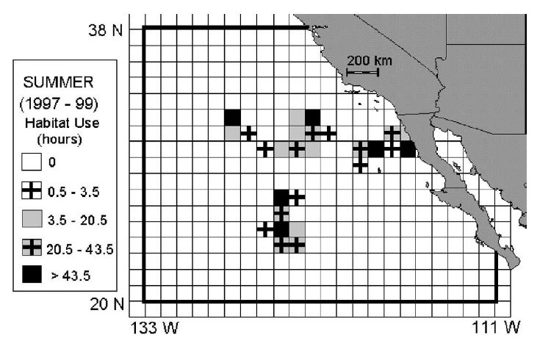
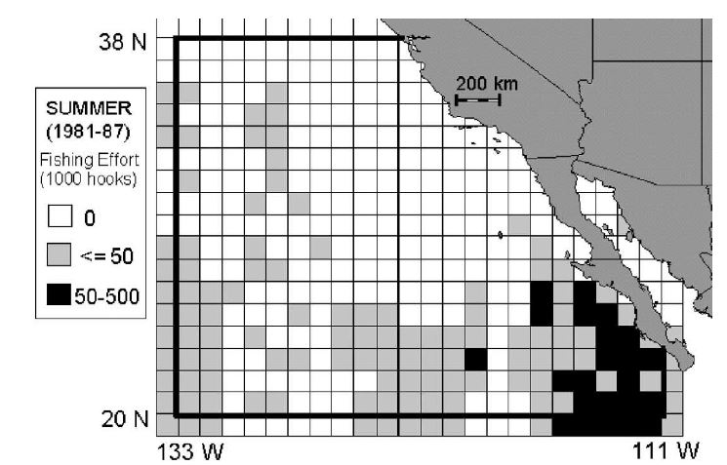
Spatial distribution of satellite
tracked black-footed
albatross tracked during
July–September, 1997–1999
Disconnect in
space and time
Spatial distribution of Japanese
EPO longline fishery
(July–September) 1981-1987
Hyrenbach, K.D. & Dotson, R.C. (2003)
Assessing the susceptibility of female
black-footed albatross
(Phoebastria nigripes) to longline fisheries
during their post-breeding dispersal:
an integrated approach.
Biological Conservation, 112, 391-404.
Notes:
Fig. 2. Spatial distribution of black-footed albatross females tracked during their summertime (July–September,1997–1999) post-breeding dispersal
off southern California. four satellite-tracked black-footed albatross females off southern California (July–September 1997–1999
Fig. 3. Spatial distribution of summertime (July–September) fishing effort by the Japanese EPO longline fishery.
The coarse temporal (monthly) and spatial (11) resolution of the fisheries data, and the dynamic nature of the fishing effort inhibited a fine-scale analysis of
albatross overlap with longline fisheries.

Slide 14
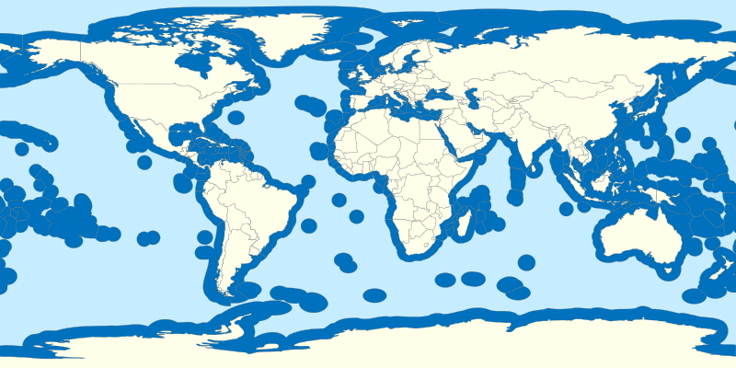
Exclusive Economic Zones (EEZ): within 200 nm of coast for each country
About 60 percent of the world’s oceans outside EEZs → unmonitored, unregulated, unknown

Slide 15
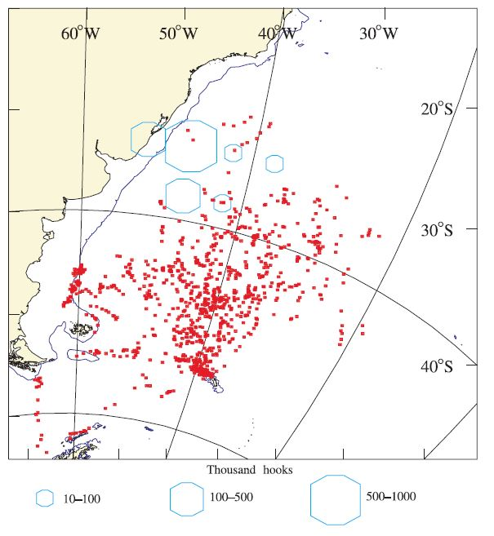
Spatial distribution of wandering albatross and tuna longline fishing effort (May-July 1999)
Low resolution
and aggregated data
Xavier, J.C., Trathan, P.N., Croxall, J.P., Wood, A.G., Podesta, G. & Rodhouse, P.G. (2004)
Foraging ecology and interactions with fisheries of wandering albatrosses (Diomedea exulans) breeding at South Georgia. Fisheries Oceanography, 13, 324-344.
Notes:
Figure 7. Distribution of uplinks (red
dots) from satellite-tracked wandering
albatrosses (males and females combined)
breeding at Bird Island, South
Georgia between May and July 1999 in
relation to tuna longline fishery effort
(blue symbols; there were no data for
2000). The position of 1000 m isobath is
shown.

Slide 16
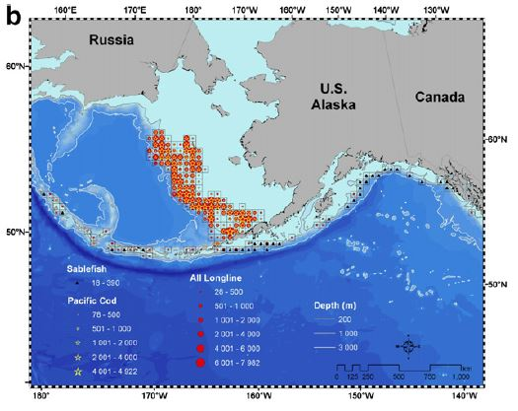
Longline effort (1000 s hooks) for all longline fisheries, May-Nov 2002 and 2003, 50 X 50 km
Within US EEZ data still
large scale and aggregated.
Suryan, R.M., Dietrich, K.S., Melvin, E.F., Balogh, G.R., Sato, F. & Ozaki, K. (2007) Migratory routes of short-tailed albatrosses:
Use of exclusive economic zones of North Pacific Rim countries and spatial overlap with commercial fisheries in Alaska. Biological Conservation, 137, 450-460.
Notes:
Spatial distribution of: (a) observed trawl effort (two hours) for walleye pollock, flatfish (see Results for dominant
species), and all trawl fisheries (pelagic and nonpelagic); (b) longline effort (1000 s hooks) for sablefish, Pacific cod, and all
longline fisheries; and (c) all pot fisheries (primarily Pacific cod and sablefish) in Alaska, May–November 2002 and 2003. Effort
is summarized within 50 km by 50 km grid cells for trawl and longline fisheries and 100 km by 100 km grid cells for pot
fisheries.

Slide 17
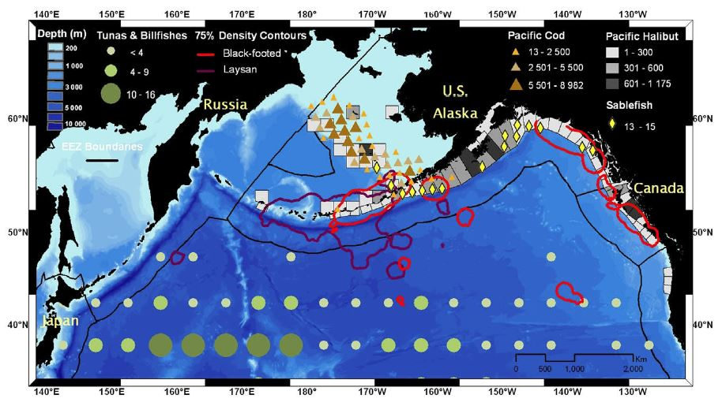
Overlap between black-footed and Laysan albatross and longline fishing effort (1000s of hooks)
during July–October
Fischer, K.N., Suryan, R.M., Roby, D.D. & Balogh, G.R. (2009) Post-breeding season distribution of black-footed and
Laysan albatrosses satellite-tagged in Alaska: Inter-specific differences in spatial overlap with North Pacific fisheries. Biological Conservation, 142, 751-760.
Notes:
Fig. 1 – Overlap between black-footed and Laysan albatross 75% density contours of tracking hours and the spatial
distribution of observed or reported longline fishing effort (1000s of hooks) in the North Pacific during July–October (years and
data sources vary with fisheries, see Section 2). Most notably, sablefish effort in the Central and Western Aleutian Islands is
not displayed. Fishing effort for tunas and billfishes east of 150W is underrepresented (see Section 2). The North Pacific
subarctic transition domain is located at about 40–45N during the study months (Polovina et al., 2001).

Slide 18
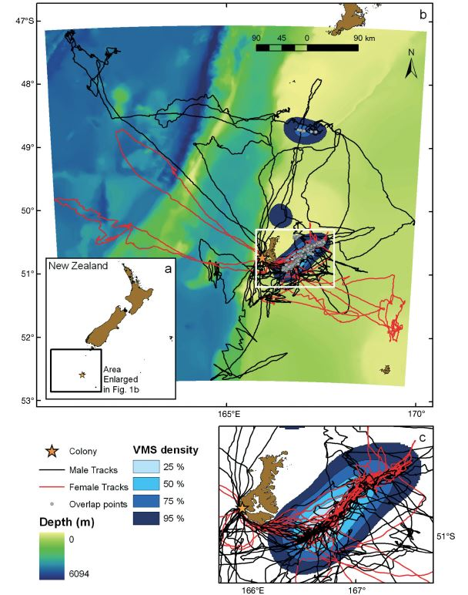
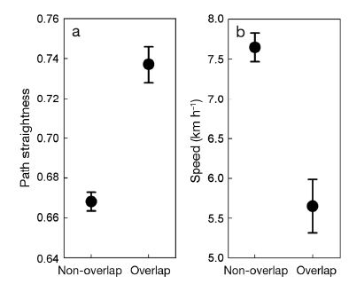
NZ EEZ → High resolution
albatross tracking data and fishing effort data
GPS and VMS
Torres, Leigh G., D. R. Thompson, S. Bearhop, S.C. Votier, G. A. Taylor, P. M. Sagar, and B. C. Robertson.
"White-Capped Albatrosses Alter Fine-Scale Foraging Behavior Patterns When Associated with Fishing
Vessels." Marine Ecology Progress Series 428 (2011): 289-301.

Slide 19
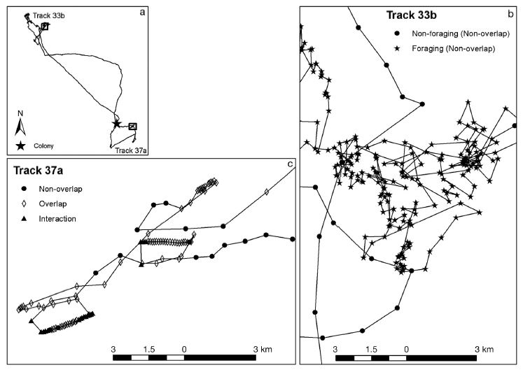
Torres, Leigh G., D. R. Thompson, S. Bearhop, S.C. Votier, G. A. Taylor, P. M. Sagar, and B. C. Robertson.
"White-Capped Albatrosses Alter Fine-Scale Foraging Behavior Patterns When Associated with Fishing
Vessels." Marine Ecology Progress Series 428 (2011): 289-301.

Slide 20
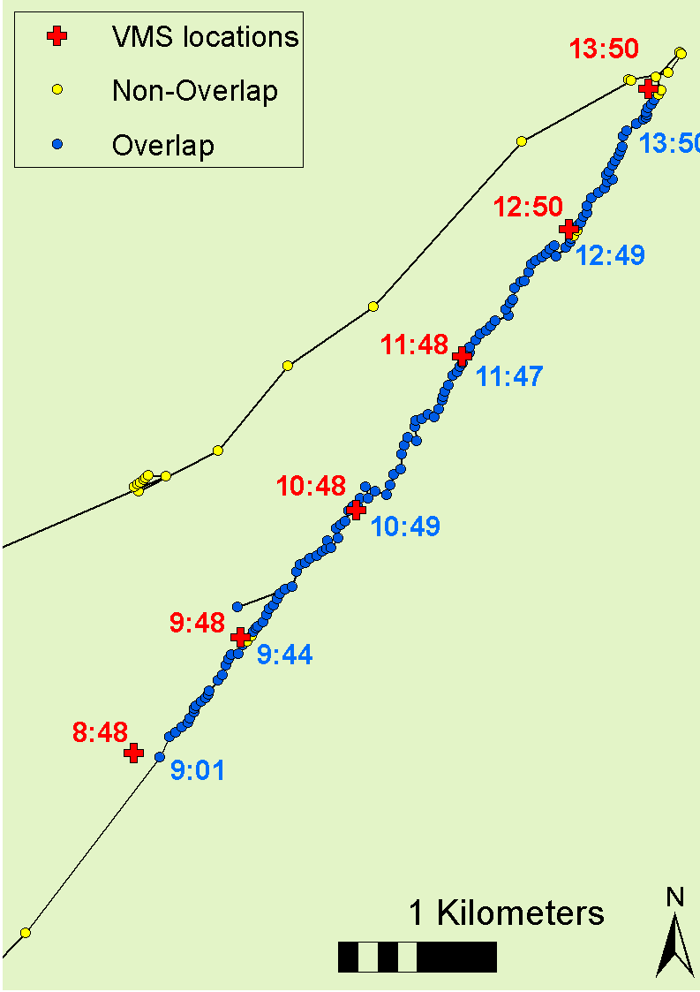
Albatross
follows vessel
for 4:50
Albatross fly
straighter and slower
when feeding near fishing vessels
Notes:
When associating with fishing vessels, reduced (or different) searching effort.

Slide 21
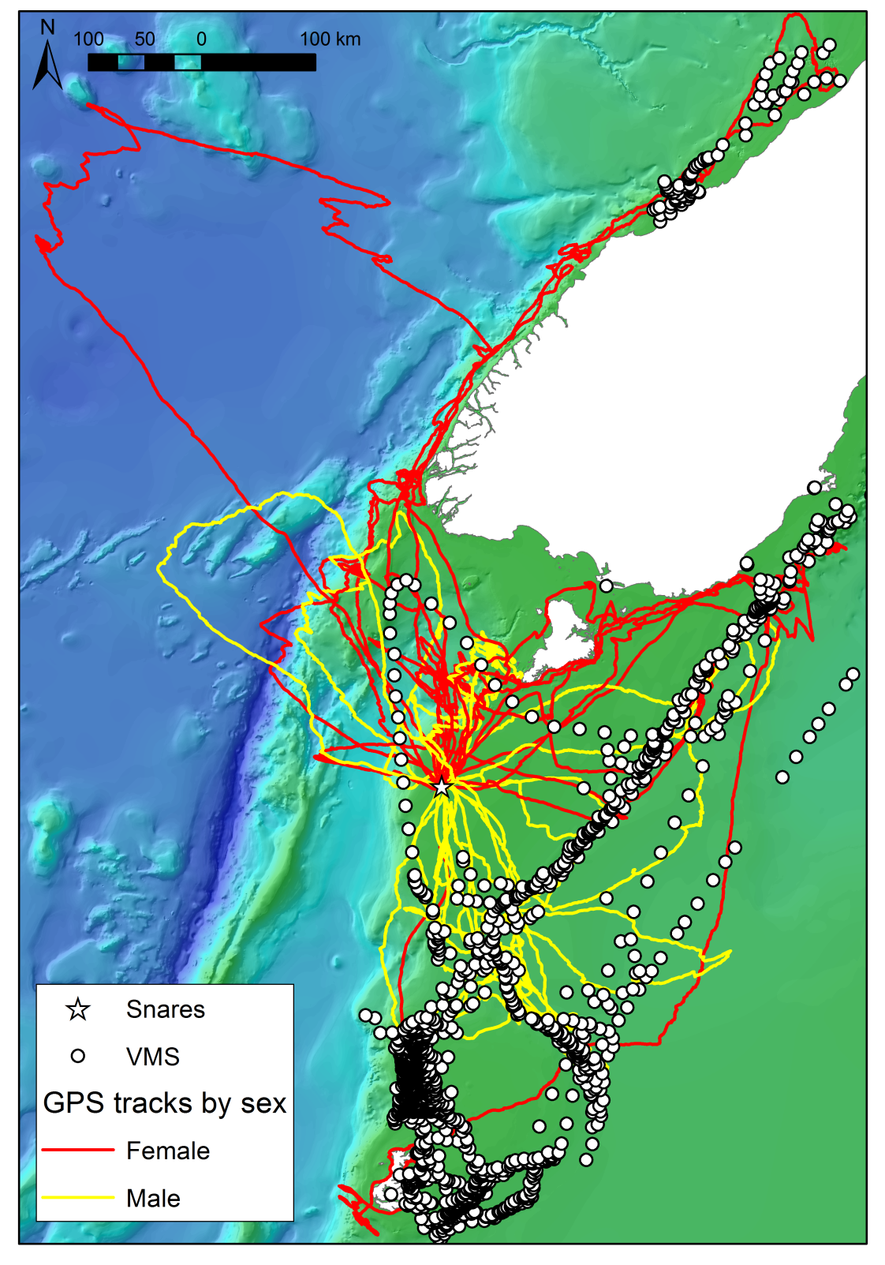
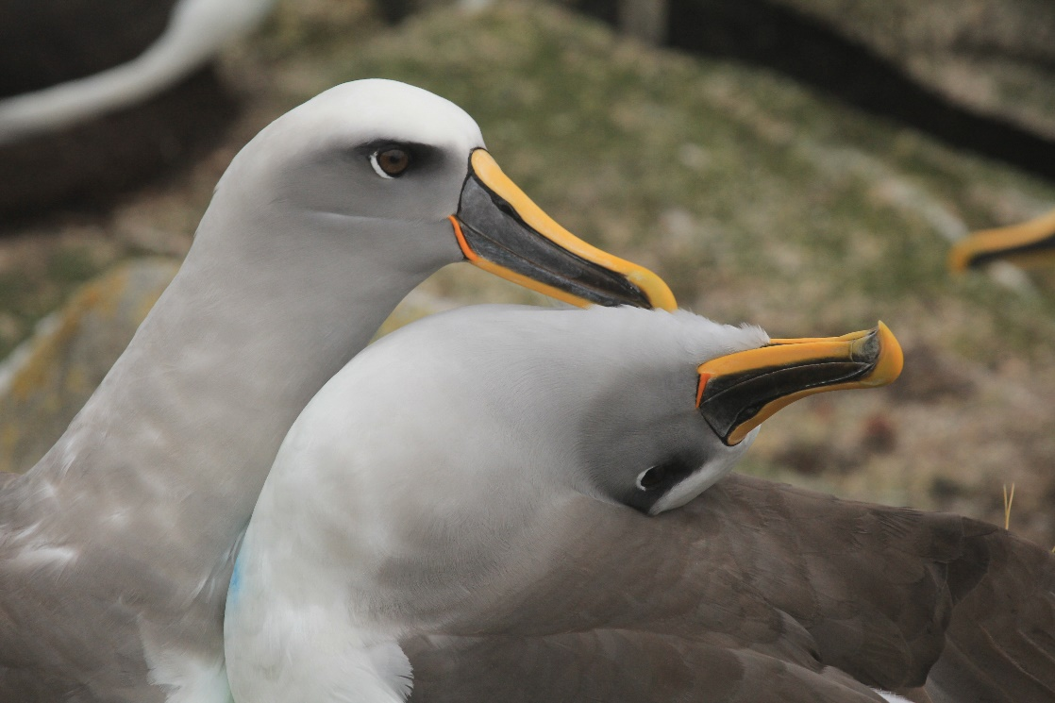
NZ EEZ → High resolution
albatross tracking data and fishing effort data
4 years of tracking data
4 years of fisheries effort data
Torres, L. G., P. M. Sagar, D. R. Thompson, and R. A. Phillips. "Scale-Dependence of Seabird-Fishery
Data Analysis and Management: Reply to Croxall Et Al. (2013)." Marine Ecology Progress Series 493 (2013): 301-04.
Notes:
Impacts on marine megafauna from fisheries interactions can be direct and indirect, and positive and negative.
For seabird, direct negative effects of mortality and injury.
Also indirect negative effects on ecological patterns (energetics, food quality, behavior patterns)
But also indirect positive effects on food consumption rates, as birds frequently feed in association with the target catch and the discards of fishing vessels.
Project over 4 years. Spatially and temporally variable distribution patterns of both birds and boats.
Fishing effort concentrated spatially and temporally.
A lot of foraging effort independent of fishing activity.

Slide 22
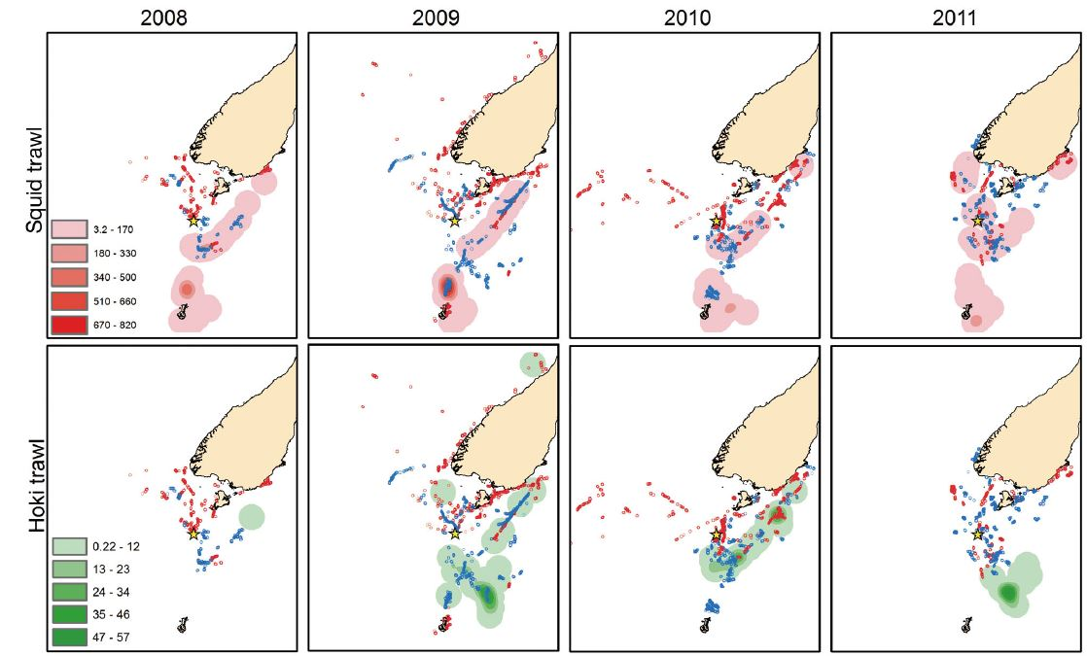
Annual variation in fishing and albatross distribution → changes in where overlap occurs
Torres, L. G., P. M. Sagar, D. R. Thompson, and R. A. Phillips. "Scale-Dependence of Seabird-Fishery
Data Analysis and Management: Reply to Croxall Et Al. (2013)." Marine Ecology Progress Series 493 (2013): 301-04.

Slide 23
Exclusive Economic Zones (EEZ): within 200 nm of coast for each country
About 60 percent of the world’s oceans outside EEZs → unmonitored, unregulated, unknown

Slide 24
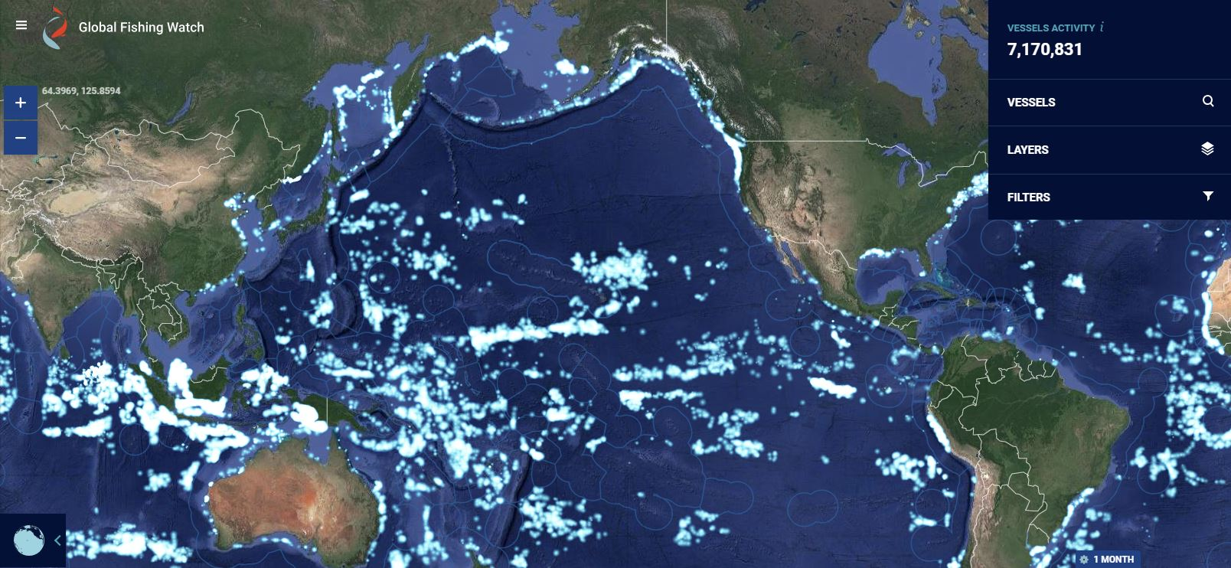

http://globalfishingwatch.org/

Slide 25
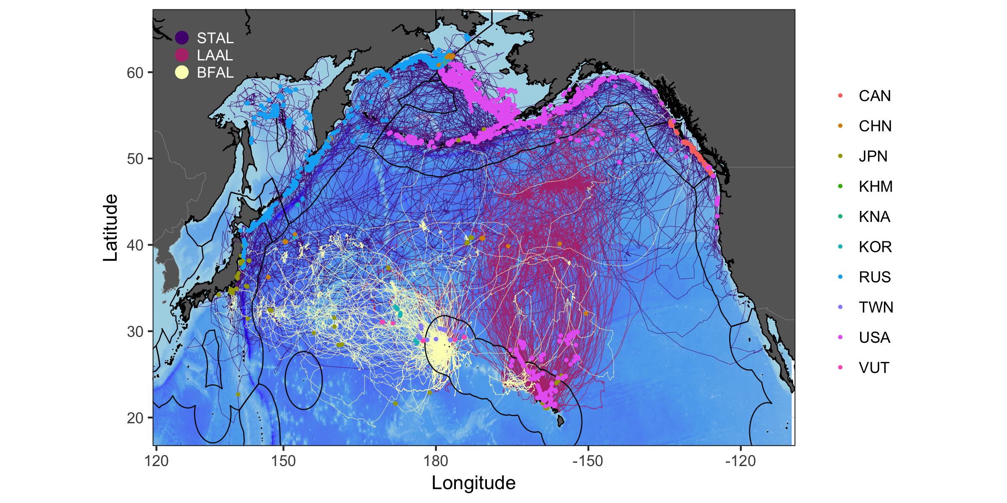

Slide 26
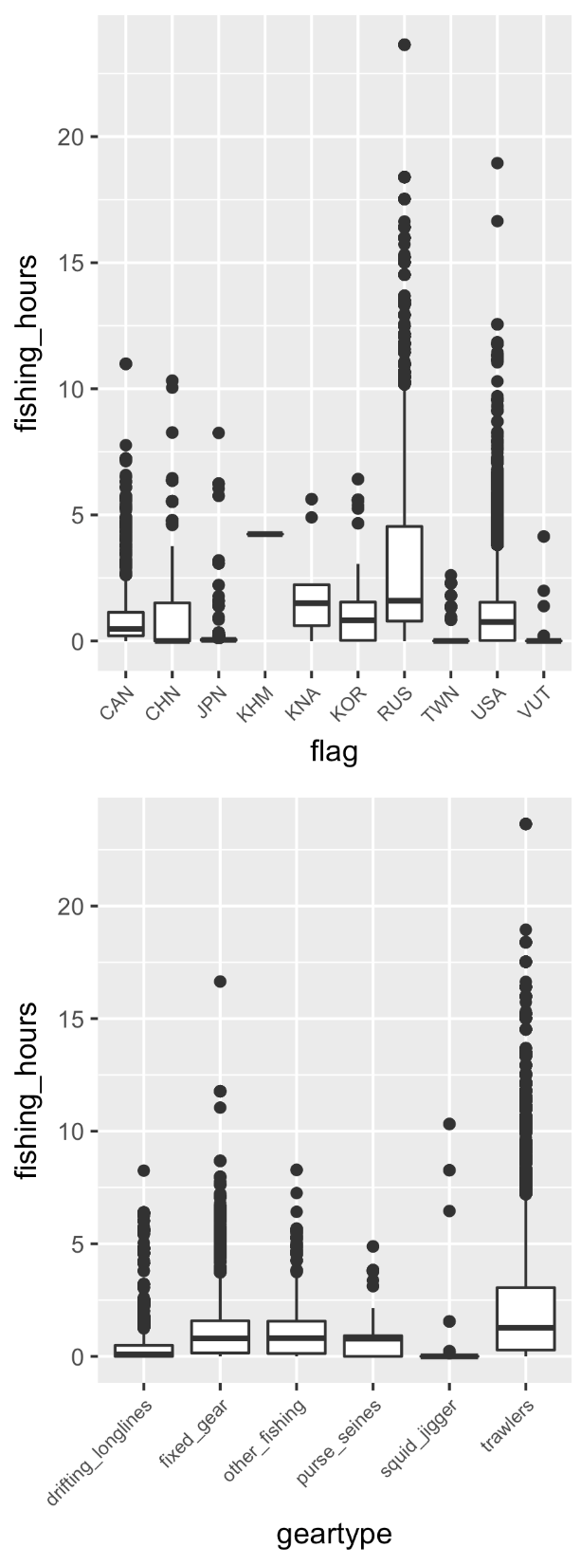

Slide 27
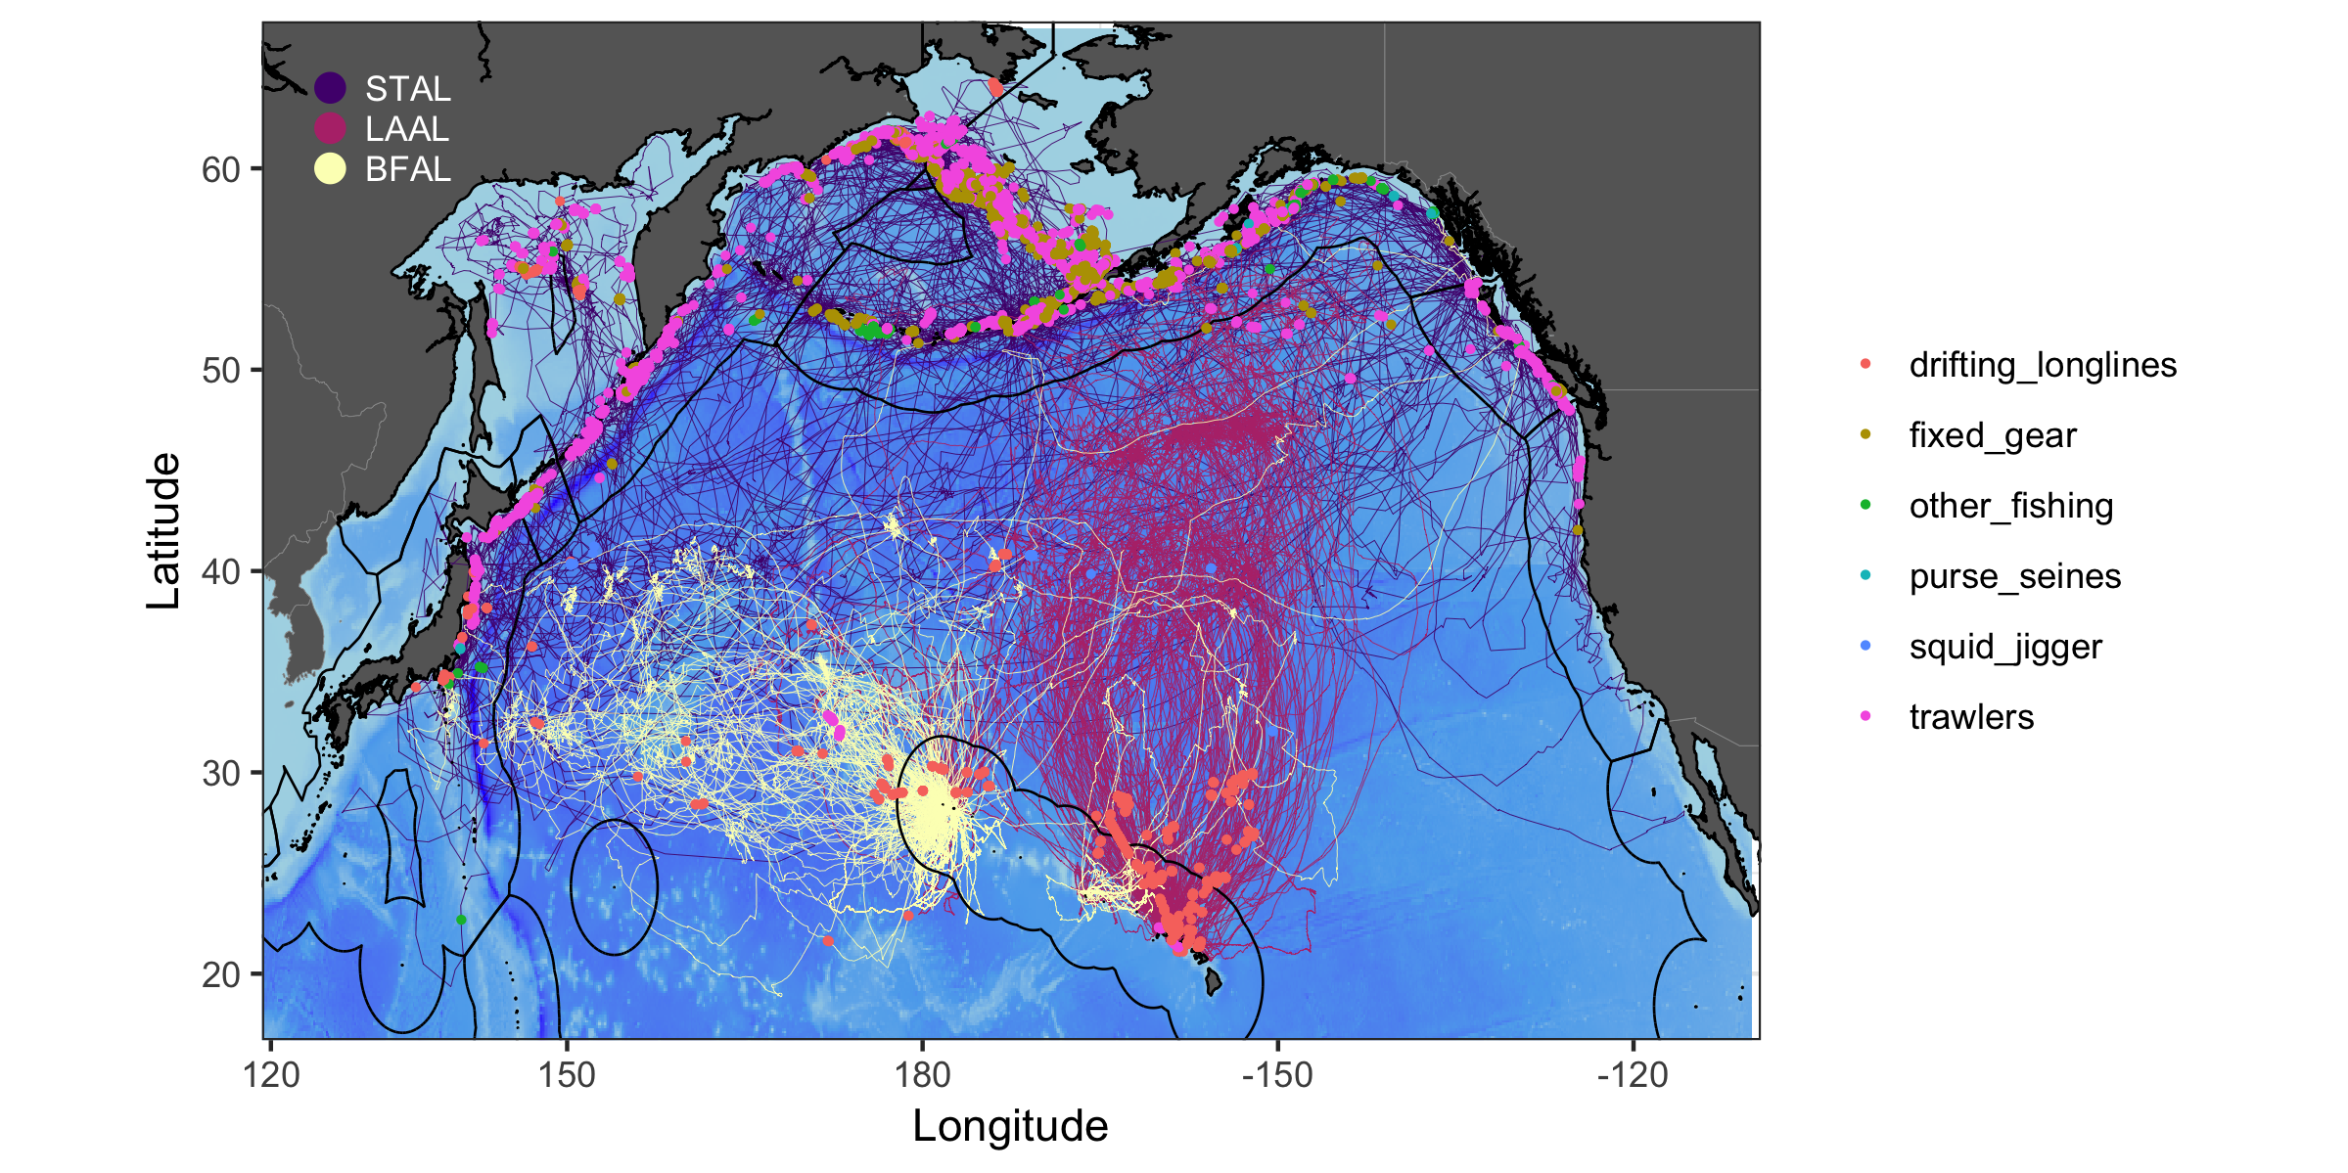

Slide 28
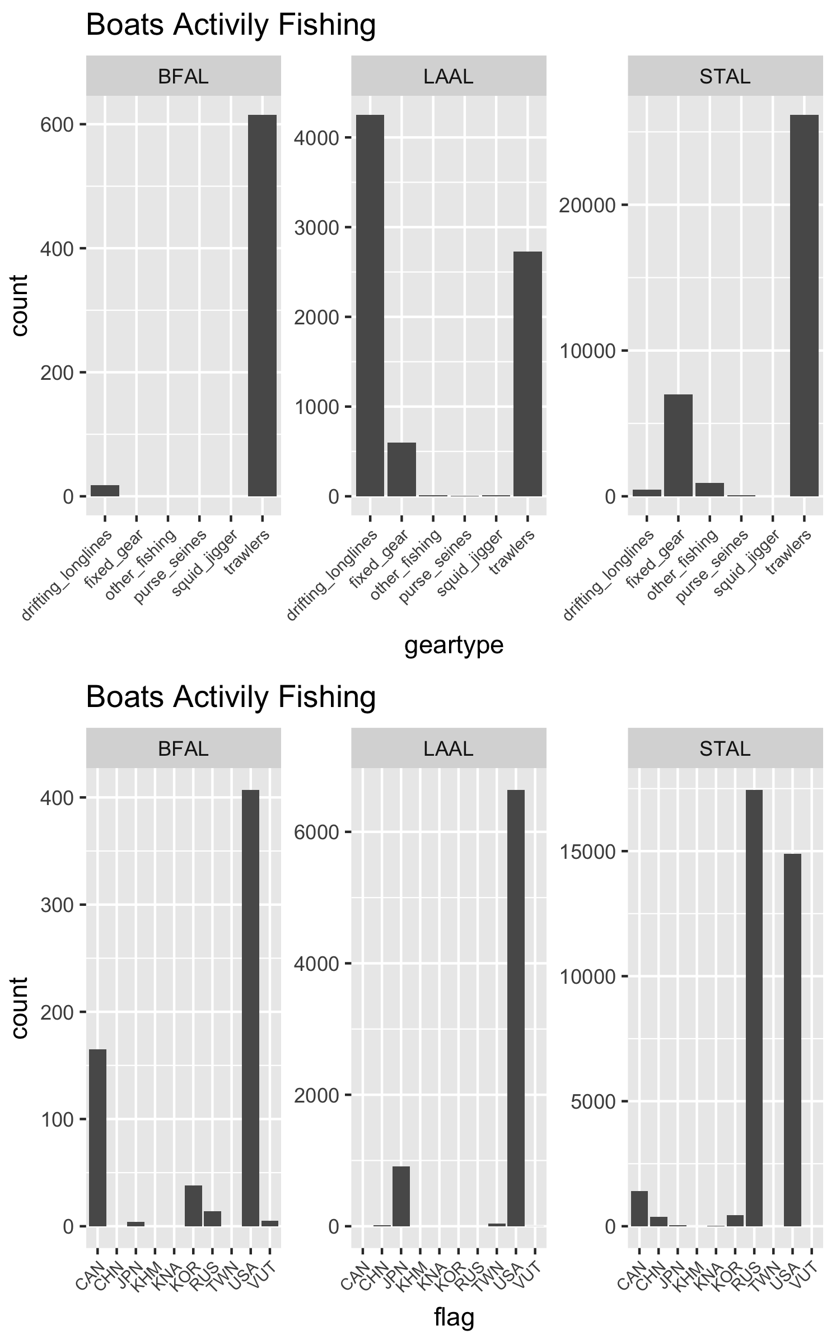

Slide 29
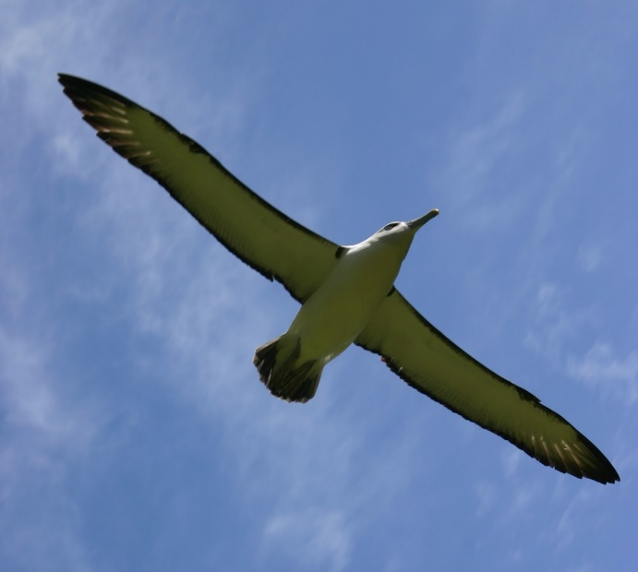



Seabird tracking data + High resolution fishing effort data =
Where?
When?
Who?
That we need to know to inform management efforts

