Slide 1


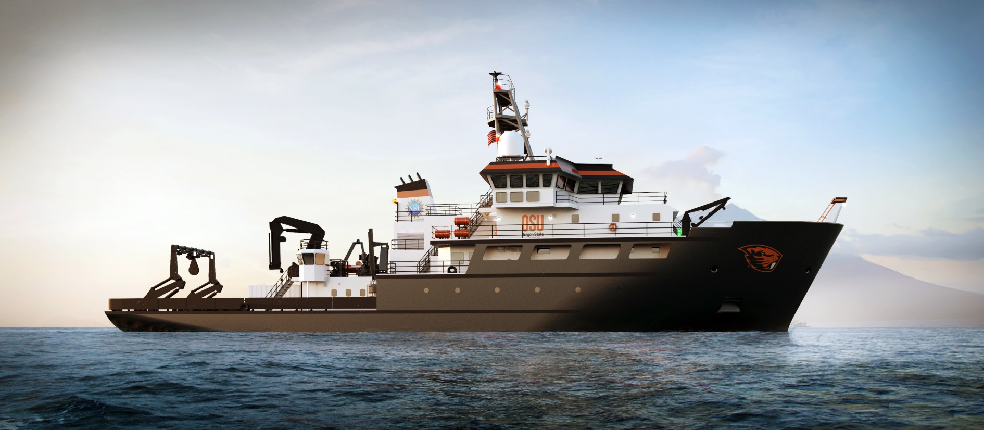
Datapresence Capabilities of the
Regional Class Research Vessels:
Chris Romsos
MBARI EARTH WORKSHOP
Newport, OR - June 2018

Slide 2
The “Charge”
YOU:
  Brief Bio Sketch
YOUR RESEARCH:
  Fleet Renewal
    In General – Replacing Aging Vessels
  Fleet Improvement
    Specifically – New “enabling” technologies for science
YOUR DATA:
  Not Operational Yet – But not far away

Slide 3


My Background:
East coast transplant:
  Came west to Oregon in 1997 after undergrad.
B.S. Environmental Resource Management:
  Penn State 1996
Worked at HMSC for ODFW 1997-2000 as a biological technician
M.S. Marine Resource Management:
  Oregon State 2004
Senior Faculty Research Assistant (2004-2015), Geology and Geophysics at CEOAS
Datapresence Systems Engineer, RCRV Project since 2015:
  Lead a team of 2.45 people ☺
Notes:
I grew up roughly 580 miles from the Ocean but was fortunate to have the influence of the Great Lakes.

Slide 4
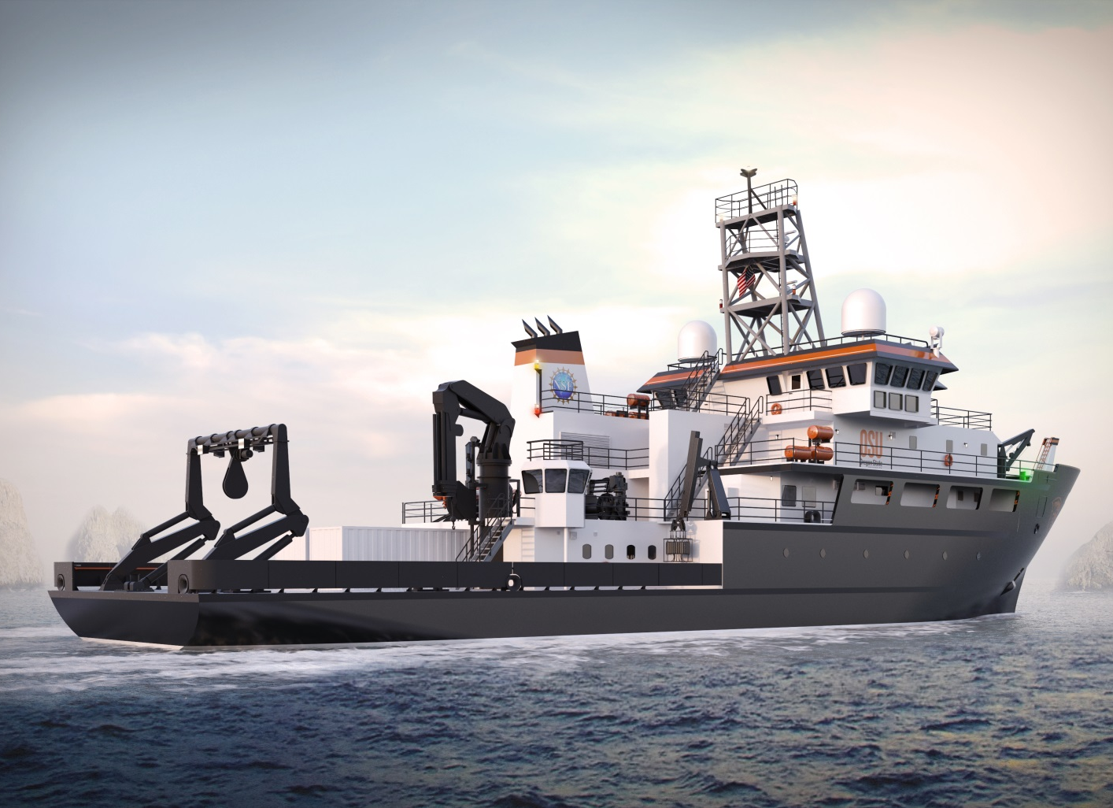
REGIONAL CLASS RESEARCH VESSELS
Coming to an Ocean Near You
Oregon State University (OSU) is leading a project to finalize the design and coordinate the construction of as many as three new coastal research vessels to bolster the marine science capabilities of the United States. OSU intends to operate the first vessel built, and expectations are that these vessels will serve research needs on the West, Gulf, and East Coasts.
Notes:
The need was identified so we began the RCRV

Slide 5
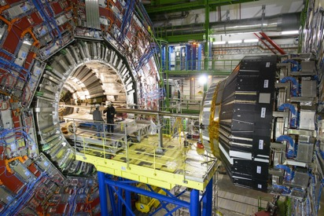
National Science Foundation Large Facilities
U.S. Antarctic Program
Arecibo Observatory
Large Hadron Collider
Gemini Observatory
LIGO (Gravity Wave Detector)
Nat’l Superconducting Cyclotron

Slide 6
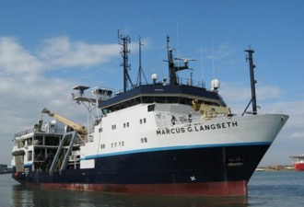
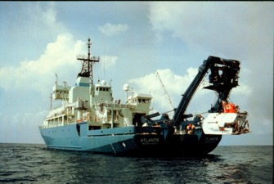
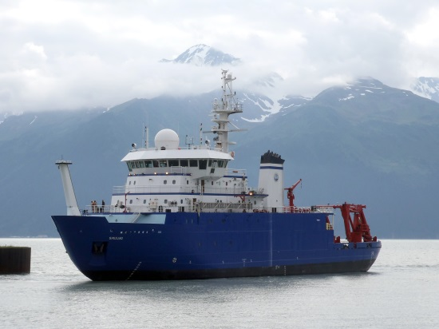
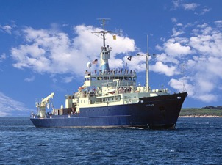
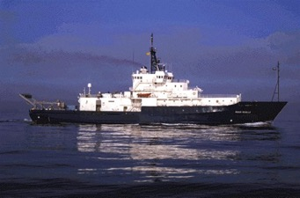
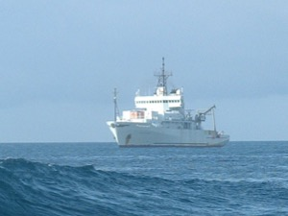
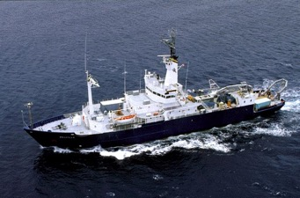
Global
Class
High endurance vessels, capable of operating world-wide
Large general purpose, multi-discipline research ships
Accommodate large science parties of 30-38
Marcus G. Langseth
Atlantis
Sikuliaq
Roger Revelle
Thomas G. Thompson
Melville/Knorr
Notes:
In the next slides I will briefly describe the UNOLS fleet.
Global Class ships are the high endurance vessels, capable of operating world-wide.
They are large general-purpose, multi-discipline oceanographic research ships capable of worldwide cruising (except in close pack ice) and able to support both over-the-side and laboratory work in high sea states.
The ships can accommodate large scientific parties of 30 to 38 people.
The newest vessels of this Class were built in the 1990s: Marcus Langseth, Thompson, Atlantis, and Revelle. Knorr and Melville, the oldest of the Global vessels, received extensive refits in 1989 and 1990, respectively.
There are two special purpose vessels within the Global Class, Atlantis, support ship for the deep submersible Alvin, and Marcus Langseth, a modern seismic vessel. The Langseth began science operations in 2008 after completing shipyard modifications.

Slide 7
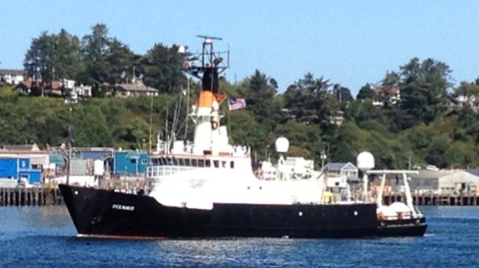
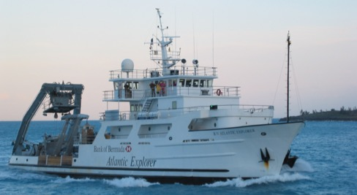
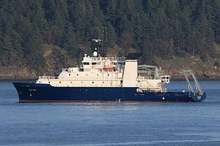
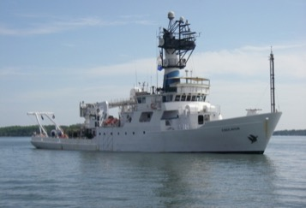
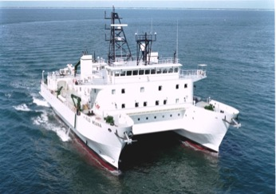
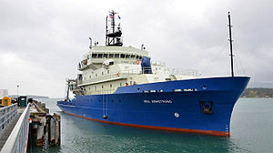
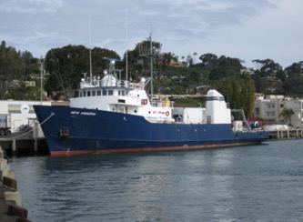
Ocean/Intermediate Class
Medium general purpose, ocean-going vessels, not globally ranging
Accommodate science parties of 18-20
Oceanus
Atlantic Explorer
Sally Ride
Endeavor
Kilo Moana
Neil Armstrong
New Horizon
Notes:
Intermediate Class: The Intermediate ships are medium endurance general-purpose vessels.
These are ocean-going vessels, though not globally ranging.
They range in size from 170 feet to 186.
Most have science accommodations for approximately 18 to 20. Many of the vessels of this class are approaching the end of their projected service life.

Slide 8
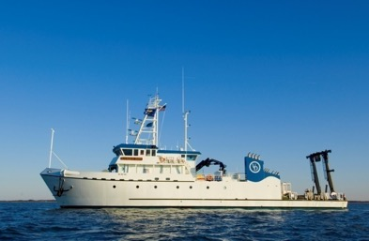
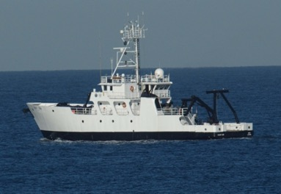
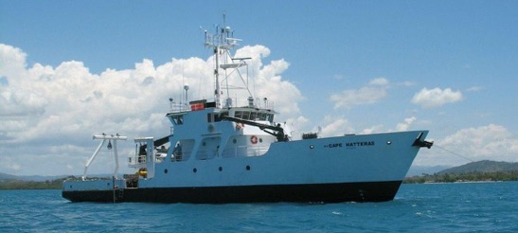
Regional Class
General purpose, designed to support integrated, interdisciplinary coastal oceanography in the broadest sense from shallow coastal bays to deep waters
The vessels’ endurance, draft, ice classification and science mission equipment will be tailored for essential science in these “regional environments” along all US coasts, including Alaska
Hugh R. Sharp
Point Sur
Cape Hatteras
Notes:
Regional Class: Regional Class ships work in and near the continental margins and coastal zone.
They are general-purpose ships, designed to support integrated, interdisciplinary coastal oceanography in the broadest sense from shallow coastal bays and estuaries out to deep water beyond the shelf.
The primary requirement is a maximum capability commensurate with ship size to support science, educational, and engineering operations in the coastal regions of the continental United States, including the Gulf of Mexico basin
The class system for the UNOLS fleet has never had rigid differentiators. Each class has an expected primary mission that is matched to the capabilities of the vessels within the class. The primary mission of the new Regional Class Research Vessels will be research operations in the coastal ocean ranging from nearshore environments to the outer continental rise. The vessels' endurance, draft, ice classification and science mission equipment will be tailored for essential science in these "regional environments" along all US coasts including Alaska.
$13K 2K

Slide 9
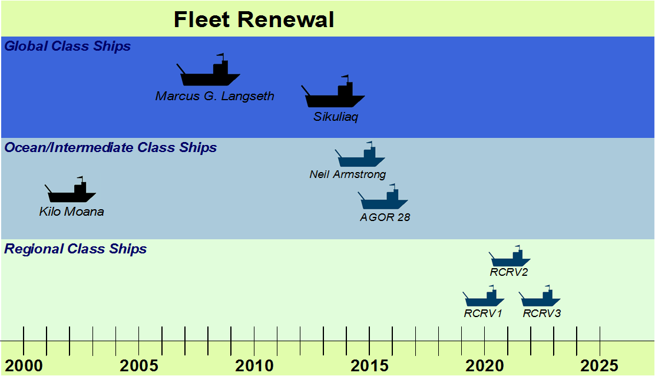
Academic Fleet Renewal is part of long-term UNOLS community planning
Notes:
This slide show the current fleet renewal timeline. At present there are no plans beyond the RCRVs. At the current rate of vessel retirements, the academic oceanographic fleet will be reduced to 15 vessels by the time the RCRVs enter service. There are no federal agency plans for new vessel construction after the RCRVs. • The new capabilities of these ships will be crucial for oceanographic research for the next 35-40 years and possibly longer.
Ships are designed to operate for 30-40 years and they take a long time to design and build. For that reason a slow process of fleet planning, and turn over is maintained through UNOLS.
To help fleet planning and scheduling, UNOLS ships are divided into 4 size classes. Size also is tied to capabilities, the number of science berths and cost.
LOA = length overall
The fleet currently has 20 vessels but 10 of these are >30 old which can mean they do not meet modern SMR and they experience equipment failures. This is a reason fleet renewal is needed.

Slide 10
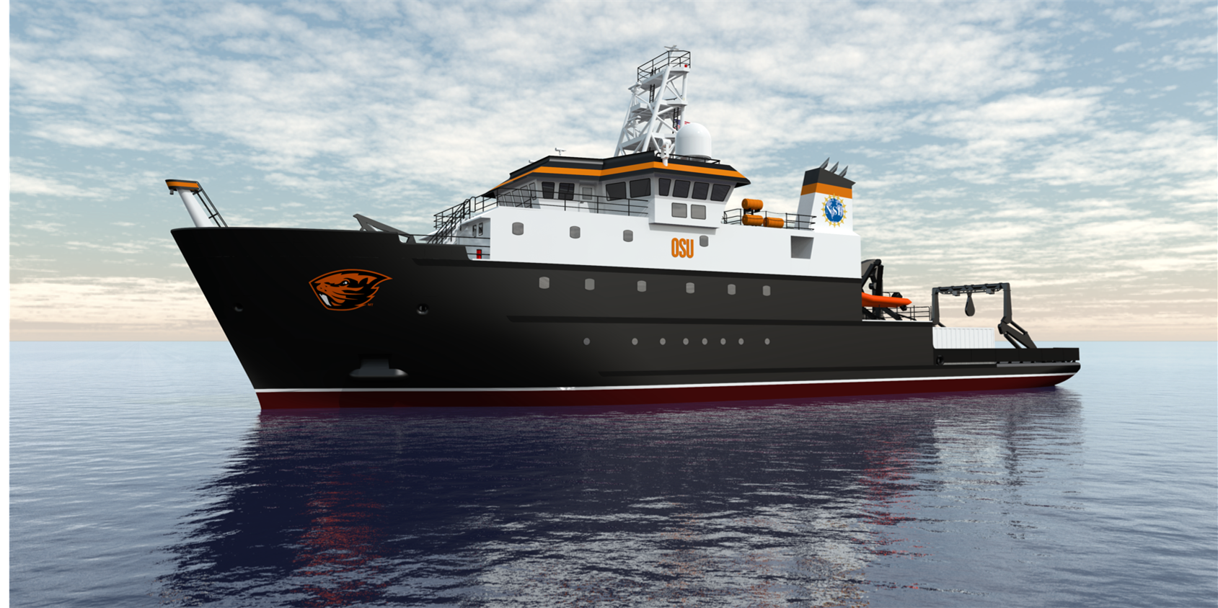
OSU’s Ocean Research Ships: Past, Present, and Future (but mostly future)

Slide 11
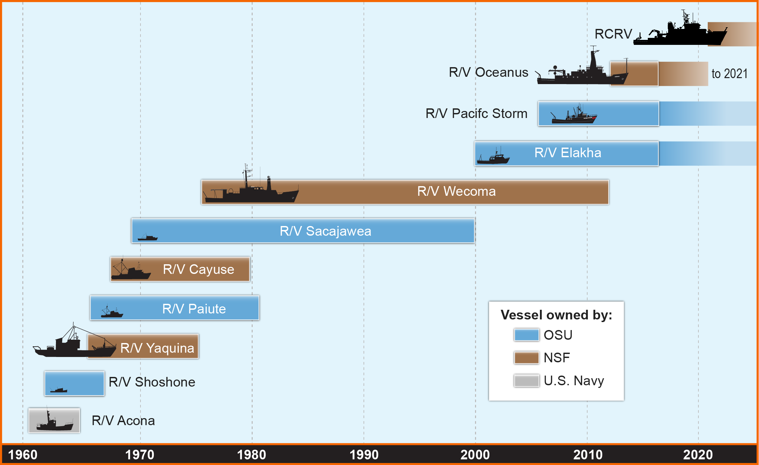
OSU Fleet Timeline

Slide 12
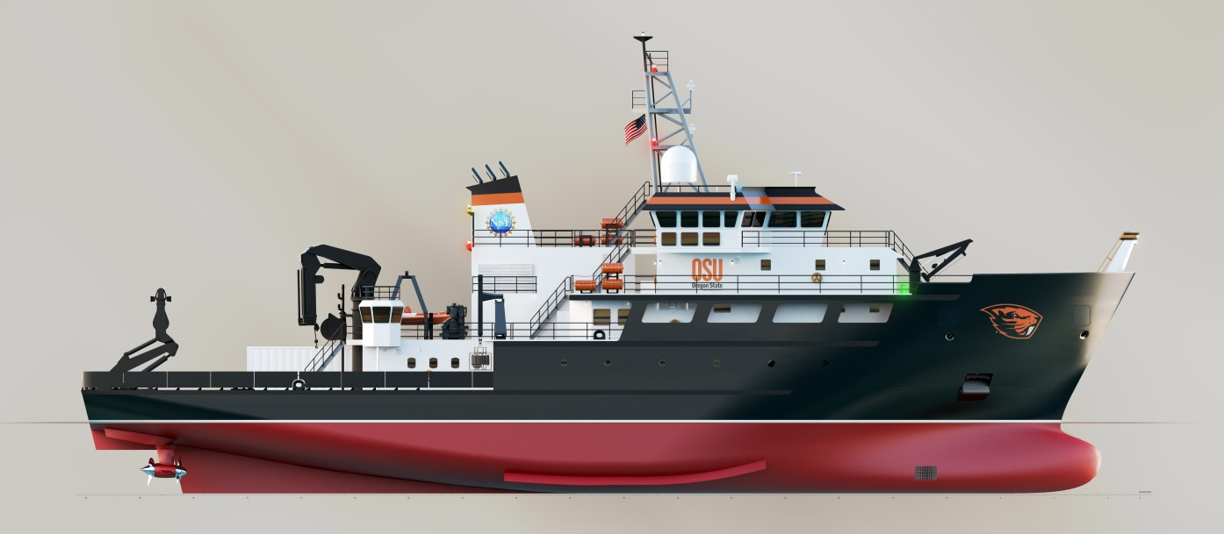
Building a Research Vessel:
What are the requirements?
Define the Basic Design
Define the Science Mission Characteristics
Comply with Regulatory and Classification Regimes
General purpose, designed to support integrated, interdisciplinary coastal oceanography in the broadest sense from shallow coastal bays to deep waters
The vessels’ endurance, draft, ice classification, and science mission equipment will be tailored for essential science in these “regional environments” along all US coasts, including Alaska
Notes:
Top Level Requirements:
Basic Design (The RCRV shall be a modern monohull research vessel, with integrated diesel-electric propulsion, capable of general-purpose interdisciplinary oceanographic research in areas from shallow coastal bays and estuaries to and beyond the continental shelf and slope. The ship shall be capable of operating on any ocean worldwide, in a regional research capacity. Vessel particulars shall be determined by: Payload: Science payload of 50 long tons at departure condition, with up to 29 total personnel (16 science + martech, 13 crew). Additionally, the RCRV is expected to have the capability to carry and dock a 4-person UNOLS berthing van.  Speed: Calm water cruising speed of 11.5 to 12.0 knots  Endurance: 21 days and range of 5,400 nm)
Science Mission Characteristics :The ship will operate in coastal regions worldwide, will make open ocean transits, and may operate in or around light first-year ice and call into ports which occasionally experience some ice. This is met by requiring ABS Ice Class classification C0. The ship shall be capable of high-performance station keeping and will be designed to meet ABS Dynamic Positioning classification DPS1 with some DPS2 capability for reliability and redundancy. The vessel’s Underwater Radiated Noise (URN) will be minimized through treatments and vibration dampening to meet a URN amplitude-frequency curve similar to that established for the R/V Sikuliaq making it acoustically quiet under most general oceanographic operating scenarios. The vessel shall be fuel-efficient and have minimal impacts on the natural environment (i.e., shall be “Green”), as economically and technically practicable while meeting the regulatory requirements and operational goals for the vessel. The ship shall be capable of performing the following tasks: Sampling and data collection of surface, mid-water, and sea floor parameters using modern scientific laboratories and instrumentation, including portable laboratory vans  Acoustic multibeam bottom mapping and sub-bottom profiling  Launch and recovery of scientific packages, both tethered and autonomous using state-of-the-art handling systems  Handling, monitoring, and servicing of remotely operated vehicles (ROVs) (appropriate for vessel size) and autonomous underwater vehicles (AUVs)  Deployment and recovery of unmanned aerial systems (UASs) and weather balloons  Deployment and recovery of moorings and coring equipment (appropriate for vessel size)  Deployment and recovery of small craft (appropriate for vessel size), including autonomous surface vehicles (ASVs)  Deployment and recovery of free-floating instruments, Full-time, high speed satellite connectivity for communications, internet access and data transfer including telepresence between researchers afloat and researchers, students and the general public ashore  Precise navigation, station-keeping and track-line maneuvering to support deep sea and coastal operations  Long periods of operation on-station, or underway at low speeds for towing and bathymetric surveys  Providing access to the sea for scientific personnel with visual, hearing or mobility limitations within the limitations of regulatory and other requirements.
Regulatory and Classification Regimes: The Design Refresh shall comply with appropriate regulations and classification society requirements: United States Coast Guard (USCG); International Convention for the Safety of Life at Sea (SOLAS); International Convention on Standards of Training, Certification and Watchkeeping for Seafarers (STCW); International Convention for the Prevention of Pollution From Ships (MARPOL); United States Environmental Protection Agency (EPA); and, the American Bureau of Shipping (ABS).

Slide 13
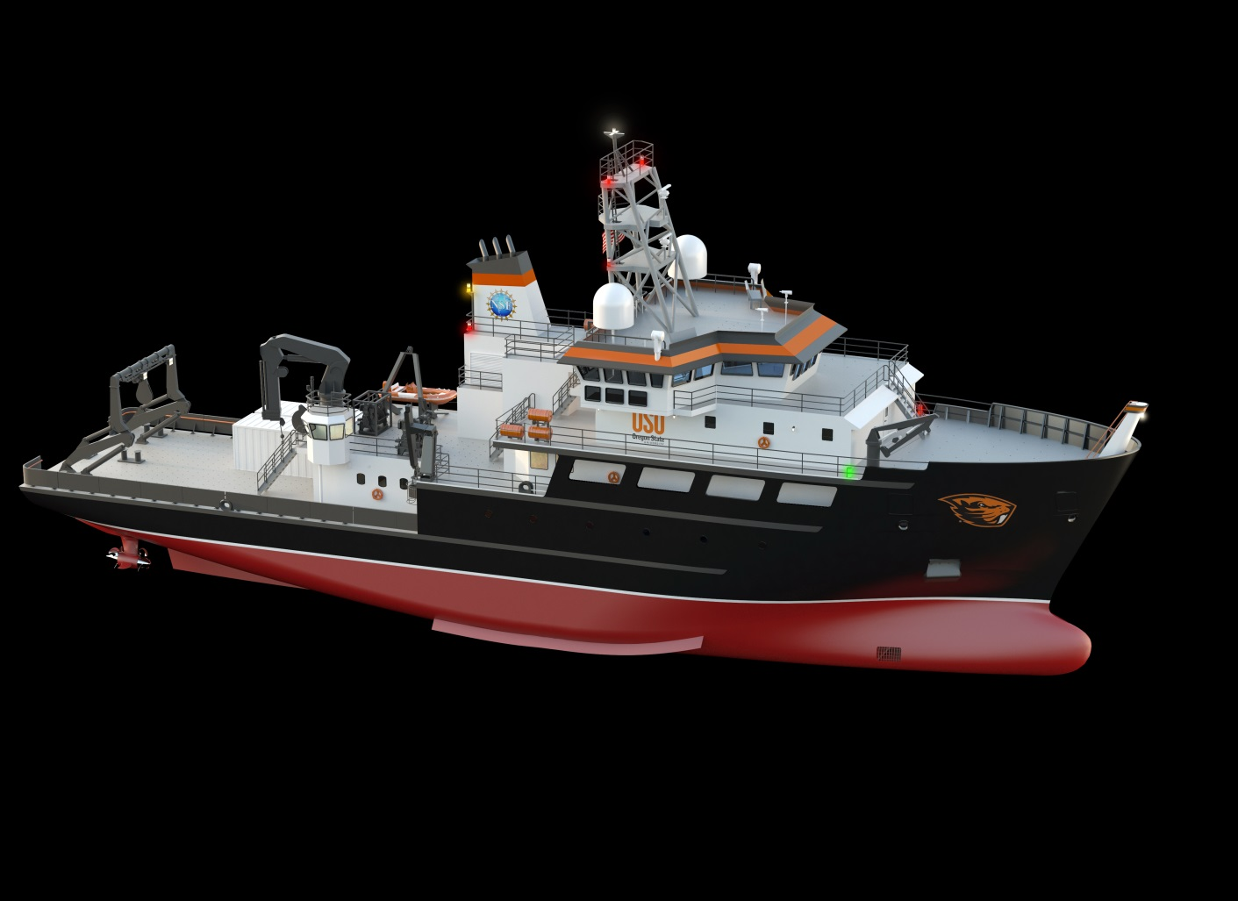
State of the Art Research Vessels
Funded by the National Science Foundation (NSF) to PROMOTE MARINE RESEARCH and join the University-National Oceanographic Laboratory System (UNOLS) fleet
Overall Length: 192’ 10”
Science and Marine Tech Berths: 16
Crew Berths: 13
Endurance: 21 days
Range: 5400 Nautical miles (6214 miles)
ADA informed design
Enviro Certified
Dynamic Positioning System
State of the Art Over the Side Handling System
Retractable Centerboard
First vessel hits the water in 2021
Notes:
Up to 12 knots
Bulbous bow increases fuel efficiency by ~6%
Green Marine and IAPH Environmental Ship Index
5-15% fuel savings in using 3 identical variable speed generators, variable generation allows the generators to operate more efficiently.
Dynamic positioning allows the ship to set up in the trough, reducing heave at stern. This in turn extends the operational window increasing science productivity.
Starboard side CTD launch and recovery system (LARS) with a CTD docking head, allows for hands free deployment and recovery of the CTD rosette.
Retractable centerboard, removable transducer mounting area to allow alternative configurations for fisheries sonars, ADCP etc.

Slide 14
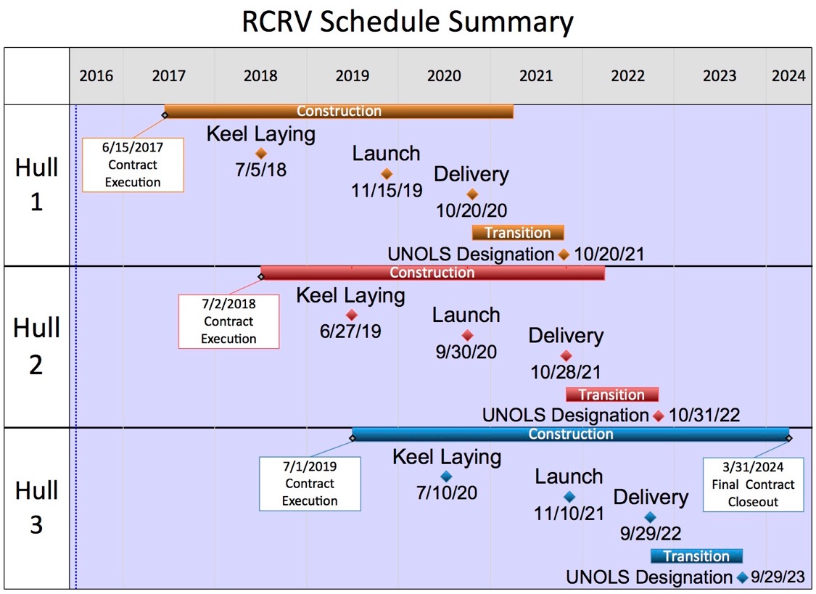

Slide 15
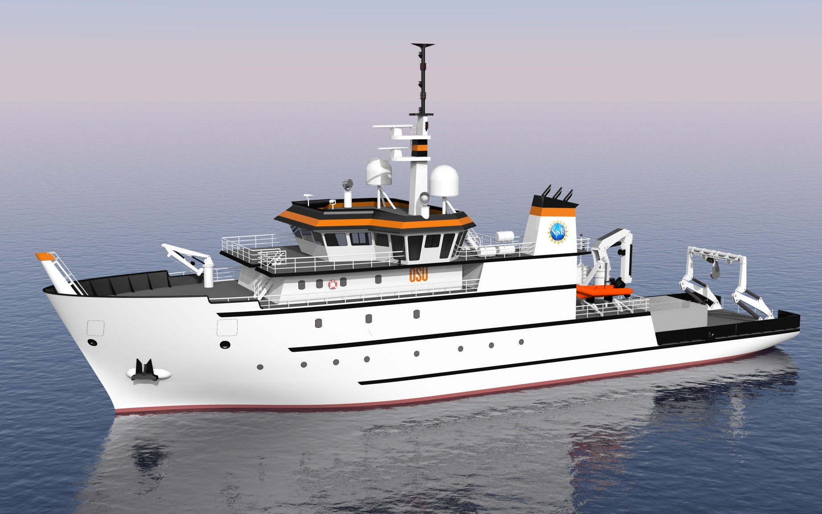
Versatile • Capable • Efficient • Desirable
Notes:
Design Drivers

Slide 16
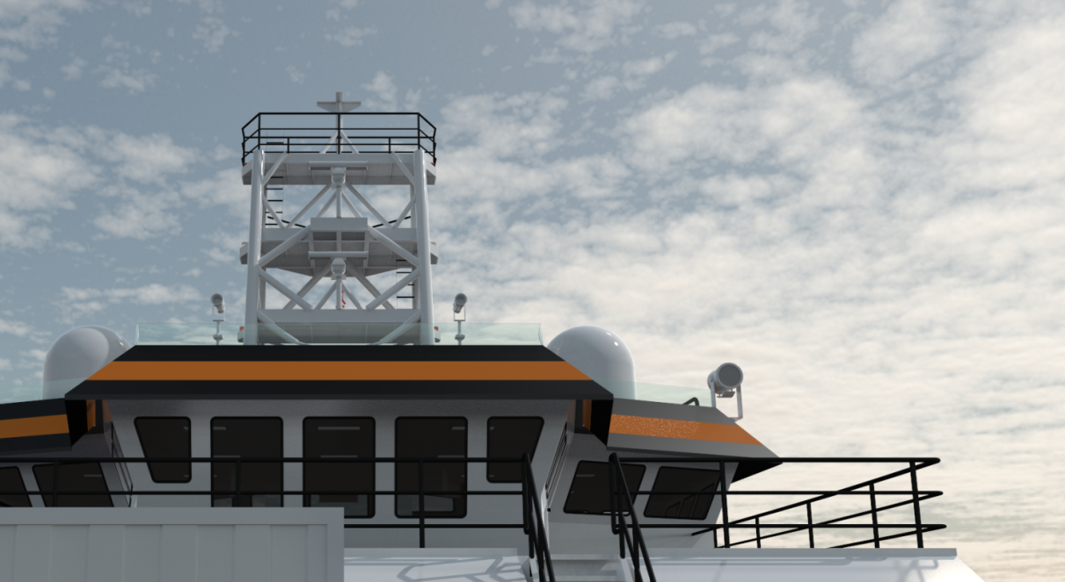
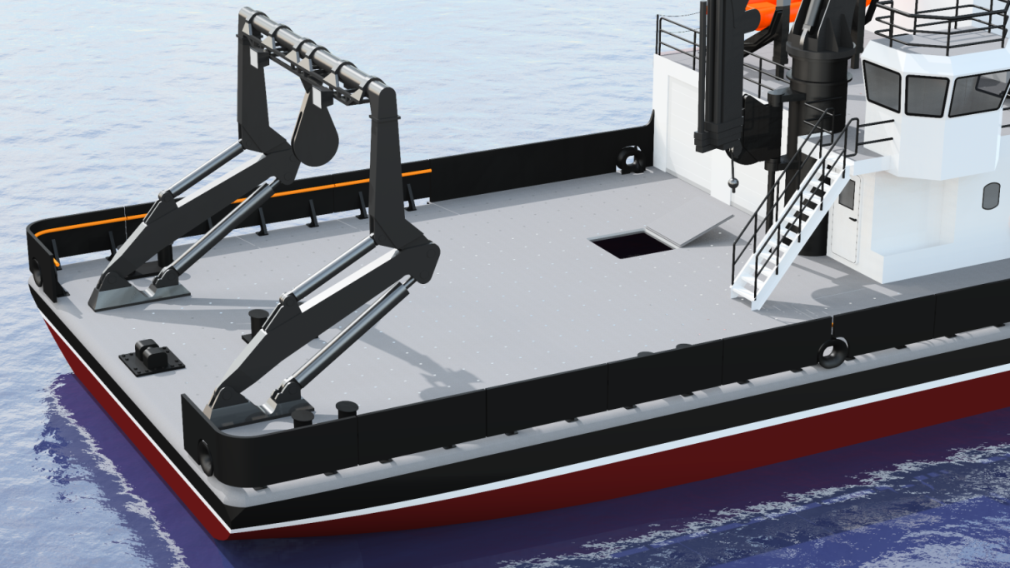
Versatile
Large Back Deck
Matable Vans
Adaptable Centerboard
Customizable Labs
Accessible Masts
OHS swappable spools & variety of deployment options
Notes:
Matable 4 person accommodation van, up to 3 – 20ft vans for either accommodation or scientific use.
3/8”, 5/8”, 9/16” and .393

Slide 17
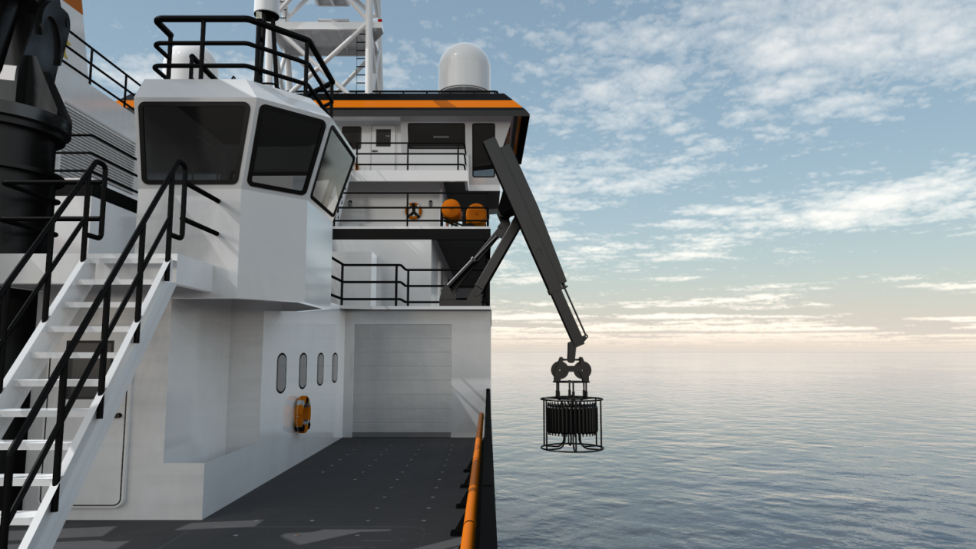
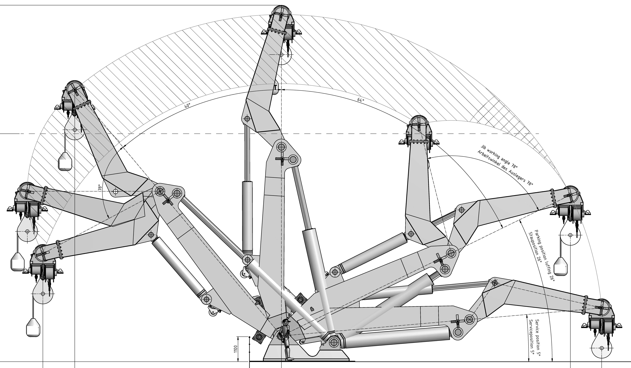
Capable
Dynamic Positioning with two stern and two bow thrusters
Wide suite of sonar options
Double articulated A-frame
As strong a crane as stability allows
Miranda Style Davit for small boat launches
Acoustically Quiet
Virtual Participation through Datapresence

Slide 18
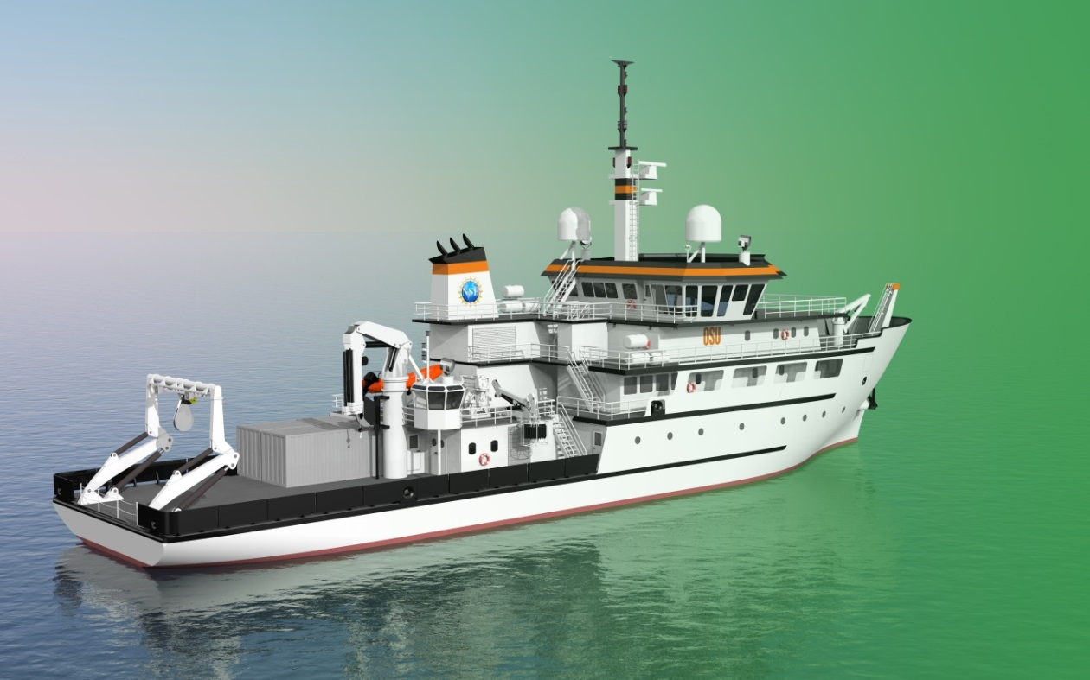
Efficient
Optimized Hull / Bulbous bow
Waste Heat Recovery
Variable Speed Power Generation
Wake Adapted Propellers
Ultra Efficient Pumps / Motors
LEDs and smart energy use features
Push/Pull Z-Drives

Slide 19
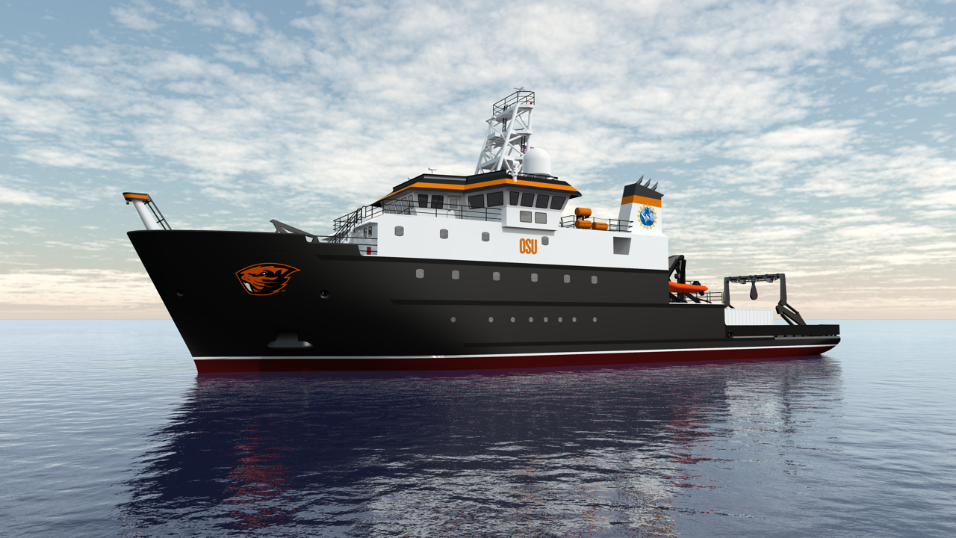
Desirable
Strong Focus on Sea Keeping
U-Tube, Beam (41ft), Centerboard
Interior Design Focus
European Influenced
Individual Staterooms
User driven, detail focused design

Slide 20
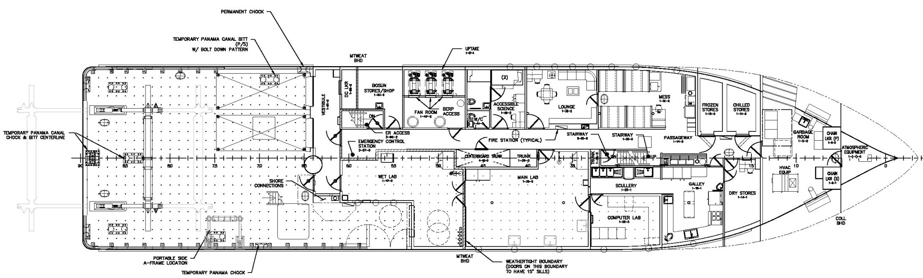
General Arrangement: Main Deck
Main Lab 510 ft²
Wet Lab 365 ft²
Computer Lab 175 ft²
Enhanced Accessibility
Main Deck (aft of house) 2,020 ft²
Main Working Deck (including side deck) 2,230 ft²
Side Deck Length 70 ft
Space on the port side for two vans (mated to superstructure)
Notes:
Main Deck is designed with enhanced accessibility. Includes double science stateroom, mess and galley.
Oceanus 177 LOA, 33 ft beam
Space for up to 3x 20’ science vans

Slide 21
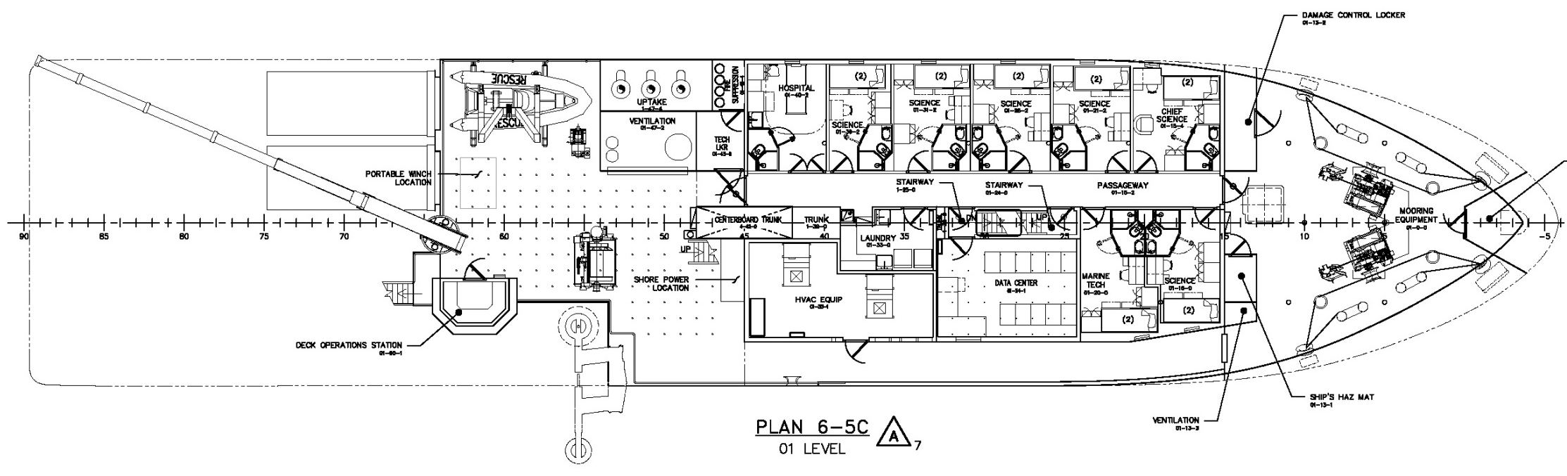
General Arrangement: 01 Deck
Science Berths 8 Double Staterooms
(includes accessible stateroom on Main Deck)
+laundry and hospital
Marine Technician 1 Double Stateroom
Datapresence Center 215 ft²
Winch Deck Area 550 ft²

Slide 22
Enabling Technologies
Not enough time to cover all of them but we can hit the big ones..
Over The Side Handling Systems
Hydroacoustic Systems
Systems for Remote Participation
  Telepresence
  Datapresence

Slide 23

Enabling Technologies:
Active Heave Compensation and Constant Tension Winches
Reduce Heave-Induced cable snap to Sea State 5 (rough, 8-13ft seas)
Assist in the deployment and recovery of equipment (e.g. cores, nodes, ROVs) from the seafloor smoothly with wires over the stern or side A-frames
Hands Free
Notes:
Reduce heave-induced cable snap to SS5
Can help deploy and recover equipment (e.g., cores, nodes, ROVs) from seafloor smoothly with wires over stern or side A-frames
Active Heave Compensation: start at 2:00
https://www.youtube.com/watch?v=S5deYQ_uOCQ
Active Heave Comp and Render recover will increase safety of operations and enable deployments in higher environmental conditions.
Synthetic line, neutrally buoyant in water, will open up new possibilities for coring including video coring.
<iframe width="560" height="315" src="https://www.youtube.com/embed/S5deYQ_uOCQ" frameborder="0" allow="autoplay; encrypted-media" allowfullscreen></iframe>

Slide 24
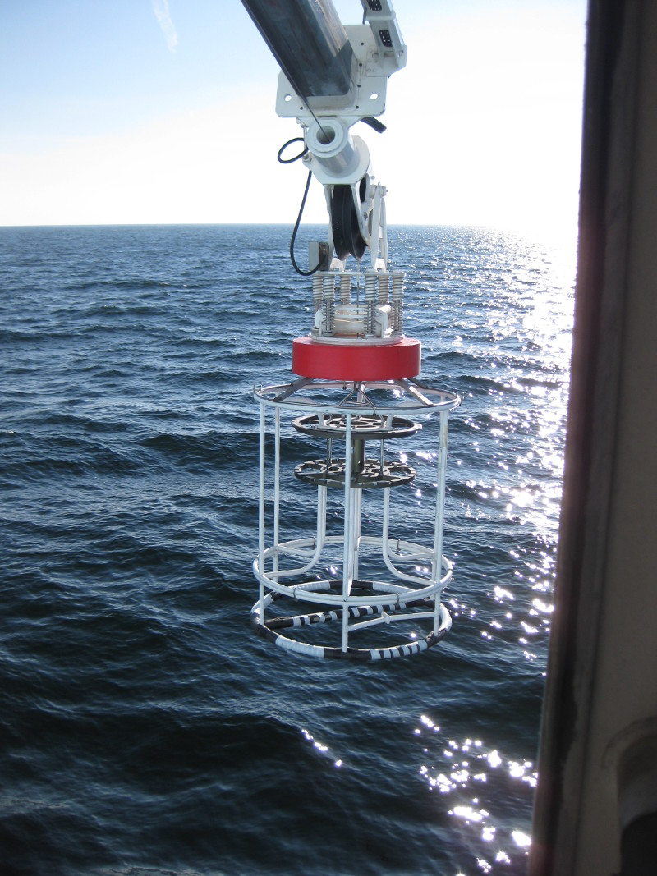
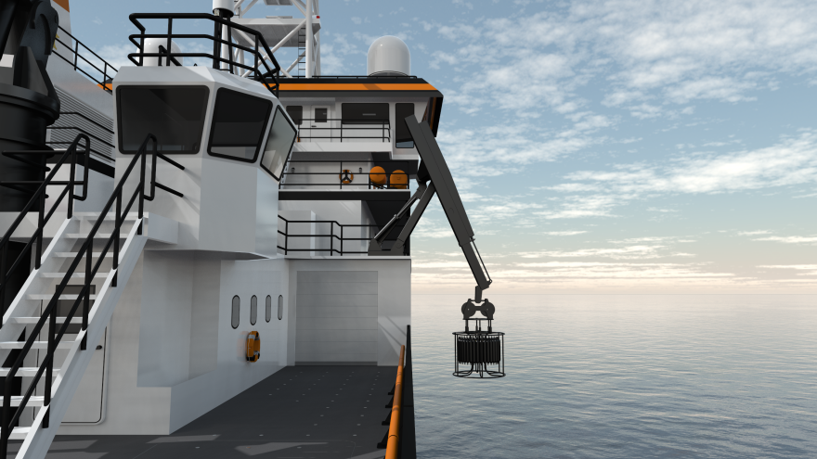
Enabling Technologies: Over the Side Handling
Starboard side CTD launch and recovery system (LARS)
CTD Docking head
Hands free
Notes:
Launch and Recovery System (LARS) specified as an integrated system including Hydro Winch, Side Boom, Bulwark Doors and Package Movement System.
Overall LARS designed to move package from water to lab with minimal hands-on.
Side Boom DLT = 16,000 lbf lowering, 3,000 lbf towing.
Normal CTD package will go through rail, not over.

Slide 25
Enabling Technologies: Articulating Stern A-Frame
  Clear height – 25 feet Clear width – 20 feet
Notes:
Main A-Frame
DLT 51,400 lbs, sized for 5/8” Spectra line
Choice of synthetic line may be informed by R. Trask tests on Endeavor in April, 2016.
25ft vertical clearance, 20ft horizontal
Double articulated
Bolting flange on trunion
Wing extensions
Tuggers on crossbar

Slide 26
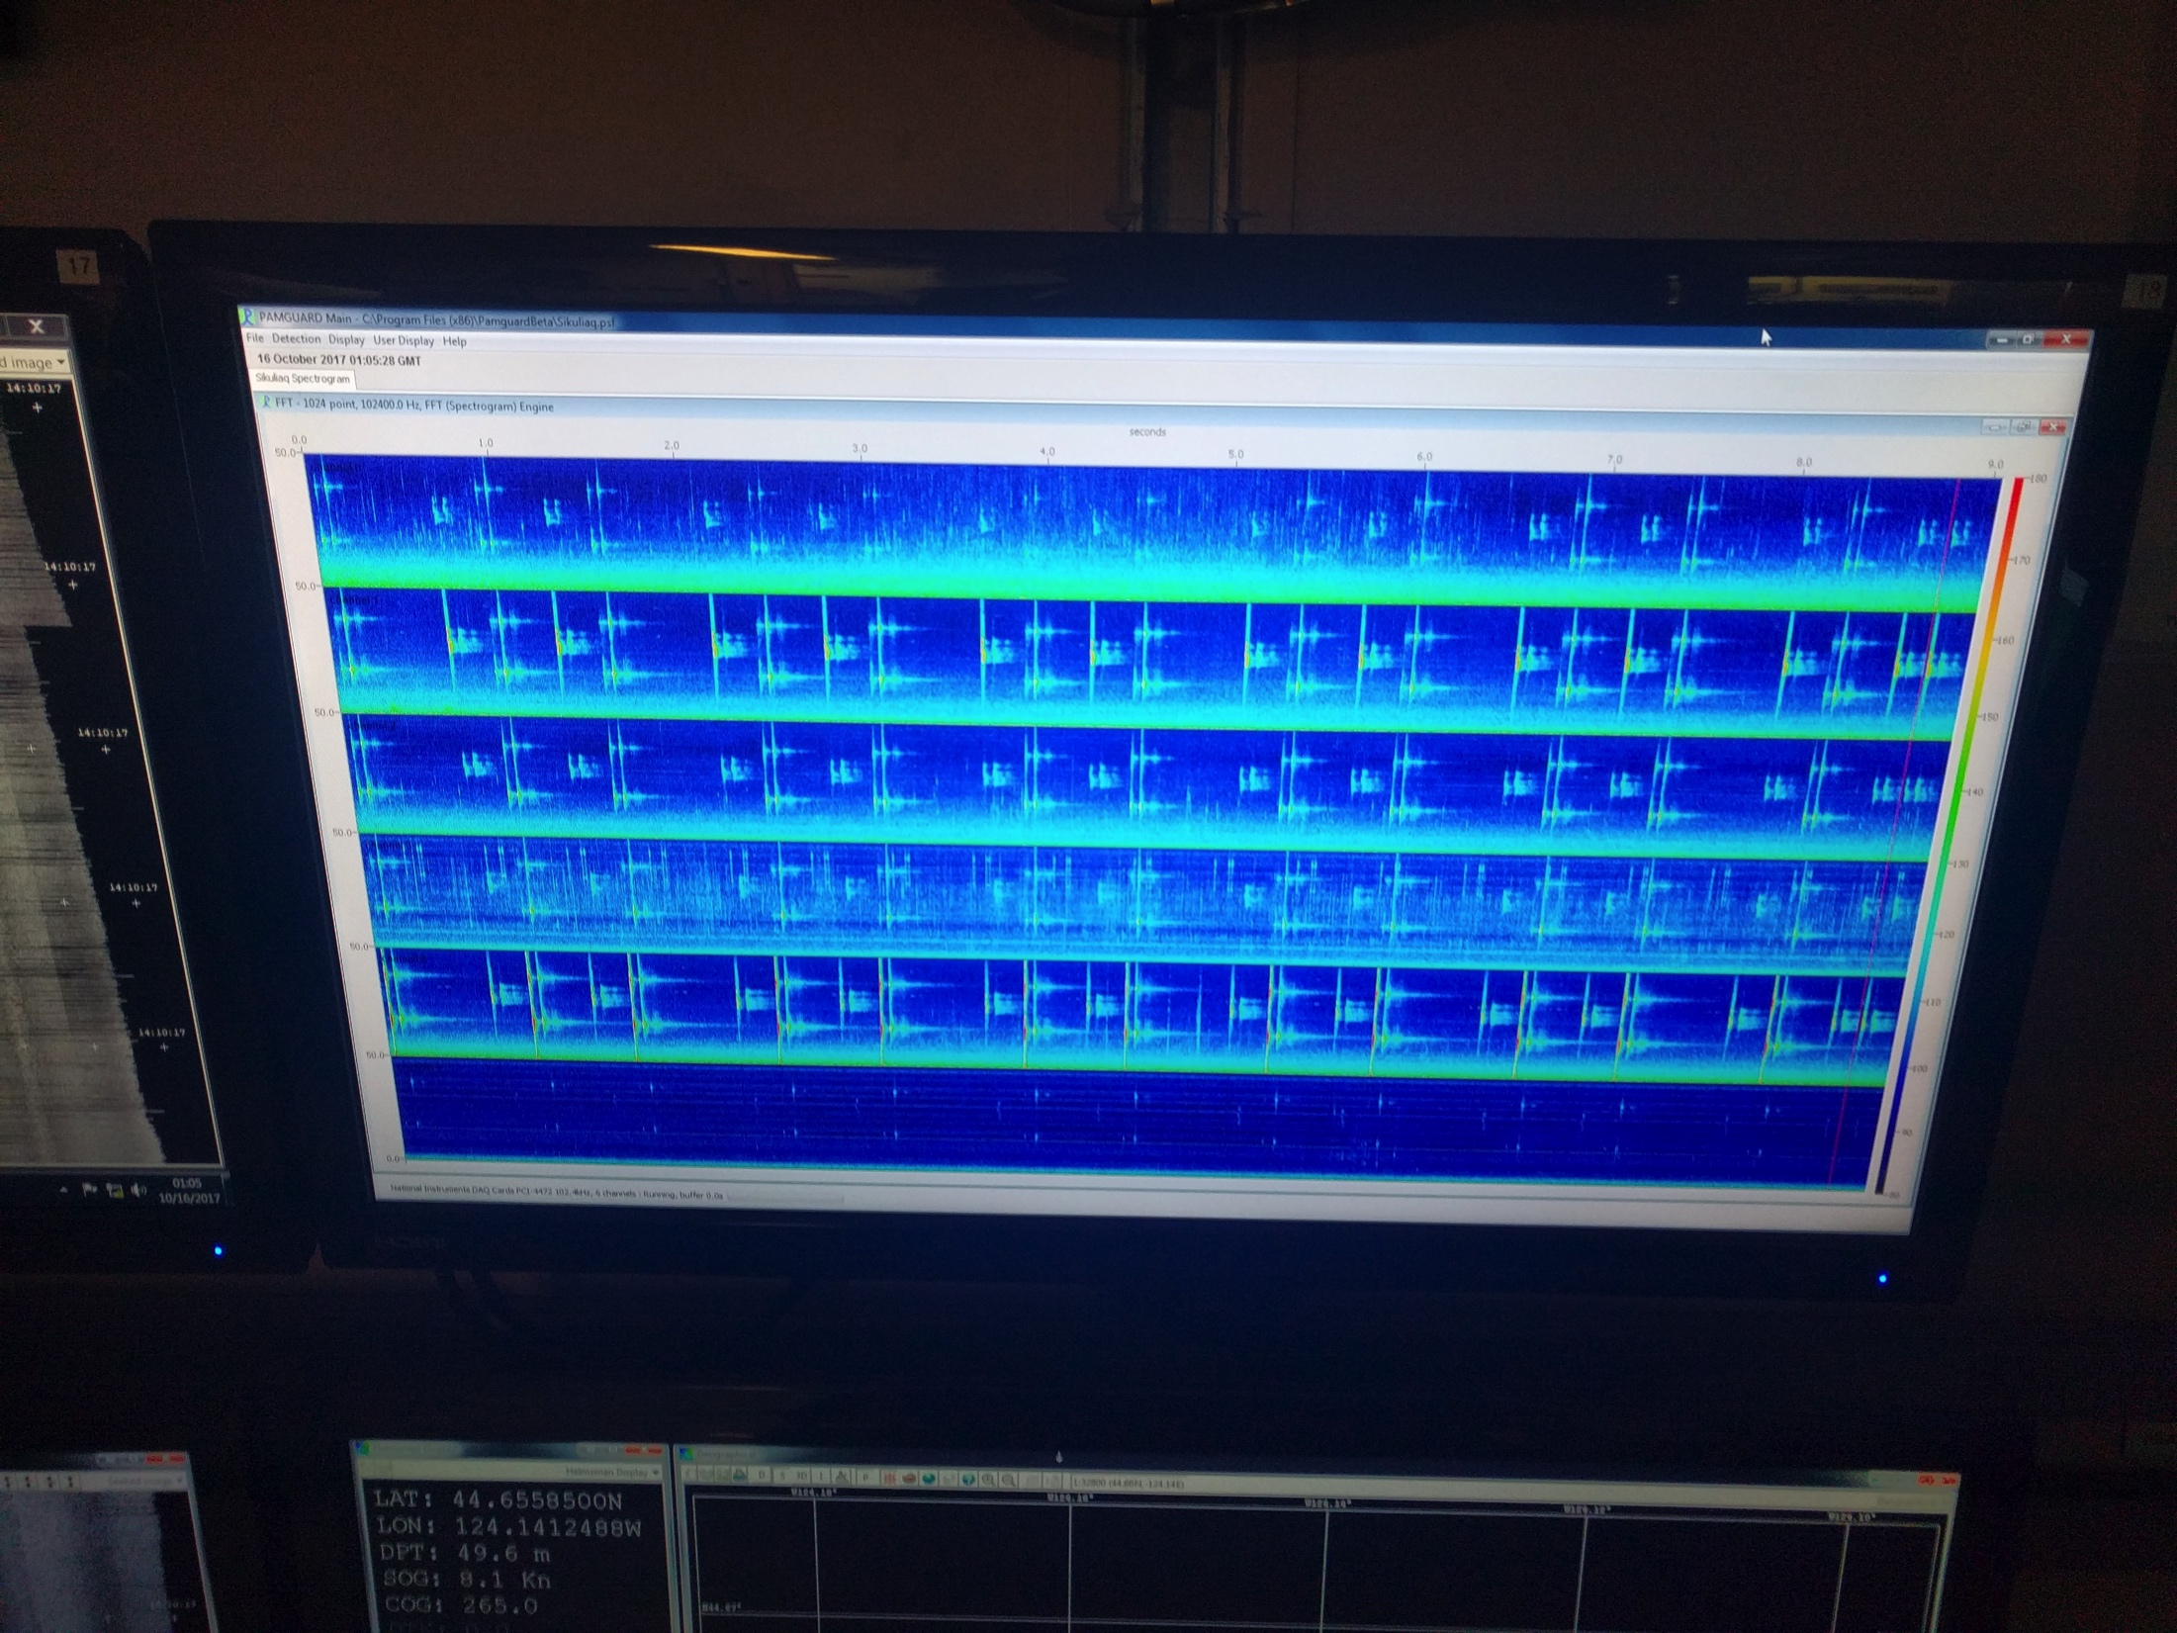
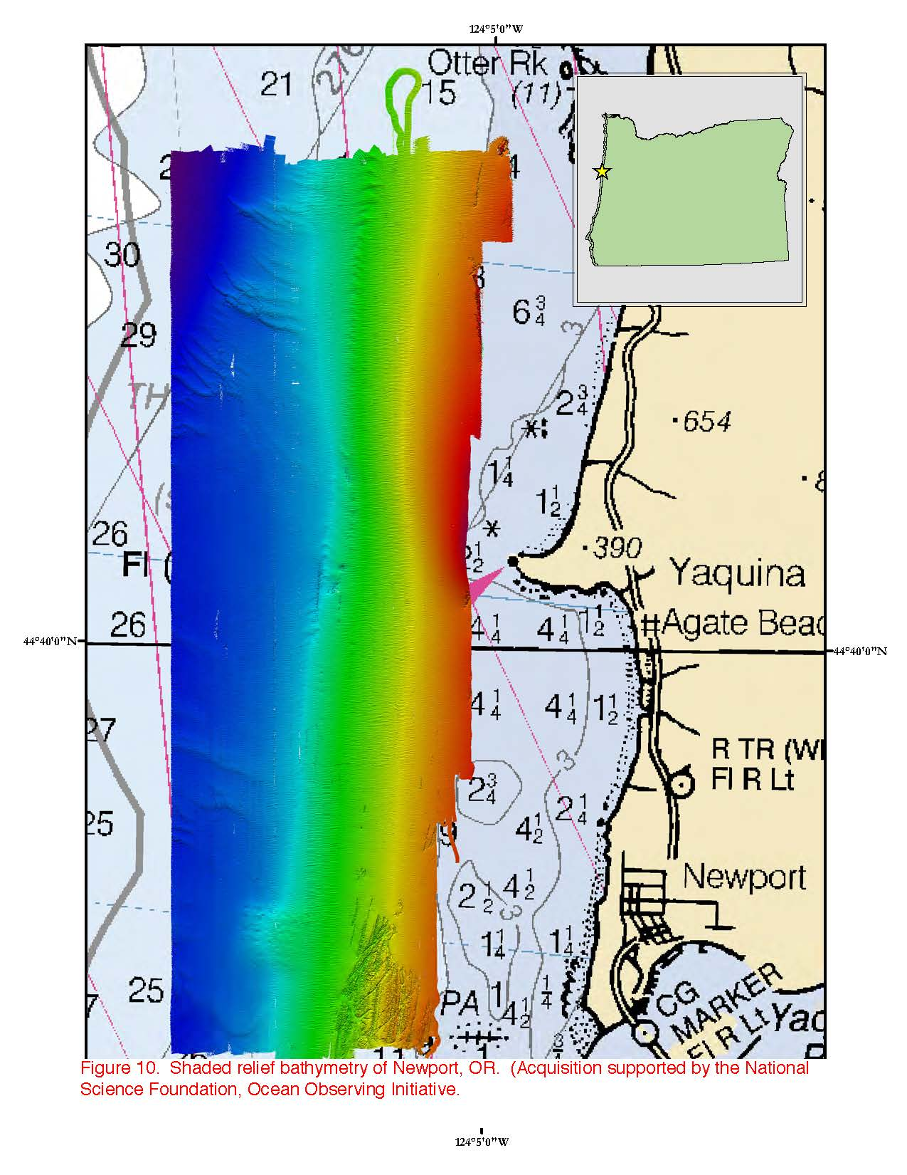
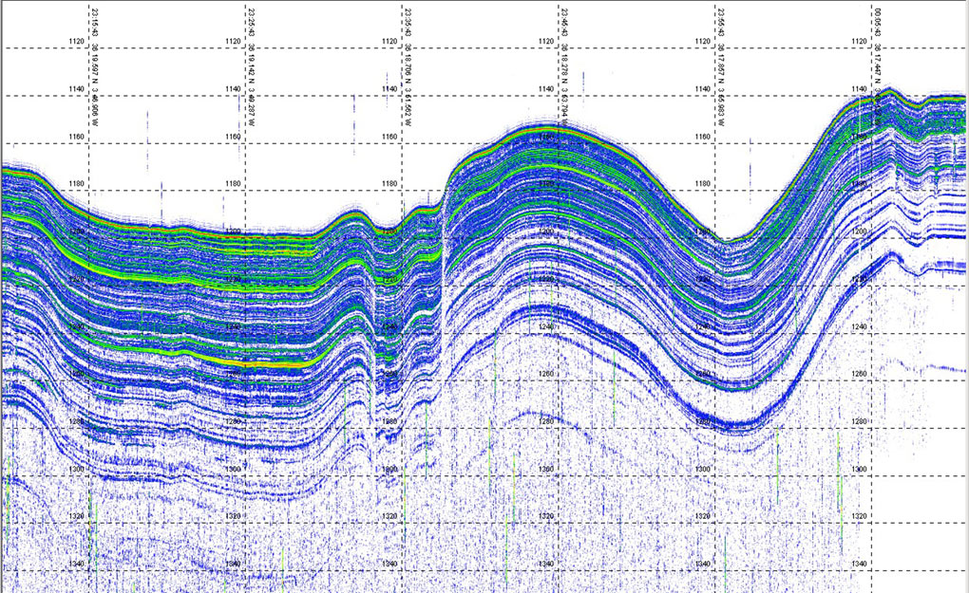
Enabling Technologies: Acoustics
Notes:
RCRV will have the ability to collect high quality and high resolution ocean floor and subfloor acoustic data (multibeam) from near shore to midwater depths. We are working with hydrographers to ensure that RCRV multibeam data collected in shallow and midwater depths will be "chart quality" (i.e. of the highest quality that will potentially be useful for charting and habitat mapping, an ability that is important to the ocean energy industry, for example).
RCRV will also introduce a deployable "centerboard" that will, with high positional precision, provide at versatile platform on to which a wide variety of acoustical sensors can be easily installed based on specific mission requirements. These could possibly include fisheries survey transducers (EK-60), current profilers (ADCP), and shallow water multibeam units (2040), among other possibilities. The innovation of the RCRV's centerboard will be that it will have a removable "foot" that can be used to easily swap out families of sensors AND it will have swappable plates that will provide the maximum flexibility for individual sensors. Presently, no vessel in the academic research fleet has as versatile a centerboard or one so precisely spatially referenced in order to provide highly reliable data.
Centerboard
EM2040C shallow water multibeam
ADCPs – 75 kHz and 300 kHz
Secondary 12 kHz transducer
Spare mounting hole for project transducer or USBL transducer
Sonar Flat:
EM 302 (optional EM 712), 0.5˚ x 1˚
TOPAS PS18 Subbottom profiler
EK80 Fisheries Sonar
Primary 12 kHz transducer
Navigational echosounder and speed log
At least 3 spare holes for project transducers

Slide 27
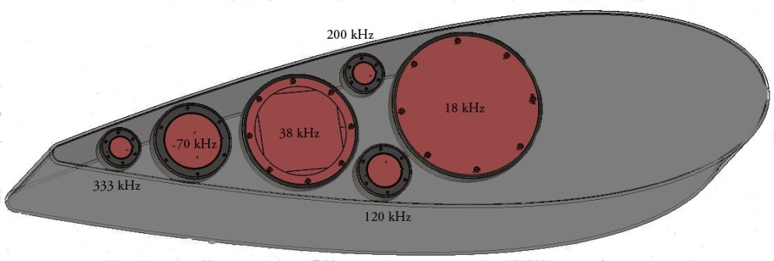
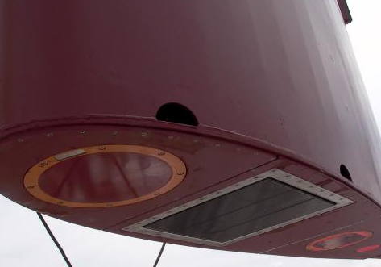
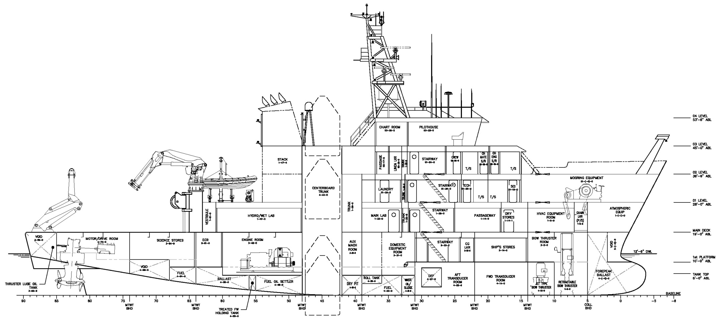
Enabling Technologies: Retractable Centerboard
EM 2040
Removable transducer mounting area to allow alternative configurations for fisheries sonars, ADCP, etc.
Notes:
RCRV will have the ability to collect high quality and high resolution ocean floor and subfloor acoustic data (multibeam) from near shore to midwater depths. We are working with hydrographers to ensure that RCRV multibeam data collected in shallow and midwater depths will be "chart quality" (i.e. of the highest quality that will potentially be useful for charting and habitat mapping, an ability that is important to the ocean energy industry, for example).
RCRV will also introduce a deployable "centerboard" that will, with high positional precision, provide at versatile platform on to which a wide variety of acoustical sensors can be easily installed based on specific mission requirements. These could possibly include fisheries survey transducers (EK-60), current profilers (ADCP), and shallow water multibeam units (2040), among other possibilities. The innovation of the RCRV's centerboard will be that it will have a removable "foot" that can be used to easily swap out families of sensors AND it will have swappable plates that will provide the maximum flexibility for individual sensors. Presently, no vessel in the academic research fleet has as versatile a centerboard or one so precisely spatially referenced in order to provide highly reliable data.
Centerboard
EM2040C shallow water multibeam
ADCPs – 75 kHz and 300 kHz
Secondary 12 kHz transducer
Spare mounting hole for project transducer or USBL transducer
Sonar Flat:
EM 302 (optional EM 712), 0.5˚ x 1˚
TOPAS PS18 Subbottom profiler
EK80 Fisheries Sonar
Primary 12 kHz transducer
Navigational echosounder and speed log
At least 3 spare holes for project transducers

Slide 28
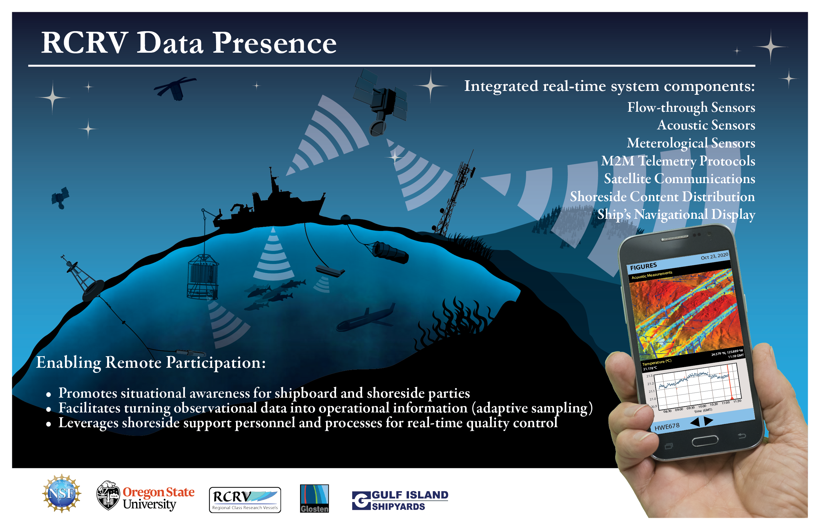
Enabling Technologies: Remote Participation

Slide 29
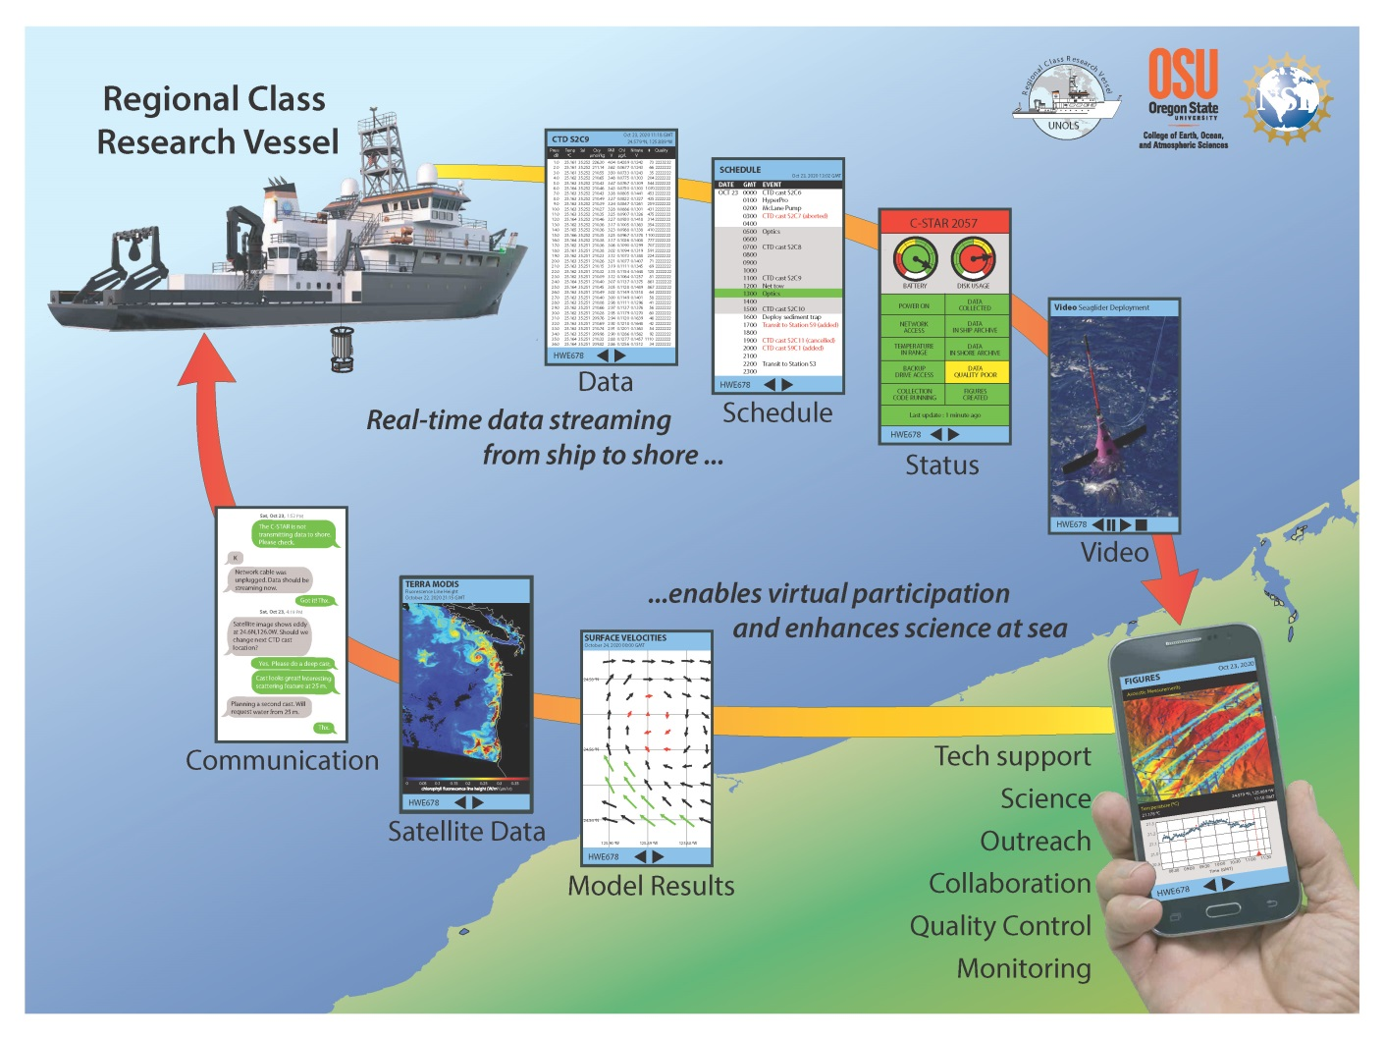
DATAPRESENCE :
An interdisciplinary approach to ocean science research enhancing observational, experimental, and analytical capabilities
Providing a suite of instrumentation, tools, and services to facilitate virtual research at sea
Linking scientists everywhere to quality real time data
Promoting shore –based expertise in guiding and participating in sea-going operations
Enabling scientists onboard to readily participate in outreach activities, engaging local communities and the general public
Creating a visualization program that can be utilized by all
Notes:
When we were in the early design phase we coined the term datapresence. For a long time telepresence has been around and primarily consisted of video streaming but we envisioned something greater, targeting the heart of research enterprise- data. The RCRV project team envisions the Datapresence System as a suite of tools and services to facilitate virtual research at sea while promoting an interdisciplinary approach to ocean science research, one that enhances observational, experimental and analytical capabilities. Implementing the RCRV class as a continuous data collection system will link scientists everywhere to quality real-time data and promote unprecedented access to shore-based expertise and participation in sea-going operations. This approach will also enable the class to readily participate in outreach activities and further engage local communities and the general public.

Slide 30
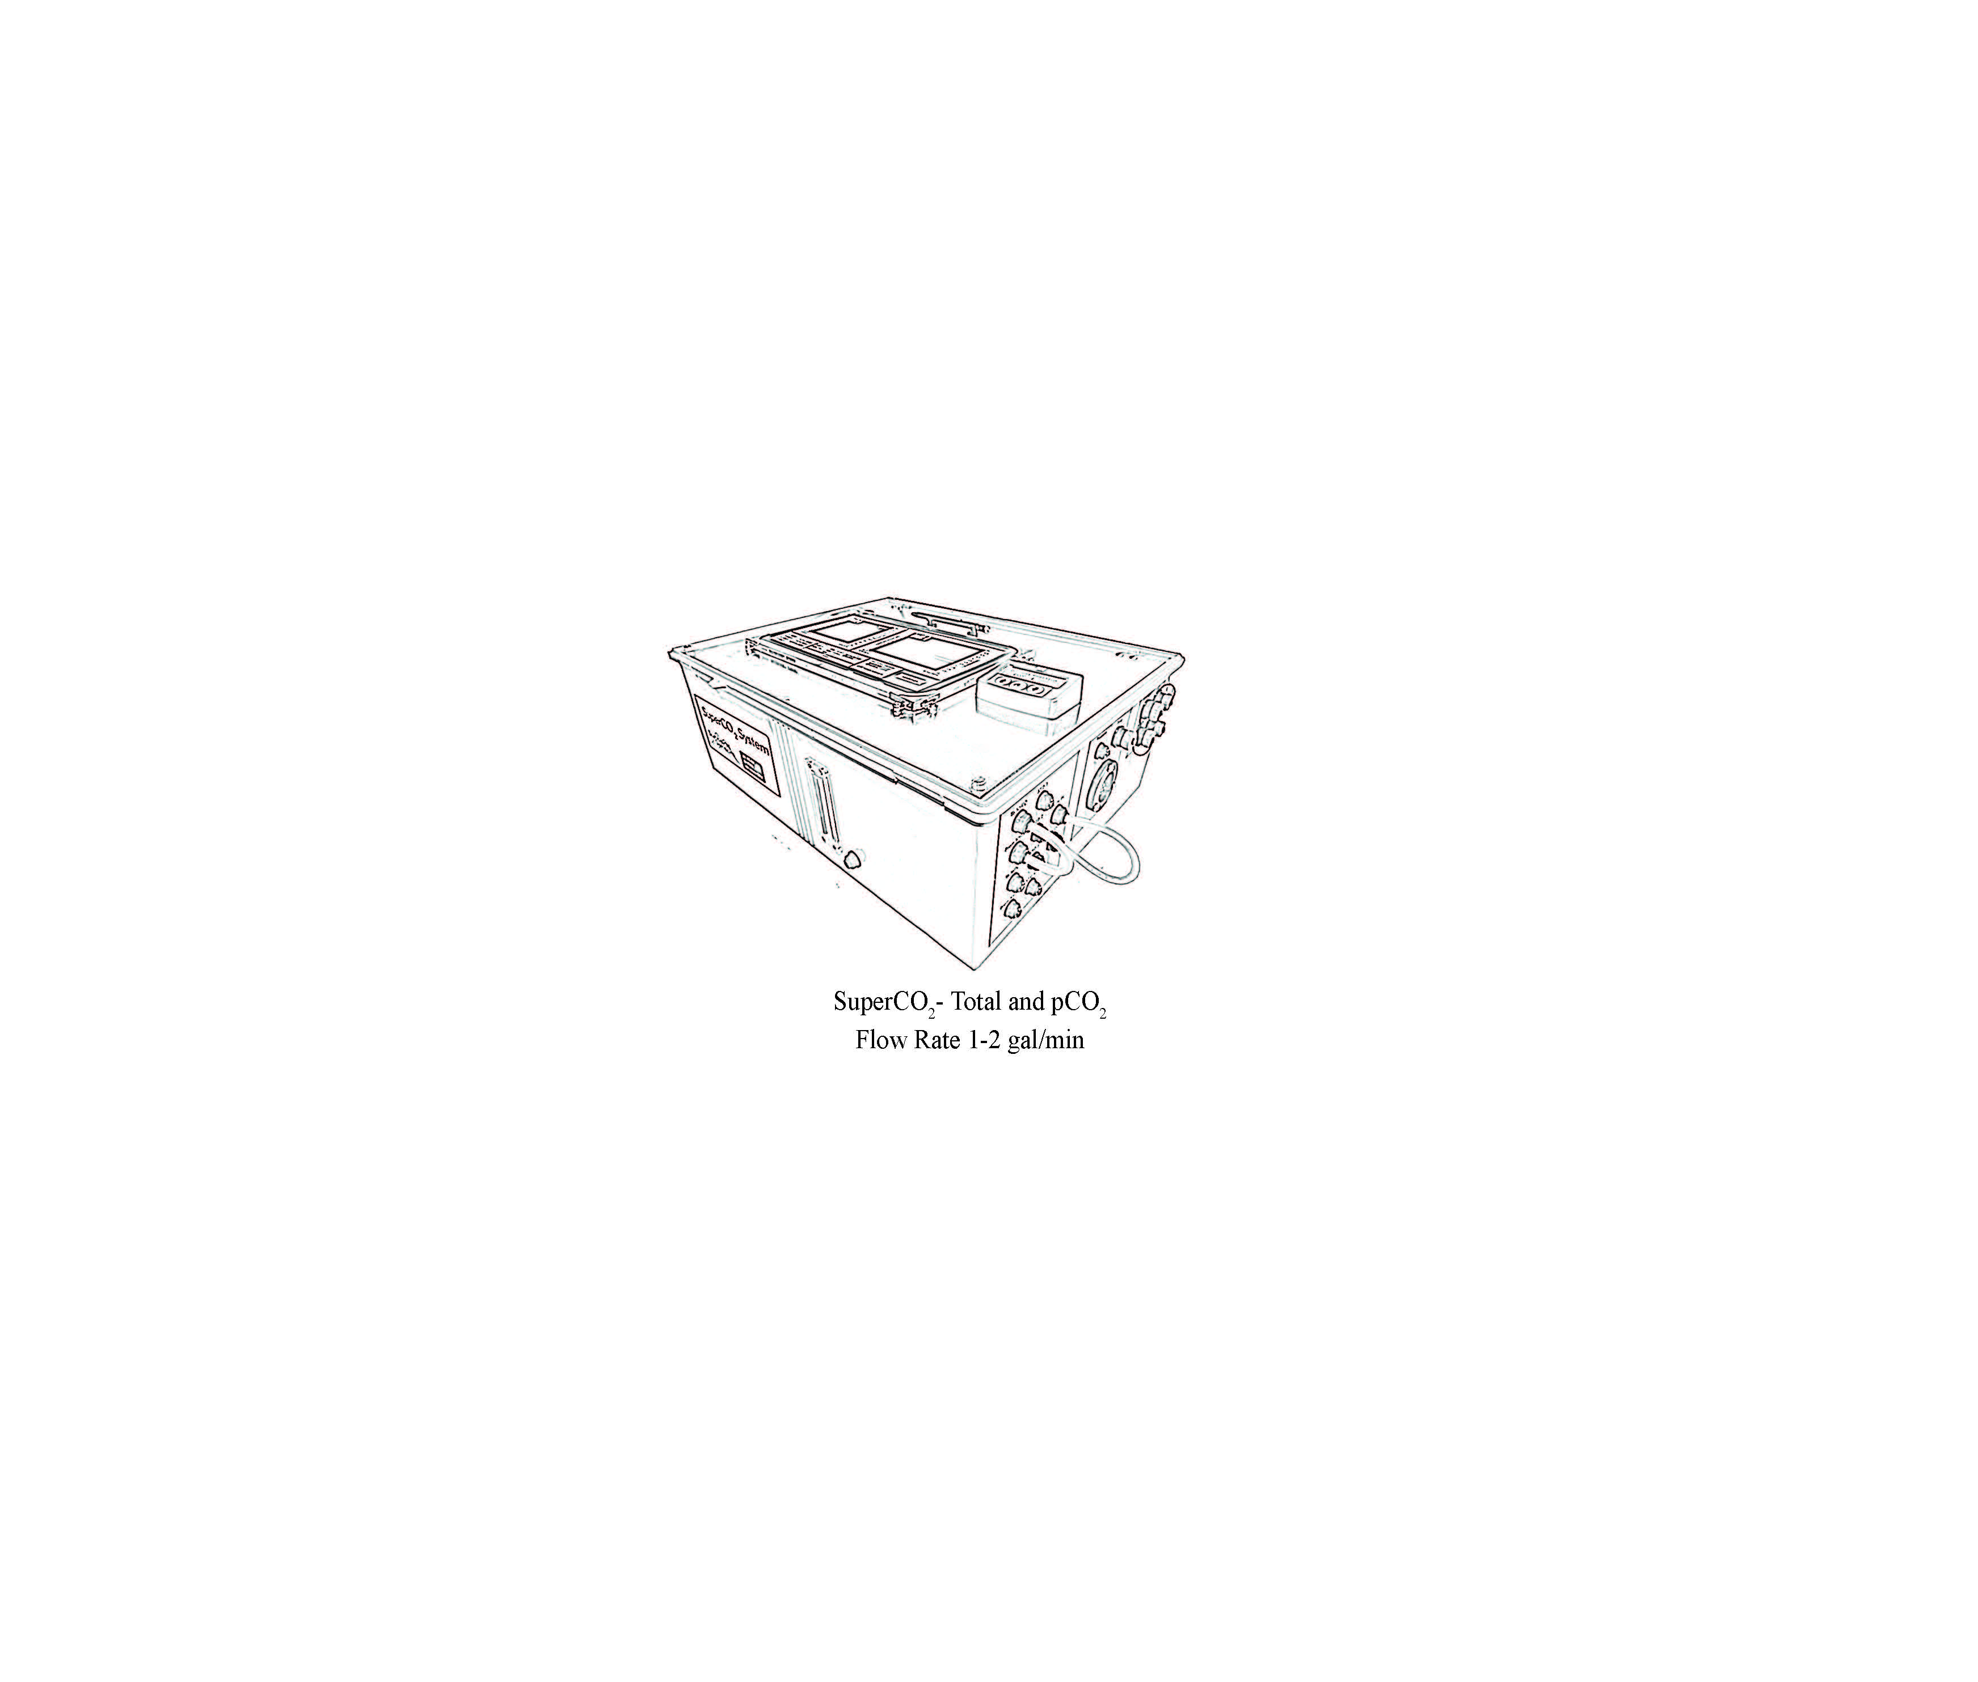
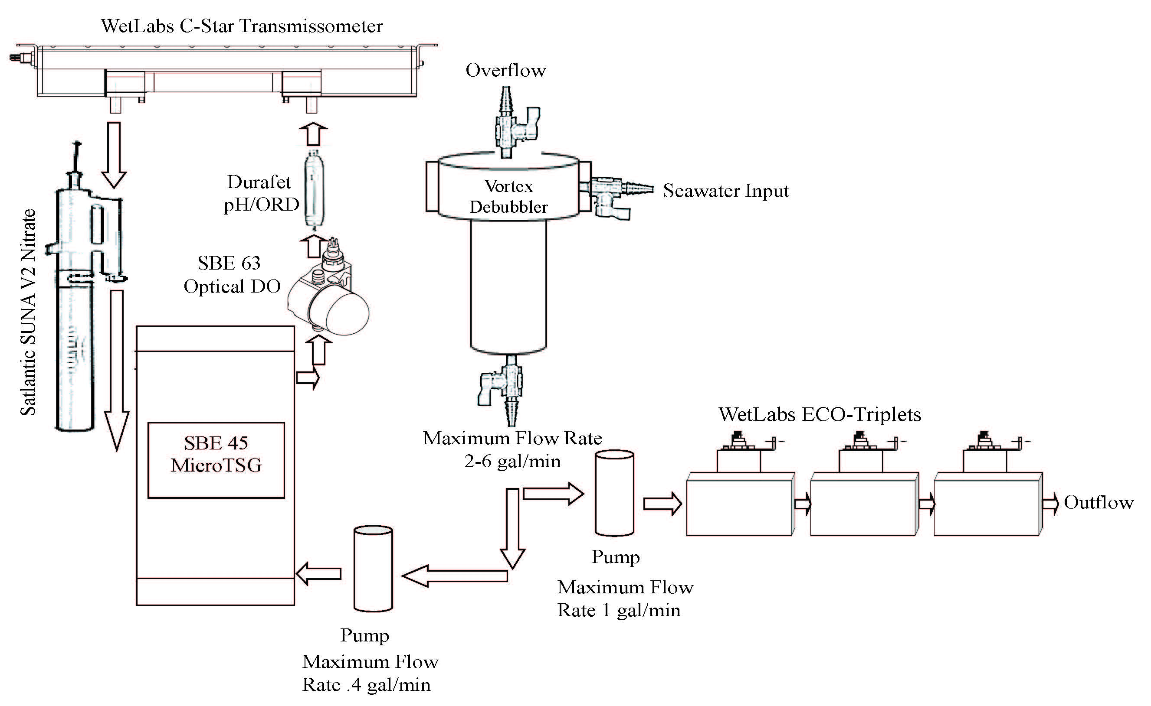
New Concept: A Continuous & Thorough Sampling Platform
Other Research Vessels provide only ancillary data such as Temperature and Salinity, few include transmittance and chlorophyll but rarely is this data provided in real time or QC’ed
Candidate Flow Through Sensors
Data Stream
Surface Salinity
Surface Temperature
Light Transmission
Dissolved Oxygen
pH/ Oxidation Reduction Potential
Chlorophyll
Phycoerythrin or Rhodamine
Phycocyanin
Colored Dissolved Organic Matter
Turbidity- Red, Blue and Green Scattering
Nitrate
Total CO₂ and pCO₂
Irradiance

Slide 31
Datapresence Drivers
Enhance the Science Mission (alert system, science & crew participation)
Real-time monitoring on and off the ship
Shore-based participation (development of partnerships and collaborations)
Spatial and temporal resolution- as many as 3 coastlines!
Environmental Monitoring (HABs, Acidification, O₂ minimum zones, etc.)
Remote sensing validation
Education outreach & community engagement

Slide 32
Datapresence Customers
Identified Customers:
  Shipboard Science Party
  Shoreside Science Party
  Ship Operations
  Science Community
  Educators & Students
  Public Access
Currently, we are implementing a restricted level of access for the first 3 of the above
Working with our outreach and education team to create features and curated materials for Educators, Students and general public audiences.

Slide 33
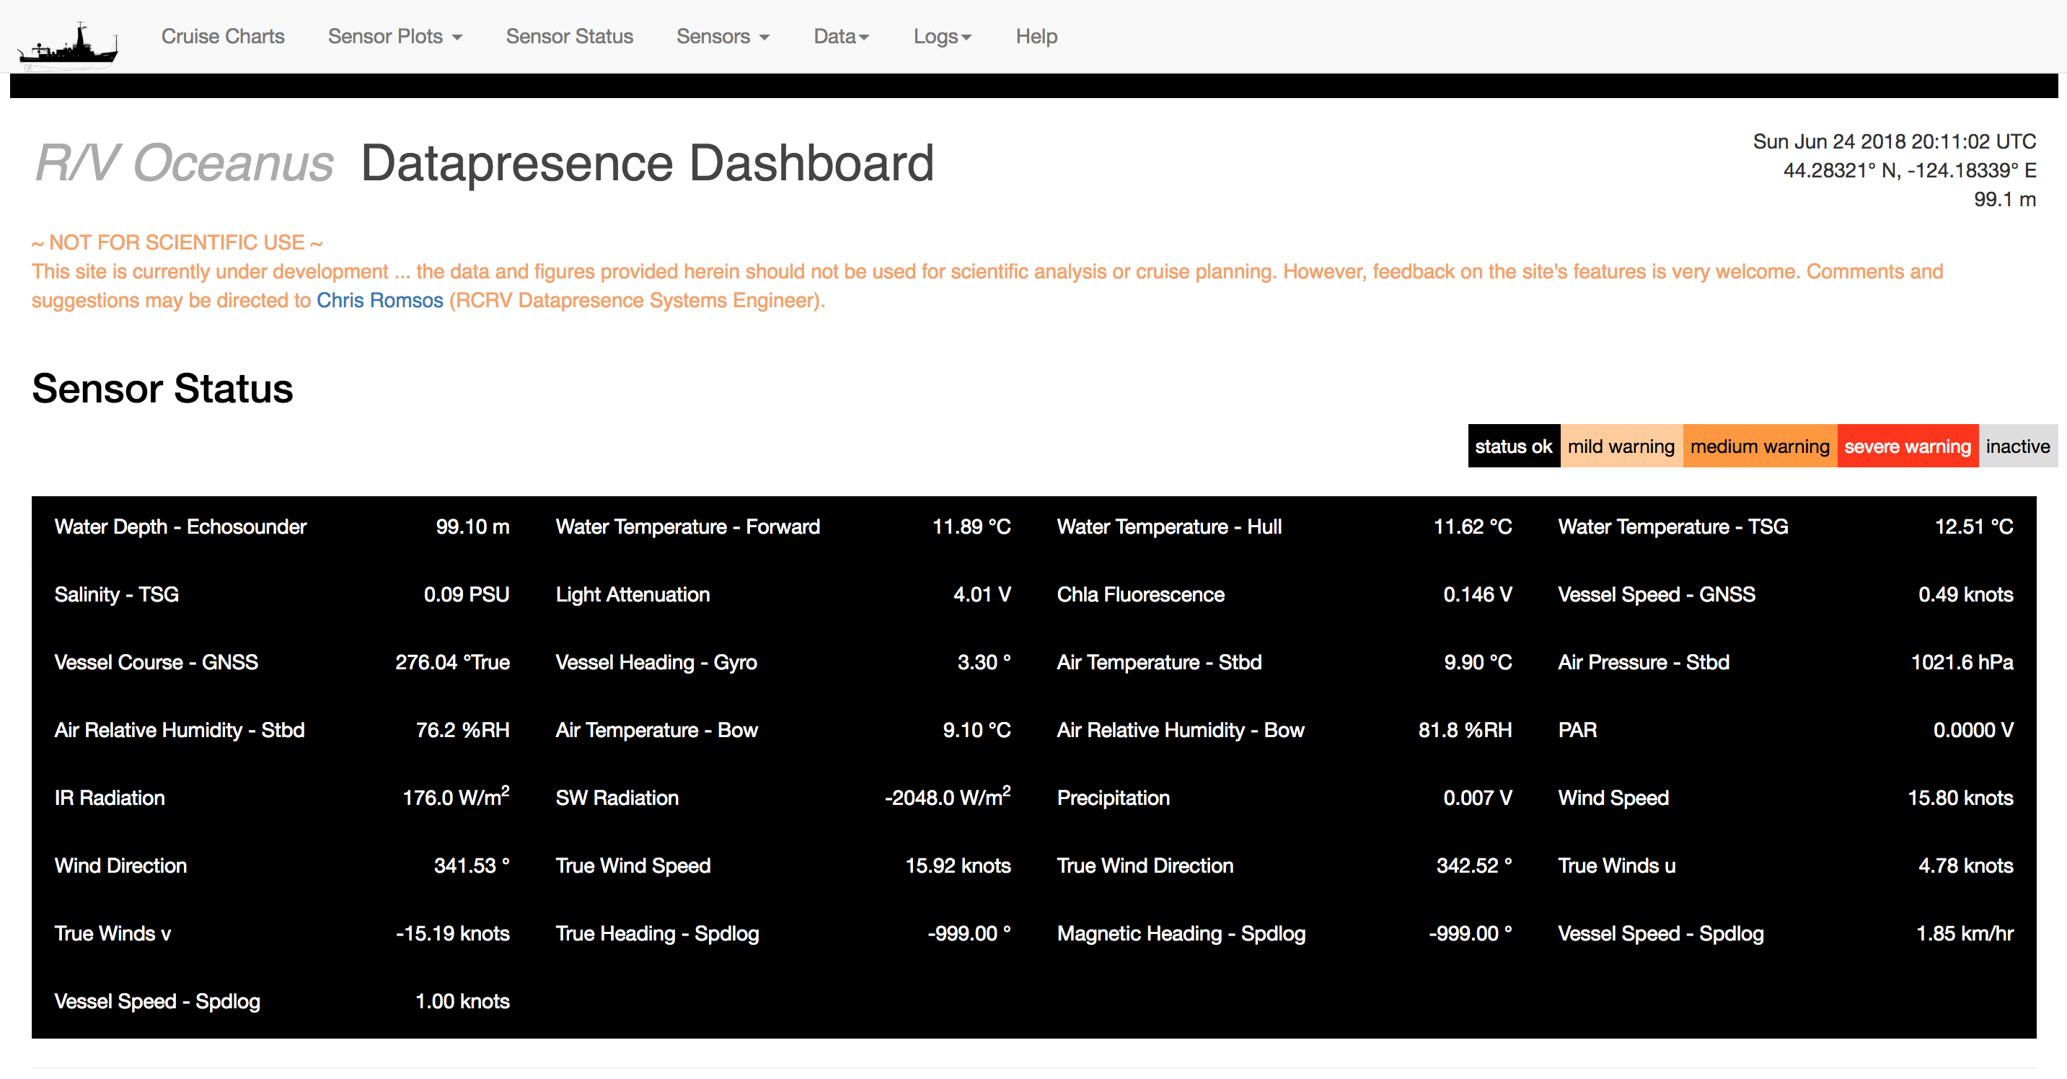
Enough Powerpoint

Slide 34
A Few Items to Keep In Mind
Research vessels are observatories, but
  You must appreciate the differences
Research vessels generate real-time data, but
  With any real-time data never know exactly what you’ll get...
Some assembly will be required.
  We do have outreach and education specialists working on curriculum, it’s part of our construction plan
  Best results will come from working cooperatively with science, operations, and education teams

Slide 35
Observatory vs. Research Vessel
Observatory:
  Standard Sensor Suite
  Consistent/Predictable Mission
  Consistent Predictable Geography
  Open and free data access
  All customers are equal
  Research Vessel:
  Standard sensor suite + BYOD
  Missions vary
  Geography varies
  Some data may be provisional
  Science party has priority

Slide 36
To Ensure Your Success:
Coordinate with Shipboard Science Party and Vessel Operators.
General Guidance:
If possible, or for best results:
  Develop a partnership, relationship, or plan with an engaged science team well in advance.
  While it may be possible to “tune-in” occasionally and have success, your experience will be greatly enhanced if you partner with the seagoing team
Be an active participant:
  Be willing to evaluate your experience or use of the information and pass this info along to the science team and the system operators. Science teams and operators have incentive to report partnerships and the like. Operators want to know what works and what needs improvement

Slide 37
RCRV Education Outreach:
Bringing Ocean Research to the Classroom and Community
Bringing Datapresence to the Classroom
  Develop lesson plans designed for teachers to obtain data, visualize it, and discuss important trends and themes.
Virtual Fieldtrips: A Day in the Life of a Scientist at Sea
  Provide streaming capabilities from ship to shore for “ask a scientist” sessions.
Datapresence for the Community
  Develop a website for the community to investigate what we do as oceanographers, how we do it, where the ship is now, and where it has been.
Notes:
Today we would really like to focus on the use of datapresence in the classroom. Our goal is to not only use datapresence in the classroom and develop lesson plans around it but also have it available to the community, including teachers as an open data source to utilize. These are the 3 main ideas focused on datapresence that we are developing outreach with the overall goal of bridging science, technology, and the community.

Slide 38
How Do I?
Access the Oceanus or Pacific Storm Shoreside Interface to the Datapresence System?
  http://datapresence.coas.oregonstate.edu:8101/
Get Help?
  Contact myself or Jasmine Nahroniak
    cromsos@coas.oregonstate.edu
    jasmine@coas.oregonstate.edu
Notes:
Today we would really like to focus on the use of datapresence in the classroom. Our goal is to not only use datapresence in the classroom and develop lesson plans around it but also have it available to the community, including teachers as an open data source to utilize. These are the 3 main ideas focused on datapresence that we are developing outreach with the overall goal of bridging science, technology, and the community.

Slide 39
Acknowledgements
National Science Foundation (NSF)
Project Manager: Demian Bailey
Project Scientist: Clare Reimers
Datapresence Team members:
  Jasmine Nahorniak and Katie Watkins-Brandt
RCRV Technical Team:
  John Comar, Marc Willis, Don Hilliard, Fred Jones, and Daryl Swenson
RCRV Science Oversight Committee
Education and Outreach Team:
  Renee O’Neil, Tracy Crews, Mark Farley and Danielle Miller

Slide 40
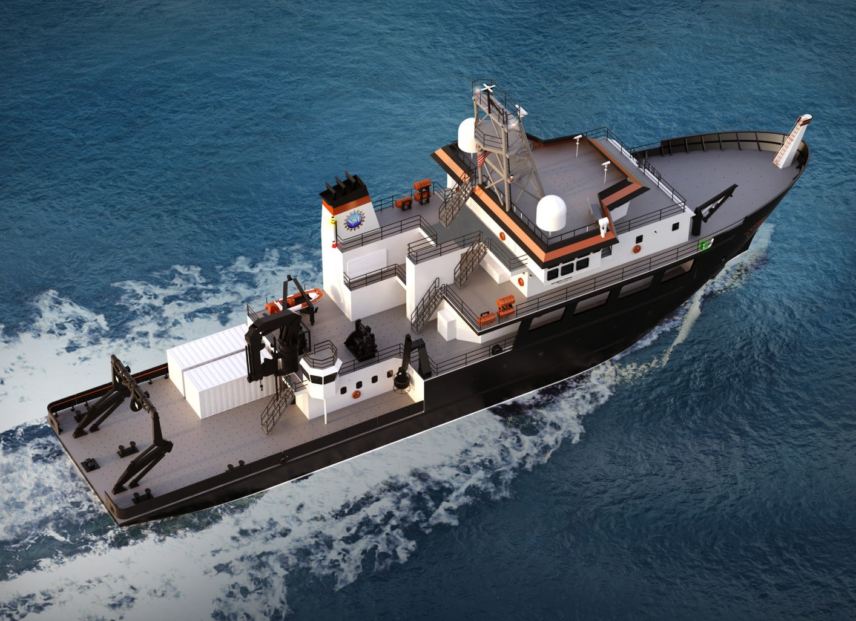
Thank you for listening, please visit our website for more information and updates about the project: http://ceoas.oregonstate.edu/ships/rcrv/
Contacts:
Demian Bailey
Project Manager
dbailey@coas.oregonstate.edu
Clare Reimers
Project Scientist
creimers@coas.oregonstate.edu
Chris Romsos
Datapresence Systems Engineer
cromsos@coas.oregonstate.edu
All items presented are contingent on Federal funding for FY 2017 and beyond.
Any equipment pictured is for illustration purposes only and may not reflect final installations.

