Slide 1
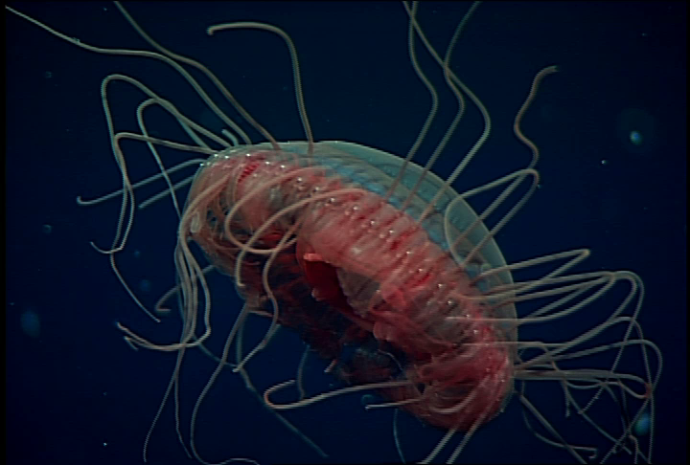
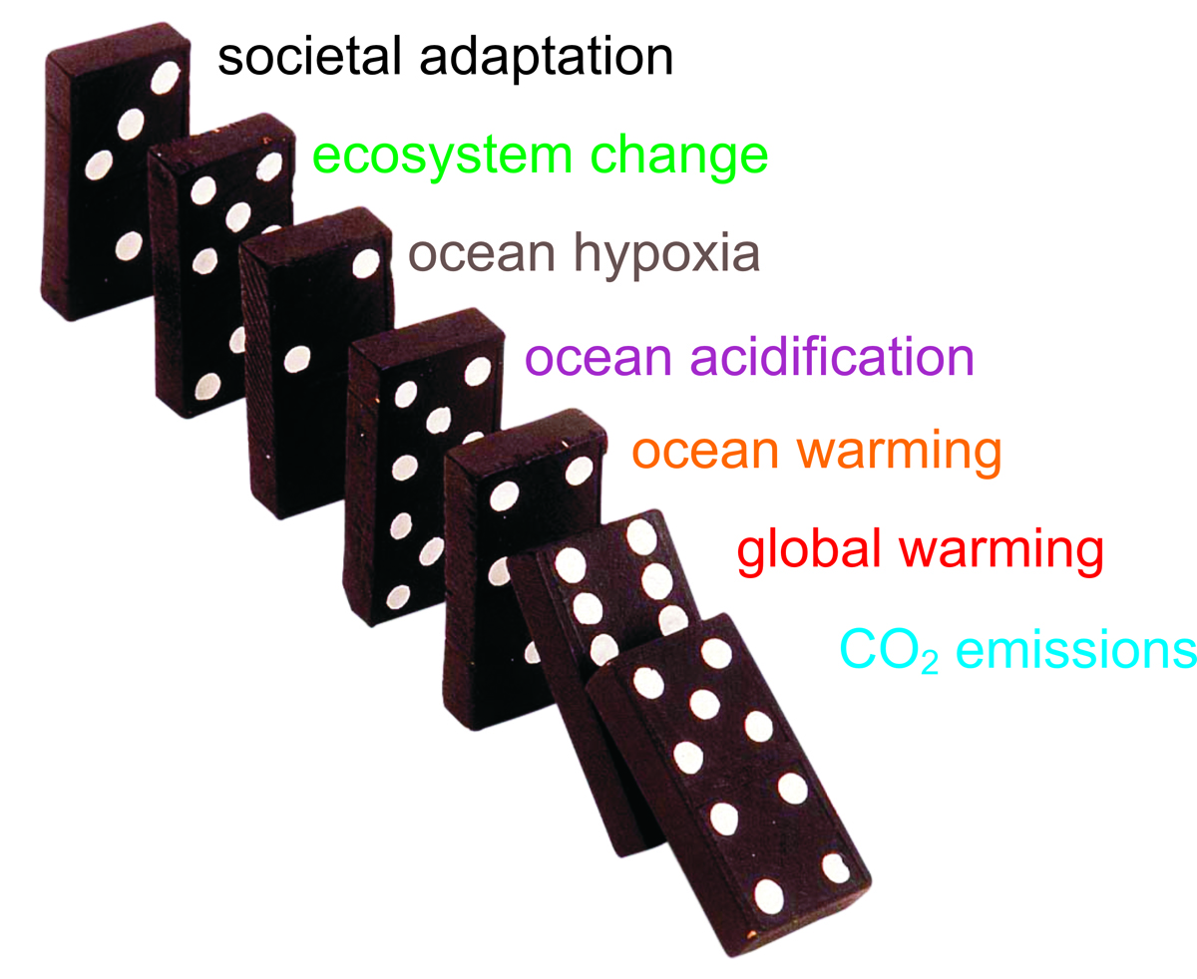
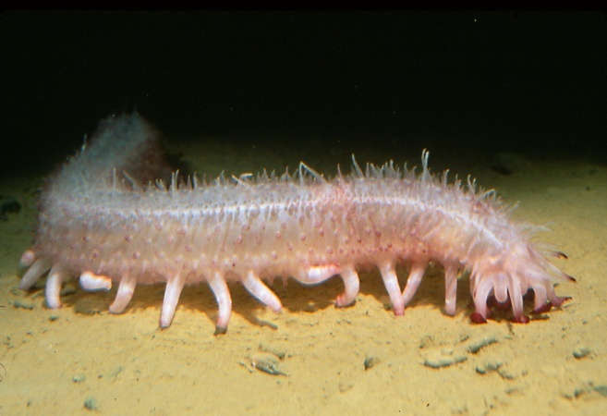
Climate change and the oceans:
effects on coastal upwelling systems
Ocean acidification, warming, hypoxia related to CO₂ emissions
Affects physiology and performance of animals
Potential for large effects on ocean ecosystems (e.g. Cal. Cur.) and society
Jim Barry, MBARI
Center for Ocean Solutions, Ocean Policy Course, 2011

Slide 2
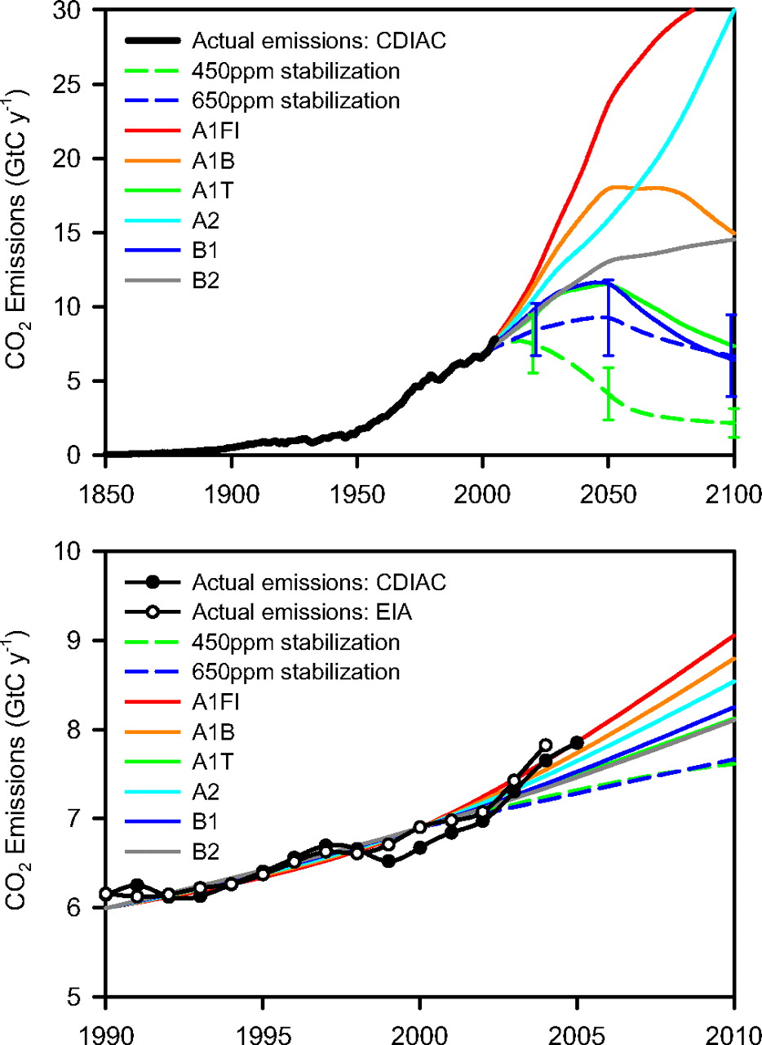
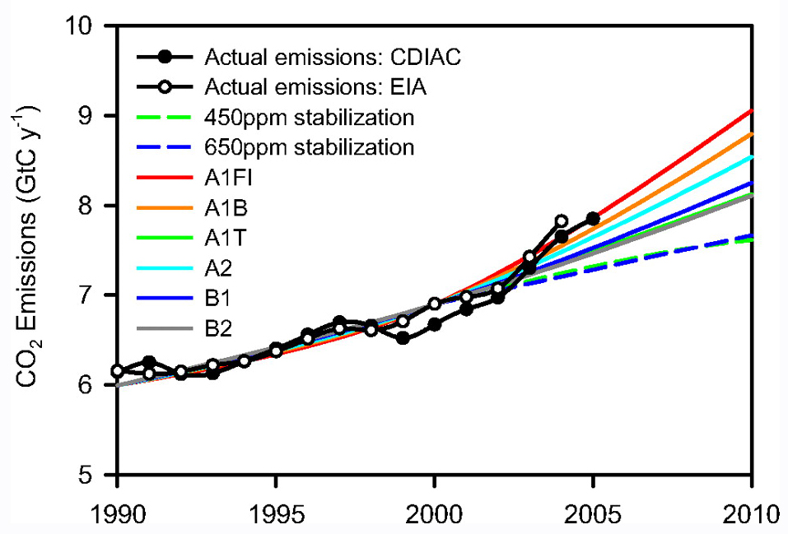
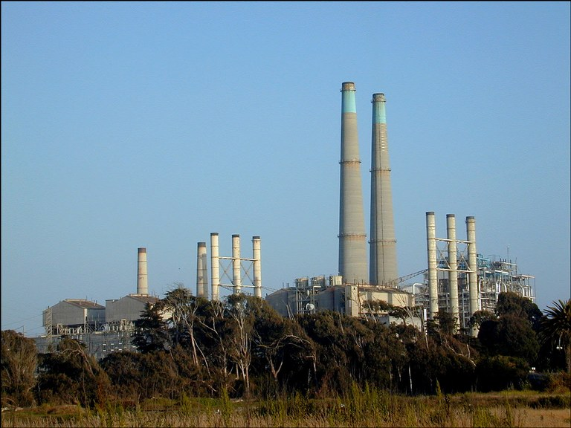
CO2 emissions are rising rapidly
Various scenarios
Current emissions high, increasing
Climate-agreements / legislation
High emissions = larger climate / ocean
changes

Slide 3
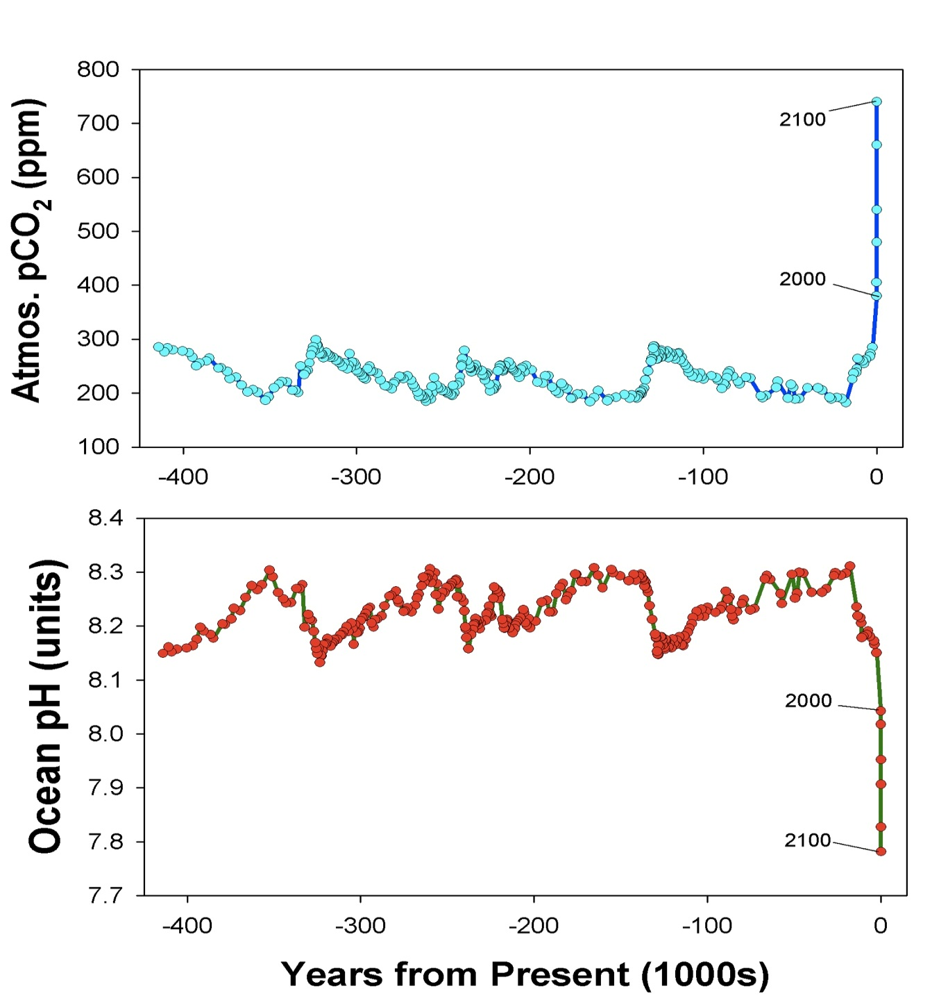
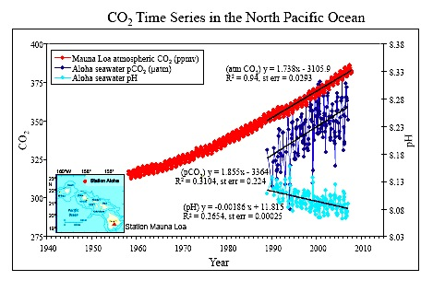
CO₂ emissions are changing ocean chemistry
Higher atmos. CO₂ increases ocean acidity
Ice Ages
Low CO2 during ice ages, higher in warm periods
Very high CO2 is rare in recent Earth history
Ocean acidity tracks changes in atmospheric CO₂
Global CO₂ Increase
Massive, rapid rise in CO₂
Ice Ages
Atmospheric CO₂ (ppm)
Ocean pH (units)
Ice Ages
Massive, rapid rise in acidity
Doney et al. 2009

Slide 4
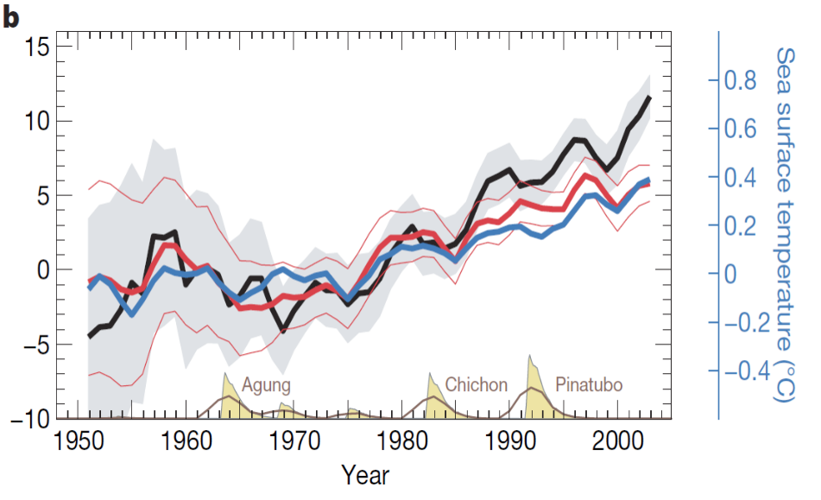
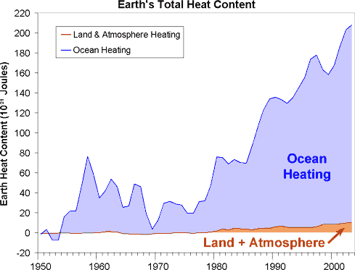
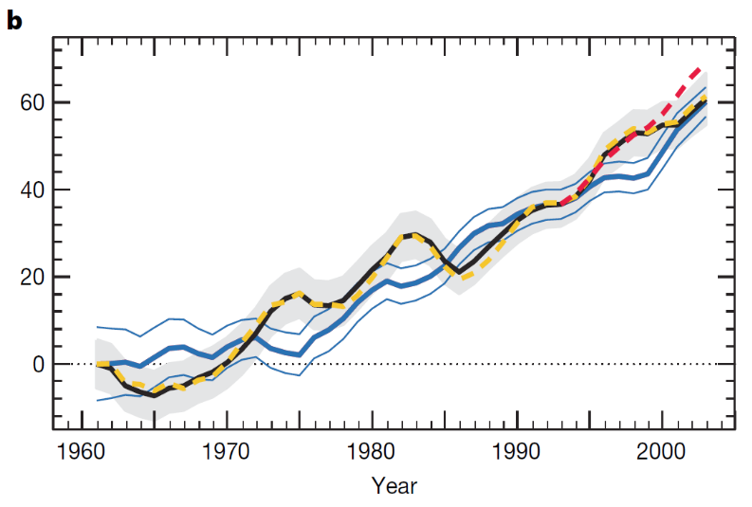
Global warming occurs mainly in the oceans
Ocean Heat Content
10²² Joules
Sea Level Rise
millimeters
Year
Dominguez et al. 2008, Murphy et al. 2009

Slide 5
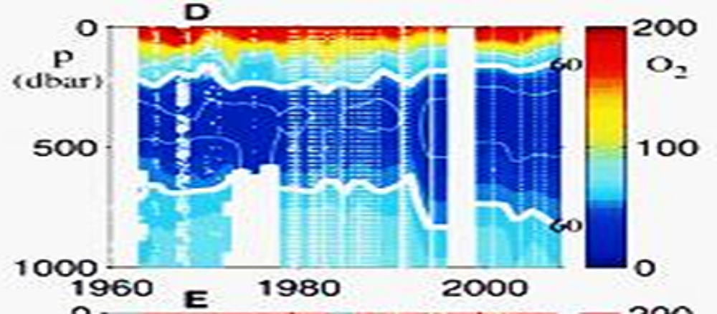
Oxygen levels in many ocean areas is declining (hypoxia)
Warmer surface waters inhibit mixing of surface and deep waters
Less mixing leads to lower deep-sea oxygen levels
Oxygen minimum zones are expanding and intensifying
Expected to be stressful for ocean life
Eastern Equatorial Pacific
0
200
60
500
Oxygen Minimum Zone
Oxygen (µM)
Depth (m)
no data
no data
100
no data
60
1000
0
1960
1980
2000
Year
Stramma et al. 2010

Slide 6
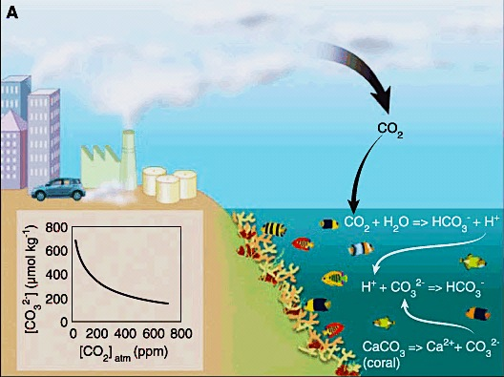
CO₂ emissions cause Ocean Acidification
Notes:
This process works well with ocean acidification and its impact on ocean ecosystems.
In its purest sense, ocean acidification involves two steps. The first being the very deterministic step between rising atmospheric carbon dioxide and changing ocean chemistry, and the second being the link between changing ocean chemistry and biological processes such as calcification.
In this flow of effects and impacts, there are different levels of certainty. For example, the physiochemical relationship between the atmospheric concentration of carbon dioxide and the carbonate chemistry of sea water is highly deterministic, the relationship between changing chemistry and biological responses is subject to greater variability. This is especially so when one considers the influence of different species, genetics, environmental history and so on.

Slide 7
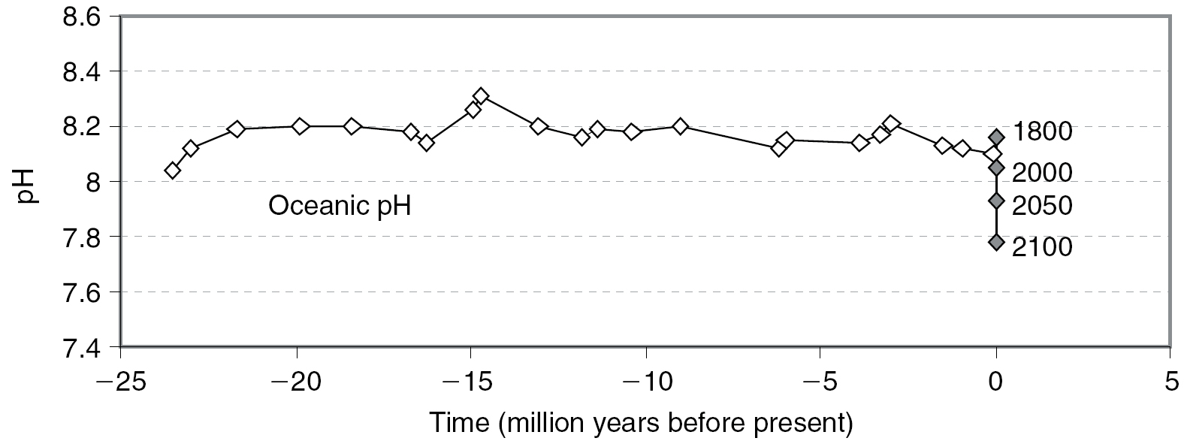
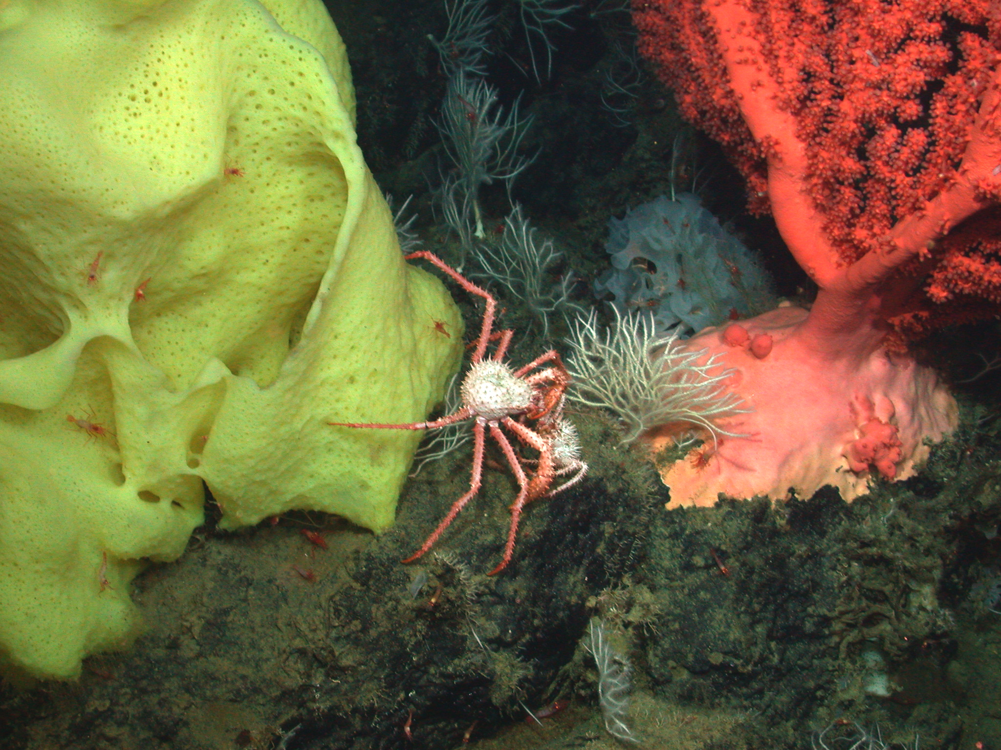
Change in ocean pH over 25 million years
Ice Ages
Effect of fossil fuel emissions
Turley et al 2005
Ocean pH (acidity) has been ~stable over 25+ million years
Changes in acidity caused by CO₂ emissions are massive and rapid.
Will ocean organisms tolerate ocean conditions so large?

Slide 8
Environmental Stress, Ecosystems, and Society
Environmental
Changes
Physiology
Growth
Survival
Reproduction
Food Web Changes
Societal Effects
(fisheries, reefs)

Slide 9
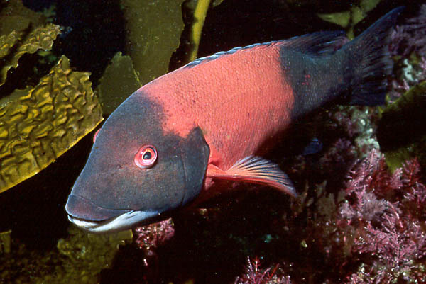
How do animals cope with changing ocean conditions?
What to
do..?
Migration
Acclimation
Adaptation
Extinction

Slide 10
Warming

Slide 11
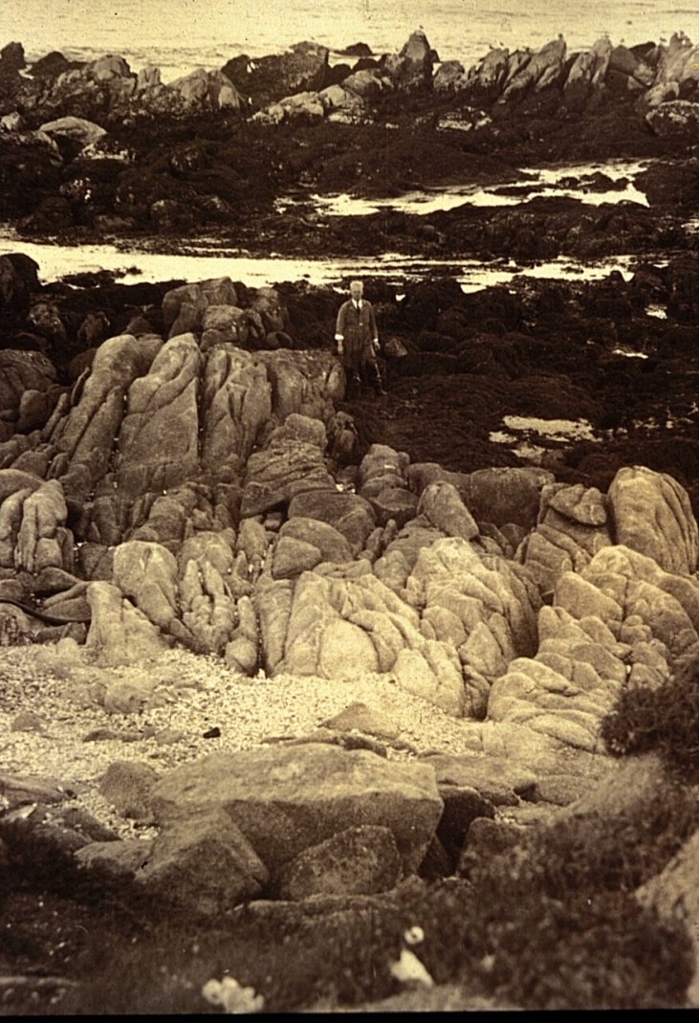
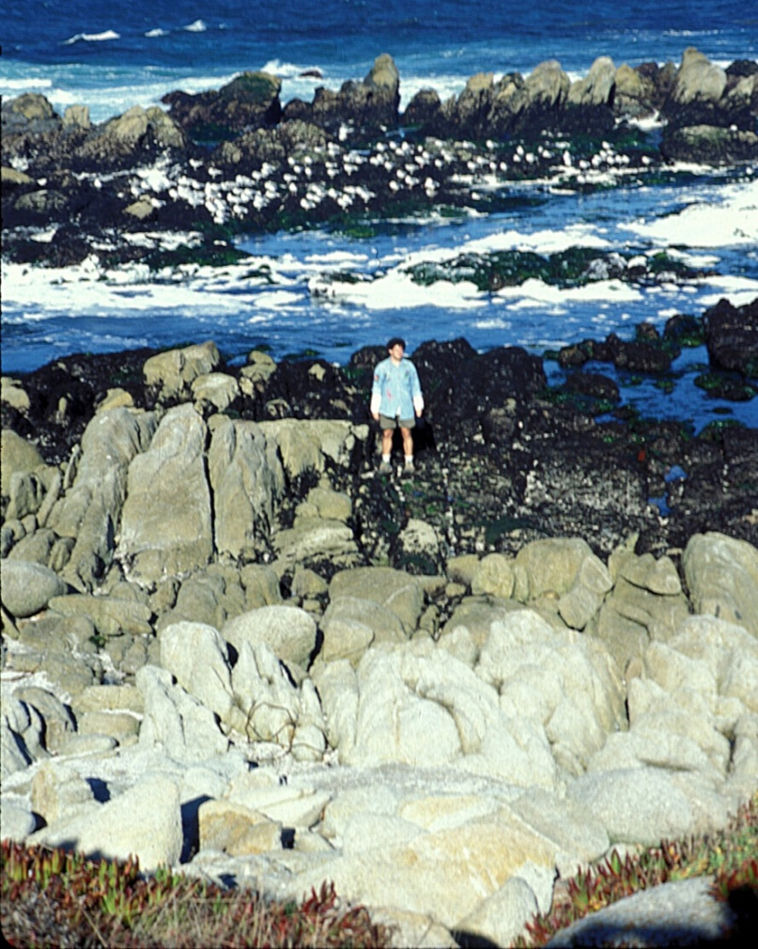
Changes in intertidal animals over 75 years
Hewatt: 1931 Barry, Baxter, Sagarin &
Gilman: 1990’s & continuing

Slide 12
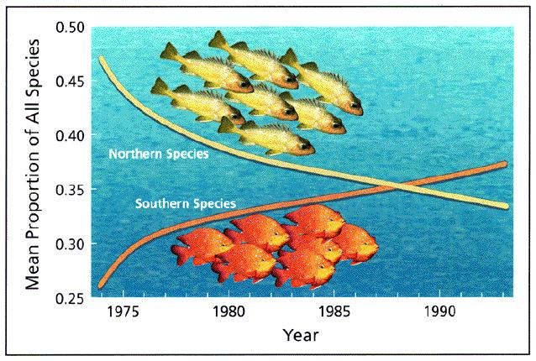
California Marine Populations Shifting Northward
(Holbrook et al)

Slide 13
Hypoxia
(low oxygen levels)

Slide 14
Biodiversity decreases as O₂ levels drop
Fish
Mobile Inverts
Sessile Inverts
Dissolved Oxygen
Large Infauna
1.4 ml l⁻¹
Hypoxia-tolerant Infauna
62 umol/l
1.0 ml l⁻¹
Stressed
0.5 ml l⁻¹
Absent or Dead
0 ml l⁻¹
from Rabalais et al. 2002

Slide 15
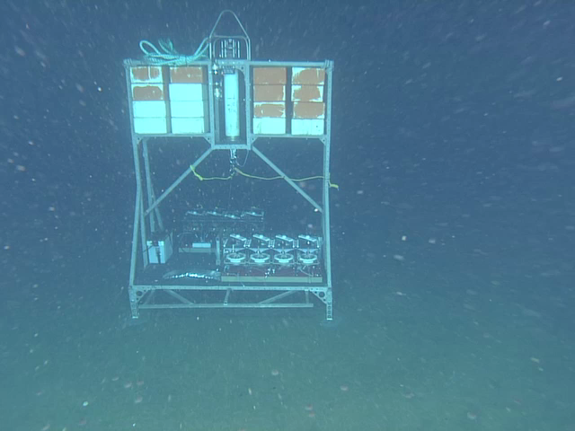
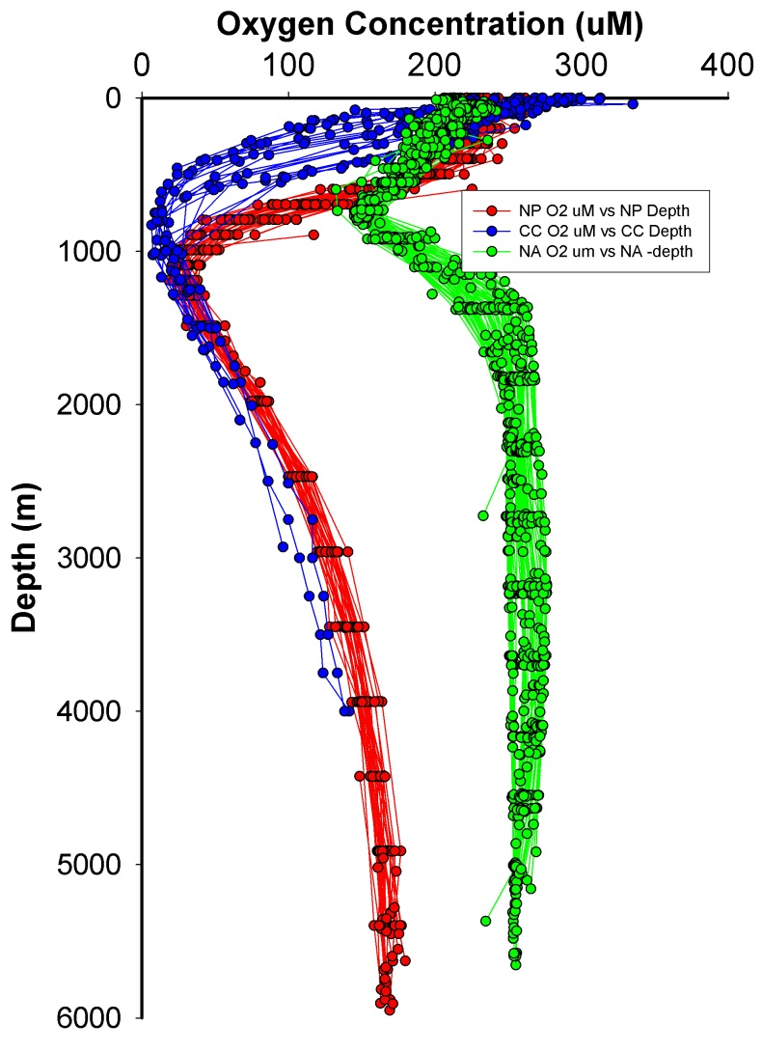
Measuring sea urchin respiration rates in the deep-sea
Oxygen Minimum Zone (OMZ)
In situ respiration chambers, 650 m, oxygen minimum zone

Slide 16
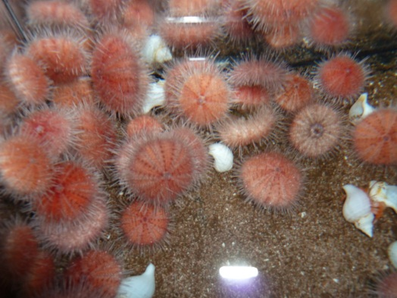
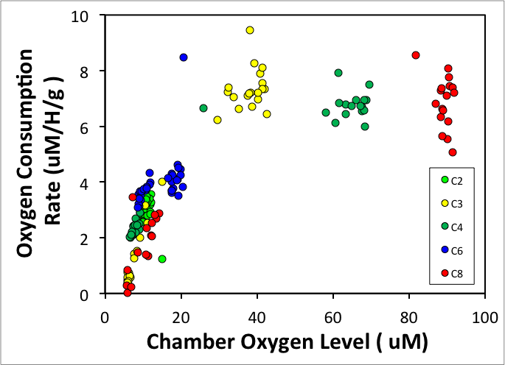
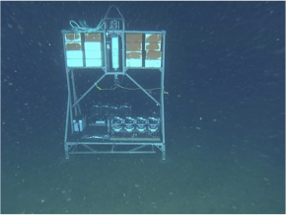
Expansion, intensification of hypoxic zones likely to affect urchins and other deep-sea animals
Urchin O₂ Consumption vs. Available O₂
OMZ
Fragile Urchin
BRS Platform
Notes:
The in situ benthic respiration system (bottom photo) is capable of perturbation experiments. Animals are placed in chambers (N=8),(upper photo) and oxygen consumption rates are measured over consecutive 8 h periods, between which chambers are flushed with ambient water. We can injection small amounts of high CO2 seawater to produce a pH reduction to simulate future conditions, or in this case, we injected high O2 water to evaluate the response of urchins living in the OMZ to higher O2 availability.
Main message - When more oxygen is available, the animals will increase their metabolic rates. In contrast, expanding and intensifying hypoxia will impact these deep sea populations.

Slide 17
Ocean Acidification

Slide 18
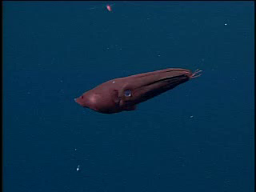
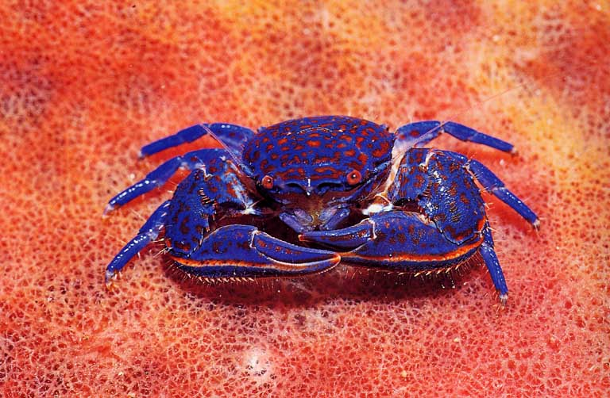
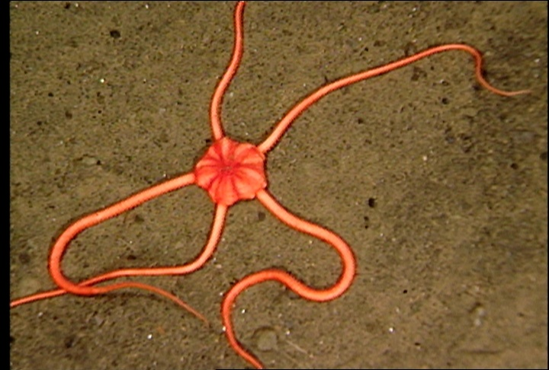
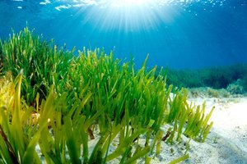
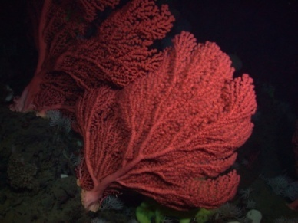
Ocean change affects physiological function
Photosynthesis
Calcification *
Respiration
Acid – Base Balance
Metabolism
Vampire Squid

Slide 19
Environmental change can increase the ‘cost of living’
Normal
Stressed
Cost of
Living
Growth
Cost of
Living
Growth
Reproduction
Energy
Budget
Reproduction
Notes:
Stress increases “cost of living” , with less energy for growth and reproduction.
Individuals = reduced 1) survival, 2) size, 3) reproductive output.
Populations = Reduced abundance, productivity, resilience, and greater likelihood of extinction.

Slide 20
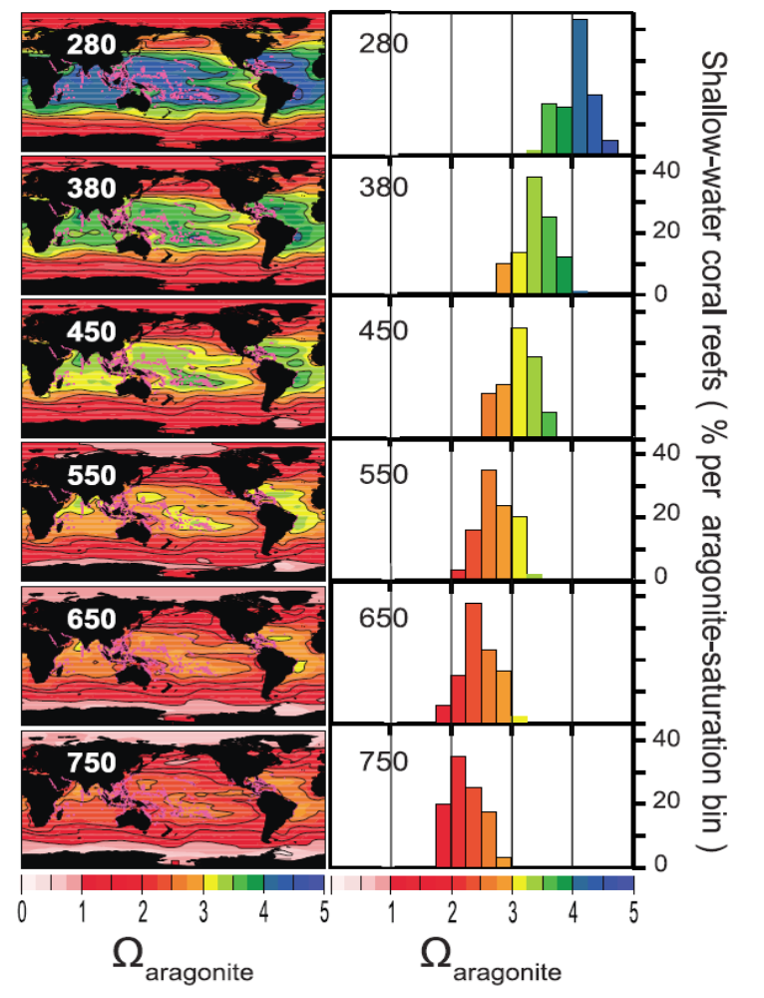
Ocean chemistry and the future of coral reefs?
Predicted aragonite saturation (Ω) [a measure of the amount of minerals available to make coral skeletons] is shown over a global map of existing coral reef locations (pink dots) for various atmospheric CO2 levels. Note that Ω decreases drastically with higher CO2 levels.
280 ppm is the preindustrial level of CO2 in the atmosphere. During 2011 CO2 is ~390 ppm. Most climate models indicate that we will reach ~800 ppm CO2 by 2100.
Corals grow best when carbonate minerals are abundant (Ω >3), and cease to grow at low mineral levels (Ω ~2) and can dissolve at very low levels (Ω < 1).
On the right, there is a count of the mineral conditions for the locations of all global coral reefs. Note that the preindustrial climate (280 ppm CO2) all reef locations had mineral conditions favorable to growth (high Ω ). As CO2 levels rise through this century, ALL existing reef are expected to have marginal or poor conditions for coral growth.
Bad
Marginal
Good
Ω_{aragonite}
Ω_{aragonite}

Slide 21
Ecosystem Consequences of Ocean Change

Slide 22
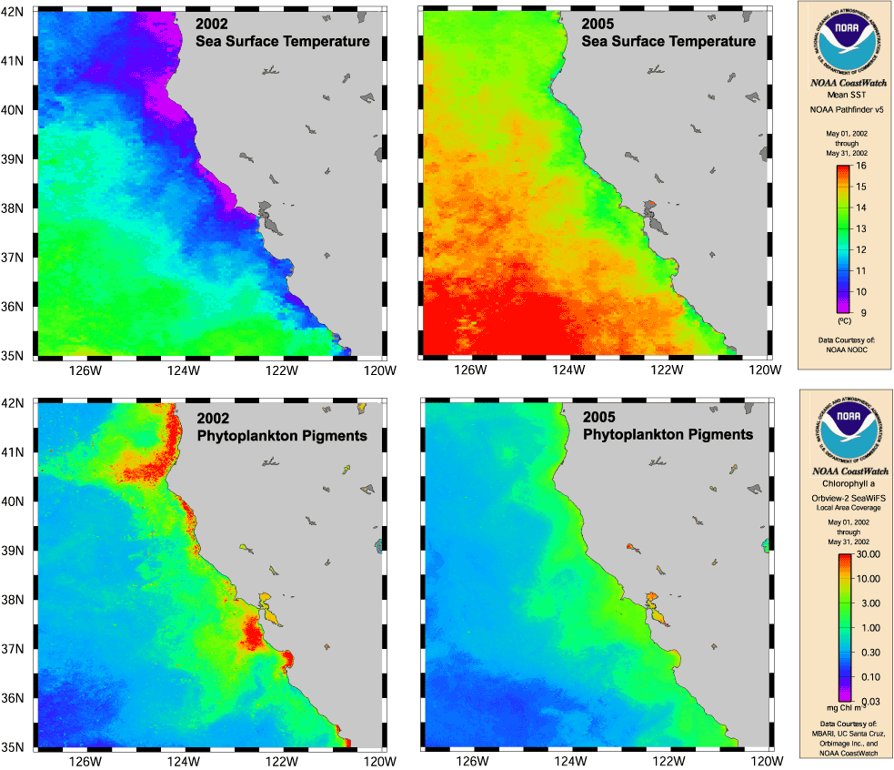
Lower production in 2005 & 2006 due to weak spring upwelling
(from David Foley, NOAA NESDIS)

Slide 23
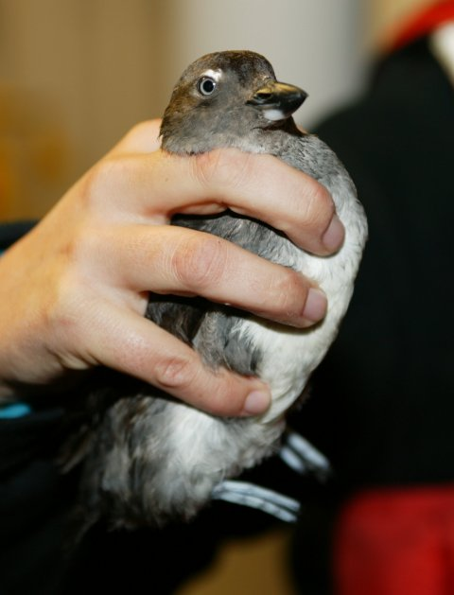
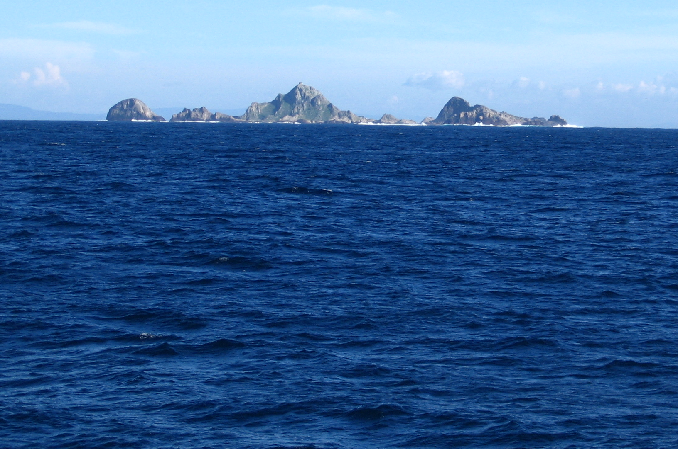
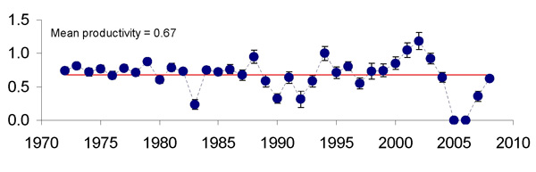
2005-2006 - worst years on record for Farallon Island auklets (42 km west of San Francisco)
Mean productivity = 0.70
#young/breeding-pair
Nests abandoned due to delayed upwelling
From Sydeman and Bradley, PRBO

Slide 24
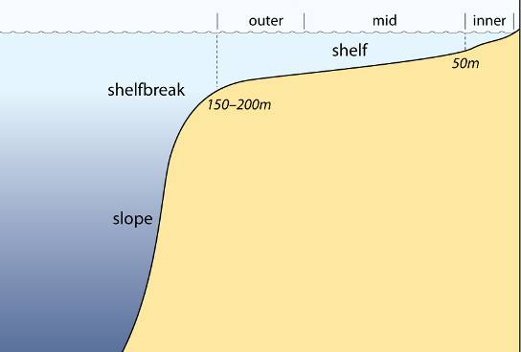
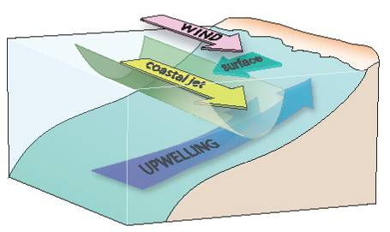
Expanding Oxygen Minimum Zones are affecting inshore environments
changes in upwelling sourcewater properties
strength and persistence of winds
both of which are influenced by climate change
hypoxia
upwelling
normal
low oxygen

Slide 25
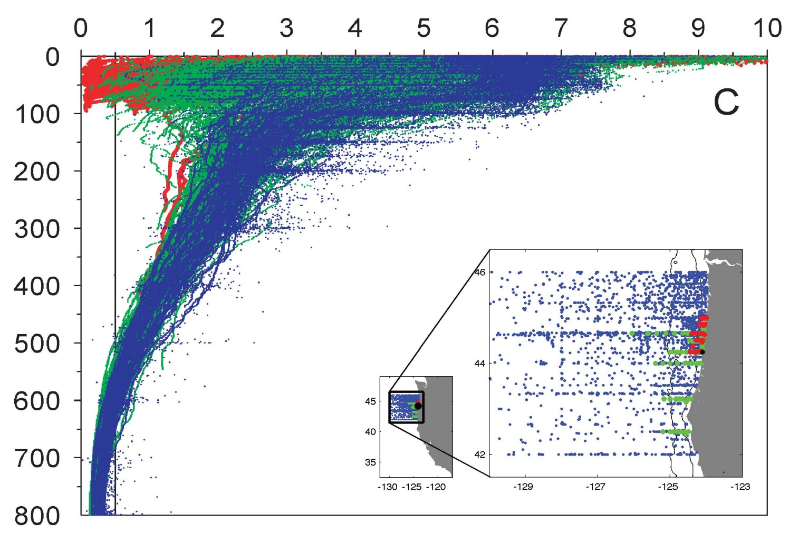
Is hypoxia/anoxia normal?
Dissolved oxygen (ml l⁻¹)
1950 to 1999
2000 to 2005
2006
Depth (m)
N ~ 4000 hydrocasts
Chan et al. (2008, Science)

Slide 26
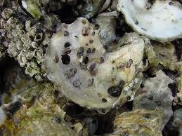
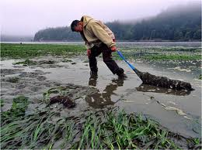
Hypoxic events are also acidification events
Recent failure of oyster aquaculture related to low pH waters
Oyster spat on shell

Slide 27
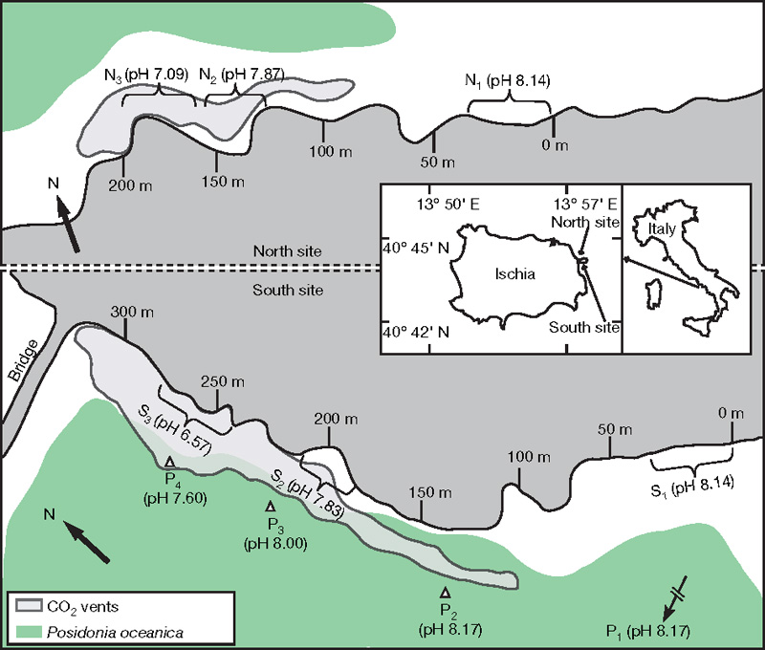
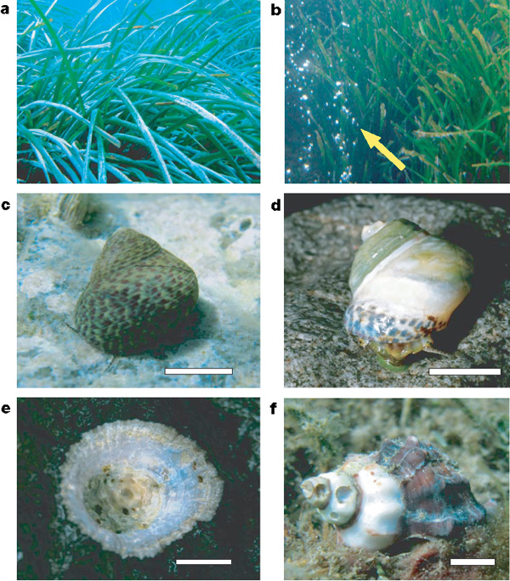
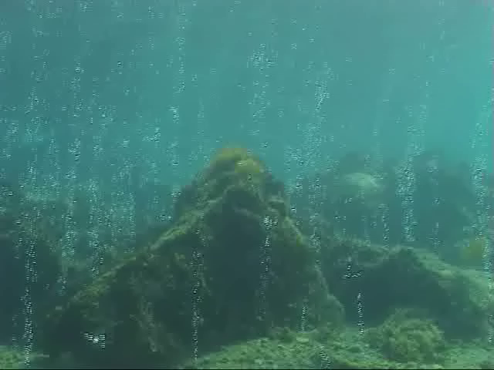
Biodiversity is low at natural CO₂-venting sites
Echinoderms conspicuously absent, shell dissolution
Seagrasses thrive
Jason Hall-Spencer et al. 2008

Slide 28
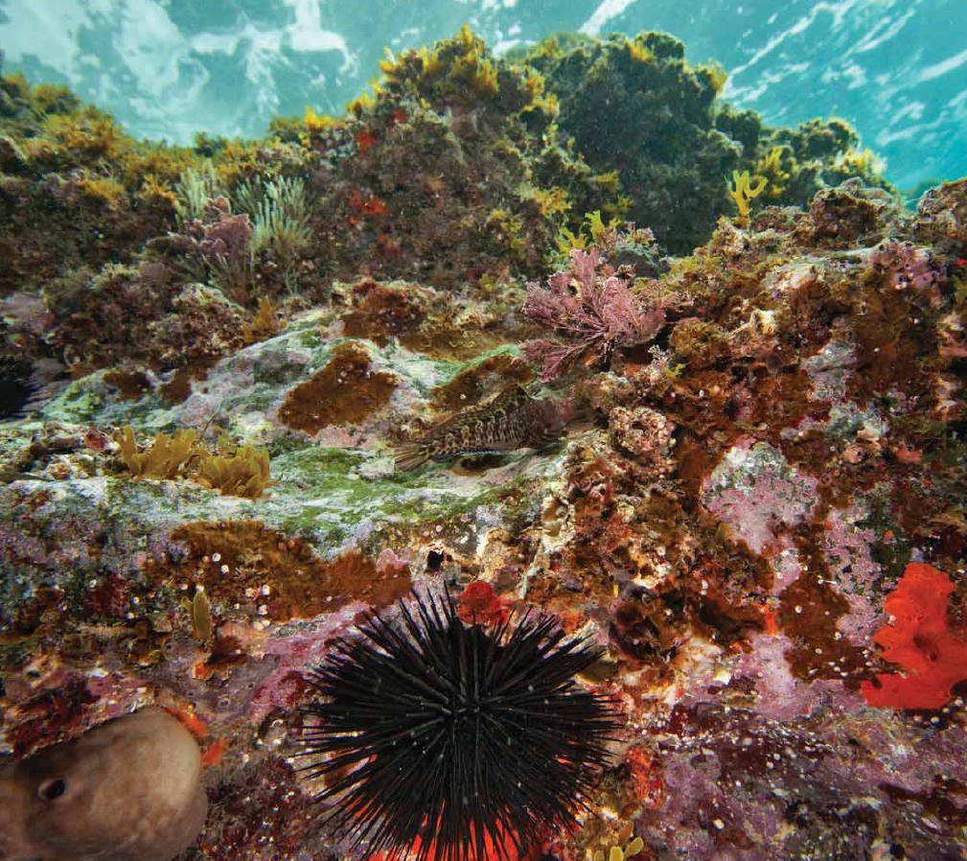
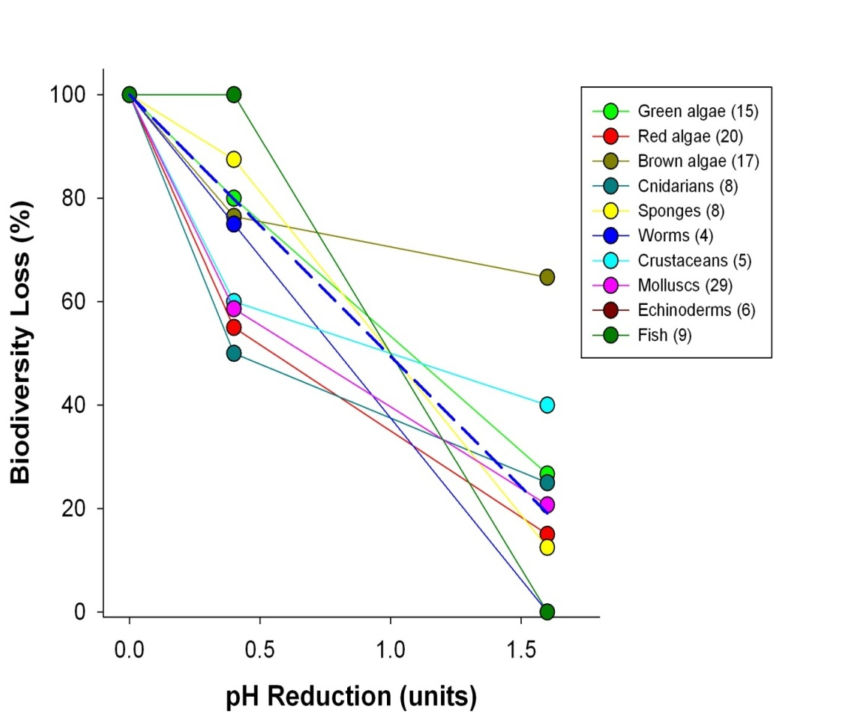
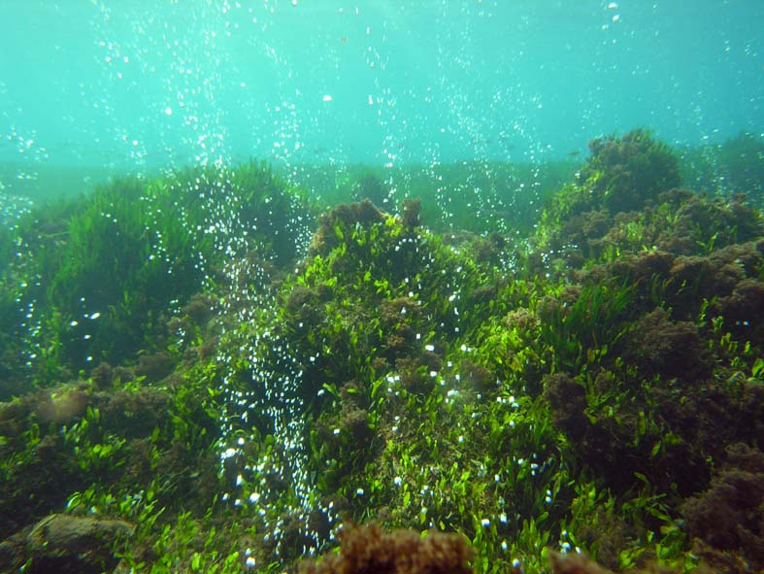
High-CO₂ areas have fewer calcifiers, fleshy algae, and more invasive algae
Typical Ischia shallow-water community
Biodiversity is reduced at natural CO₂ vents
51% loss of species per 1 pH unit
Community in high-CO₂ areas at Ischia
Modified from
Barry et al. 2011
Jason Hall-Spencer et al. 2008

Slide 29
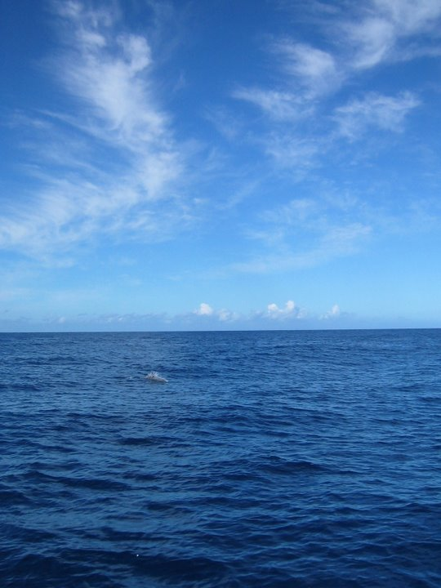
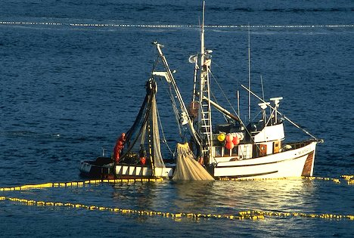
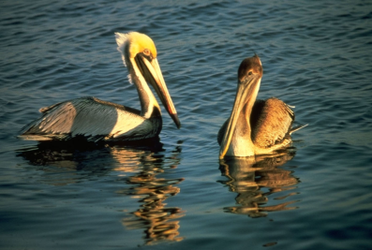
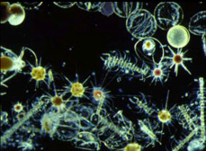
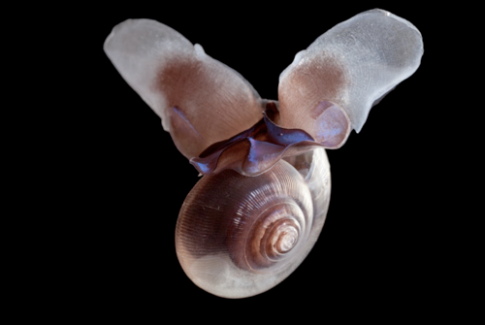


















Marine Communities are Biological Networks
Primary Production
Humans
Seabirds
Phytoplankton
Zooplankton
Squid
Fish
Large zooplankton
Detritus / Bacteria
Sea butterfly
Limacina
Seafloor Animals
Mammals
Marine Food Web
Notes:
Food web isn’t a very good image, but could be improved.

Slide 30






A worrisome storyline
Rising
atmospheric CO₂
Changing benefits
Socioeconomic consequences
Decreasing ocean pH, Ω, [CO₃²⁻]
Altered physiology, population changes
Food web changes,
ecosystem shifts
Rising uncertainty
After Sarah Cooley

Slide 31


Ecosystem-based management of marine resources
ian.umces.edu/press

Slide 32

Significant Contributions by:
Kurt Buck
Chris Lovera
Eric Pane
Josi Taylor
Patrick Whaling
MBARI
The oceans – love them or lose them

