Slide 1
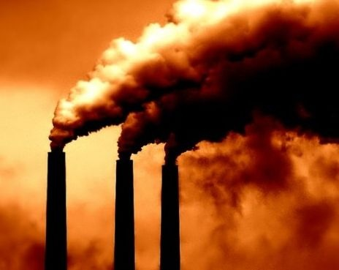
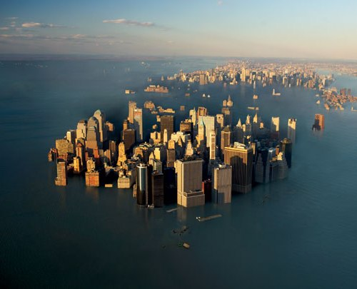
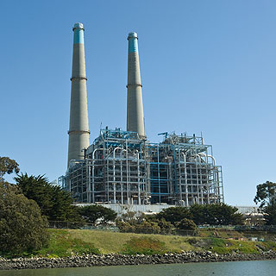
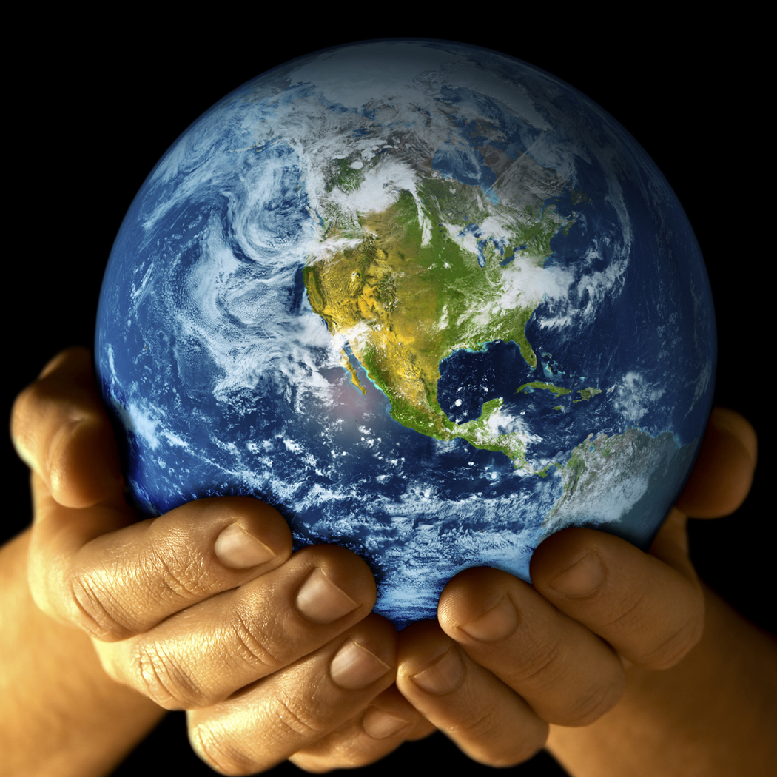
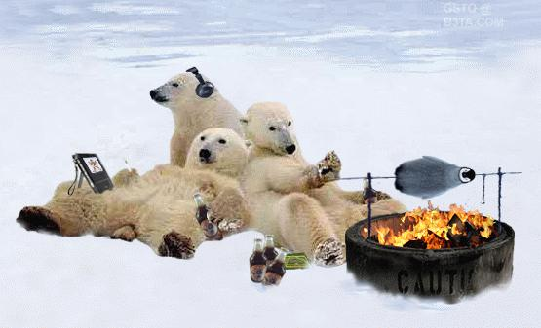
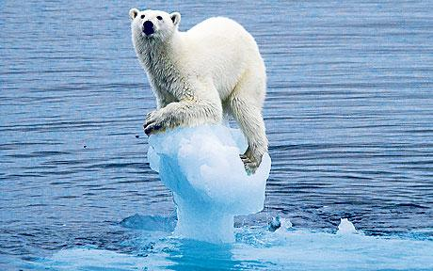
Climate Change and the Oceans
Jim Barry
Monterey Bay Aquarium Research Institute
Warming and ecosystem change
Ocean acidification, the other CO2 problem

Slide 2
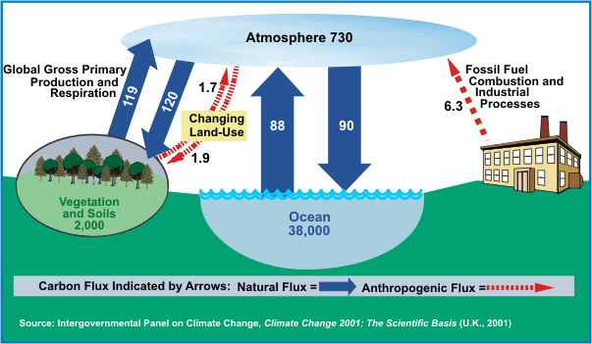
The Global Carbon Cycle
~200 Gt C (or 750 Gt CO2) are recycling between the atmosphere and the biosphere
The numbers are Billions of tonnes of Carbon (1 ton of Carbon = 3.7 tons of CO₂)

Slide 3
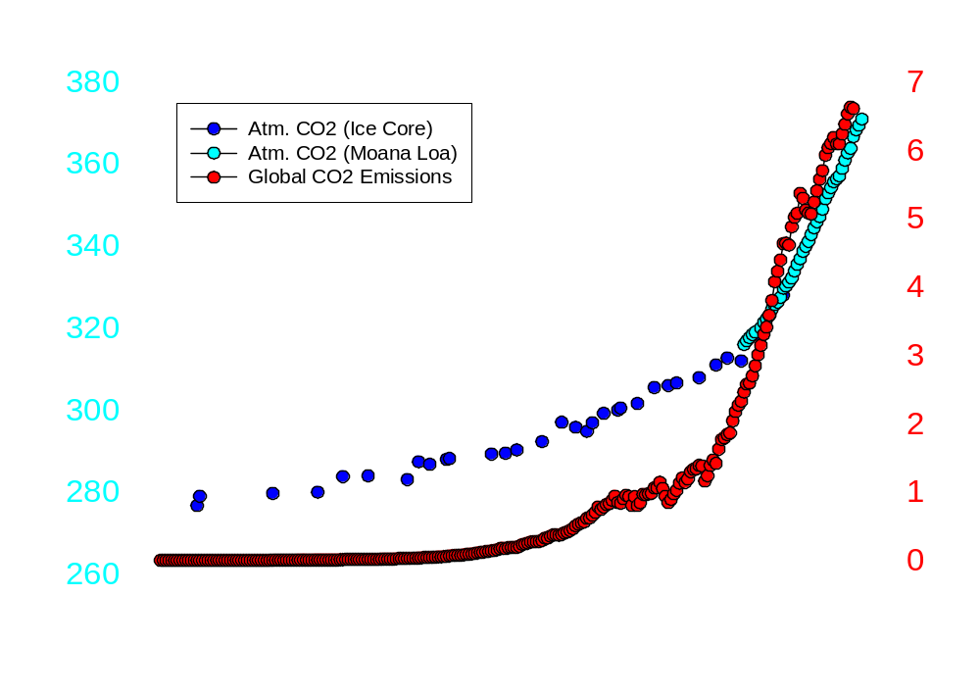
History of CO₂ Emissions & Atmospheric CO₂ Levels
Iraq War 1
Poor US Economy
Peak OPEC
Oil Prices
1973
Oil Embargo
WW2
WW1
Stocks Crash

Slide 4
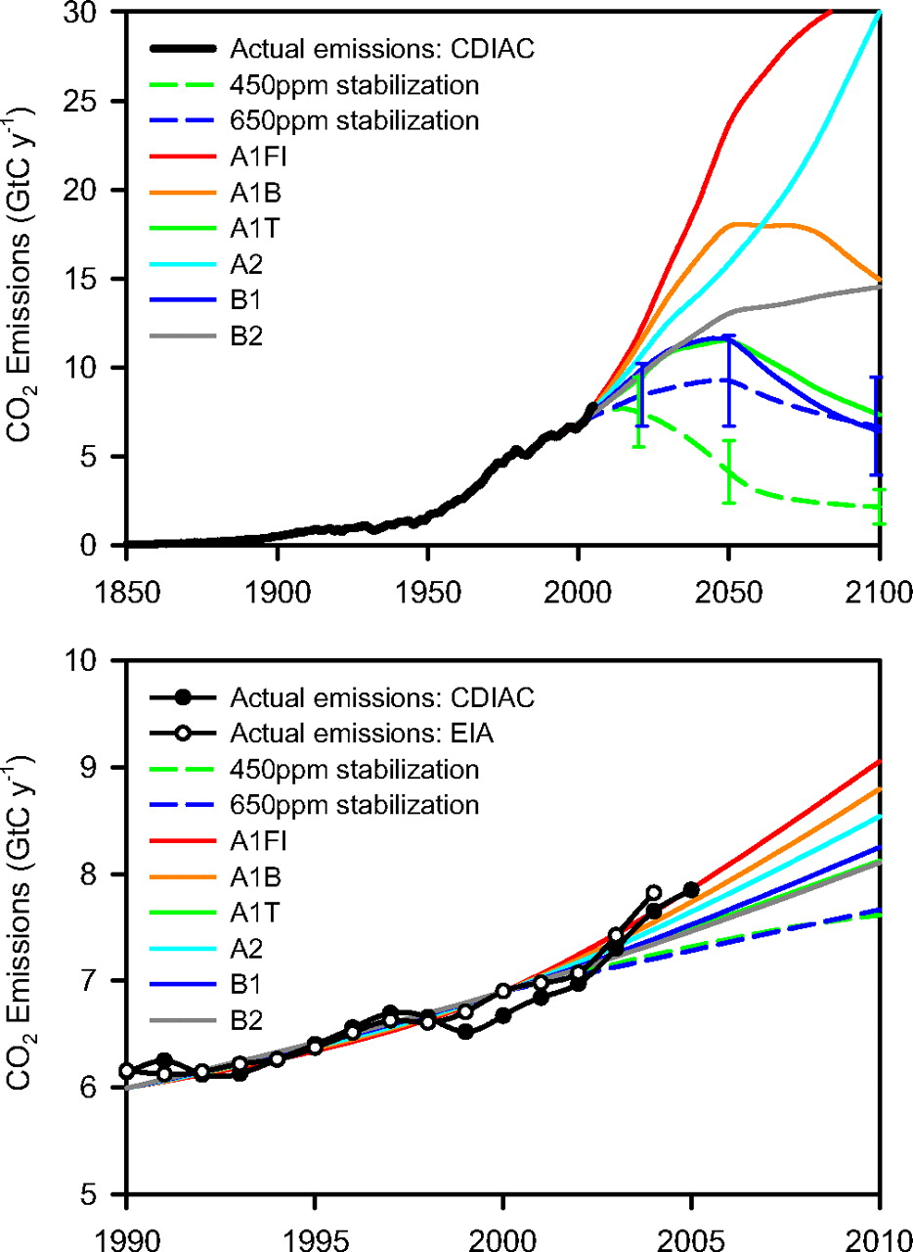
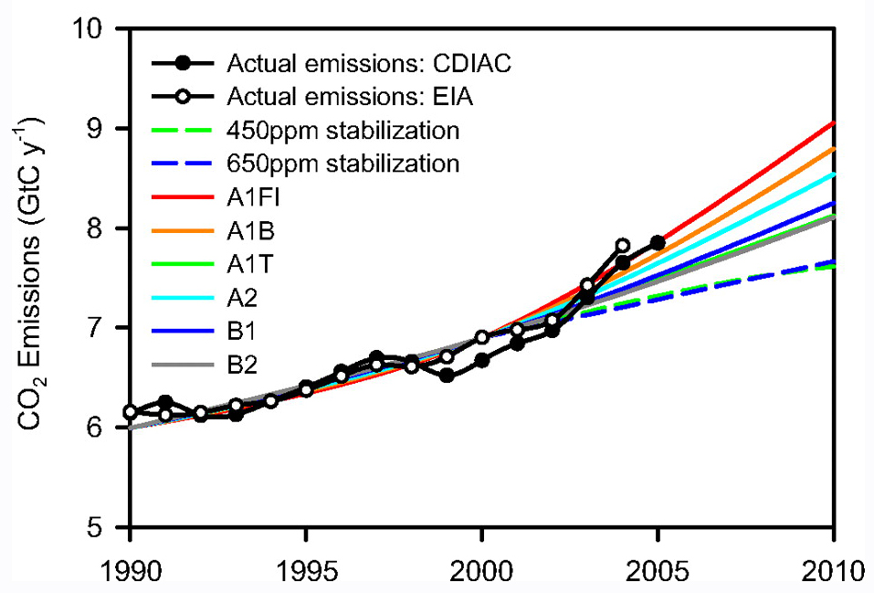
Future CO₂ Emissions?
Scenarios based on population, economic development, ‘green-ness’
Current emissions very high, increasing
Future climate-agreements may change trajectory
High emissions = more ocean acidification

Slide 5
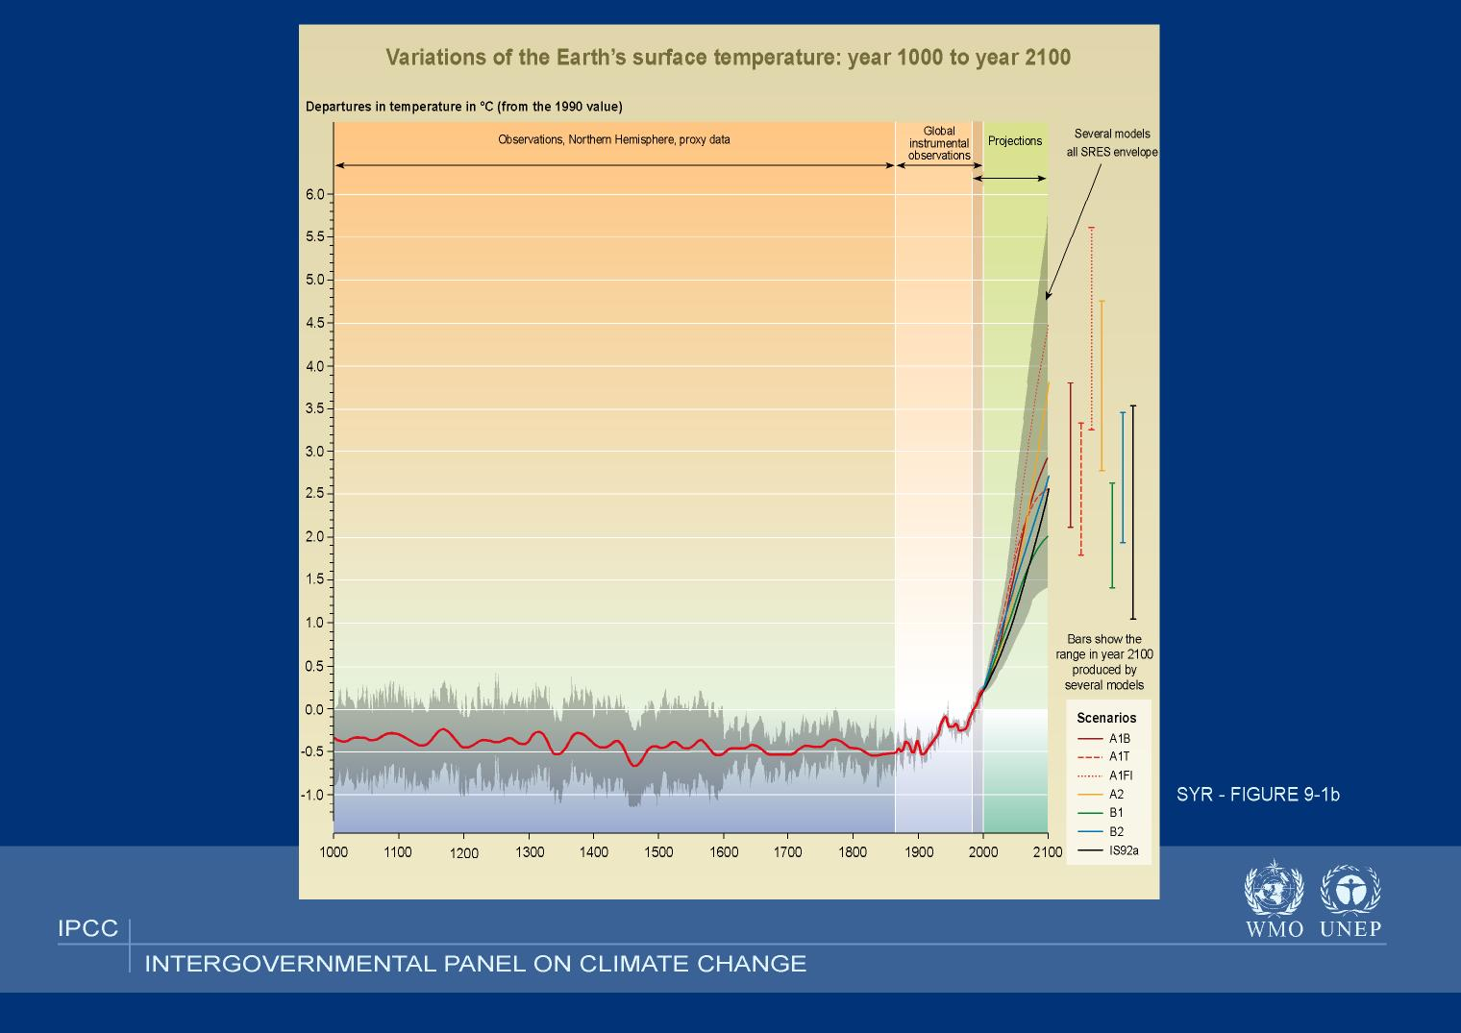
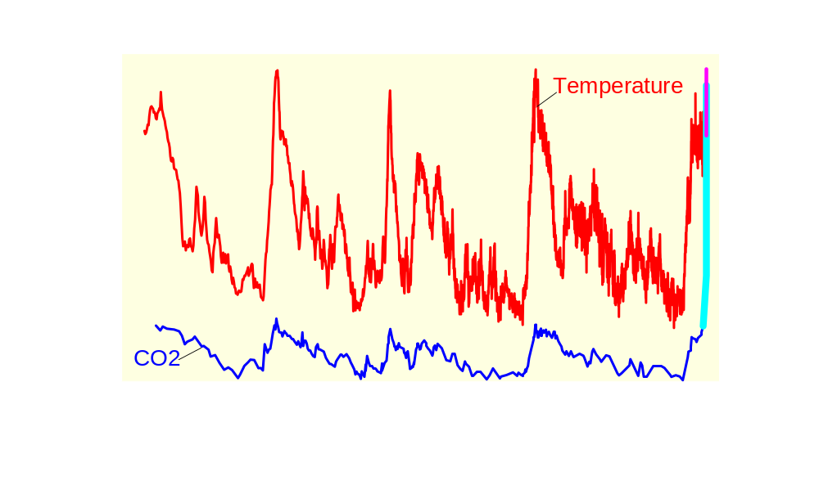
Climate Response =
1.0 - 4.5 ºC per
PAL CO₂
PAL = Present Atmospheric Level

Slide 6
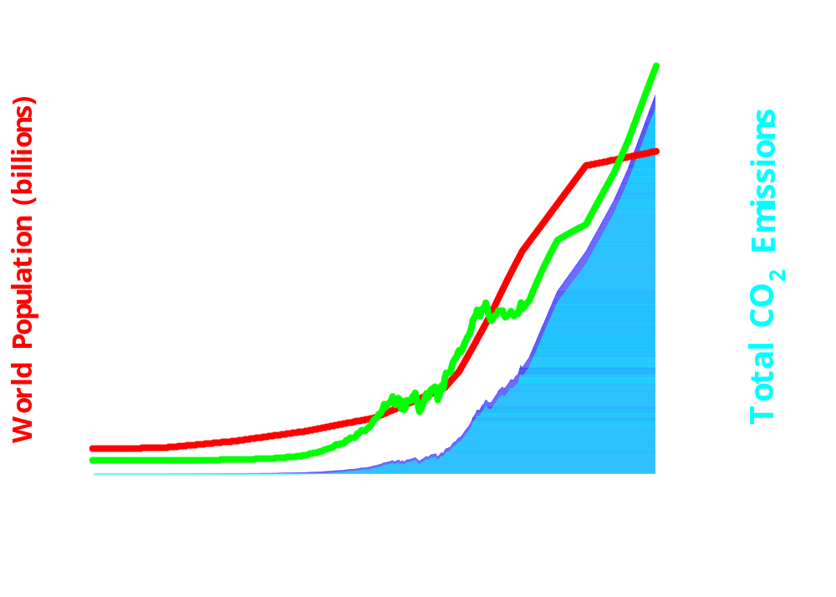
Role of Human Activities in the Carbon Cycle
How has our carbon ‘footprint’ changed?
Human CO₂ emissions as a
percentage of global C budget?
2100
14.8%
Per Capita CO₂ Emissions (T/y)
2007
4.2%
1800
<0.1%
Fossil Fuel
CO₂
Fossil fuel emissions are not recycled

Slide 7
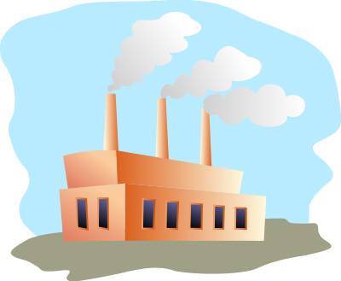







The Global Carbon Cycle
Arrows indicate CO2 absorbed or released per year
Natural
Cycle
207
Atmosphere
Year Human %C
<1800 <0.1
2007 4
2100 15
119
8
<0.01
119
30
120
88
88
89
125?
100?
Land
Ocean
Numbers are Billions of tons of Carbon (1 ton of Carbon = 3.7 tons of CO₂)

Slide 8
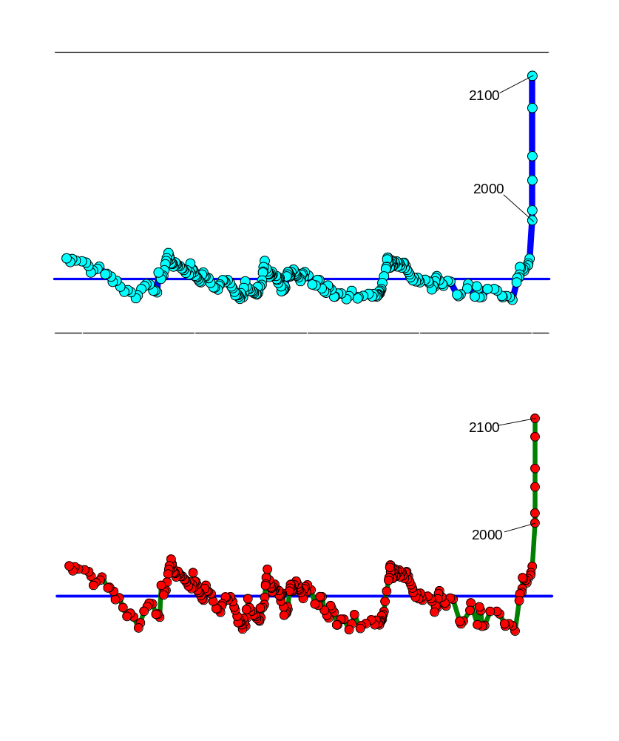
Is Rising CO₂ Unusual in Earth History?
CO₂ on Earth
425,000 Year History of Change
Ice Ages
CO₂ emissions causing rapid and
significant change in ocean
chemistry
Ocean surface is 25% more acidic
than 50 y ago
Ocean acidification will intensify in
future
Global CO₂ Increase
Massive & Rapid
CO₂ Increase
Atmospheric CO₂ (ppm)
Ice Ages
Sea Cucumber (Scotoplanes)
Increase in Ocean Acidity due to added CO₂
200
150
Massive & Rapid
Ocean Acidification
100
50
Ocean pH (units)
Ice Ages
Percent Change in Acidity
25
0
-25

Slide 9
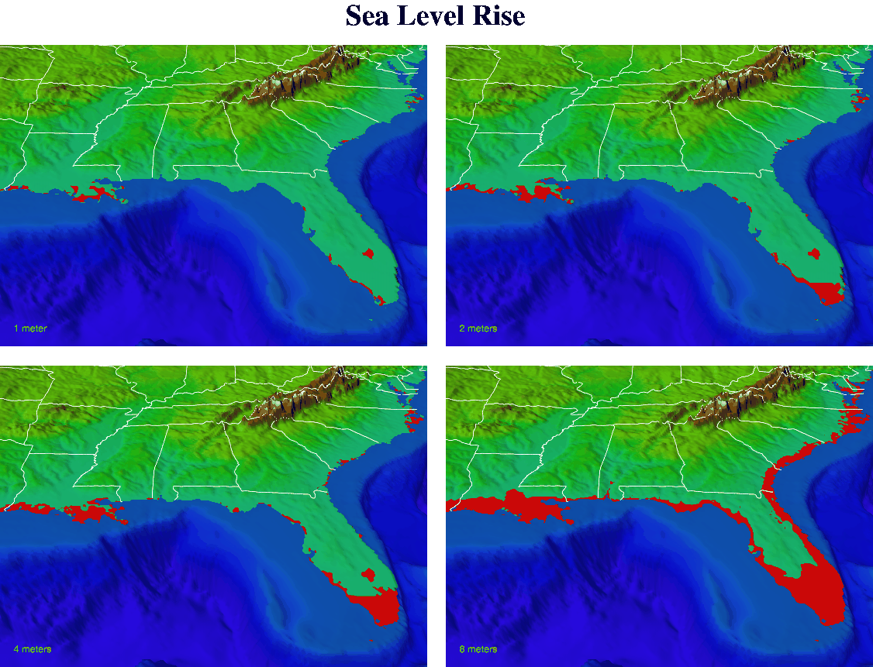
Sea Level Rise and Coastal Flooding
1 m
2 m
4 m
8 m
Intergovernmental Panel on Climate Change

Slide 10
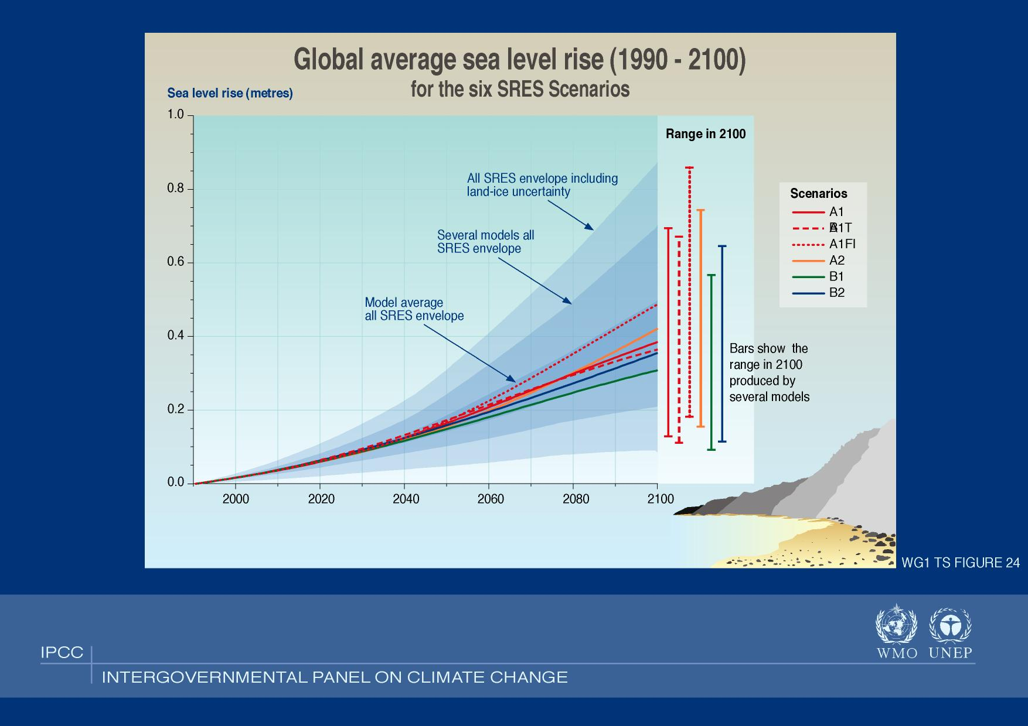
Sea Level Rise and Coastal Flooding
Intergovernmental Panel on Climate Change

Slide 11
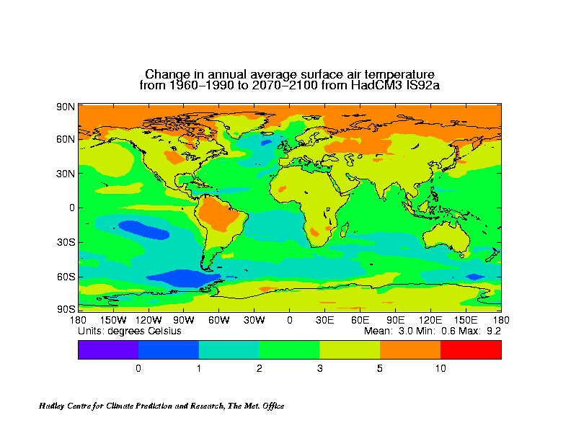
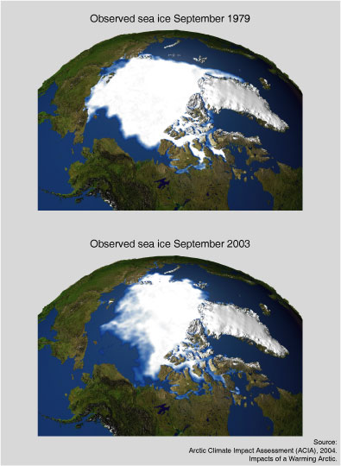
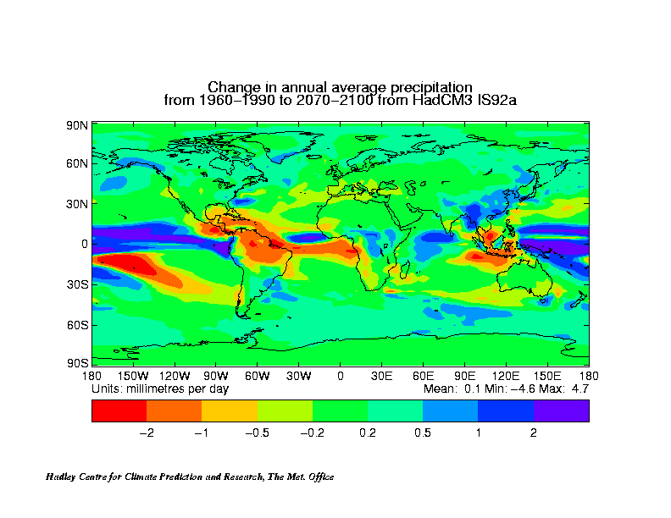
Warming by ~2090
Arctic Ice Cover Sept. 1979
Temperature
Arctic Ice Cover Sept. 2003
Precipitation

Slide 12
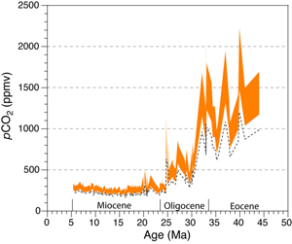
When did Earth last have high CO2 levels?
Ongoing CO2 increase unseen for 25 to 35 million years
Rate of CO2 increase as rapid as any period in Earth History
Will it matter to life on Earth?
33 My
2100 - 2200
25 My
2050 - 2075
2009
Preindustrial
Millions of years ago
Pagani et al. 2005

Slide 13
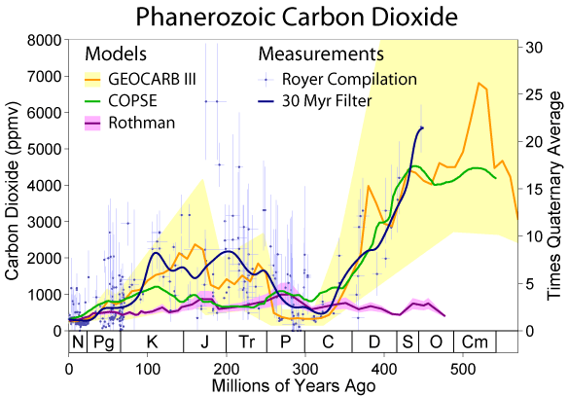
Carbon Dioxide and Life on Earth
Large variation in CO₂ over 600 My, low in last 100 My
CO₂ levels typically change slowly
Mass extinctions occur during periods of rapid climate change (CO₂)
Paleocene Eocene
Thermal Maximum (PETM)
Mass Extinctions
84%
47%
52%
60%
57%

Slide 14
Climate Response =
1.0 - 4.5 ºC per
doubling of CO₂

Slide 15
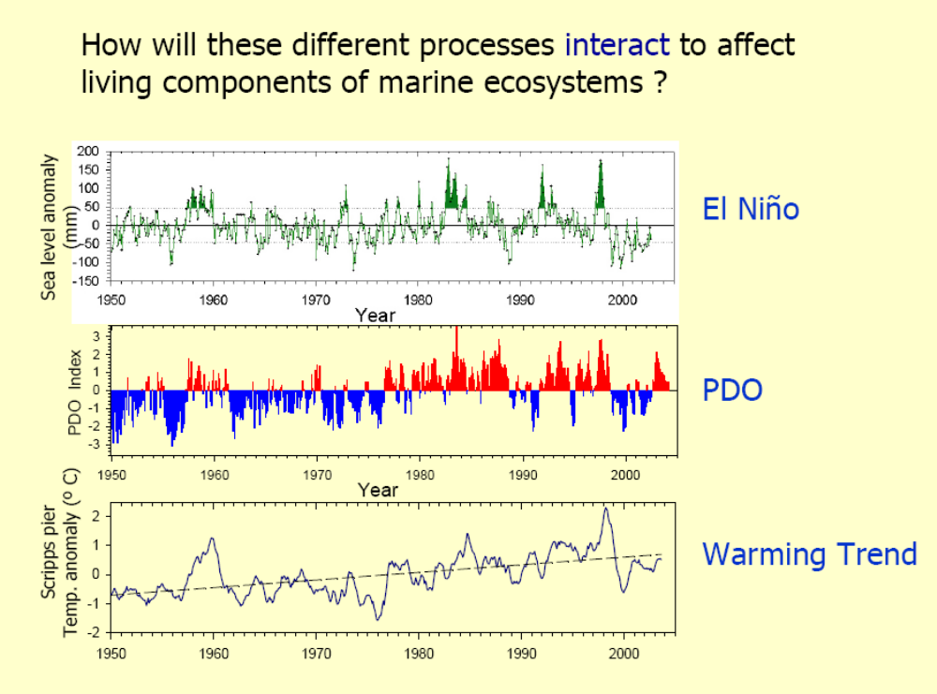
Scale of Ocean Climate Variability
3-12 years
~25 years
Centuries+?

Slide 16
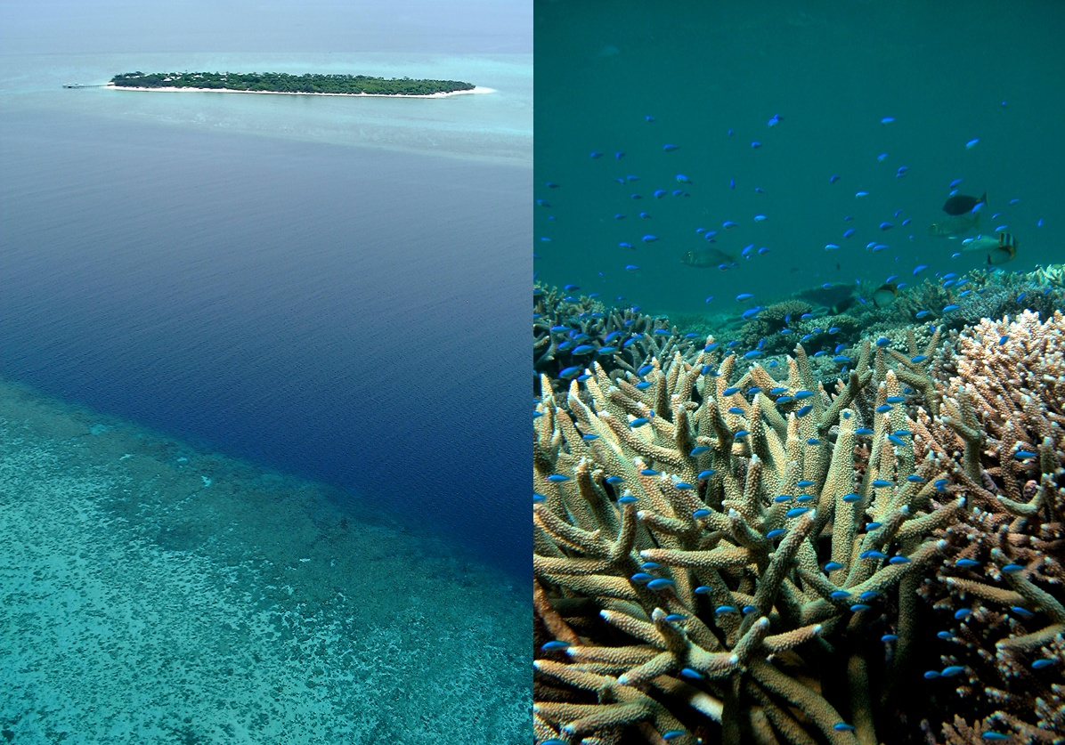
Coral Reefs and Climate Change
Notes:
Coral reef ecosystems line the coastlines of at least 94 nations across the planet and play host to some of the most beautiful seascapes the world over.

Slide 17
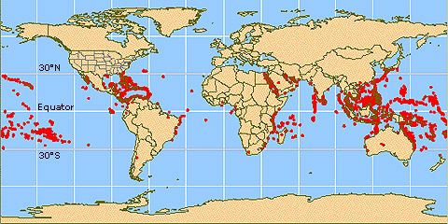
Coral reefs around the world
Warmest, most sunlit,
highest alkalinity
Notes:
Basically, coral reefs live in warm, alkaline and sunlit waters. They are probably limited due to the energy demand and the need for carbonate to sunlit waters that have a high aragonite saturation. I suspect that they have adapted secondarily to warmer temperatures.

Slide 18
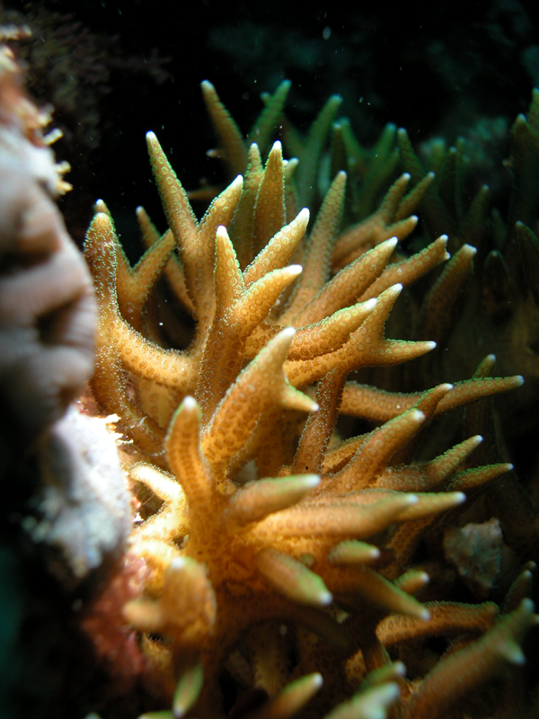
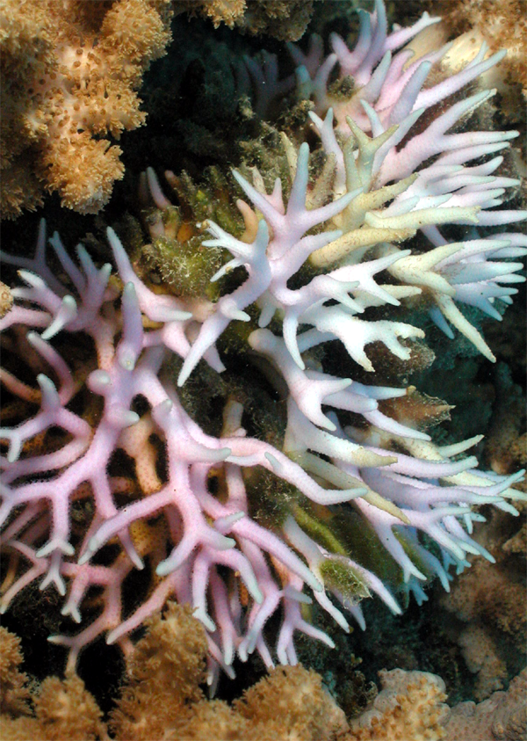
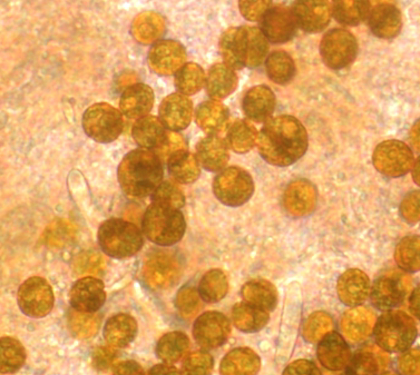
What is Coral Bleaching?
Notes:
Now I want to change track and talk about events that caught most coral reef biologists off guard. Starting in 1979, large sectors of the world’s coral reefs began to undergo a phenomenon called bleaching. Basically bleaching occurs when corals become stressed. Healthy corals such as those on he left have about 1 million dinoflagellate algal cells per cm². When conditions turn bad, corals will expel their symbionts, leaving their tissues translucent – what you see here is a living coral with the skeleton shining through. This pink colour is due to the remaining algal pigments.

Slide 19


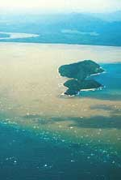
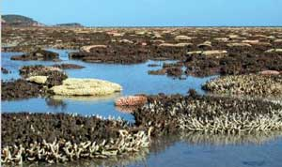
What can stress a coral?
High light or UV levels
Cold temperatures
Low salinity and high turbidity from coastal runoff events or heavy rain
Exposure to air during very low tides
Major: high water temperatures
Photos: AIMS and GBRMPA
Notes:
Poll answer before this

Slide 20
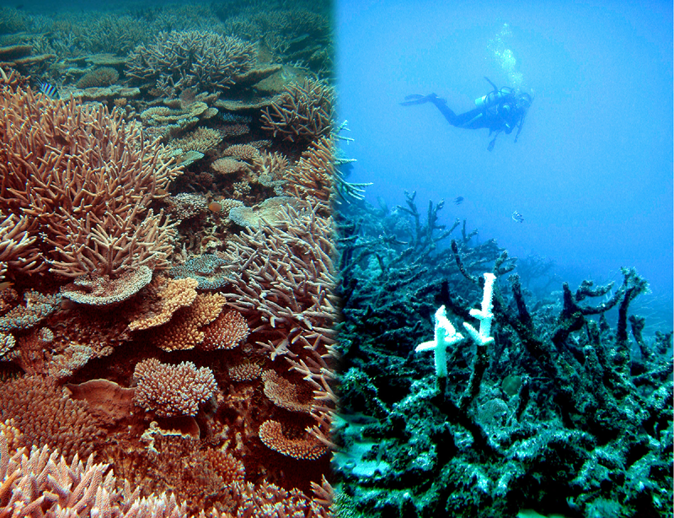
Notes:
Unfortunately, changes in sea temperature are rapidly changing coral reefs from looking like this, to virtual graveyards. In 1998, a single warming event event caused the estimated loss of almost 20% of the world’s living coral. The prognosis of the future is not much better.
With these grim and emotional words said, I want to talk about the drivers of these changes and to suggest the type of tropical reef system that we might well end up with.

Slide 21
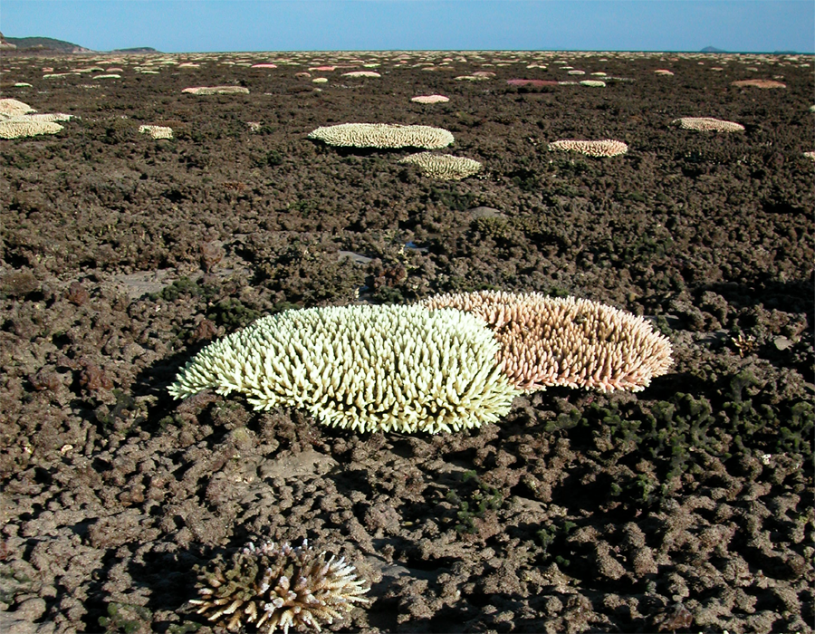
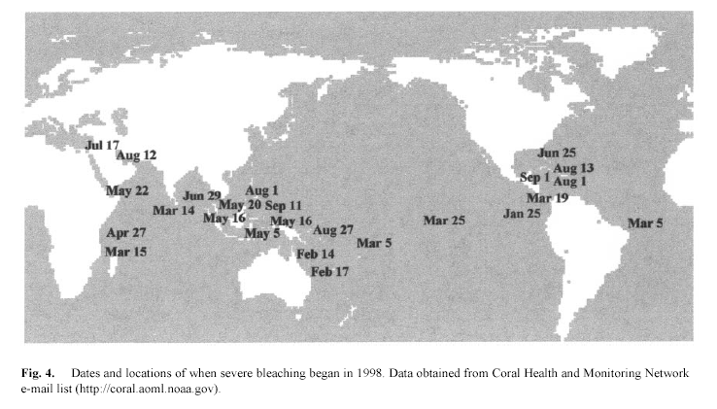
1998
Estimated loss of living coral colonies from reefs in 1997-1998 = 16% worldwide
48%

Slide 22
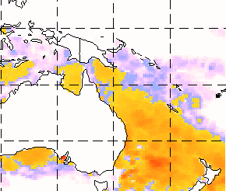
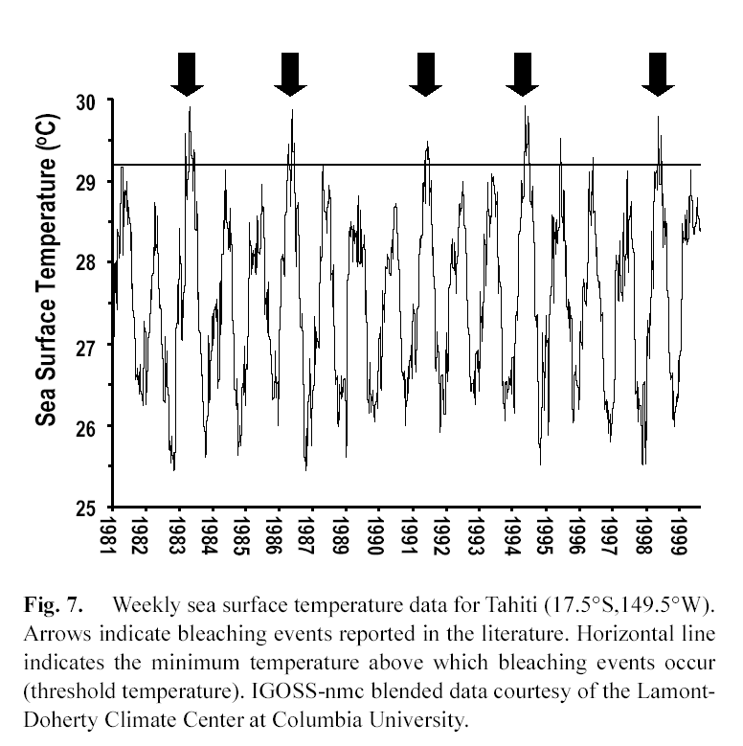
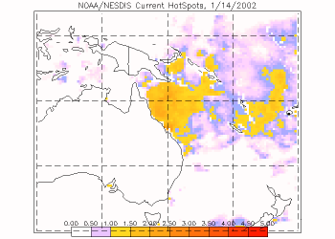
Mass coral bleaching caused by thermal stress
Warm water events (1-2ºC above long-term summer maxima)
Bleaching predictable from satellite –based sea surface temperature
1998
2002
Strong, Hayes, Goreau, Causey and others

Slide 23
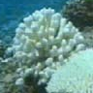
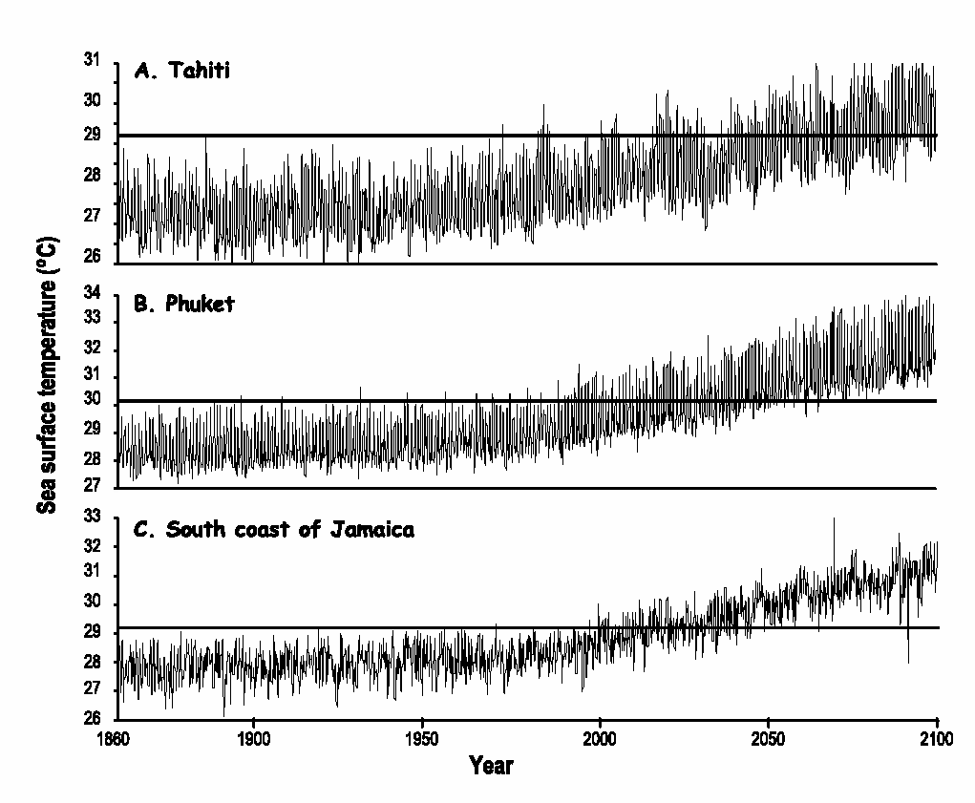
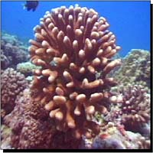
Threshold temperature – above which bleaching manifests itself (1-2oC above the long-term summer maximum temperatures
WHAT DOES THE FUTURE HOLD?
Hoegh-Guldberg (1999)

Slide 24
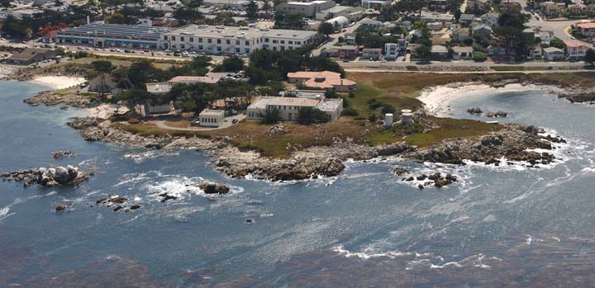
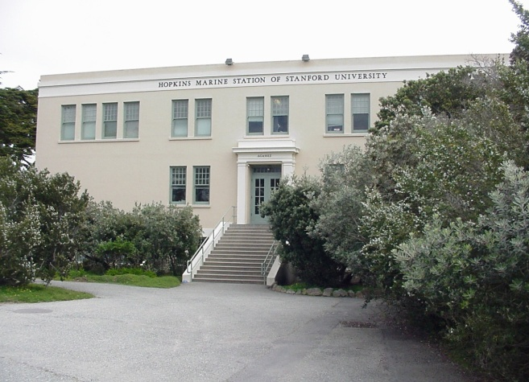
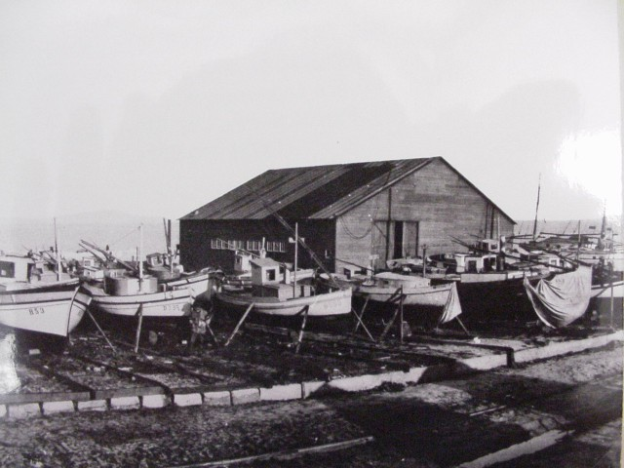
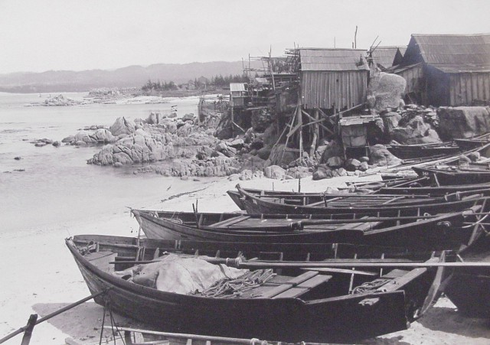
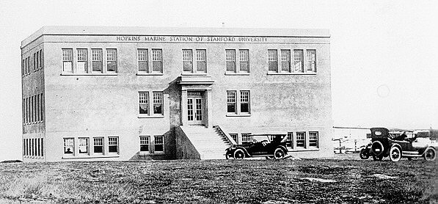
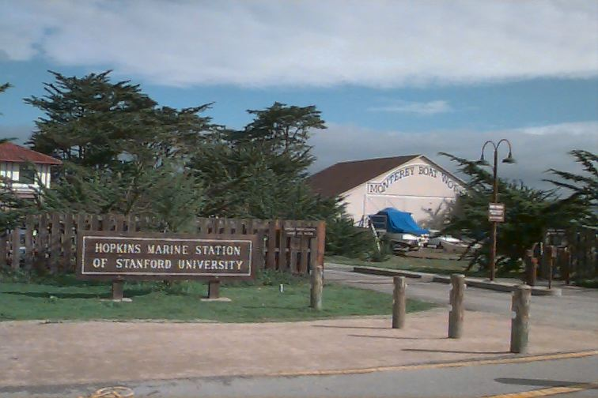
China Point and the Hopkins Marine Station

Slide 25
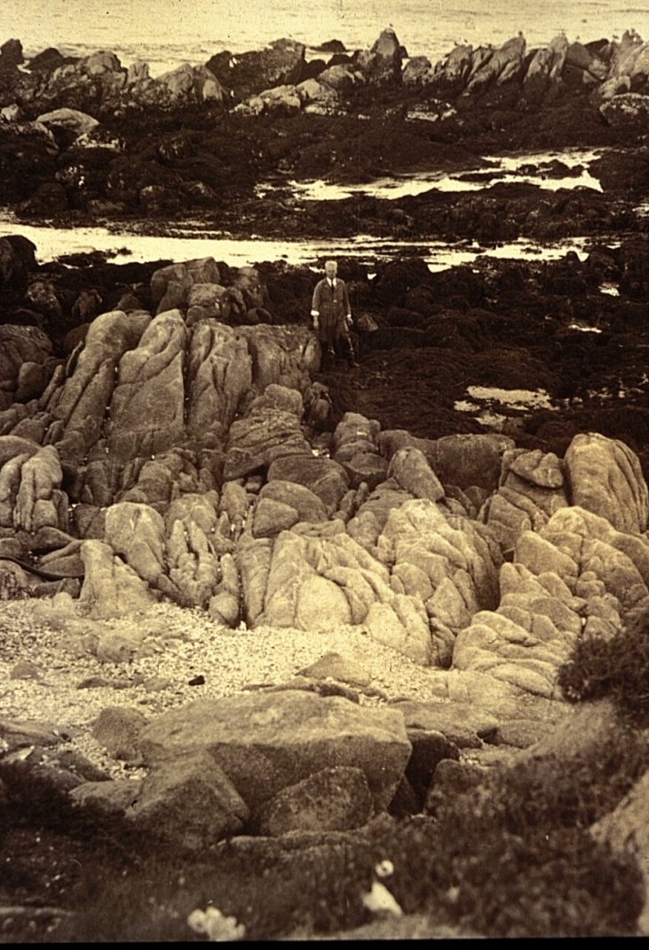
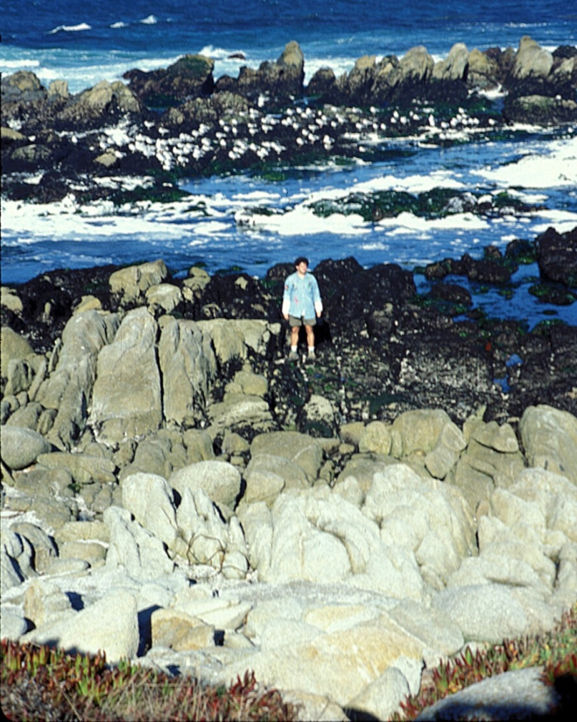
Changes in who lives at China Point: a 75 year perspective
Hewatt: 1931 Barry, Baxter, Sagarin &
Gilman: 1990’s & continuing

Slide 26
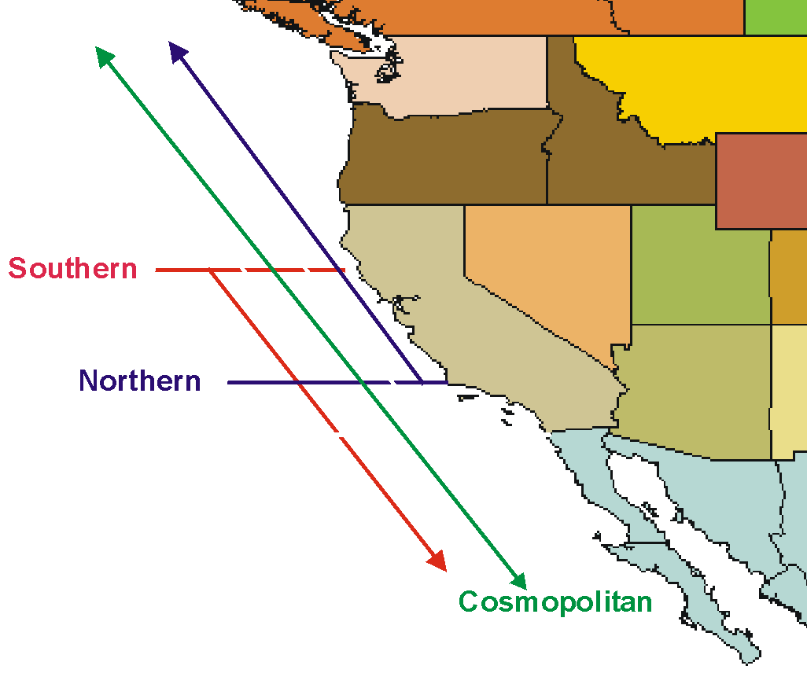
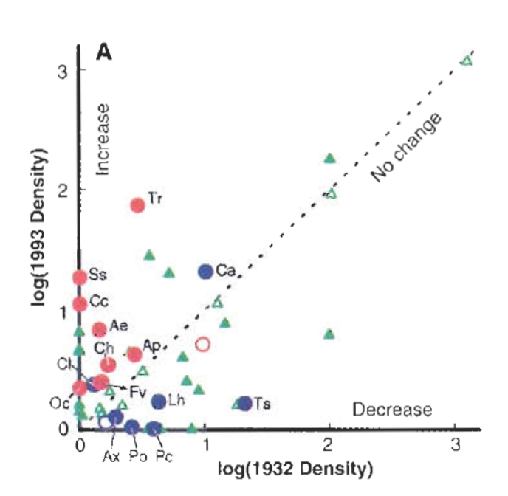
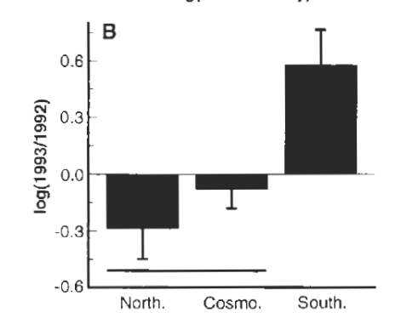








Climate-related shifts in rocky intertidal animals (1932-1993)
Warming of water temperatures over 60 years has been accompanied by a shift in the geographic ranges of species
More
Southern Species
Northern Sp.
Cosmopolitan Sp.
1993 Abundance
Monterey
Less
1932 Abundance
Warming prediction: Species ranges should migrate poleward with warming temperatures
Southern Species Increased
Northern Species Declined
Barry et al. 1995, Sagarin et al. 1999
Notes:
Summary of our research on changes in intertidal invertebrate communities in Monterey at Hopkins Marine Station.
During warming over the past 60 years;
warm-adapted species increased
cold adapted species decreased
cosmopolitan species showed no trend
No other hypotheses could explain these patterns.

Slide 27

Can We Adapt?
Effects of Climate Change on Land
Global Warming
Sea Level Rise
Changes in rainfall & storms
Changes in agriculture
Changes in diseases

Slide 28


Change in Wheat, Corn, Rice Yield
2020s
2050s
2080s
Jackson Institute, University College London / Goddard Institute for Space Studies / International Institute for Applied Systems Analysis

Slide 29


Ocean acidification: The Other CO₂ Problem
Jim Barry, Monterey Bay Aquarium Research Institute
Fossil fuel CO₂ emissions are making the oceans more acidic
More acidic ocean is stressful for marine organisms
Potential for large effects on ocean ecosystems and society
Notes:
Demonstration of melting clam shell…..

Slide 30





What is Ocean Acidification?
Carbon Dioxide
Low Carbonate = Problems for shell-makers
CO₂
Carbonic
acid
bicarbonate
protons
carbonate
+ H₂0
H₂CO₃
HCO₃⁻ + H⁺
CO₃⁻² + H⁺
Abundance in
Seawater
Acidity
Marine Shells = CaCO₃

Slide 31


Rising Atmospheric CO₂ and Ocean Chemistry
Atmospheric, Ocean CO₂, & Ocean pH
Ocean pH over the past 25 million years
Doney et al. 2009
Turley et al. 2006

Slide 32



Fossil Fuel Carbon Dioxide in the Ocean
Sabine et al. (2004)
South
North
Fossil fuel CO₂ signal has penetrated to >1000+ meters
~450 billion tons of CO₂ in the world ocean
Ocean CO₂ ‘disposal’ is now ~3 million tons per hour

Slide 33





Physiological Effects on Individuals
Shell and skeleton formation
Respiratory Stress
Enzyme Function
Metabolic Depression

Slide 34




End Cretaceous Extinctions
a shift in foraminifera
Post-impact – small forams
Microtectites
Shocked quartz
Pre-impact – large forams

Slide 35





Slide 36


Effect of stress on individuals
Normal
Stressed
Cost of
Living
Growth
Cost of
Living
Growth
Energy
Budget
Reproduction
Reproduction
Notes:
Conceptual model showing an energy budget under normal CO2 conditions and high CO2 conditions.
All animals have energy budgets where energy taken in is allocated to maintenance, growth, and reproduction. If the costs of maintenance increase, as occurs with CO2-related stress, animals must reallocate energy, thereby reducing that available for growth and reproduction.
Although the individual may survive in the high CO2 conditions, there will be negative consequences for the population.

Slide 37


Are CO₂-related stresses severe for deep-sea animals?
Deep-Sea Animals
pH variation in the Pacific Ocean
Reduced metabolic rates
Reduced enzyme function
Evolved in highly stable deep-sea environment
Food-limited –
“Living on the edge”
More
Acidic
Less
Acidic
Future Ocean
Depth (m)
Deep-sea Octopus

Slide 38

What are the options for organisms faced with ocean acidification?
Acclimation (tolerance)
Adaptation (linked to evolutionary history, generation time)
Extinction
What to do..?

Slide 39

Mass extinctions during Earth history
5 major mass extinctions with >70% extinction of all species
10+ million years to recover (rediversify)

Slide 40




MBARI small scale CO₂ experiments
ROV Tiburon
CO2 Release System
20 liter CO2 pool
Support from MBARI, DoE

Slide 41






Deep-Sea CO₂ – Release Experiments
3600 m (~12,000 ft.)
Effects of CO₂-rich
seawater on animals
Initial studies of
effect of deep-sea
CO₂ storage
Notes:
A movie of our deep-sea CO2 release experiments to simulate deep-sea ocean carbon sequestration (I’ve removed the movie and added a photo). We released liquid CO2 into chambers (20 to 100 liters), and position animals near and distant from the CO2. As the CO2 dissolves, it produces a dissolution plume of high-CO2, low pH water that drifts over animals. After a month, we return to assess the condition of the animals. We’ve studied all sorts or organisms, from bacteria to fishes. These experiments are difficult to interpret because the local currents bath animals in the dissolution plume for a while, then normal seawater for a while when the currents switch direction. Nevertheless, we’ve learned that most animals, particularly those with poorly developed physiological system to defend internal pH suffer high rates of mortality during exposure.

Slide 42



Effect of CO₂ on Sea urchin survival
Results of deep-sea CO₂ release experiments
Distant from CO₂ - Most urchins in good condition
Near CO₂ - Poor condition, dead, eroded
Urchins in cage near CO₂ pool
Post-Experiment Urchin Condition
CO₂ Pool
Control
3600 m ( > 2 miles deep)
Barry et al. 2003, 2004

Slide 43




Deep-Sea Urchins
What is their sensitivity to changing ocean pH?
  Inhabit low O2, low pH (7.6) waters
  Shallow water species sensitive to pH
Ongoing studies
  Metabolic rate
  Acid-base chemistry
  calcification
  survival
  growth
  protein synthesis
Allocentrotus fragilis

Slide 44



How is global warming / ocean acidification affecting ocean ecosystems?

Slide 45



Field Survey of Natural CO₂ Venting Sites in Italy
Echinoderms conspicuously absent, shell dissolution
Seagrasses thrive
Jason Hall-Spencer et al. 2008

Slide 46


Effects of Ocean Acidification on Ocean Food Webs
Ocean Acidification:
Reduced shell formation in pteropods
Reduced growth & survival of pteropods
Disruption of Salmon Food Web
Cascading effects for higher predators (mammals, humans)
Pteropod = Salmon food
Sockeye Salmon

Slide 47

































Present Ocean Food Web – Diverse, Complex, Productive
Primary Producers
What are the expected effects of
ocean acidification on ocean ecosystems?
Zooplankton food web
Upper Trophic levels
Sinking Organic Debris
Microbial Remineralization
Seafloor community

Slide 48

Future Ocean Food Web – Loss of biodiversity, low productivity, dominated by microbial recycling?
Primary Producers
Reduced Biodiversity
Simplified Food Web
Increased Microbial Dominance?
Upper Trophic levels
Zooplankton food web
Sinking Organic Debris
Microbial Remineralization
Seafloor community

Slide 49
The bottom line
What we know:
Ocean acidification is ongoing, massive, increasing
Causes physiological stress for many species
Can only be mitigated by reduced CO₂ emissions
What we expect:
Food webs will be affected
Ecosystem services (e.g. fisheries) will change
What we don’t know:
Capacity for acclimation and adaptation
Effects on marine communities, ecosystems - tipping points?
What will this mean for California & coastal states?
  Productivity and Stability of Fisheries
Multiple Stressors
Synergistic effects of warming, acidification, reduced oxygen levels may further impact ocean ecosystems

Slide 50



Is it hopeless, too late, too big….?
Should we worry about climate change and the oceans?
  YES! Climate change / Ocean acidification affects the quality of our lives
What can we do?
  Individuals
  Education
  Connect with nature, Value the oceans
  Teach our children that our choices and actions are important
  Vote
  Support & practice energy efficiency
  Society
  Invest in energy efficiency & non-carbon energy
  Reduce fossil fuel emissions
  Lead in technology development

Slide 51






Reasons for Hope?
Mother Nature might “bail us out”…

Slide 52












Reasons for Hope?
High-efficiency cars and trucks
Wave and Tidal Energy
Photovoltaic Energy
(Solar)
Wind Power

Slide 53

We’ll need to be pretty “adaptable”…

