Slide 1

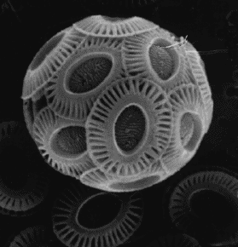
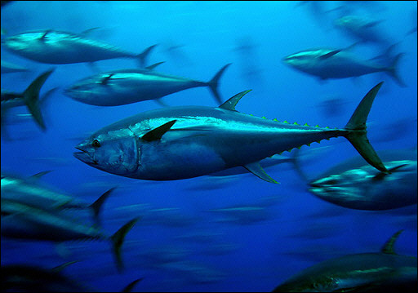
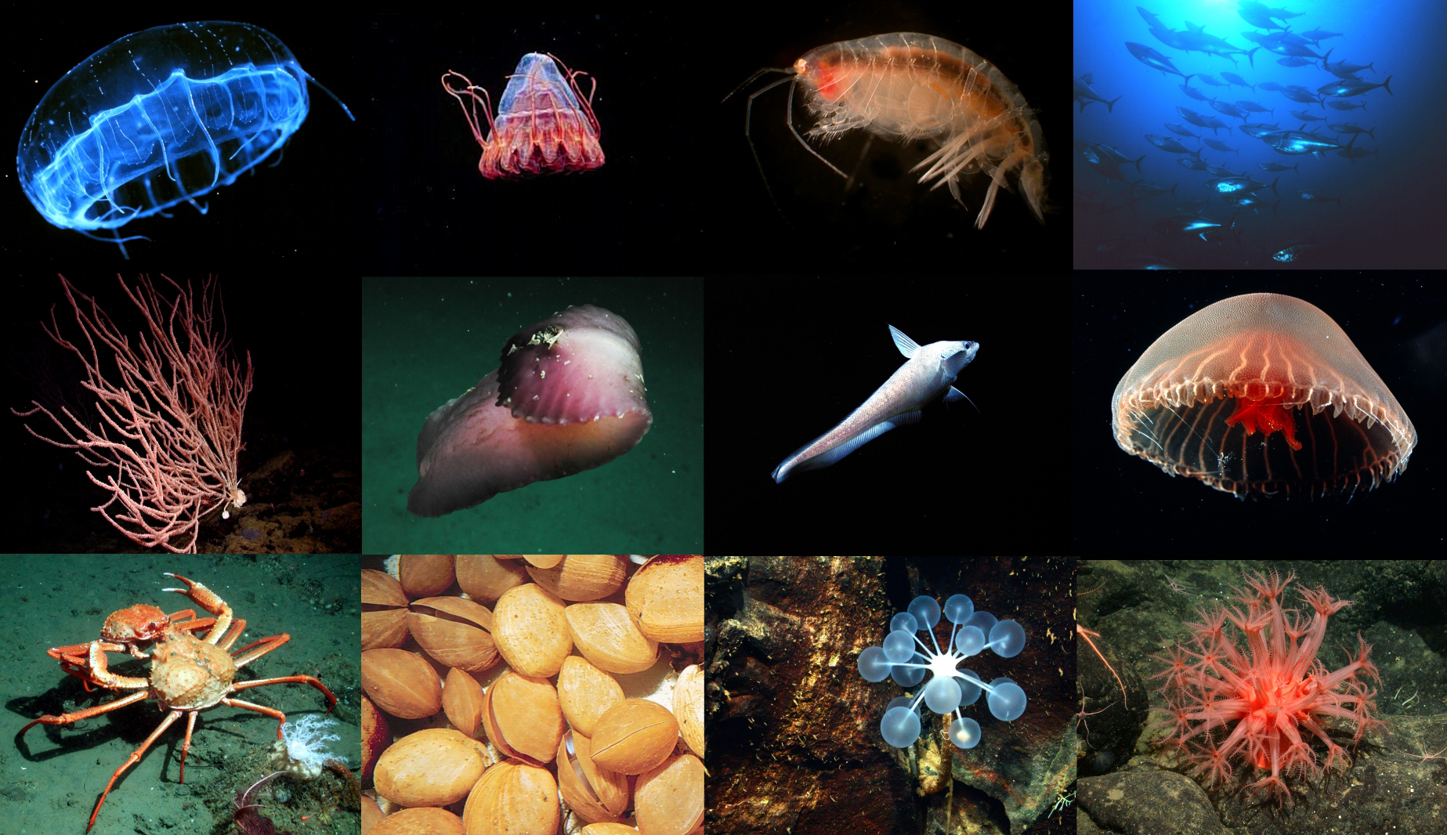
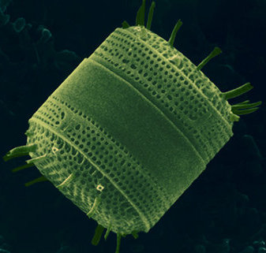
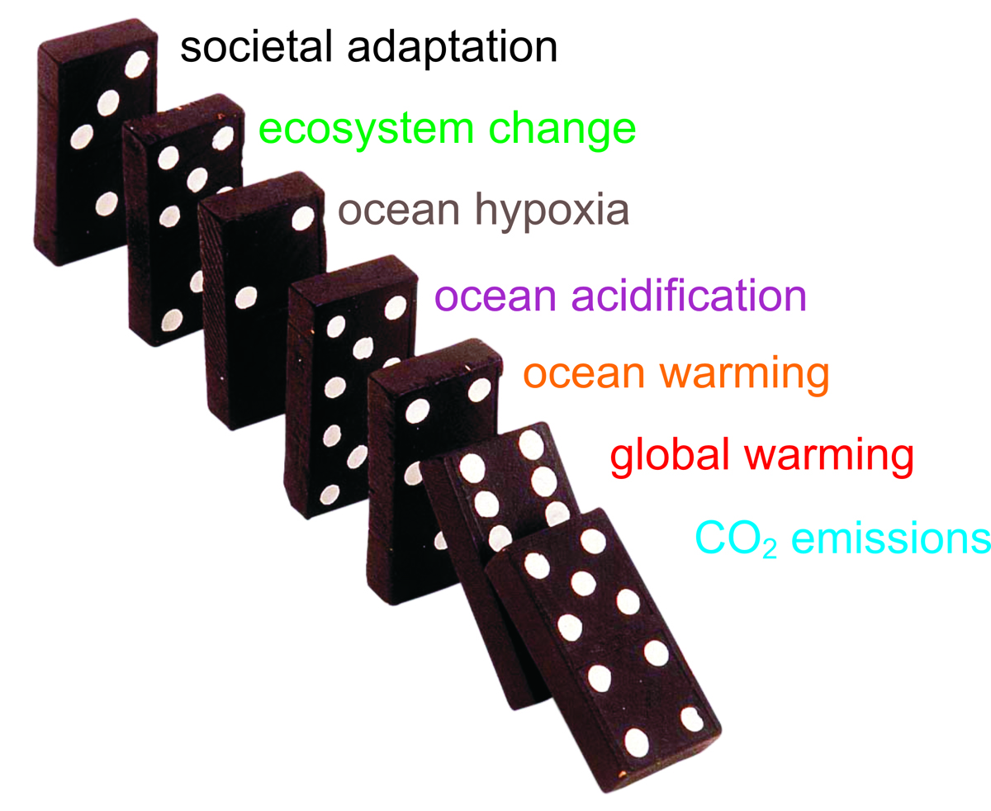
How does changing ocean chemistry affect ocean ecosystems
Jim Barry, Monterey Bay Aquarium Research Institute
IMCC, Victoria, BC, 2011

Slide 2
Environmental Stress, Ecosystems, and Society
Environment
Individuals
Populations
Species
Communities
Society
Ocean Acidification
Biodiversity
Physiological processes
(acclimation)
Ecosystem Function
Warming
Abundance
DistributionProductivity
Biological Interactions
(food web)
Fisheries
Hypoxia
Resilience
Metabolic Performance
Other
Ecosystem
Services
Adaptation
Energy Flow
Stability
Survival
Growth
Reproduction
Productivity

Slide 3
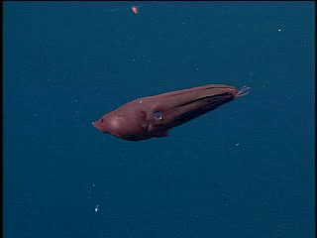
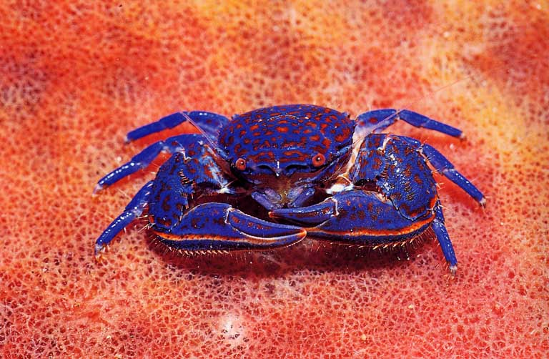
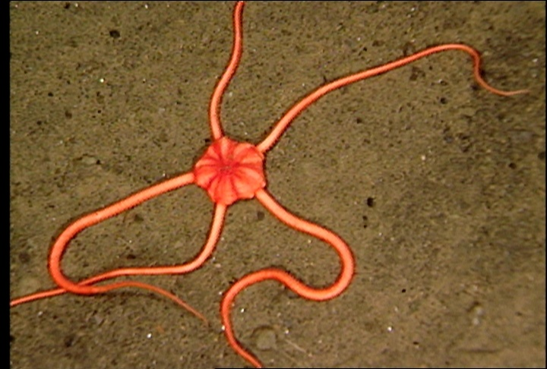
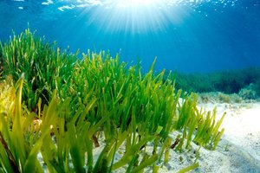
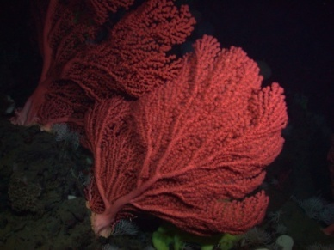
Physiological processes affected by high CO₂
Photosynthesis
Calcification
Respiration
Acid – Base Balance
Metabolic Rate
Vampire Squid

Slide 4
Stress increases the ‘cost of living’
Normal
Stressed
Cost of
Living
Growth
Cost of
Living
Growth
Reproduction
Energy
Budget
Reproduction
Energy budgets – If the cost of living (e.g. shells) increases, less is available for growth and reproduction.
Notes:
Stress increases “cost of living” , with less energy for growth and reproduction.
Individuals = reduced 1) survival, 2) size, 3) reproductive output.
Populations = Reduced abundance, productivity, resilience, and greater likelihood of extinction.

Slide 5
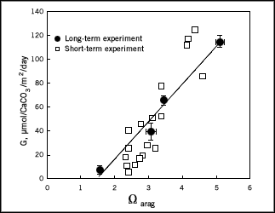
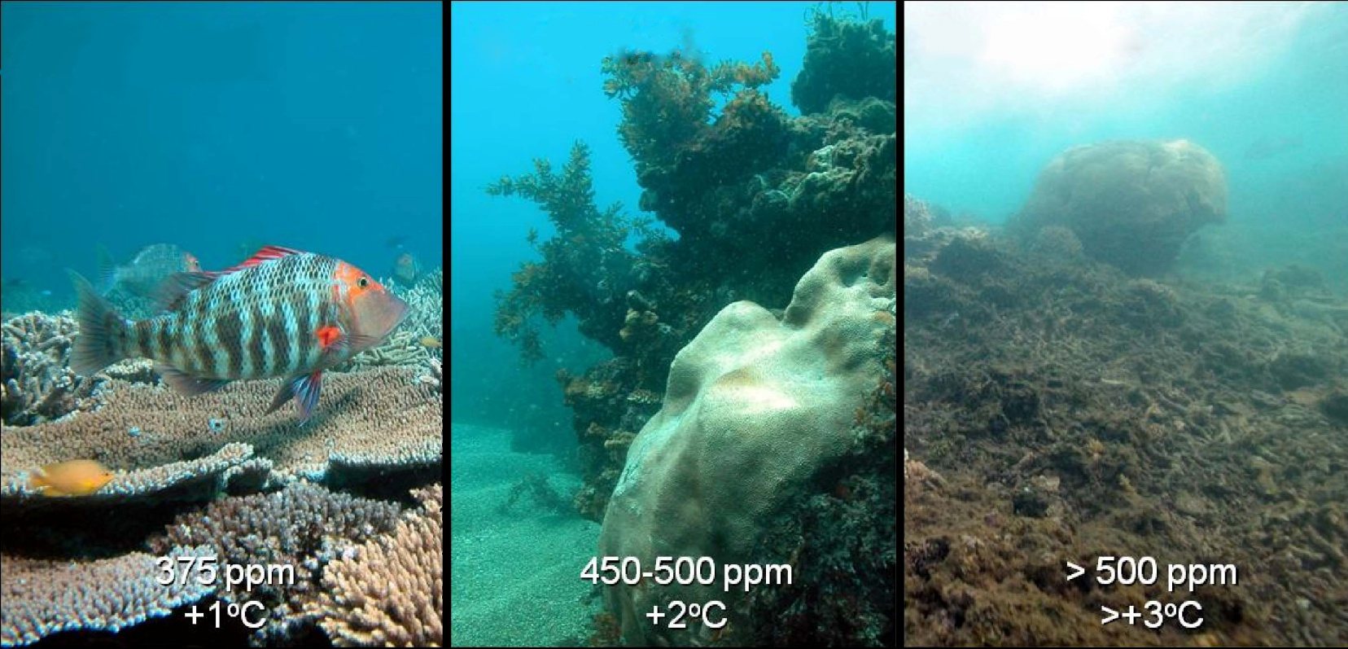
Ocean acidification reduces skeletal growth
Low carbonate saturation associated with low calcification rate
Calcification Rate
Corals
Aragonite Saturation State

Slide 6
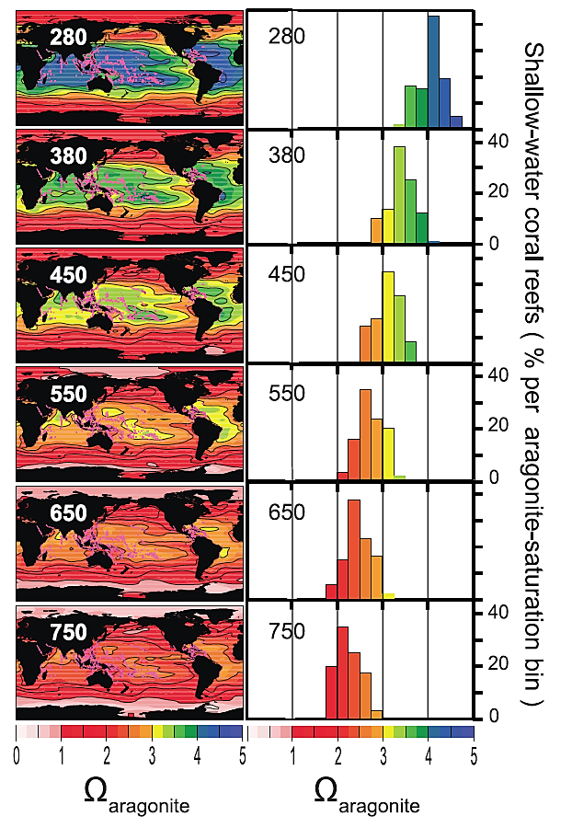
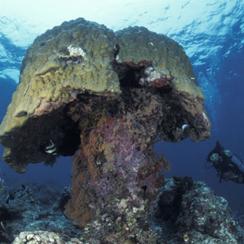
Ocean chemistry is becoming more stressful for corals
Ocean acidification reduces minerals used to make coral skeletons
  Ω_{aragonite} decreases with OA
Corals grow best with Ω > 3
Corals cease to grow when Ω ~2
All existing reefs today will have poor growth conditions for corals by 2100
Bad
Marginal
Good
Ω_{aragonite}
Ω_{aragonite}
Cao and Caldeira 2008

Slide 7
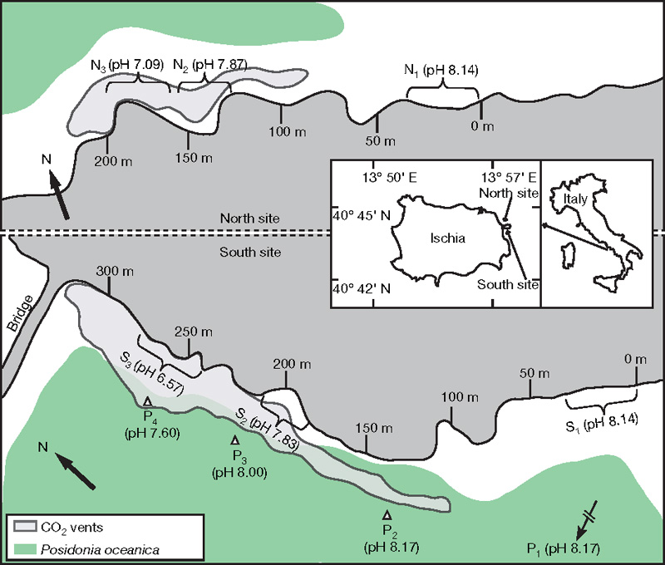
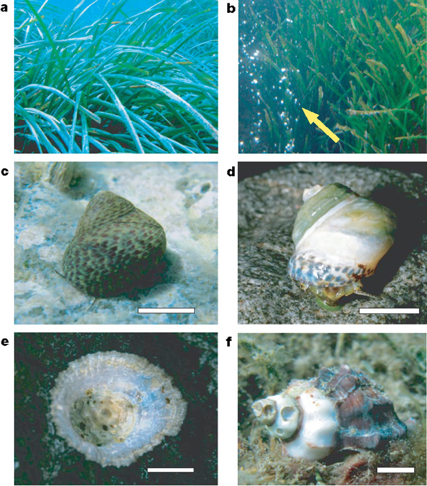
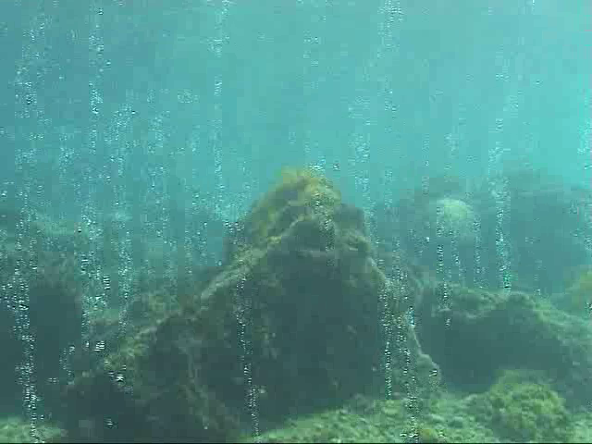
Natural CO₂-venting affects marine biodiversity
Echinoderms conspicuously absent, shell dissolution
Seagrasses thrive
Jason Hall-Spencer et al. 2008

Slide 8
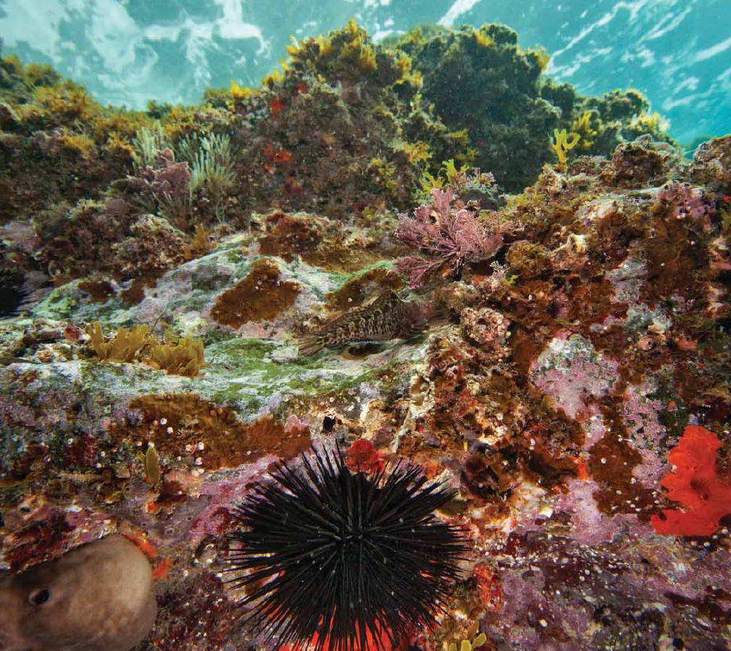
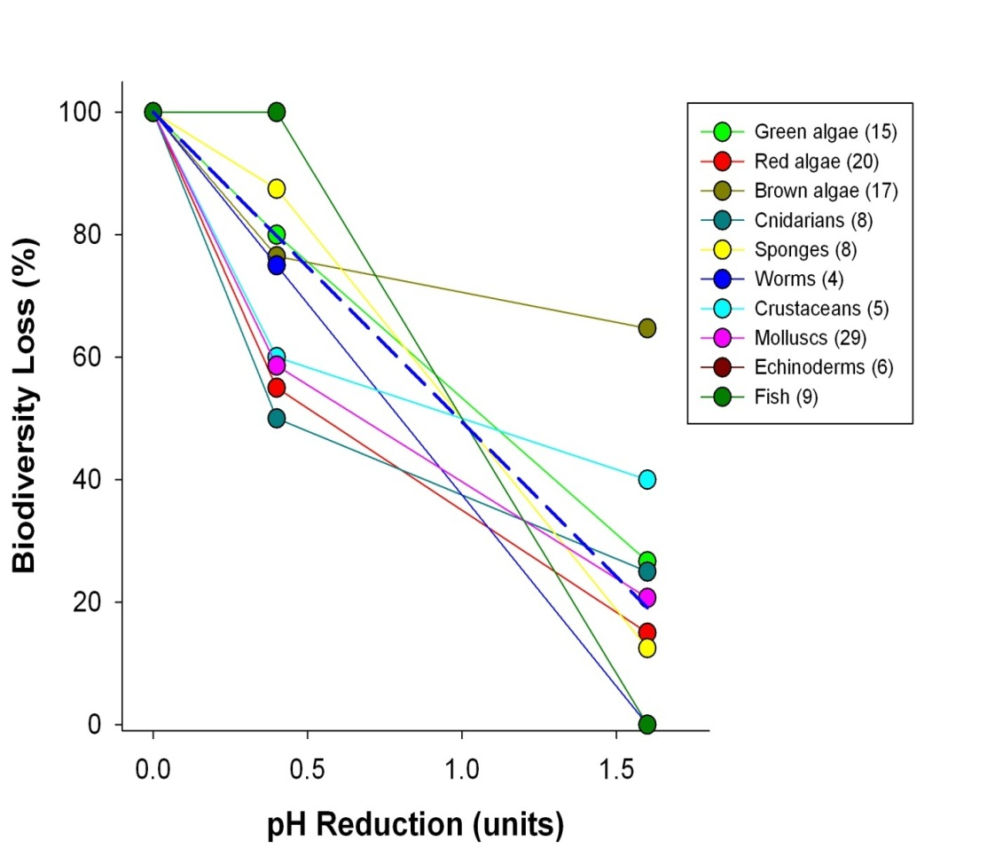
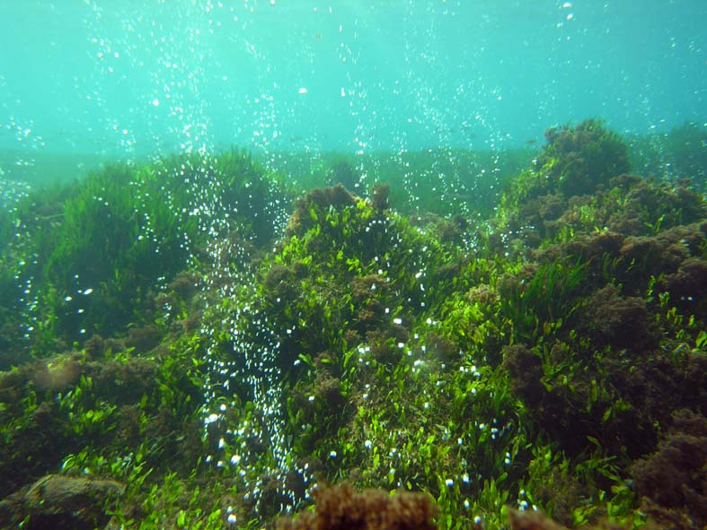
High-CO₂ areas have fewer calcifiers, fleshy algae, and more invasive algae
Typical Ischia shallow-water community
Biodiversity is reduced at natural CO₂ vents
51% loss of species per 1 pH unit
Community in high-CO₂ areas at Ischia
Modified from
Barry et al. 2011
Jason Hall-Spencer et al. 2008

Slide 9
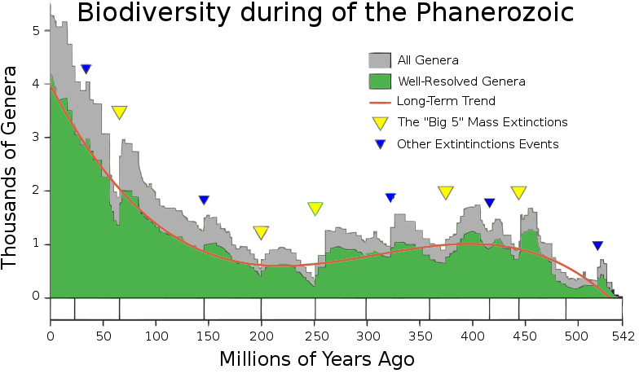
Climate change is associated with mass extinctions
5 major mass extinctions with >70% extinction of all species
10+ million years to recover (rediversify)

Slide 10
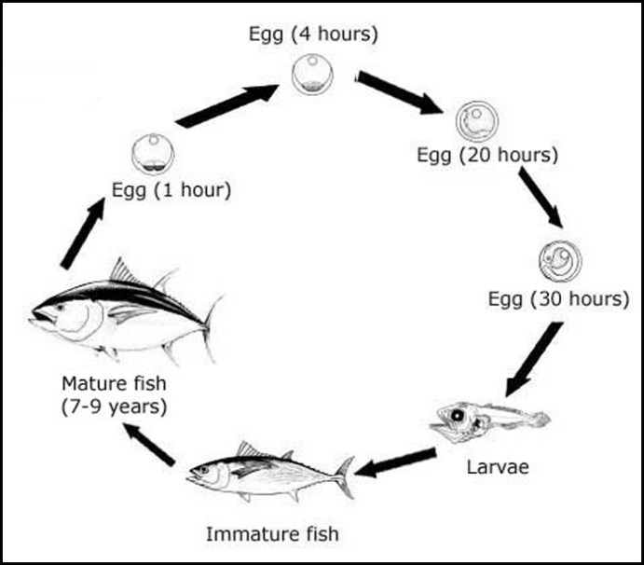
Important to consider effects on different life stages
Stage:
Duration:
Sensitivity:
Tuna Life Cycle
Fertilization
Seconds
High?
Embryo
Hours - Days
High?
Larva
Days – Months
Mod. – High?
Juvenile
Mo. – Yr.
Moderate?
Adult
Yr. – Cent.
Low – Mod.?

Slide 11
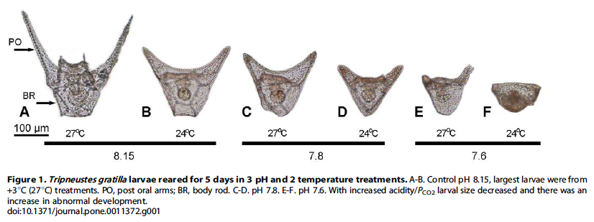
Warming may offset or amplify OA impacts for some taxa
Brennand et al. 2010

Slide 12
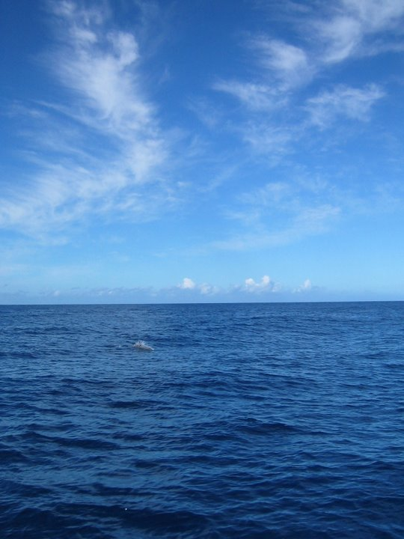
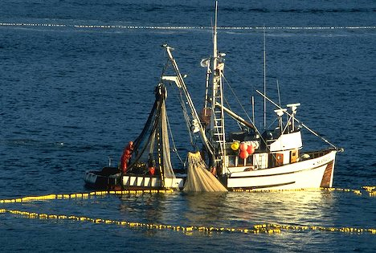
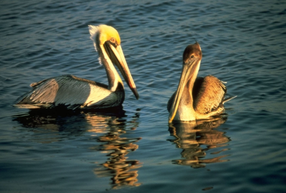
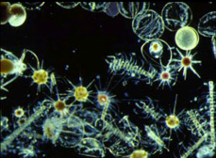
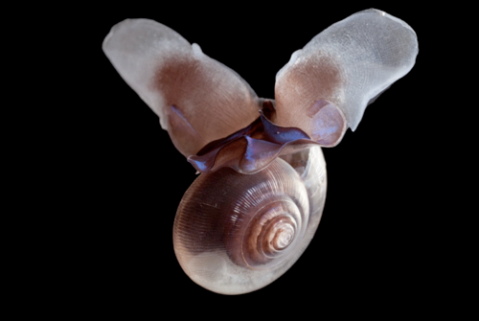
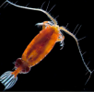
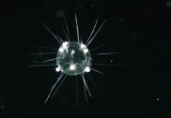





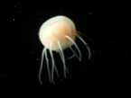
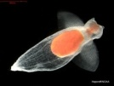
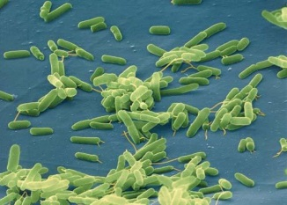
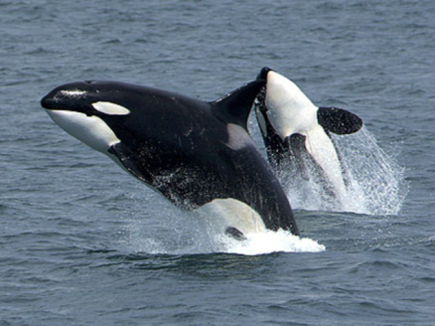
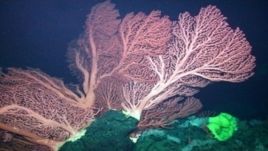
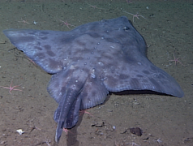
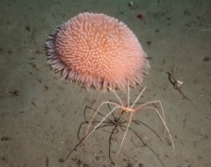
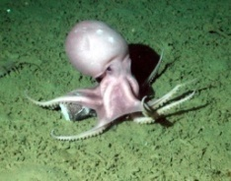
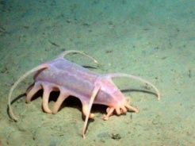
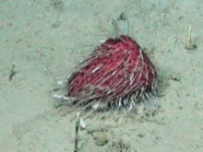
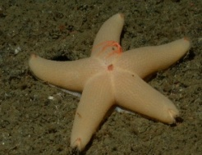
Marine Communities are Biological Networks
Primary Production
Humans
Seabirds
Phytoplankton
Zooplankton
Squid
Fish
Large zooplankton
Detritus / Bacteria
Sea butterfly
Limacina
Seafloor Animals
Mammals
Marine Food Web
Notes:
Food web isn’t a very good image, but could be improved.

Slide 13
Summary points
What we know:
Carbon dioxide emissions causing ocean change
Warming, hypoxia, acidification
Stressful for many organisms (winners and losers)
What we expect:
Food webs will be affected
Ecosystem services (e.g. fisheries) will change
What we don’t know:
Long term effects
Sensitive life stages
Acclimation and adaptation
Multiple Stressors
Ecosystem tipping points?

Slide 14
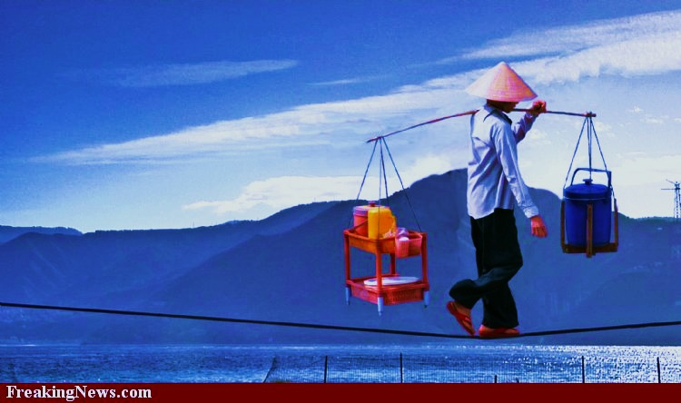
Society has choices for adaptation to a changing ocean
Climate and ocean change is a problem for society
Food and energy needs for society linked to ocean health
Balancing ocean health and societal demands
Can we avoid ocean tipping points?
Early action reduces severity of impacts
Ecosystem
impacts
Ecosystem
Services
Past
Future

Slide 15
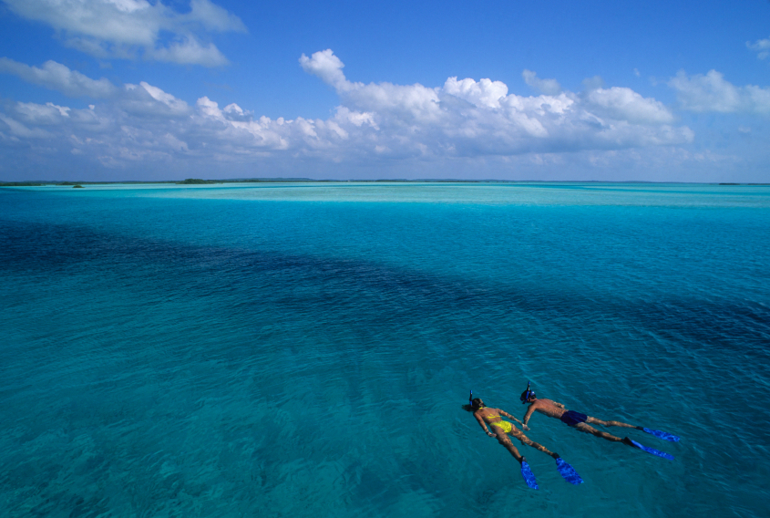
Value the oceans

