Slide 1
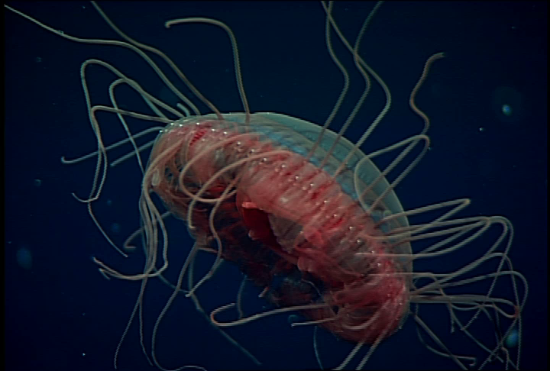
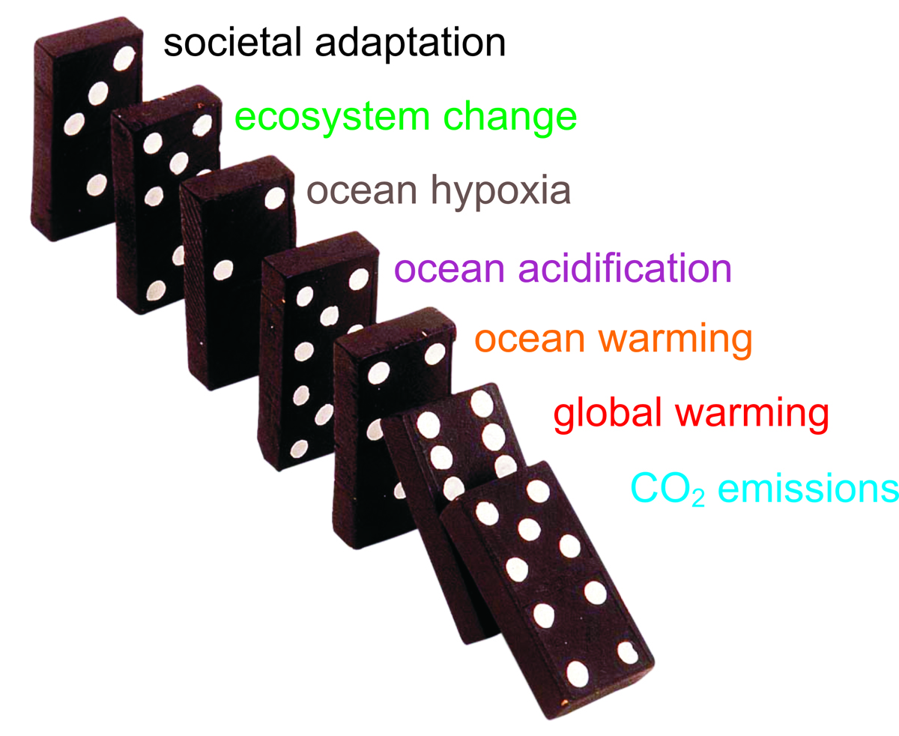
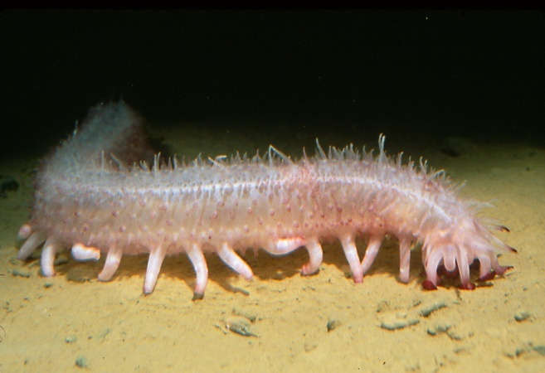
Ocean warming, acidification, and hypoxia – effects on coastal upwelling systems
Jim Barry, MBARI
West Coast Education Ocean Acidification Workshop, 2011
Ocean acidification, warming, hypoxia related to CO₂ emissions
Affects physiology and performance of animals
Potential for large effects on ocean ecosystems (e.g. Cal. Cur.) and society

Slide 2
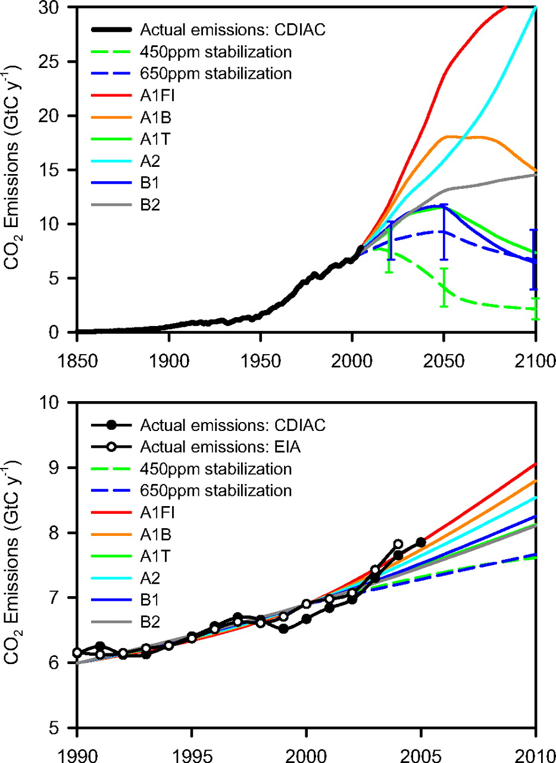
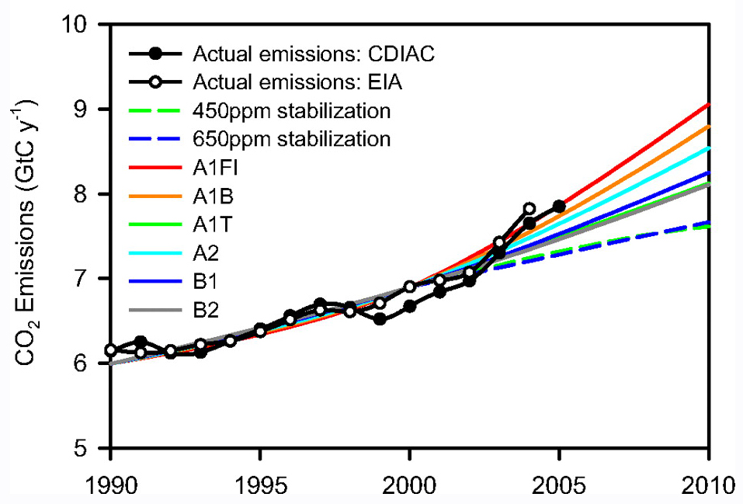
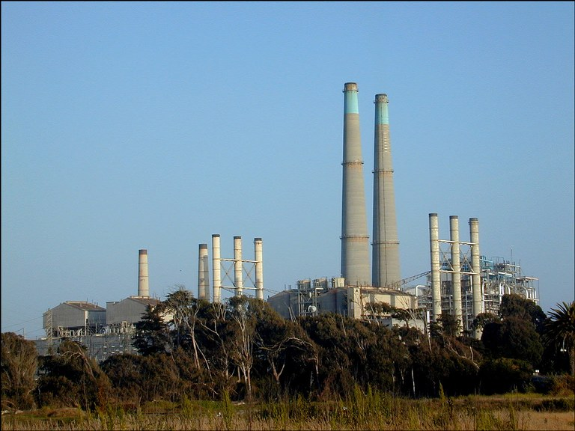
CO2 emissions are rising rapidly
Various scenarios
Current emissions high, increasing
Climate-agreements / legislation
High emissions = larger climate / ocean
changes

Slide 3
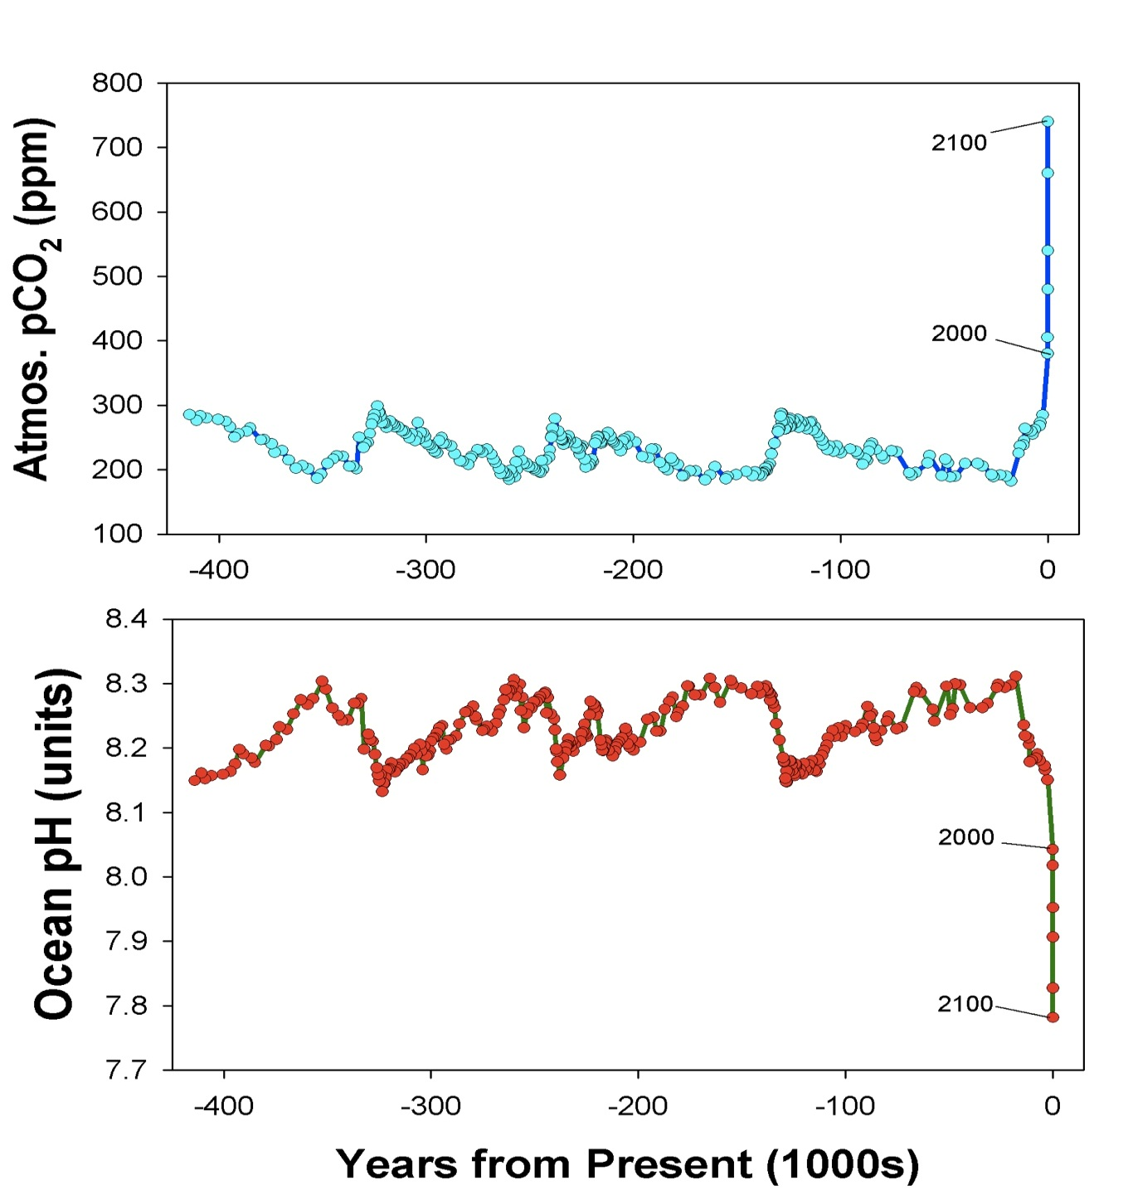
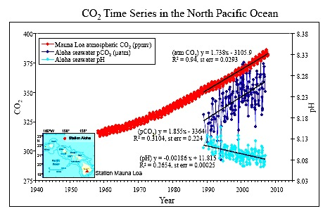
CO₂ emissions are changing ocean chemistry
Higher atmos. CO₂ increases ocean acidity
Ice Ages
Low CO2 during ice ages, higher in warm periods
Very high CO2 is rare in recent Earth history
Ocean acidity tracks changes in atmospheric CO₂
Global CO₂ Increase
Massive, rapid rise in CO₂
Ice Ages
Atmospheric CO₂ (ppm)
Ocean pH (units)
Ice Ages
Massive, rapid rise in acidity
Doney et al. 2009

Slide 4
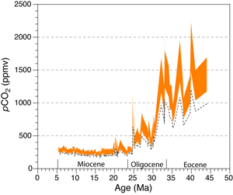
When did Earth last have high CO2 levels?
Ongoing CO2 increase unseen for 25 to 35 million years
Rate of CO2 increase as rapid as any period in Earth History
33 My
2100 - 2200
25 My
2050 - 2075
2009
Preindustrial
Millions of years ago
Pagani et al. 2005

Slide 5
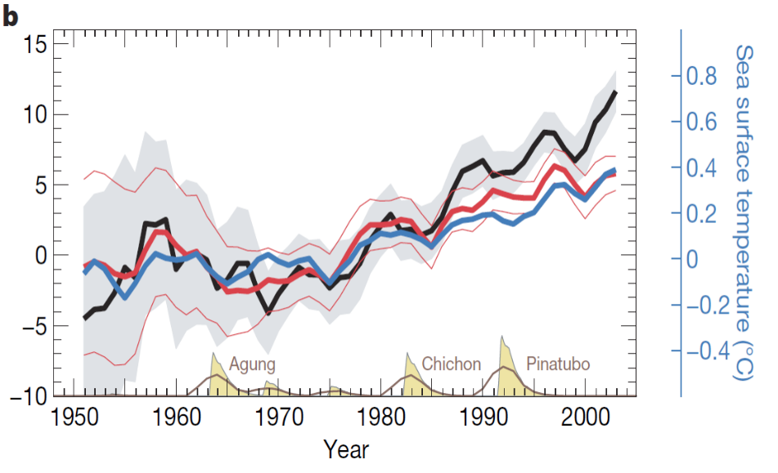
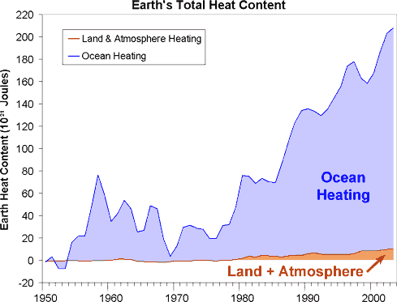
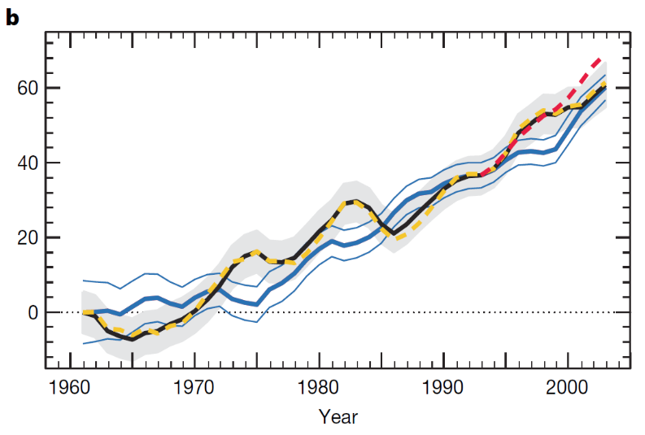
Global warming occurs mainly in the oceans
Ocean Heat Content
10²² Joules
Sea Level Rise
millimeters
Year
Dominguez et al. 2008, Murphy et al. 2009

Slide 6
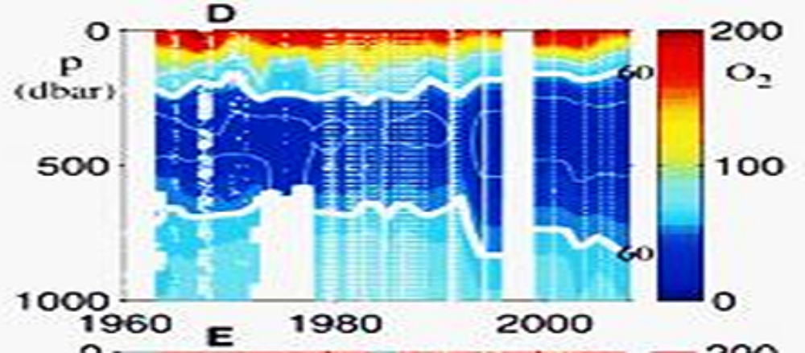
Oxygen levels in many ocean areas is declining (hypoxia)
Warmer surface waters inhibit mixing of surface and deep waters
Less mixing leads to lower deep-sea oxygen levels
Oxygen minimum zones are expanding and intensifying
Expected to be stressful for ocean life
Eastern Equatorial Pacific
0
200
60
500
Oxygen Minimum Zone
Oxygen (µM)
Depth (m)
no data
no data
100
no data
60
1000
0
1960
1980
2000
Year
Stramma et al. 2010

Slide 7
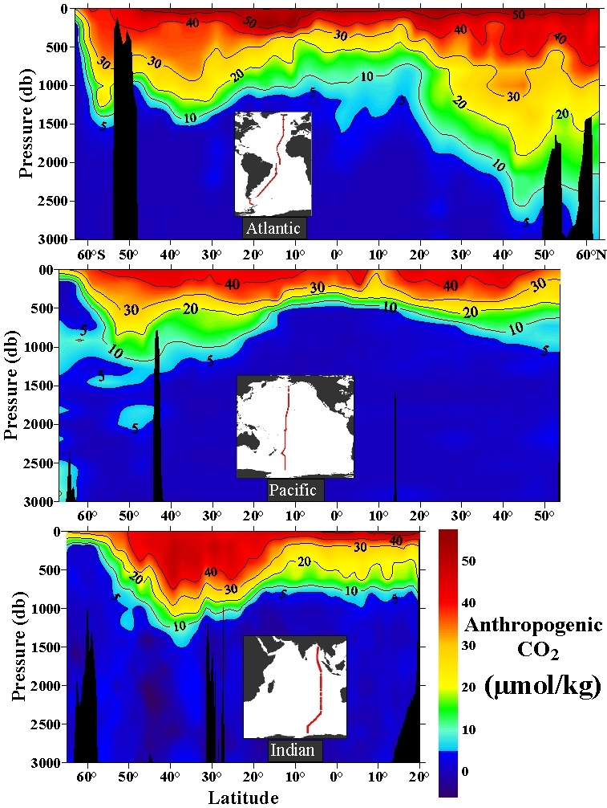
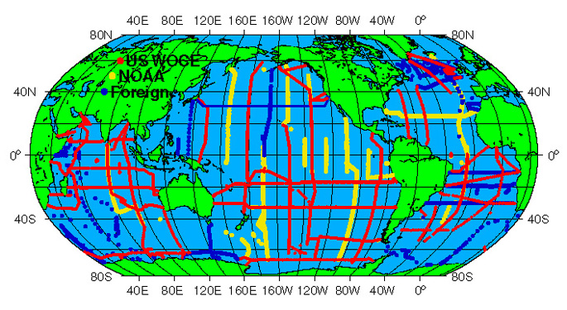
Fossil fuel CO₂
in the oceans (1994)
South
North
Atlantic
50
40
30
Anthropogenic CO₂ concentration
(μmol kg⁻¹)
20
10
Pacific
0
Indian
[Sabine et al. Science, 2004]

Slide 8
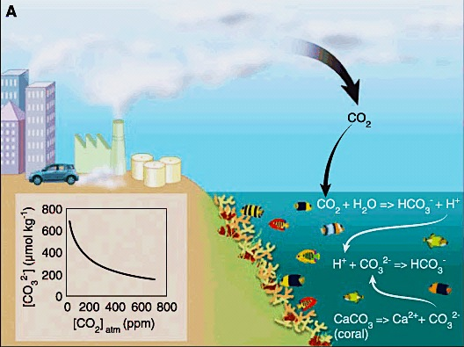
CO₂ emissions cause Ocean Acidification
Notes:
This process works well with ocean acidification and its impact on ocean ecosystems.
In its purest sense, ocean acidification involves two steps. The first being the very deterministic step between rising atmospheric carbon dioxide and changing ocean chemistry, and the second being the link between changing ocean chemistry and biological processes such as calcification.
In this flow of effects and impacts, there are different levels of certainty. For example, the physiochemical relationship between the atmospheric concentration of carbon dioxide and the carbonate chemistry of sea water is highly deterministic, the relationship between changing chemistry and biological responses is subject to greater variability. This is especially so when one considers the influence of different species, genetics, environmental history and so on.

Slide 9
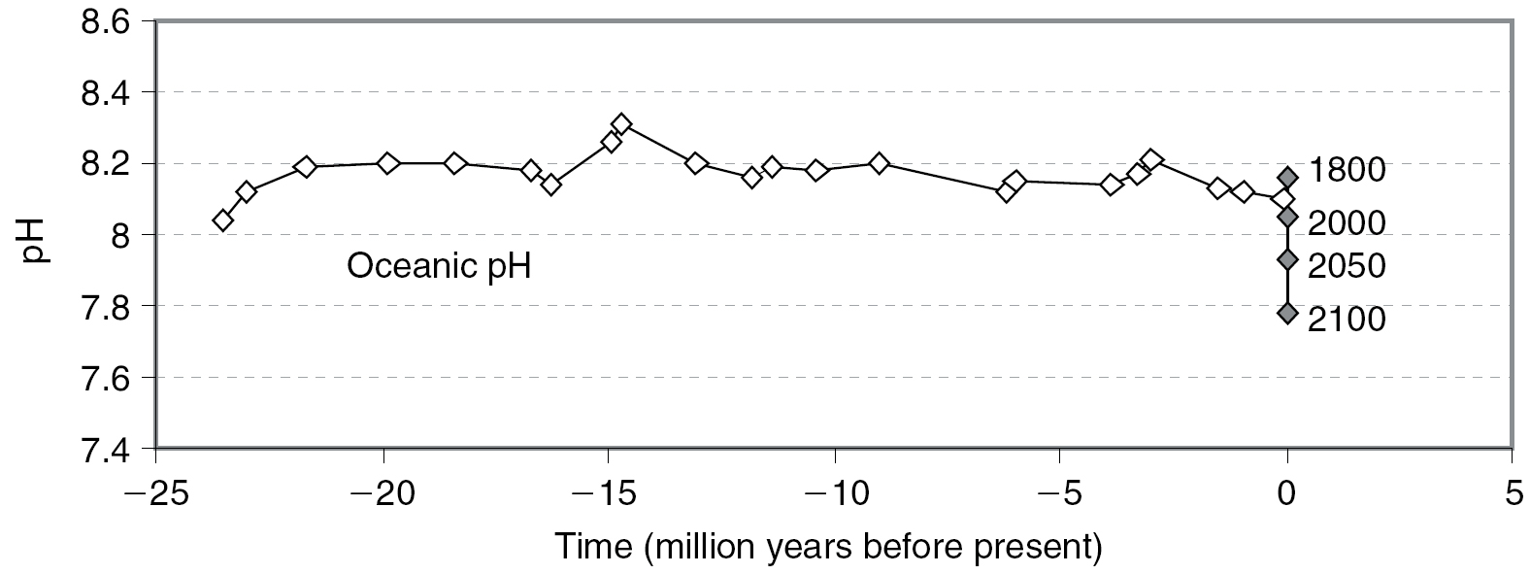
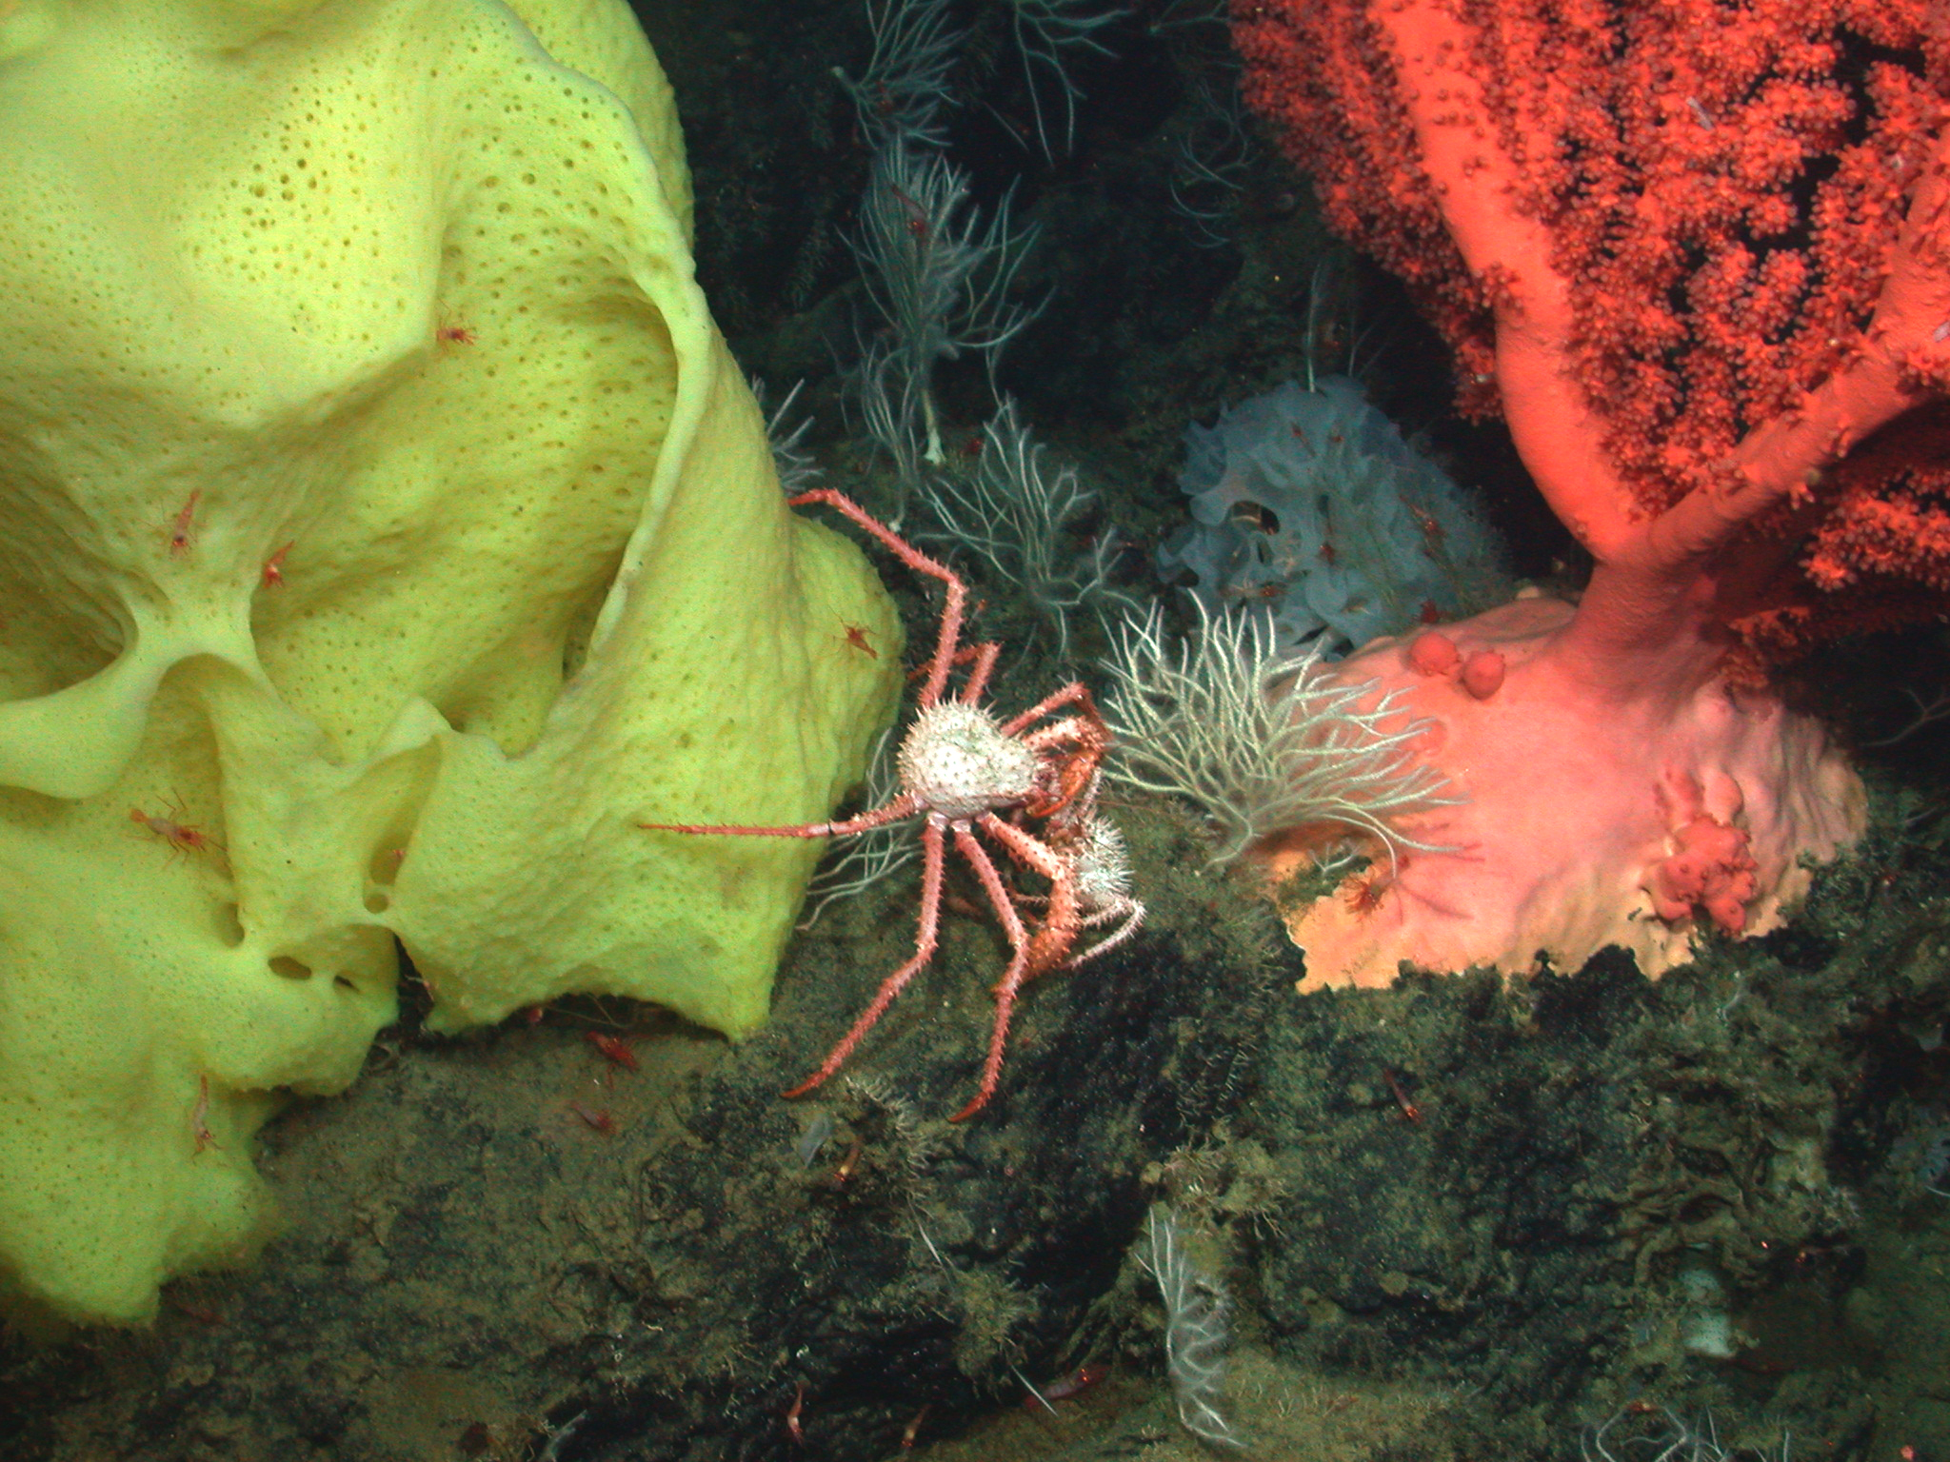
Change in ocean pH over 25 million years
Ice Ages
Effect of fossil fuel emissions
Turley et al 2005
Ocean pH (acidity) has been ~stable over 25+ million years
Changes in acidity caused by CO₂ emissions are massive and rapid.
Will ocean organisms tolerate ocean conditions so large?

Slide 10
Environmental Stress, Ecosystems, and Society
Environmental
Changes
Physiology
Growth
Survival
Reproduction
Food Web Changes
Societal Effects
(fisheries, reefs)

Slide 11
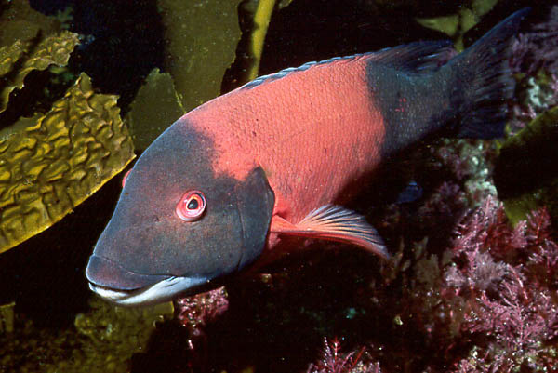
How do animals cope with changing ocean conditions?
What to
do..?
Migration
Acclimation
Adaptation
Extinction

Slide 12
Warming

Slide 13
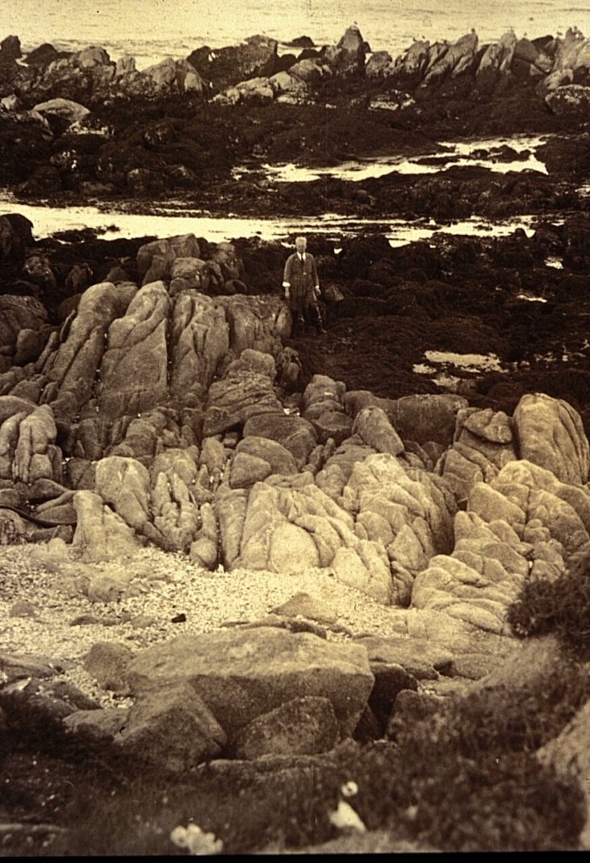
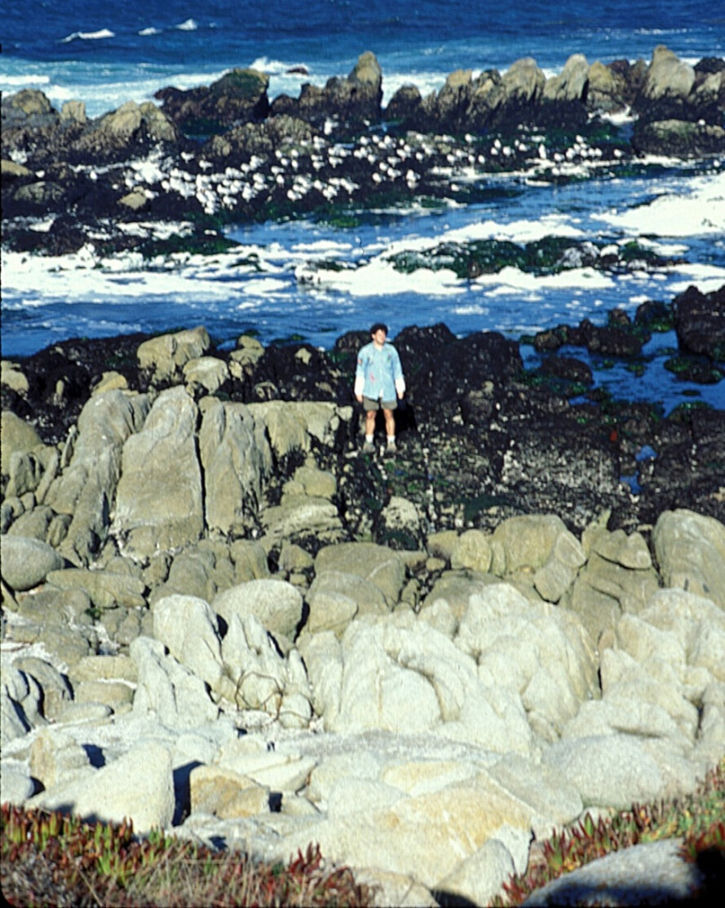
Changes in intertidal animals over 75 years
Hewatt: 1931 Barry, Baxter, Sagarin &
Gilman: 1990’s & continuing

Slide 14
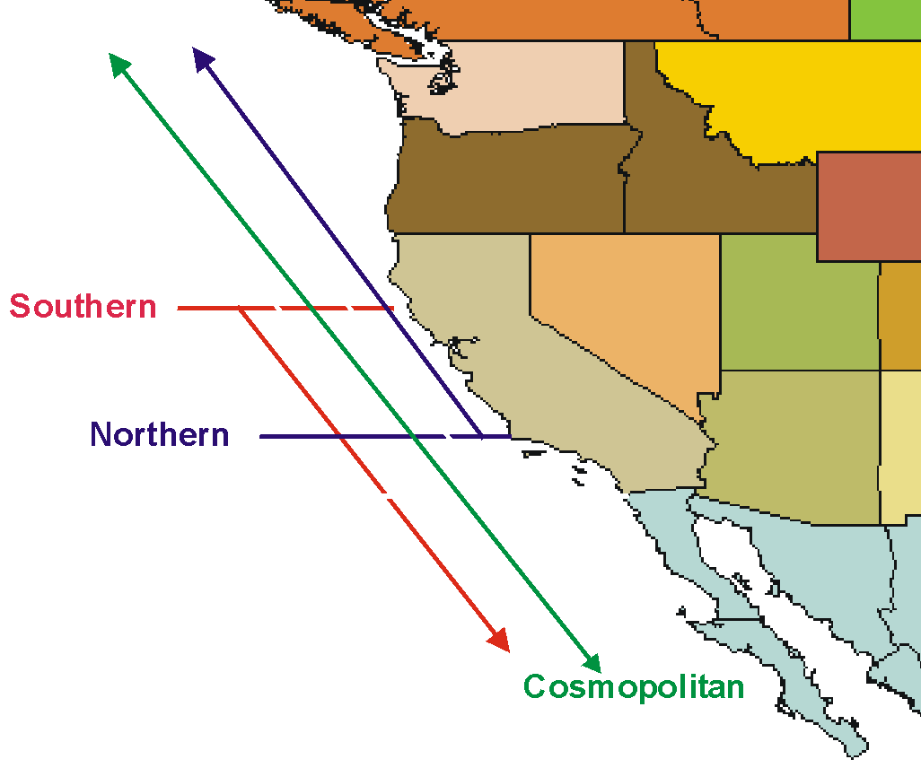
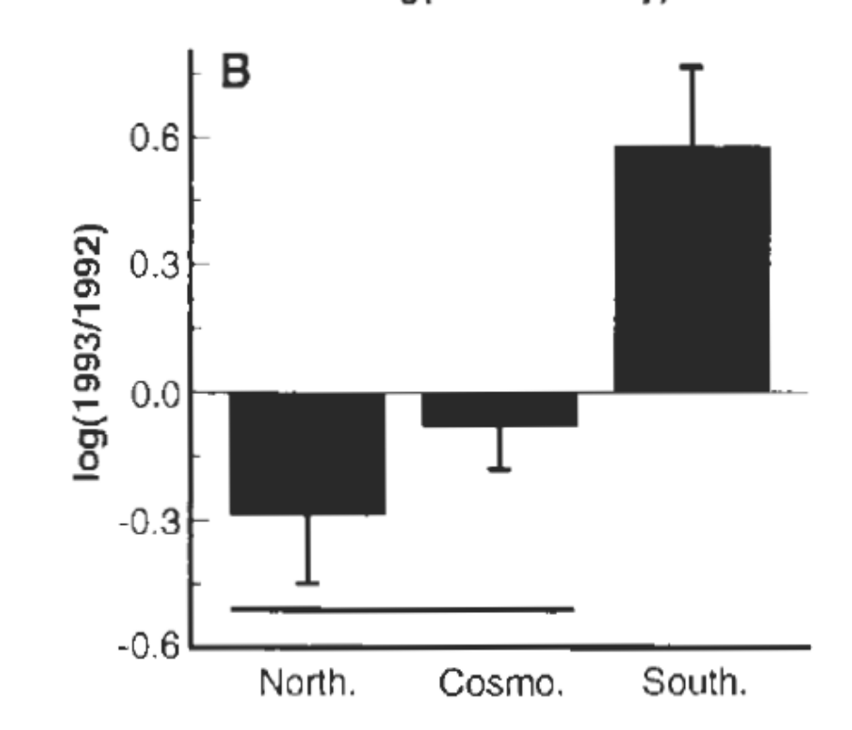
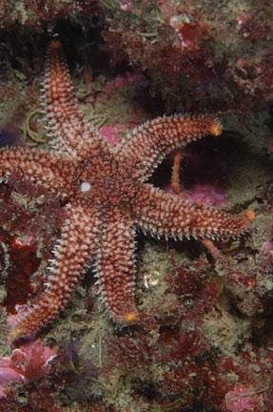
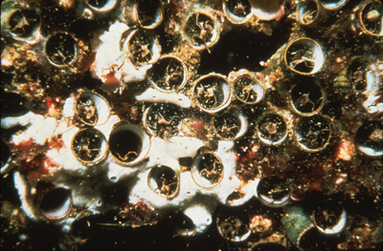
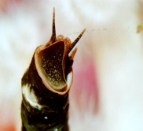
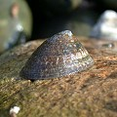
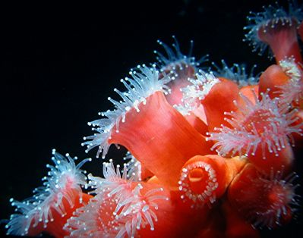
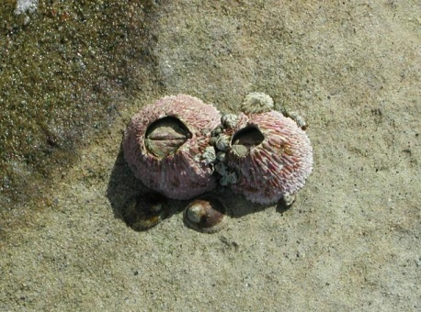
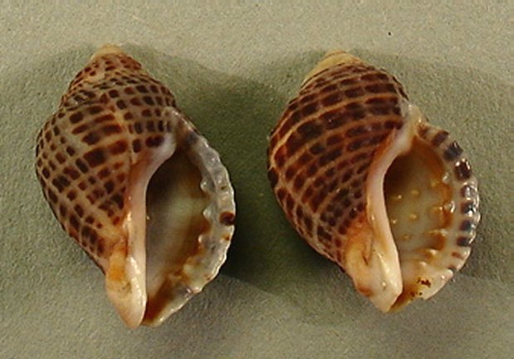
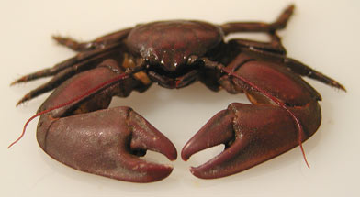
Intertidal animals in Monterey changed as water warmed 1933 and 1993
More
Monterey
Change from 1933 to 1993
Less
Southern Species Increased
Northern Species Declined
Barry et al. 1995, Sagarin et al. 1999
Notes:
Summary of our research on changes in intertidal invertebrate communities in Monterey at Hopkins Marine Station.
During warming over the past 60 years;
warm-adapted species increased
cold adapted species decreased
cosmopolitan species showed no trend
No other hypotheses could explain these patterns.

Slide 15
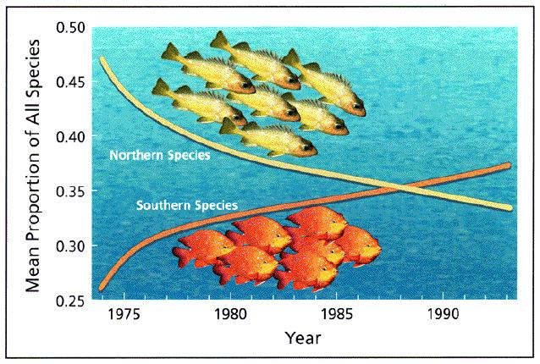
California Marine Populations Shifting Northward
(Holbrook et al)

Slide 16
Hypoxia
(low oxygen levels)

Slide 17
Biodiversity decreases as O₂ levels drop
Fish
Mobile Inverts
Sessile Inverts
Dissolved Oxygen
Large Infauna
1.4 ml l⁻¹
Hypoxia-tolerant Infauna
62 umol/l
1.0 ml l⁻¹
Stressed
0.5 ml l⁻¹
Absent or Dead
0 ml l⁻¹
from Rabalais et al. 2002

Slide 18
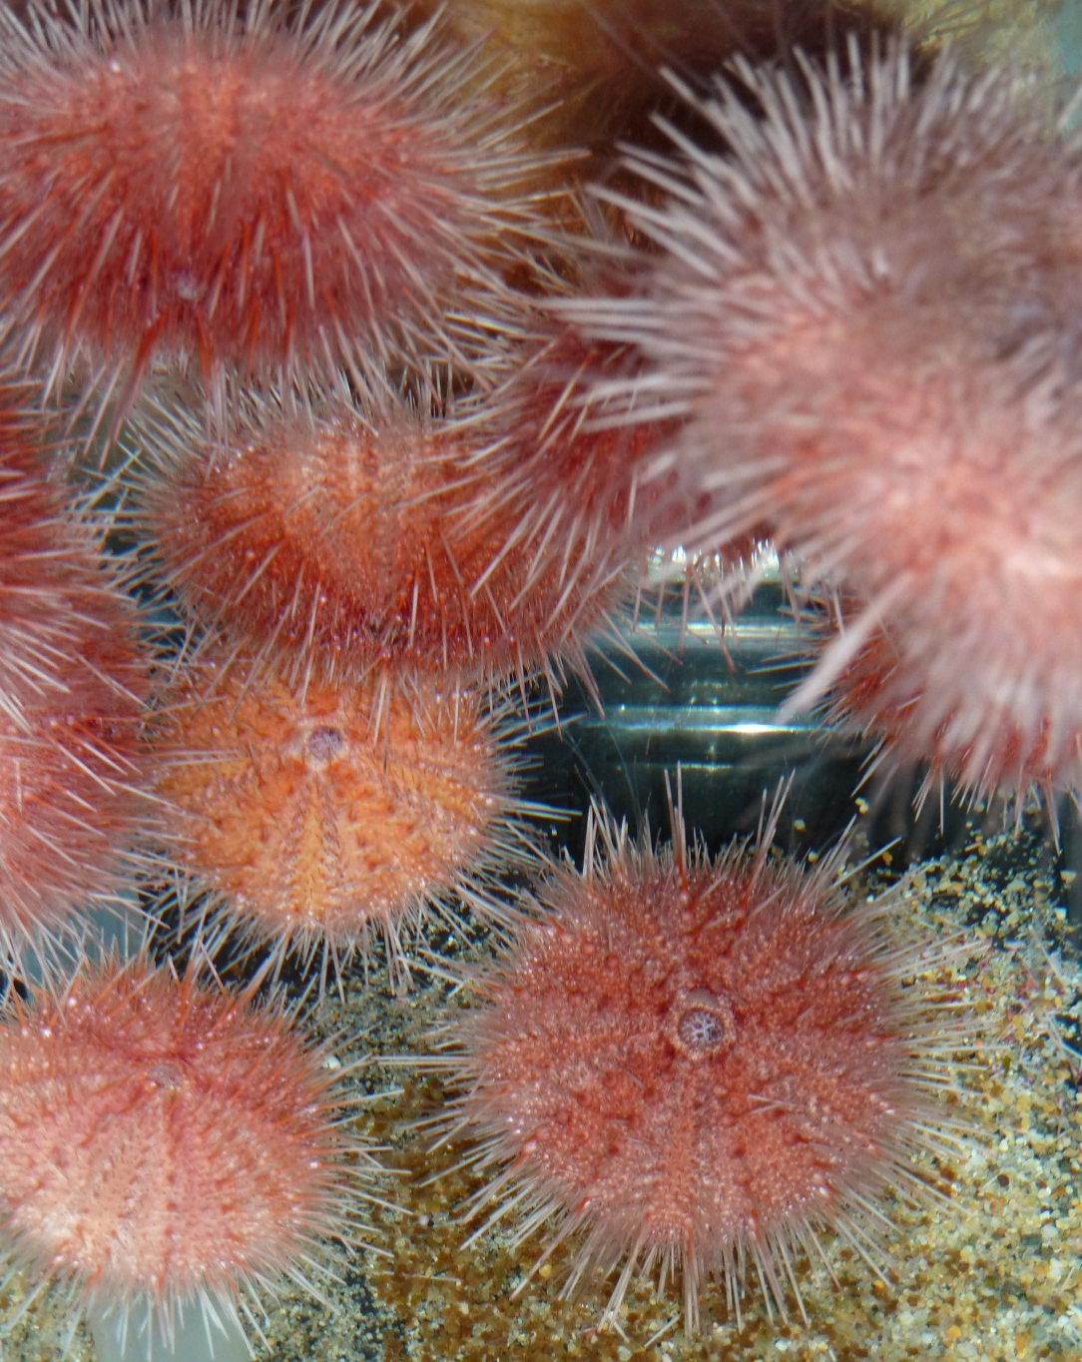
Urchin physiological performance impaired by hypoxia & acidification
Metabolism
  Low, limited by hypoxia
Acid-base regulation
  Weak
Consequences?
  Survival
  Growth
  Reproduction

Slide 19
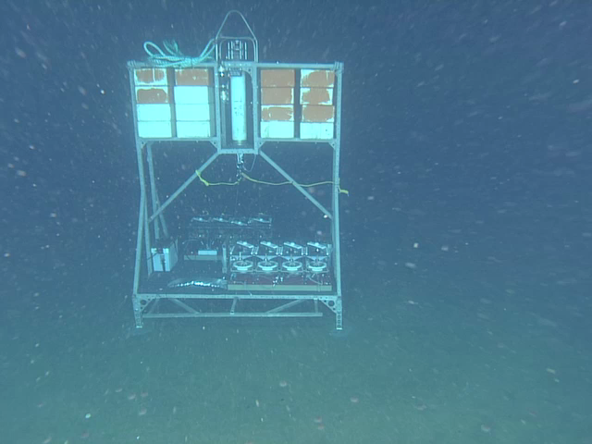
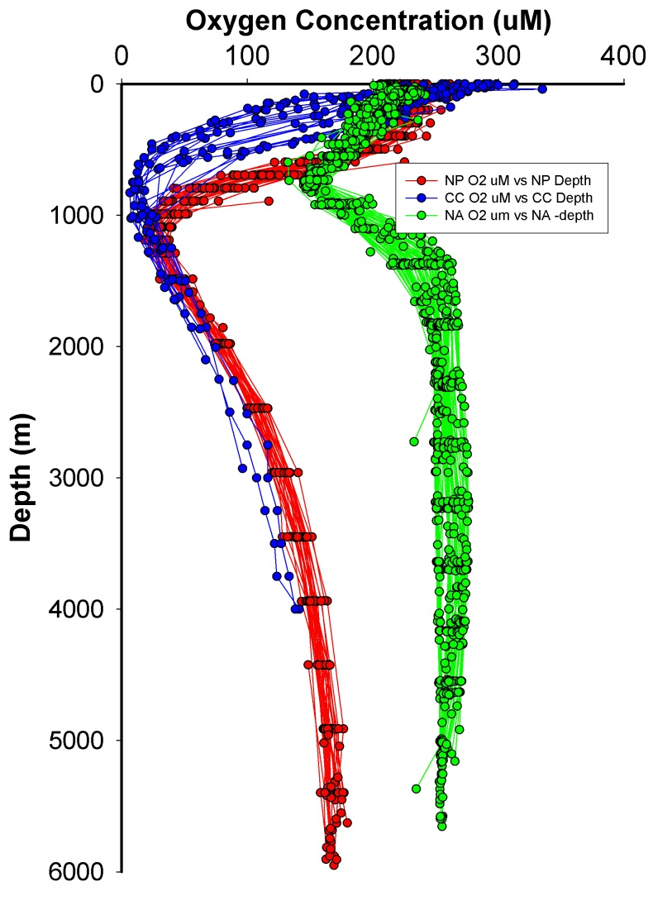
Measuring sea urchin respiration rates in the deep-sea
Oxygen Minimum Zone (OMZ)
In situ respiration chambers, 650 m, oxygen minimum zone

Slide 20
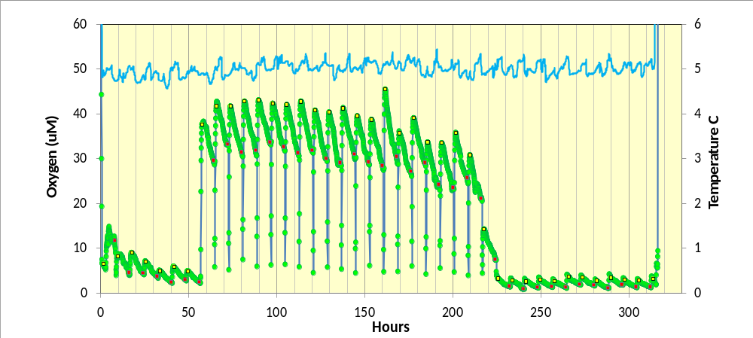
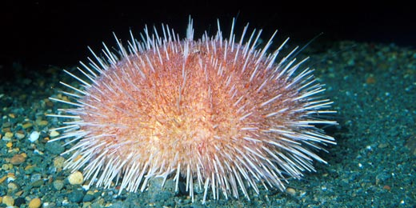
Raw Oxygen Data from a BRS Chamber
Temperature
Injections elevated
Chamber O₂
Normal O₂
Normal O₂
Fragile Urchin – Strongylocentrotus fragilis

Slide 21
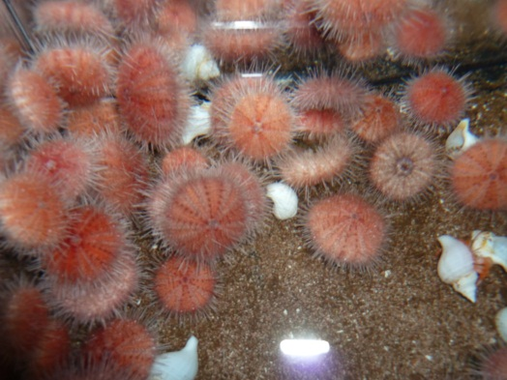
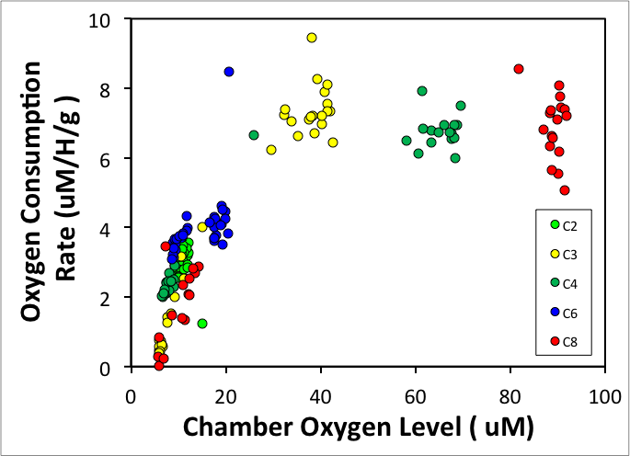
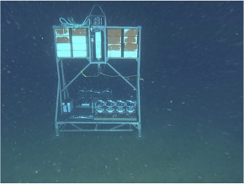
Expansion, intensification of hypoxic zones likely to affect urchins and other deep-sea animals
Urchin O₂ Consumption vs. Available O₂
OMZ
Fragile Urchin
BRS Platform
Notes:
The in situ benthic respiration system (bottom photo) is capable of perturbation experiments. Animals are placed in chambers (N=8),(upper photo) and oxygen consumption rates are measured over consecutive 8 h periods, between which chambers are flushed with ambient water. We can injection small amounts of high CO2 seawater to produce a pH reduction to simulate future conditions, or in this case, we injected high O2 water to evaluate the response of urchins living in the OMZ to higher O2 availability.
Main message - When more oxygen is available, the animals will increase their metabolic rates. In contrast, expanding and intensifying hypoxia will impact these deep sea populations.

Slide 22
Ocean Acidification

Slide 23
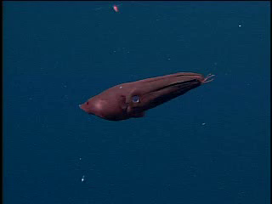
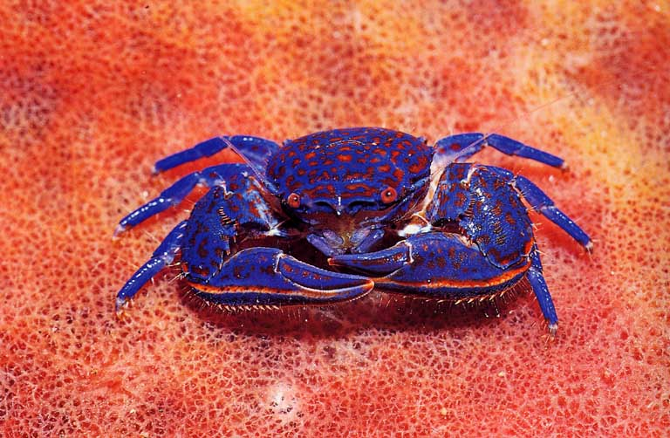
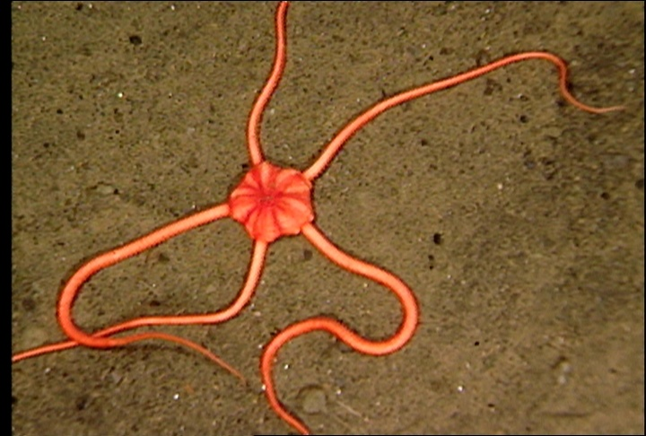
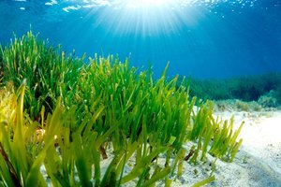
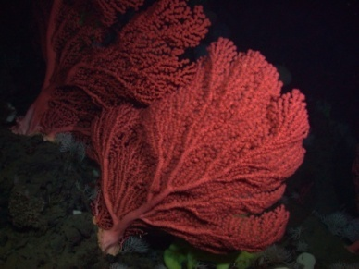
Ocean change affects physiological function
Photosynthesis
Calcification *
Respiration
Acid – Base Balance
Metabolism
Vampire Squid

Slide 24
Environmental change can increase the ‘cost of living’
Normal
Stressed
Cost of
Living
Growth
Cost of
Living
Growth
Reproduction
Energy
Budget
Reproduction
Notes:
Stress increases “cost of living” , with less energy for growth and reproduction.
Individuals = reduced 1) survival, 2) size, 3) reproductive output.
Populations = Reduced abundance, productivity, resilience, and greater likelihood of extinction.

Slide 25
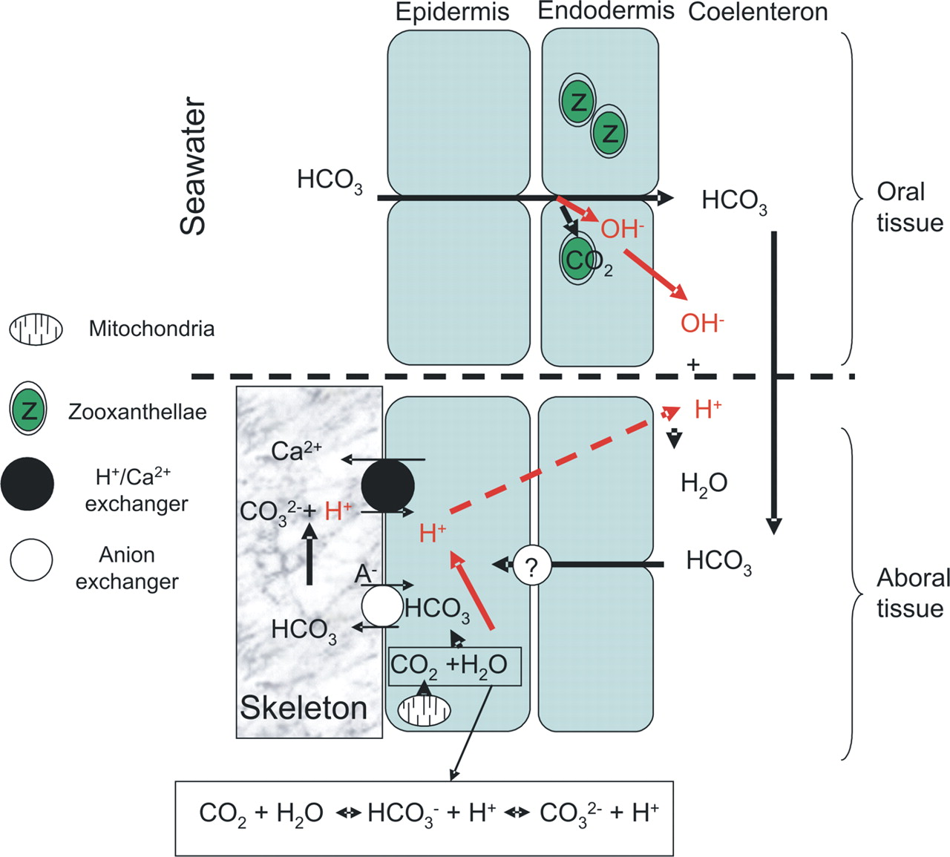
Calcification is more costly in a high CO₂ ocean
Model of Coral Calcification
Cost to raise pH (Ω)
Ambient pH
Brownlee, 2009

Slide 26
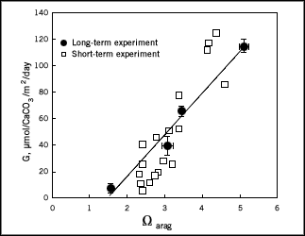
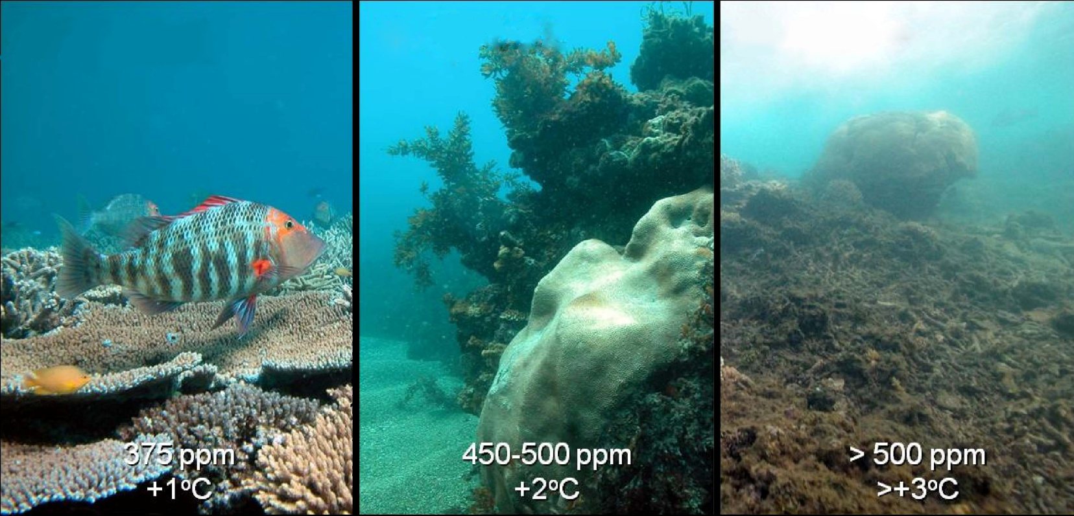
Calcification and Coral Ecosystem Tipping Points
Low carbonate saturation associated with low calcification rate
Calcification Rate
Corals
Aragonite Saturation State
Hoegh-Guldberg et al. 2007

Slide 27
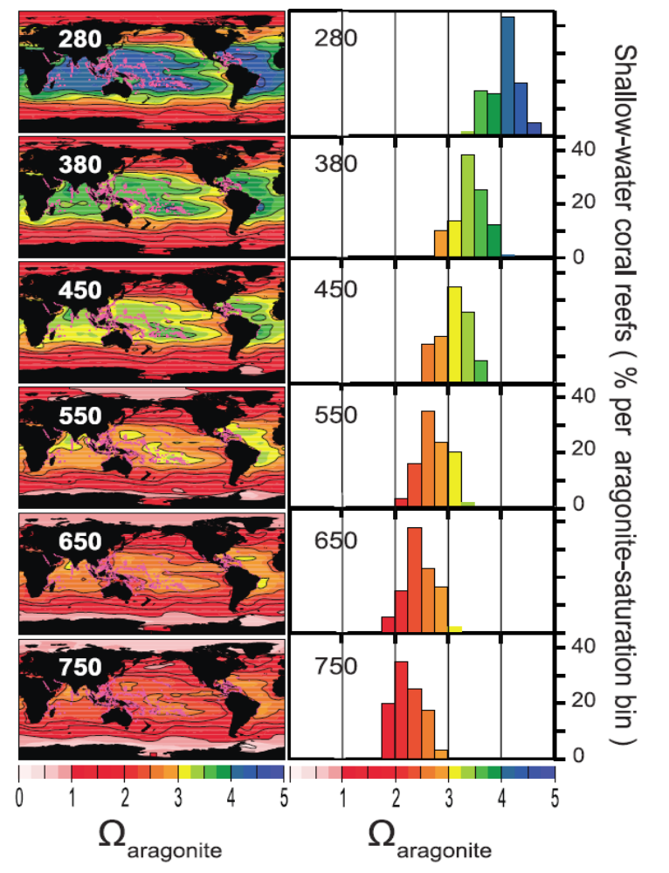
Ocean chemistry and the future of coral reefs?
Predicted aragonite saturation (Ω) [a measure of the amount of minerals available to make coral skeletons] is shown over a global map of existing coral reef locations (pink dots) for various atmospheric CO2 levels. Note that Ω decreases drastically with higher CO2 levels.
280 ppm is the preindustrial level of CO2 in the atmosphere. During 2011 CO2 is ~390 ppm. Most climate models indicate that we will reach ~800 ppm CO2 by 2100.
Corals grow best when carbonate minerals are abundant (Ω >3), and cease to grow at low mineral levels (Ω ~2) and can dissolve at very low levels (Ω < 1).
On the right, there is a count of the mineral conditions for the locations of all global coral reefs. Note that the preindustrial climate (280 ppm CO2) all reef locations had mineral conditions favorable to growth (high Ω ). As CO2 levels rise through this century, ALL existing reef are expected to have marginal or poor conditions for coral growth.
Bad
Marginal
Good
Ω_{aragonite}
Ω_{aragonite}

Slide 28
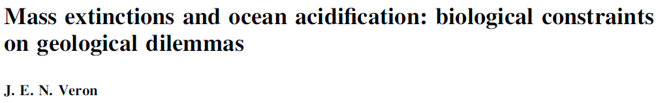


Slide 29


Ocean change is difficult for deep-sea animals
Deep-Sea Animals
pH variation in the Pacific
Low metabolism
Low enzyme function
Low environmental variation
Food-limited –
“Living on the edge”
More
Acidic
Less
Acidic
Future Ocean
Depth (m)
Deep-sea Octopus

Slide 30



Laboratory studies augment field studies
Strongylocentrotus fragilis
Chionoecetes tanneri

Slide 31


Acid-base control in deep-sea crab is weak
Shallow versus deep-living species?
Combined effects of low pH, low O2?
Tanner Crab (deep-sea)
Metabolic alkalosis
Weak pH compensation
Dungeness Crab (shallow water)
Strong Acidosis
Respiratory Acidosis
NBB
Pane and Barry, 2007, 2008

Slide 32

Coastal Upwelling Ecosystems
California Current
Canary Current
Peru Current
Benguela Current
1% of surface area, but > 20% of wild caught seafood

Slide 33
Climate Change Issues for Coastal
and Marine Ecosystems
Ocean physical changes (e.g., warming, currents)
Ocean acidification
Effects of global change vs. natural variation
Freshwater supply
Sea level rise
Loss of sea ice

Slide 34

Coastal Upwelling Ecosystems are Dynamic
pCO₂ variation off Monterey (Chavez and Friedrich)
Distance offshore (km)
Coastal upwelling is patchy and episodic (wind direction and stress)
Ocean chemistry closely linked
Liu et al. (2010)

Slide 35




Interdecadal climate variability (“regime shifts”) changes ecosystem structure and productivity
Pacific Decadal Oscillation
zooplankton
OR coho
copepods
warm phase
cool phase
(from Nathan Mantua, U. Washington)
(from Peterson and Schwing, 2003)

Slide 36

Lower Production in 2005 & 2006 due to Weak Springtime Upwelling
(from David Foley, NOAA NESDIS)

Slide 37



2005-2006 - worst years on record for Farallon Island auklets (42 km west of San Francisco)
Mean productivity = 0.70
#young/breeding-pair
Nests abandoned due to delayed upwelling
From Sydeman and Bradley, PRBO

Slide 38

Oxygen is decreasing in deep Monterey Bay waters
18 years of data
Low oxygen waters (oxygen minimum zone) just below the surface
Depth ranges of some species are changing
shoaling of low OMZ
B – Bathochordaeus
A – Acanthomunnopsis
P – Poeobius meres
S – Sergestes siimilis
Hd – Hastigerinella digitata
Hc – Halicera conica
C – Colobonema sericeum
Robison et al., unpublished
Notes:
7 common species plotted
4 average depth has moved up
The giant larvacean - Bathochordaeus
the munnopsid isopod - Acanthomunnopsis
the Polychaete worm- Poeobius
the sergestid shrimp – Sergestes similus

Slide 39

Is hypoxia/anoxia normal?
Dissolved oxygen (ml l⁻¹)
1950 to 1999
Depth (m)
Chan et al. (2008, Science)

Slide 40
Is hypoxia/anoxia normal?
Dissolved oxygen (ml l⁻¹)
1950 to 1999
2000 to 2005
Depth (m)
Chan et al. (2008, Science)

Slide 41
Is hypoxia/anoxia normal?
Dissolved oxygen (ml l⁻¹)
1950 to 1999
2000 to 2005
2006
Depth (m)
N ~ 4000 hydrocasts
Chan et al. (2008, Science)

Slide 42






Biological impacts of low oxygen on the Oregon shelf
normal rockfish
community
2000
2002
2004
2004
2006

Slide 43


Low-Oxygen zone formation
Air-Sea Gas Exchange
Phytoplankton Bloom
Consumers
Nutrients from upwelling
HYPOXIA
Flushing
Bottom Respiration
Primary production >> surface respiration (very high export)
Bottom respiration >> air-sea exchange
Poorly flushed surface and bottom water

Slide 44


Low oxygen on the shelf influenced by:
changes in upwelling sourcewater properties
strength and persistence of winds
both of which are influenced by climate change !
hypoxia
upwelling
normal
low oxygen

Slide 45


Hypoxic events are also Acidification events
Recent failure of oyster aquaculture related to low pH waters
Oyster spat on shell

Slide 46


Acidification may affect coastal fisheries
Ocean Acidification:
Reduced shell formation in pteropods
Reduced growth & survival of pteropods
Disruption of Salmon Food Web
Cascading effects for higher predators (mammals, humans)
Pteropod = Salmon food
Sockeye Salmon

Slide 47



Biodiversity is low at natural CO₂-venting sites
Echinoderms conspicuously absent, shell dissolution
Seagrasses thrive
Jason Hall-Spencer et al. 2008

Slide 48



High-CO₂ areas have fewer calcifiers, fleshy algae, and more invasive algae
Typical Ischia shallow-water community
Biodiversity is reduced at natural CO₂ vents
51% loss of species per 1 pH unit
Community in high-CO₂ areas at Ischia
Modified from
Barry et al. 2011
Jason Hall-Spencer et al. 2008

Slide 49























Marine Communities are Biological Networks
Primary Production
Humans
Seabirds
Phytoplankton
Zooplankton
Squid
Fish
Large zooplankton
Detritus / Bacteria
Sea butterfly
Limacina
Seafloor Animals
Mammals
Marine Food Web
Notes:
Food web isn’t a very good image, but could be improved.

Slide 50
Biodiversity is insurance for ecosystem function
Large Marine Ecosystems with lower biodiversity have:
Lower catch
More variable
Fisheries more likely to collapse
Acidification/hypoxia, warming can reduce biodiversity

Slide 51






A worrisome storyline
Rising
atmospheric CO₂
Changing benefits
Socioeconomic consequences
Decreasing ocean pH, Ω, [CO₃²⁻]
Altered physiology, population changes
Food web changes,
ecosystem shifts
Rising uncertainty
After Sarah Cooley

Slide 52
Summary points
What we know:
Carbon dioxide emissions causing ocean change
Warming, hypoxia, acidification
Stressful for many organisms (winners and losers)
What we expect:
Food webs and fisheries will be affected
What we don’t know:
Long term effects
Sensitive life stages
Acclimation and adaptation
Multiple Stressors
Ecosystem tipping points?

Slide 53


Ecosystem-based management of marine resources
ian.umces.edu/press

Slide 54












Reasons for Hope?
High-efficiency cars and trucks
Wave and Tidal Energy
Photovoltaic Energy
(Solar)
Wind Power

Slide 55

Significant Contributions by:
Kurt Buck
Chris Lovera
Eric Pane
Josi Taylor
Patrick Whaling
MBARI
The oceans – love them or lose them

